Slide 1

MODULE 5 · LESSON 5-8
Building Experience
By the end of this lesson you can
Write navigate_with_detection(): Lesson 5-7's step inside a while loop that runs until the robot arrives
Explain why remembering obstacles improves navigation
Start a run with obstacles already known, so the planner avoids them from the first path
Compare Run 1 and Run 2 with metrics (steps, reroutes)
Explain the GPS/Waze analogy for crowd-sourced obstacle data
Notes:
50 minutes. Better data, same algorithm: the robot learns. Spend the first fifteen minutes on the while loop. The rerouted flag is the only new Python idea in the lesson, which is why the outline spells the loop out: the shape is the lesson, the typing is theirs.

Slide 2
Two things are missing
In Lesson 5-7 the robot found one obstacle, re-planned once, and the loop stopped with a break.
The robot should keep going: follow the new path, and if it finds another wall, re-plan again, until it arrives
It rediscovers every obstacle from scratch each run, like being surprised by the same construction zone every morning
Today: a function that re-plans until arrival, and a way to start Run 2 knowing what Run 1 found out

Slide 3
Add to robot.py: this lesson's skeleton
At the end of the OBSTACLES section, under test_detect_once(). One setting, and the one function the capstone is built from.
# --- Lesson 5-8: re-plan until you arrive ---
# navigate_with_detection() is the 5-7 loop inside a while:
# plan, follow, and if something got in the way, plan again
# from here, until a whole path is driven with no reroute. It
# hands back position and heading, as drive_path() does, plus
# the step and reroute counts. KNOWN_OBSTACLES is what the
# last run found, typed in by you: memory between runs.
KNOWN_OBSTACLES = [] # what the last run printed; empty on Run 1
def navigate_with_detection(position, heading, destination, rangefinder, obstacle_cm):
"""Drive from position (facing heading) to destination,
re-planning around every obstacle the rangefinder finds;
return (position, heading, step_count, reroute_count)."""
Notes:
The function's outline, which is the rest of the skeleton, is on the next slide.

Slide 4
The outline of navigate_with_detection()
# step_count = 0 ; reroute_count = 0
# arrived = False
# while not arrived:
# plan from position; print the path
# if the path is empty: say "No path"; return the four
# rerouted = False
# for each next_pos in path: -- Lesson 5-7
# face it
# look ahead with rangefinder.distance()
# if closer than obstacle_cm:
# add_blocked(next_pos); count the reroute
# rerouted = True ; break
# else:
# arrive; position = next_pos; count the step
# if not rerouted: arrived = True
# return position, heading, step_count, reroute_count
pass
Notes:
Under the docstring from the previous slide. Trace it on the board with a path that hits one wall, so students see the for break, rerouted go True, and the while plan again from the new position.

Slide 5
From break to "until you arrive"
Put Lesson 5-7's whole for loop inside a while
The while ends only when the for ran all the way through without a reroute
The inner for is Lesson 5-7 unchanged, except that the re-plan happens at the top of the while, not inside the if
So the break only has to get out of the for
Read the shape, not the lines: plan, follow, and if something got in the way, plan again from here

Slide 6
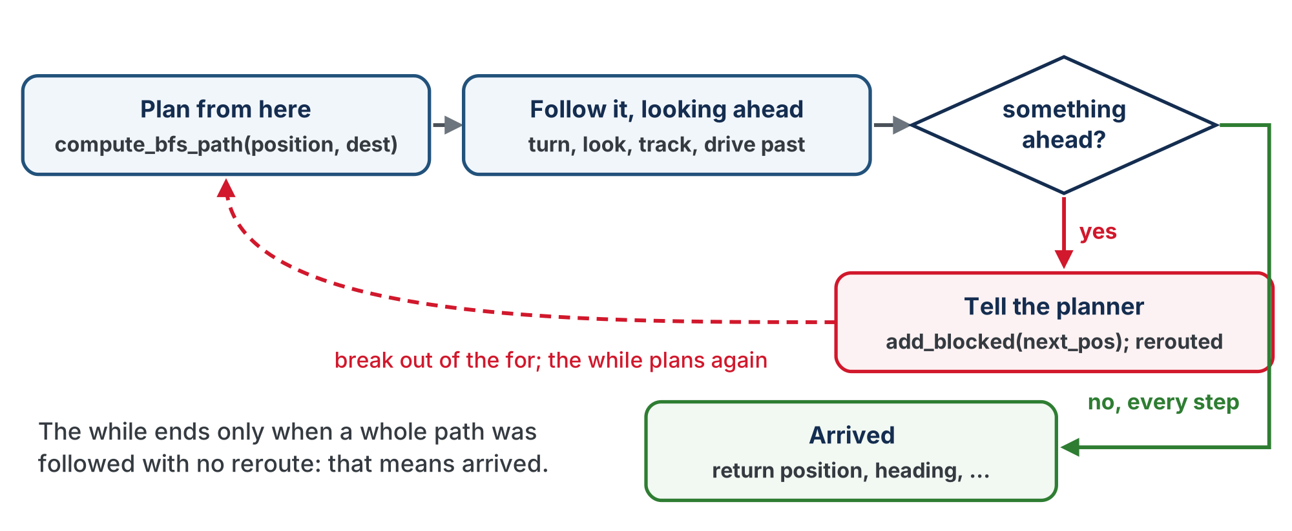
Plan, follow, plan again
Plan, follow, and if something got in the way, plan again from here.
Notes:
Plan from here with compute_bfs_path(position, dest). Follow it, looking ahead before each step. Something ahead: add_blocked(next_pos), set rerouted, break out of the for, and the while plans again. Every step followed with nothing ahead: arrived, return position, heading and the counts.

Slide 7
The rerouted flag, and what comes back
The rerouted flag is how the while finds out whether the for finished or broke out early
Set it False before the for
Set it True in the obstacle branch
After the for, "not rerouted" means "drove the whole path": arrived
The function returns the robot's new pose (position and heading)
The caller needs them to plan the next trip: Lesson 5-9 strings several of these together
Notes:
Class track: if students built the Navigator class in Lesson 4-8, this function wants to be a method of it. position and heading become self.position and self.heading and drop out of the parameters and the return; the driving calls go through self.line_track. and self.desired_heading() / self.turn_to(); the planner calls are planner.add_blocked() and planner.compute_path(). It returns only the two counts, and the caller reads navigator.position afterwards, as in Lesson 4-9.

Slide 8
Two parameters that look odd
rangefinder and obstacle_cm are already in the file, as a global and a setting
Passing them in means the function says what it depends on: read the def line and you know it needs a sensor and a cutoff
And a test can hand in a different cutoff without editing the function
The simulated sensor is a function of next_pos, not an object with a distance() method: for the dry run, swap the one look-ahead line, as in Lesson 5-7

Slide 9
Why check for an empty path?
It matters now in a way it didn't on paper
If the robot gets boxed in, compute_bfs_path() returns [] (Lesson 5-5)
Without the check, the for loop runs zero times
rerouted stays False, and the robot declares itself arrived at the wrong intersection
So: if the path is empty, say "No path" and return the four values

Slide 10
Check your understanding
In navigate_with_detection(), what makes the while loop finally stop?
A. A fixed number of iterations
B. The for loop finishes without a reroute, so rerouted stays False and arrived becomes True
C. The rangefinder returns 0
D. compute_bfs_path returns the same path twice
Notes:
Answer: B. Each pass plans a path and tries to follow it. If a wall turns up, the `for` loop breaks with `rerouted = True` and the `while` plans again from the new position. Only a complete, uninterrupted pass sets `arrived`.

Slide 11
Answer
In navigate_with_detection(), what makes the while loop finally stop?
A. A fixed number of iterations
B. The for loop finishes without a reroute, so rerouted stays False and arrived becomes True
C. The rangefinder returns 0
D. compute_bfs_path returns the same path twice
Each pass plans a path and tries to follow it. If a wall turns up, the for loop breaks with rerouted = True and the while plans again from the new position. Only a complete, uninterrupted pass sets arrived.

Slide 12
Check your understanding
Why does the function return the pose (position and heading), not just the step counts?
A. Python requires functions to return at least two values
B. So the next trip is planned from where the robot actually ended up, facing the way it faces
C. To reset them to (0, 0) and 0
D. For the print statement only
Notes:
Answer: B. The pose, `position` and `heading`, is local to the function. The caller only learns the new pose if the function hands it back, and Lesson 5-9 needs them to chain several destinations.

Slide 13
Answer
Why does the function return the pose (position and heading), not just the step counts?
A. Python requires functions to return at least two values
B. So the next trip is planned from where the robot actually ended up, facing the way it faces
C. To reset them to (0, 0) and 0
D. For the print statement only
The pose, position and heading, is local to the function. The caller only learns the new pose if the function hands it back, and Lesson 5-9 needs them to chain several destinations.

Slide 14
Why memory matters
The BFS planner doesn't change between runs. The driving functions don't change. Only the input changes:
Run | Blocked list at the start | What happens | Result
Run 1 | empty | discover obstacles the hard way | many reroutes
Run 2 | pre-loaded | plan around known obstacles | few or no reroutes
Better data leads to better performance. Run 2 runs the same algorithm on better information.
Notes:
Frame memory with Waze: students get it instantly. "What if Waze forgot every traffic report when you closed the app?"

Slide 15
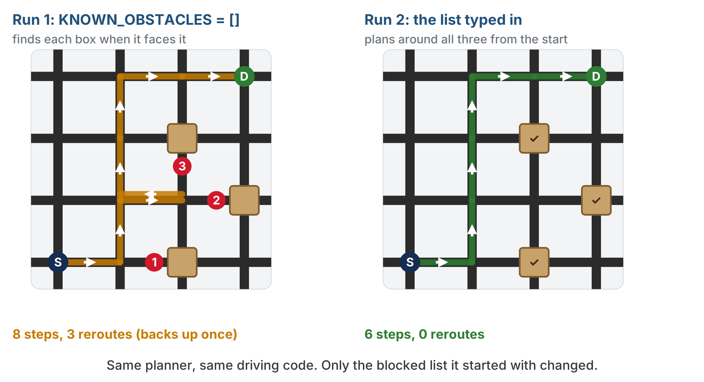
Run 1 and Run 2
One example with three boxes. Your numbers will depend on your grid; the shape of the difference won't.
Notes:
S at (0, 0) to D at (3, 3), boxes at (2, 0), (2, 2) and (3, 1). Run 1 starts empty and finds each box only when it faces it: 8 steps, 3 reroutes, backing up once. Run 2 starts with the three typed in: 6 steps, 0 reroutes.

Slide 16
Check your understanding
Why does the robot navigate better on Run 2?
A. It learns a smarter algorithm
B. Same algorithm, but the blocked list starts with Run 1's obstacles, so it plans around them
C. Its motors get faster
D. It skips destinations
Notes:
Answer: B. Same BFS, better data. Pre-loading Run 1's discoveries means Run 2 plans around those obstacles immediately instead of rediscovering them.

Slide 17
Answer
Why does the robot navigate better on Run 2?
A. It learns a smarter algorithm
B. Same algorithm, but the blocked list starts with Run 1's obstacles, so it plans around them
C. Its motors get faster
D. It skips destinations
Same BFS, better data. Pre-loading Run 1's discoveries means Run 2 plans around those obstacles immediately instead of rediscovering them.

Slide 18
Activity · Step 1 · Dry run
Activity
Write the body from the outline, with simulate_rangefinder(next_pos) in the look-ahead line for now
1
Write test_navigate(): hand every entry of KNOWN_OBSTACLES to add_blocked() (a for loop, two lines). Position (0, 0), heading 0, destination (3, 3)
2
Plan the path and print it; wait for the button
3
Call the function, assign all four return values, then print where it arrived, the step and reroute counts, and on its own line "All known obstacles:" and BLOCKED
4
Notes:
The dry run proves the loop with Lesson 5-7's simulate_rangefinder() before any box goes on the grid.

Slide 19
Assign all four return values
In test_navigate(), the call hands back four values. Catch every one:
position, heading, steps, reroutes = navigate_with_detection(
position, heading, destination, rangefinder, OBSTACLE_CM
)
With SIMULATED_OBSTACLES still [(2, 0), (2, 2)]: reaches (1, 0), "sees" (2, 0), prints a new path, takes it, and arrives at (3, 3) with one reroute
Notes:
Robot at (0, 0) facing North on an empty grid, run line set to test_navigate(), both presses. Compare with Lesson 5-7, which stopped at the reroute.

Slide 20
Step 2 · The real sensor
Activity
Change the look-ahead line to rangefinder.distance()
1
Put two boxes on the grid, on intersections the printed path crosses, and run again
2
It should reroute around the first, reroute again if the new path meets the second, and arrive
3
Write down the last line it prints: the blocked list
4
Notes:
Set up the grid so Run 1 has 2 to 3 reroutes; the contrast with a zero-reroute Run 2 is the "aha." The lesson page has a closed reveal with a finished navigate_with_detection() to check against; it is not on the slides. If a student's version re-plans at the bottom of the for instead of the top of the while and still arrives, keep theirs, but check that a boxed-in robot prints "No path" rather than claiming to have arrived.

Slide 21
Carry it into the next run
Activity
Within one program run, BLOCKED persists between function calls: that's why the while loop works
But close the program and it's gone: Python variables don't survive a restart
So how does Run 2 begin already knowing what Run 1 found out?
You tell it.

Slide 22
Type Run 1's list into KNOWN_OBSTACLES
Your test already prints All known obstacles: [(1, 2), (2, 2), (3, 0)] at the end of the run. Type that list in at the top of the Lesson 5-8 part of the file:
KNOWN_OBSTACLES = [(1, 2), (2, 2), (3, 0)] # what Run 1 discovered
Run it again: it plans around all three from its very first path. Find a fourth, and the printed list has four, ready for Run 3.
Notes:
The first two lines of test_navigate() hand each intersection to the planner the same way everything else reaches it.

Slide 23
You are the memory
The robot found the obstacles, you carried them from one run to the next, and the algorithm never changed
The planner has now been told about walls three ways:
by a test in 5-6
by the rangefinder in 5-7
by you, here
Every one of them was a call to add_blocked()
A real system writes the list somewhere and reads it back itself. What gets carried across, and what it's worth, is exactly what you just did by hand.
Notes:
Carrying the list by hand is the point, not a shortcut: it makes "same algorithm, better data" something students do with their own fingers, and keeps the lesson about navigation instead of file formats. If someone asks why the robot can't save it itself: good question, that is what a real one does, and it changes nothing about what is carried.

Slide 24
Check your understanding
Run 1 finishes and prints [(1,2), (2,2)]. What has to happen for Run 2 to start out knowing about those two obstacles?
A. Nothing: the robot remembers them automatically
B. Hand the list to add_blocked() at the start of Run 2: a variable doesn't outlive the program
C. Run 2 has to drive the same route as Run 1
D. compute_bfs_path has to be rewritten
Notes:
Answer: B. A list lives only while the program runs. Run 2 starts out knowing exactly what it is handed, which is why you print the list at the end of one run and type it into `KNOWN_OBSTACLES` at the start of the next.

Slide 25
Answer
Run 1 finishes and prints [(1,2), (2,2)]. What has to happen for Run 2 to start out knowing about those two obstacles?
A. Nothing: the robot remembers them automatically
B. Hand the list to add_blocked() at the start of Run 2: a variable doesn't outlive the program
C. Run 2 has to drive the same route as Run 1
D. compute_bfs_path has to be rewritten
A list lives only while the program runs. Run 2 starts out knowing exactly what it is handed, which is why you print the list at the end of one run and type it into KNOWN_OBSTACLES at the start of the next.

Slide 26
Activity · Measure the improvement
"It seemed faster" isn't evidence: measure. Your test prints the steps and reroutes; write them down for each run.
Metric | Run 1 | Run 2
Starting obstacles | 0 | (from Run 1)
Reroutes | ____ | ____
Total steps | ____ | ____
Fill it in from your own two runs: the numbers are the evidence, and they'll differ with your grid and where the obstacles sit
Notes:
Insist on recorded numbers: the quantitative comparison convinces far more than "it felt faster."

Slide 27
Check your understanding
Run 1 took 12 steps with 3 reroutes; Run 2 took 8 steps with 0 reroutes. Why the change?
A. The battery was fuller
B. Run 2 started knowing the obstacles, so it planned around them and never had to reroute
C. The grid got smaller
D. Random luck
Notes:
Answer: B. With obstacles pre-loaded, Run 2's initial paths already avoid them: no mid-run surprises, so zero reroutes and fewer steps.

Slide 28
Answer
Run 1 took 12 steps with 3 reroutes; Run 2 took 8 steps with 0 reroutes. Why the change?
A. The battery was fuller
B. Run 2 started knowing the obstacles, so it planned around them and never had to reroute
C. The grid got smaller
D. Random luck
With obstacles pre-loaded, Run 2's initial paths already avoid them: no mid-run surprises, so zero reroutes and fewer steps.

Slide 29
Could Run 2 still find new obstacles?
Yes. Run 2 avoids everything it already knows
But its smarter route may pass intersections Run 1 never visited, and one of those could be blocked
So Run 3 would start with even more knowledge
Eventually the robot knows every relevant obstacle, and its paths are right from the start
That is convergence
Notes:
Be honest about limits: what if an obstacle moves? Real systems need to forget stale data, not just accumulate it. Good discussion for advanced students.

Slide 30
Check your understanding
Can Run 2 discover an obstacle Run 1 never found?
A. No: Run 2 knows everything already
B. Yes: Run 2 may take a different route and encounter obstacles Run 1 never drove past
C. No: obstacles never change
D. Only if the grid grows
Notes:
Answer: B. The robot only discovers obstacles it drives toward. A new route can reach intersections Run 1 skipped, so Run 2 can still find something new, feeding Run 3 even better data.

Slide 31
Answer
Can Run 2 discover an obstacle Run 1 never found?
A. No: Run 2 knows everything already
B. Yes: Run 2 may take a different route and encounter obstacles Run 1 never drove past
C. No: obstacles never change
D. Only if the grid grows
The robot only discovers obstacles it drives toward. A new route can reach intersections Run 1 skipped, so Run 2 can still find something new, feeding Run 3 even better data.

Slide 32
Real-world connections
MAPS
AI
APPS
Waze traffic
Learning from data
Saved state
One driver hits traffic; the app warns everyone behind them. Shared, remembered data.
Machine-learning systems improve as they accumulate examples: the same "better data, better results" idea.
Games, editors and browsers store your progress before closing: the automatic version of carrying your blocked list across by hand.
Notes:
Connect lightly to machine learning: accumulate data, make better decisions.

Slide 33
Wrap-up
What turns Lesson 5-7's single reroute into "drive until you arrive"?
What actually changes between Run 1 and Run 2?
How do you show Run 2 is better?
What has to happen between runs for the robot to keep what it learned?
Next: the capstone, one complete autonomous system
Notes:
Answers: a while not arrived loop around the for, with a rerouted flag. The data (the blocked list), not the algorithm. Measure steps and reroutes. The list has to be handed back to add_blocked(): a variable doesn't survive the program ending. The wrap-up quiz question follows.

Slide 34
Check your understanding
What is "convergence" in this context?
A. The robot running out of battery
B. After enough runs it knows all relevant obstacles, so its paths are right from the start
C. Two robots meeting at an intersection
D. The grid shrinking over time
Notes:
The lesson's wrap-up quiz. Answer: B. Formative: trace the while loop through one reroute; pre-load a blocked list; articulate the Waze analogy. Exit ticket: "Run 1 took 12 steps and 3 reroutes; Run 2 took 8 steps and 0 reroutes. Explain why." Preview: the capstone chains navigate_with_detection() across several destinations, and demonstrates Run 1 vs. Run 2.

Slide 35
Answer
What is "convergence" in this context?
A. The robot running out of battery
B. After enough runs it knows all relevant obstacles, so its paths are right from the start
C. Two robots meeting at an intersection
D. The grid shrinking over time
Each run can add knowledge until there's nothing new to learn. At that point paths are right immediately: the robot's map has converged.
Notes:
The lesson's wrap-up quiz. Answer: B. Formative: trace the while loop through one reroute; pre-load a blocked list; articulate the Waze analogy. Exit ticket: "Run 1 took 12 steps and 3 reroutes; Run 2 took 8 steps and 0 reroutes. Explain why." Preview: the capstone chains navigate_with_detection() across several destinations, and demonstrates Run 1 vs. Run 2.

