Slide 1

MODULE 4 · LESSON 4-1
Coordinates on the Grid
By the end of this lesson you can
Explain what a coordinate system is and why a robot needs one
Name any intersection with an (x, y) pair
Tell x (across) from y (away from you), and remember order matters
Count the steps between two positions (the Manhattan distance)
Notes:
40 to 50 minutes, no coding: mental model first. When students ask "when do we code?", answer "next lesson; today you are building the map the code will use."

Slide 2
A name for every spot
To tell the robot where to go, you need a way to name every spot on the grid
Today: that system, (x, y) coordinates
With paper and the physical grid, no code yet
A solid mental model here makes tuples, lists and the Manhattan algorithm click later

Slide 3
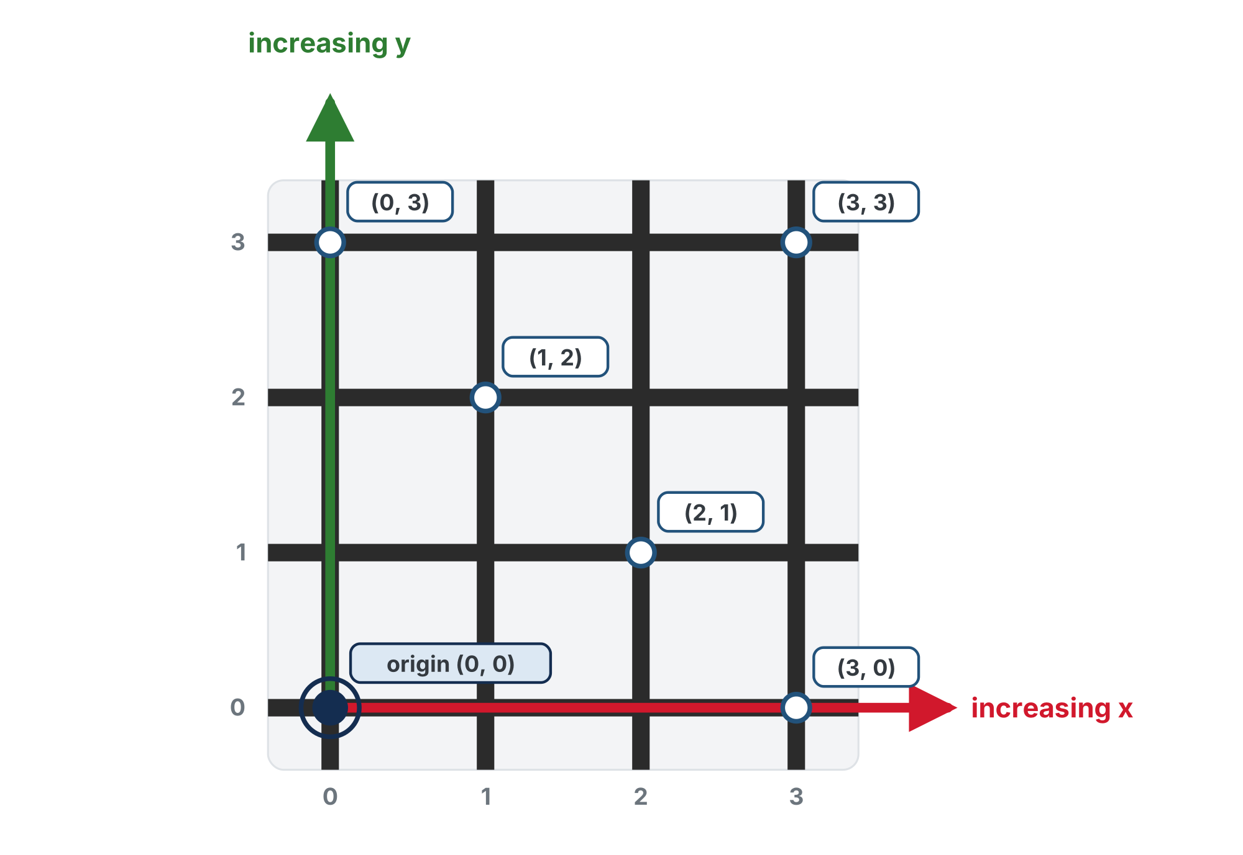
Two numbers name any spot
x increases to the right and y increases up.
Notes:
One paragraph on the page: like Battleship ("B4") or a spreadsheet cell ("A1"), two numbers name every intersection, counted from (0, 0), the corner nearest you. x counts across to the right, y counts up, away from you, both from zero. Order matters: (2, 3) and (3, 2) are different spots. Getting x and y in the right order is the number one stumble; what is new for most students is counting from zero, so name why: Python indexes from 0.

Slide 4
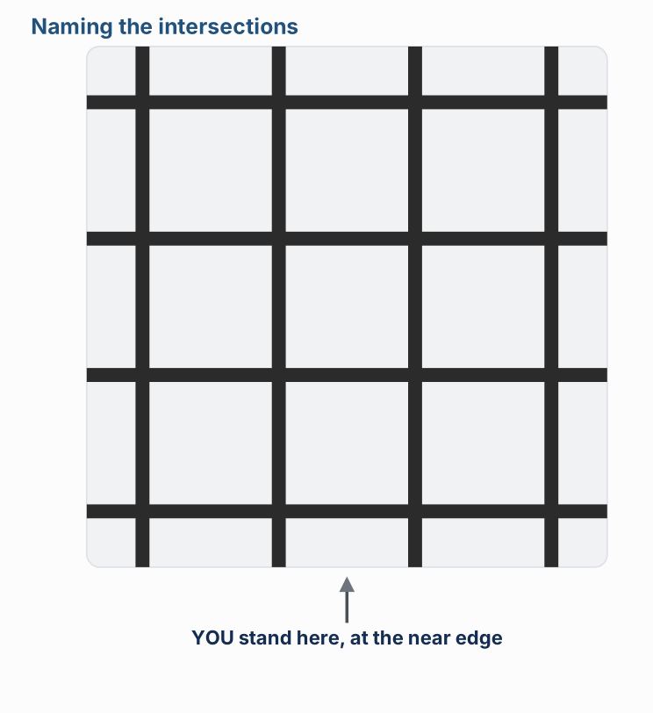
How every intersection gets its name
Watch it run. The next slide picks out the key moments.
Notes:
The lesson figure is an animation that walks through six ideas; these are three of its moments, with its side panel cropped off. If you can, have students stand at the near edge, physically walk the grid and call out their coordinates: kinesthetic beats diagrams here.

Slide 5
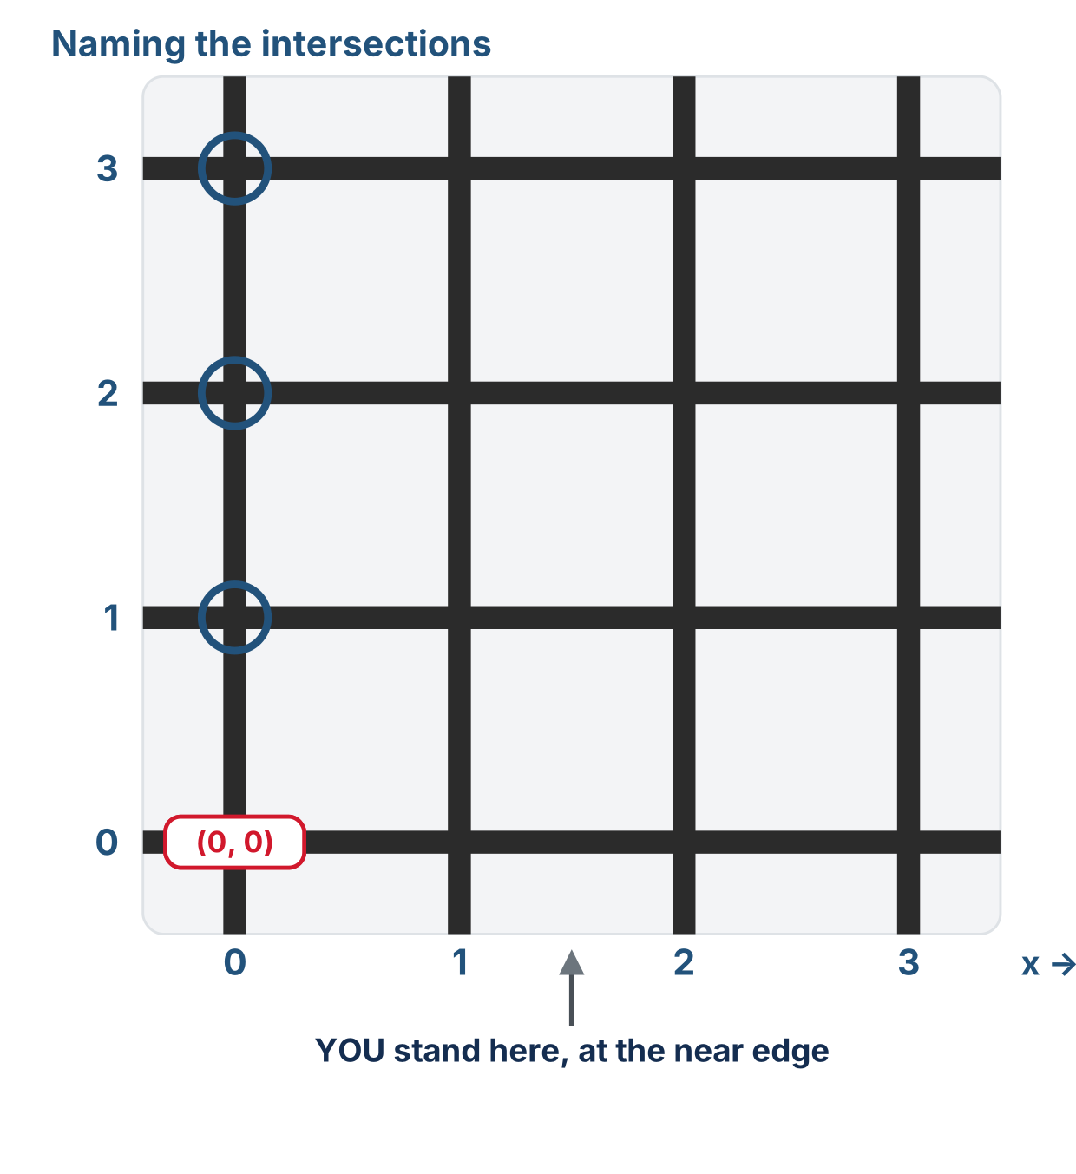
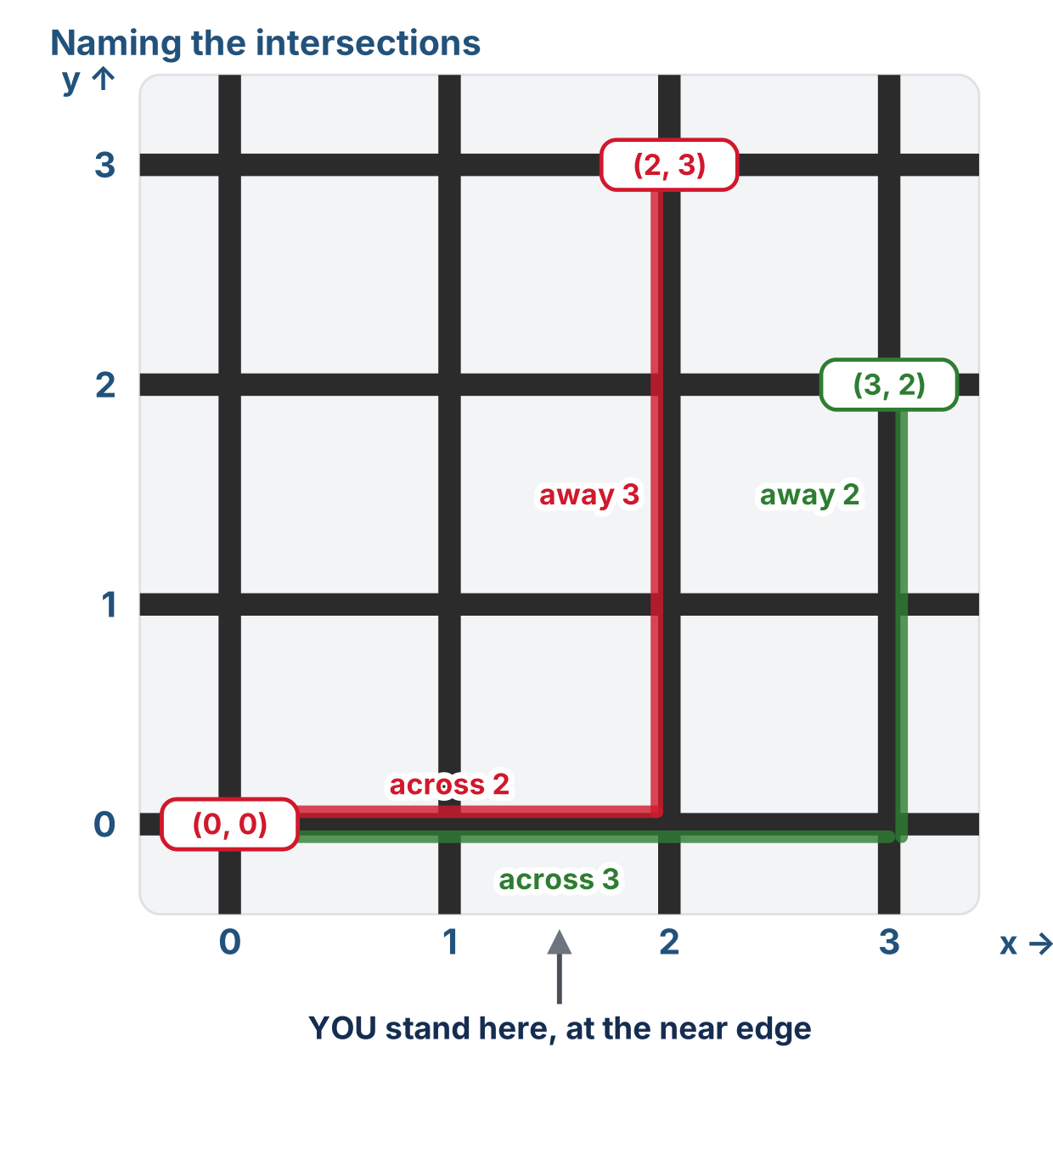
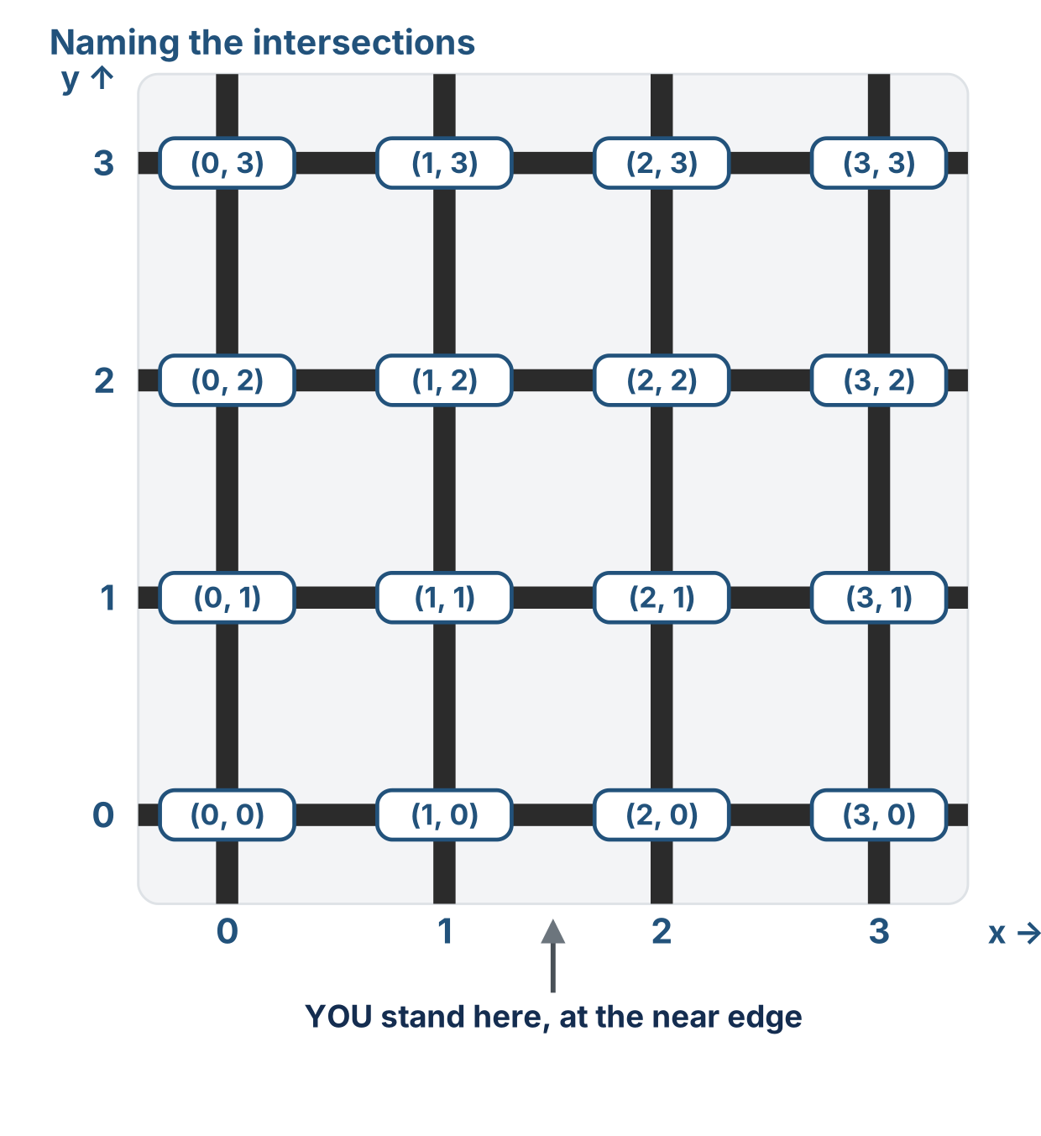
How every intersection gets its name
x counts across, y counts away
(2, 3) and (3, 2) differ
Every intersection has a name
Start at the corner nearest you, count across for x, then away for y
Notes:
The lesson figure is an animation that walks through six ideas; these are three of its moments, with its side panel cropped off. If you can, have students stand at the near edge, physically walk the grid and call out their coordinates: kinesthetic beats diagrams here.

Slide 6
Check your understanding
In the coordinate (2, 3), what does the 2 mean?
A. The y: 2 steps away from you
B. The x: 2 steps right from the left edge
C. The total number of steps
D. Nothing: the order is flexible
Notes:
Answer: B. x comes first. (2, 3) means x = 2 (two right), y = 3 (three away from you, up the page).

Slide 7
Answer
In the coordinate (2, 3), what does the 2 mean?
A. The y: 2 steps away from you
B. The x: 2 steps right from the left edge
C. The total number of steps
D. Nothing: the order is flexible
x comes first. (2, 3) means x = 2 (two right), y = 3 (three away from you, up the page).

Slide 8
Counting steps: Manhattan distance
The robot follows lines: no diagonals
So the distance between two spots is the steps across plus the steps up or down
From (0, 0) to (2, 3): 2 right + 3 up = 5 steps
This "blocks you'd walk" total is the Manhattan distance, named for walking a city grid where you can't cut through buildings
steps = (x difference) + (y difference)

Slide 9
Check your understanding
How many steps from (0, 0) to (3, 2), moving only along grid lines?
A. 5
B. 6
C. 1
D. 3
Notes:
Answer: A. 3 right + 2 up = 5 steps. That sum is the Manhattan distance.

Slide 10
Answer
How many steps from (0, 0) to (3, 2), moving only along grid lines?
A. 5
B. 6
C. 1
D. 3
3 right + 2 up = 5 steps. That sum is the Manhattan distance.

Slide 11
Activity · Map it
Activity
Grab a blank grid and label every intersection with its (x, y). Check yourself: the top-right of a 4×4 grid, the far corner, should be (3, 3). Then answer:
1
What's the bottom-right corner's coordinate?
2
If the robot is at (2, 1), what's directly to its left? Directly below it, toward you?
3
From (1, 1) to (3, 0): how many steps across, how many up or down, how many total steps?
Printable worksheet, grid and questions: learningpython.bradhouse.com/printables/lesson-4-1-blank-grid.pdf
Notes:
The answers are in the lesson's "Check your answers" box; students answer all three first. More support: start on a 3×3 grid, color-code each column, or hand out a partially filled grid. More challenge: an 8×8 grid; how many intersections on an N×N grid; and the teaser, how many different shortest paths from (0,0) to (2,3)? There are many equal-length paths; the Manhattan algorithm will pick one specific route, across first, then up or down.

Slide 12
Check your understanding
The robot is at (3, 1) and needs to get to (3, 3). Which way does it go?
A. Two steps east, to the right
B. Two steps north, away from you
C. Two steps south, toward you
D. It is already there
Notes:
Answer: B. x is the same, so it doesn't move across at all. y goes from 1 to 3, so it moves 2 steps away from you, which is north.

Slide 13
Answer
The robot is at (3, 1) and needs to get to (3, 3). Which way does it go?
A. Two steps east, to the right
B. Two steps north, away from you
C. Two steps south, toward you
D. It is already there
x is the same, so it doesn't move across at all. y goes from 1 to 3, so it moves 2 steps away from you, which is north.

Slide 14
Real-world connections
NAVIGATION
CITIES
COMPUTERS
GPS & maps
Street grids
Screens & spreadsheets
Latitude and longitude are just two numbers naming any spot on Earth.
"5th Ave and 42nd St" is a coordinate: the reason this is called Manhattan distance.
Every pixel and every cell is addressed by a row/column pair, counted from zero.

Slide 15
Wrap-up
Which number comes first, and what does it mean?
Why start counting at 0?
How do you find the number of steps between two spots?
Next: storing a coordinate like (2, 3) in Python: a tuple
Notes:
Answers: x, how far across to the right. To match how Python indexes, avoiding confusion later. x difference + y difference. Formative: name coordinates from pointed positions and vice versa, always x first, and compute a distance. Exit ticket: "Manhattan distance from (0,0) to (3,3)?" (6).

