Slide 1

MODULE 2 · LESSON 2-3
Bounce Driving
By the end of this lesson you can
Write if/else statements that choose between two actions
Combine while True, if/else and a sensor read for continuous decisions
Use and, or and not, and write is_either_on_line() around the or
Write the bounce as a test function in robot.py, from a pseudocode outline
Notes:
50 to 60 minutes. The new idea is the decision: the robot checks the sensor every moment and picks one of two actions. Everything else (the sensor read, the threshold, the drive commands) students already have from Lessons 2-1 and 2-2.

Slide 2
From stopping to bouncing
Lesson 2-2: drive to the line, stop, done
Today: keep going, bouncing off each edge like a ball in a box
That needs a decision every moment: if I see the line, turn around; otherwise, keep driving
The tool for that decision is the if/else statement

Slide 3
Making a decision with if/else
An if/else runs one block when a condition is true and a different block when it is false.
if condition:
# runs when the condition is True
else:
# runs when the condition is False
The condition is checked once
True: the if block runs
False: the else block runs
Never both
Indentation shows which lines belong to which block, the same as in a loop

Slide 4
A non-robot example
The shape is easiest to see away from the robot:
temperature = 85
if temperature > 80:
print("It's hot outside!")
else:
print("It's comfortable.")
85 > 80 is True, so only the first print runs. Change the temperature to 70 and only the second one does.
Notes:
Ask the class to predict the output before revealing it, then change the number to 70 and predict again. Also ask what happens at exactly 80 (False, so "It's comfortable.").

Slide 5
Check your understanding
When an if/else runs, how many of the two blocks execute?
A. Both, top to bottom
B. Exactly one: whichever matches the condition
C. Neither, unless you call them
D. It depends on the sensor
Notes:
Answer: B. An if/else always runs exactly one branch: the if-block when the condition is True, the else-block when it is False.

Slide 6
Answer
When an if/else runs, how many of the two blocks execute?
A. Both, top to bottom
B. Exactly one: whichever matches the condition
C. Neither, unless you call them
D. It depends on the sensor
An if/else always runs exactly one branch: the if-block when the condition is True, the else-block when it is False.

Slide 7
The bounce algorithm
The behavior in plain English:
loop forever:
read the sensor
if the sensor sees the line:
stop, then turn around
else:
keep driving forward
"Loop forever" is while True:
Notes:
Walk the loop by hand with a student as the robot: read, decide, act, repeat. The decision happens on every pass, many times a second.

Slide 8
while True: loops forever
Its condition is True, which is always true
So it runs until you power the robot off or stop it
That is completely normal in robotics
Real robots run a loop like this the whole time they are on
Read the sensor, decide, act, and go round again
Notes:
Students sometimes think while True will crash the program. Reassure them it is the standard control-loop pattern, and the way out is the robot's stop button or power. The drivetrain.stop() before the turn just makes a cleaner pivot. On real hardware the 180 degrees will not be exact: that is expected, and Lesson 2-4 turns it into a feature.

Slide 9
Check your understanding
What does while True: do?
A. Runs the loop once
B. Loops forever, until the robot is powered off or stopped
C. Causes a syntax error
D. Runs the loop only if a sensor is True
Notes:
Answer: B. The condition True is always true, so the loop repeats endlessly: the standard pattern for continuous robot control.

Slide 10
Answer
What does while True: do?
A. Runs the loop once
B. Loops forever, until the robot is powered off or stopped
C. Causes a syntax error
D. Runs the loop only if a sensor is True
The condition True is always true, so the loop repeats endlessly: the standard pattern for continuous robot control.

Slide 11
Combining conditions
One sensor can miss the line if the robot hits it at an angle
Checking both sensors is safer
or is true if either side is true
get_left() > THRESHOLD or get_right() > THRESHOLD means at least one sensor sees the line

Slide 12
The three logical operators
Operator | True when | Where you see it
and | both sides are true | Lesson 2-2
or | at least one side is true | today: either sensor on the line
not | flips True to False, False to True | whenever you need the opposite
and needs both. or needs only one.

Slide 13
The function that asks
Its name: is_either_on_line()
The or question, is either sensor on a line?, gets asked by this bounce, next lesson's random bounce, and the turns in Lesson 2-9
So it becomes the next function in your LINE SENSOR section
It returns True or False: a Boolean is a value like any other, and return hands one back just as it handed back a number in Lesson 1-11
The name starts with is_ because it answers a yes/no question
Notes:
The is_ naming convention shows up in every function like it from here on. Point out that returning True or False is no different from returning a number: the caller uses the answer, here as an if condition.

Slide 14
Check your understanding
left is 0.2 and right is 0.9 (THRESHOLD 0.5). Is left > THRESHOLD or right > THRESHOLD True?
A. False: the left sensor is on white
B. True: the right sensor is over the line, and or needs only one side
C. False: you need both sensors on the line
D. It causes an error
Notes:
Answer: B. or is true when at least one side is true. Right (0.9 > 0.5) is true, so the whole condition is true: bounce.

Slide 15
Answer
left is 0.2 and right is 0.9 (THRESHOLD 0.5). Is left > THRESHOLD or right > THRESHOLD True?
A. False: the left sensor is on white
B. True: the right sensor is over the line, and or needs only one side
C. False: you need both sensors on the line
D. It causes an error
or is true when at least one side is true. Right (0.9 > 0.5) is true, so the whole condition is true: bounce.

Slide 16
Add to robot.py: the LINE SENSOR section
is_either_on_line() goes under get_right().
def is_either_on_line():
# return True when AT LEAST ONE reading is above THRESHOLD
pass
A sensor question with a yes/no answer, so it lives with the sensor functions

Slide 17
Add to robot.py: test_bounce()
Paste it above RUN. The pseudocode is inside it as comments.
def test_bounce():
# loop forever:
# if the left sensor sees the line:
# stop, print a message, turn around
# else:
# drive forward
pass
Notes:
The test is the exercise: students turn each comment into a line of code. Step 1 uses the left sensor only; step 2 swaps in is_either_on_line().

Slide 18
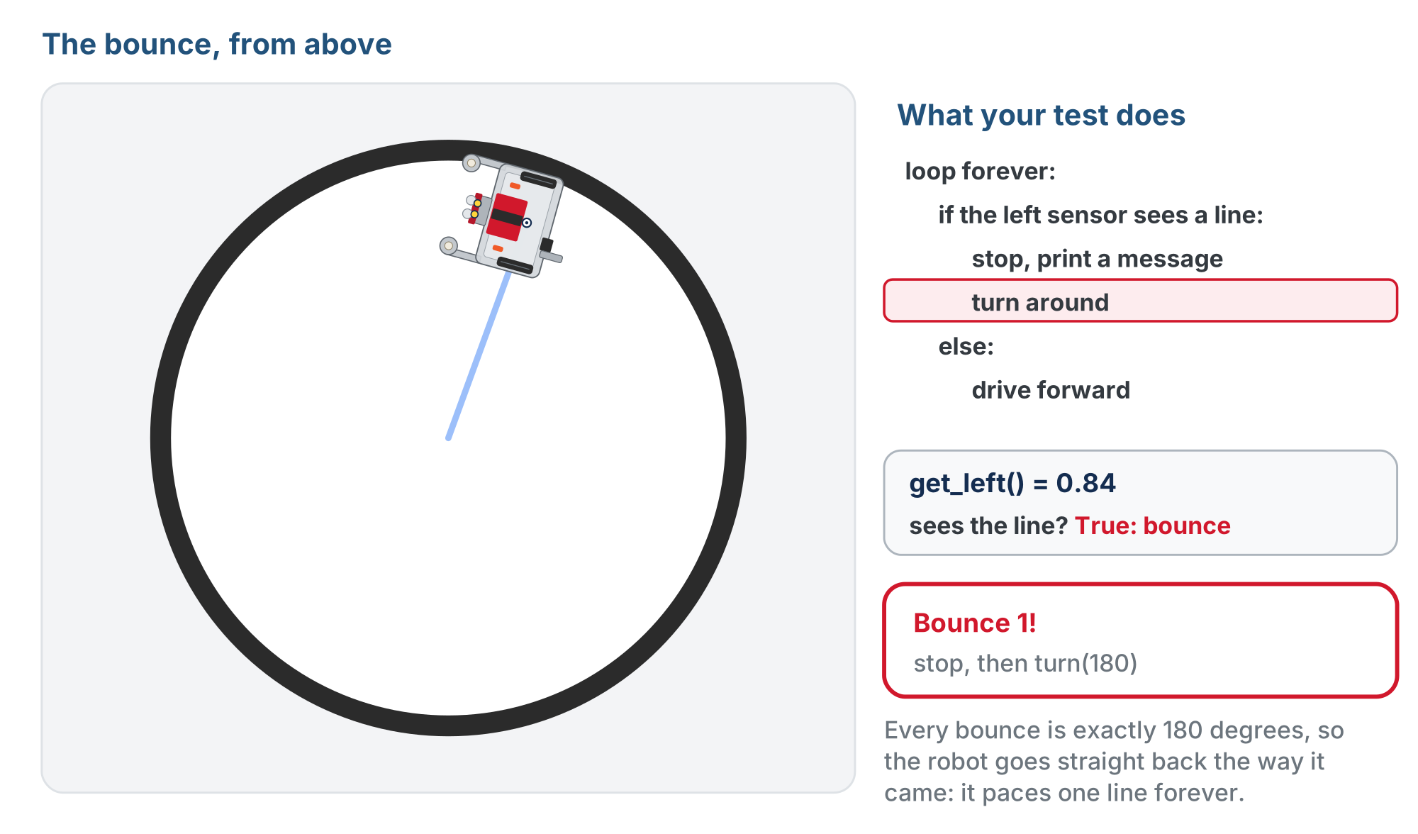
What step 1 should look like
Every bounce is exactly 180 degrees, so the robot paces one line. Lesson 2-4 fixes that.
Notes:
The lesson page shows this as an animation of the whole run; this is the moment of the first bounce. The outline on the right highlights the line of the test that is running: while the sensor reads white (about 0.20) the else branch drives forward, and when it reads the tape (0.84) the if branch stops and turns 180.

Slide 19
Step 1 · One sensor
Activity
Turn the comments in test_bounce() into code, with get_left() > THRESHOLD as the condition
1
Set the run line to test_bounce(). Start the robot inside the circle and press the button
2
Watch it bounce back and forth
3
Drives through the line? Check which way your comparison points: the sensor reads high on the line.
Notes:
More support: start with just an if (stop on the line) before adding the else and the turn. More challenge: try turn(90) and observe, or add an elif for a third case.

Slide 20
Step 2 · Either sensor
Activity
Write the body of is_either_on_line()
1
Check it first: add " On line:", is_either_on_line() to the print in test_sensors(), run that, and slide the robot by hand
2
Then change the condition in test_bounce() to call it
3
True with either sensor on tape, False with both off. Then the robot bounces whichever sensor hits first.
Notes:
Insist on the hand test before the robot drives: it separates a wrong function from a wrong loop.

Slide 21
Step 3 · Challenge: count the bounces
Activity
Add a bounce_count variable that goes up by one each bounce
1
Print it, so you can watch the count climb
2
You will build on counters like this later
Notes:
Step 3 is hand-in work. The counter pattern is the one from Lesson 1-9.

Slide 22
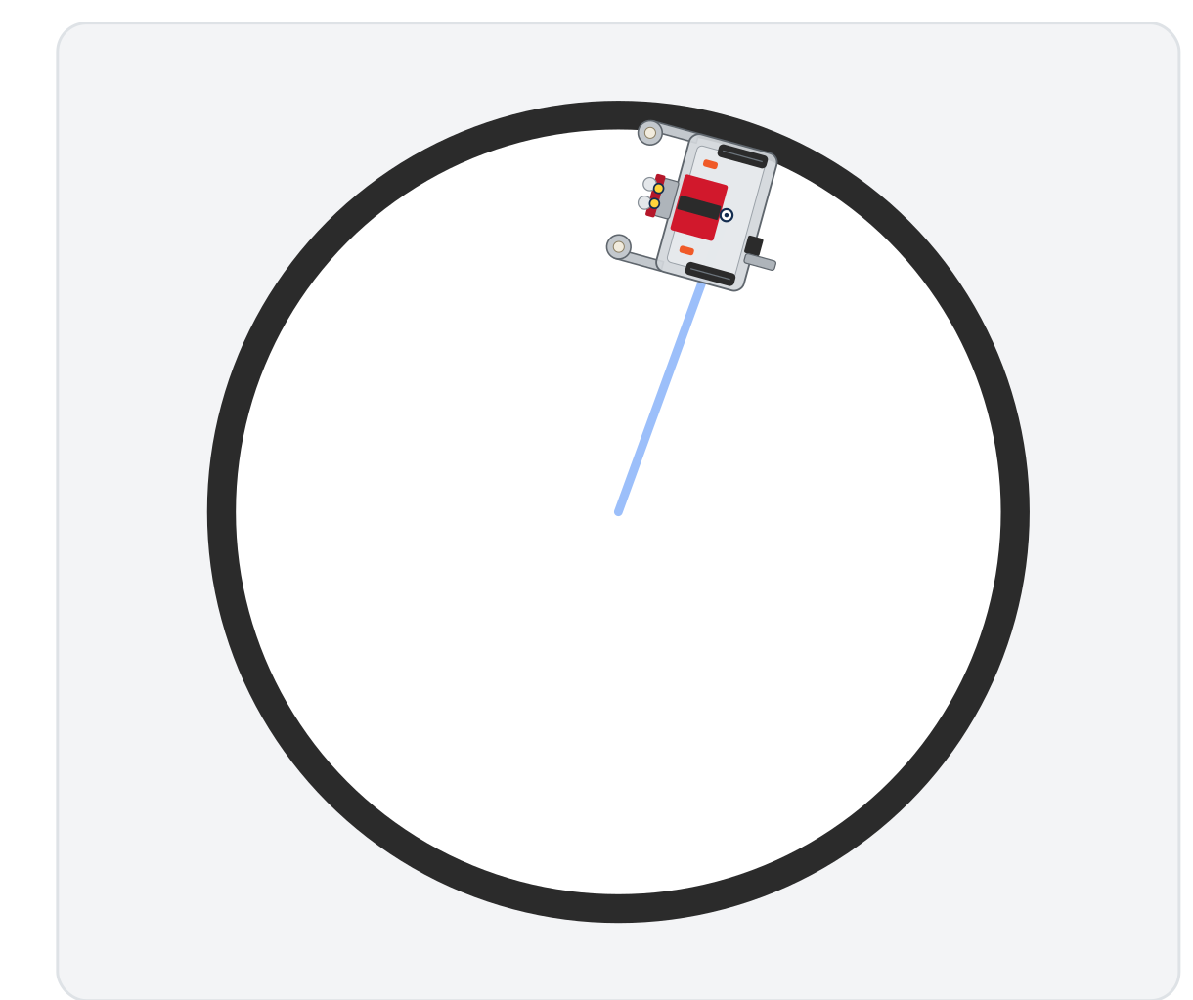
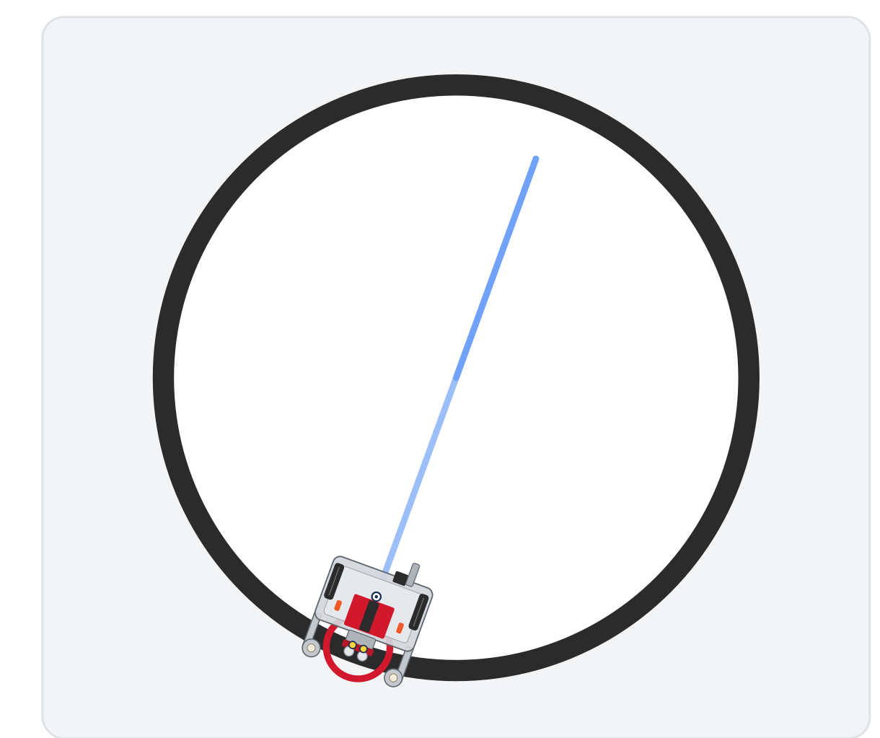
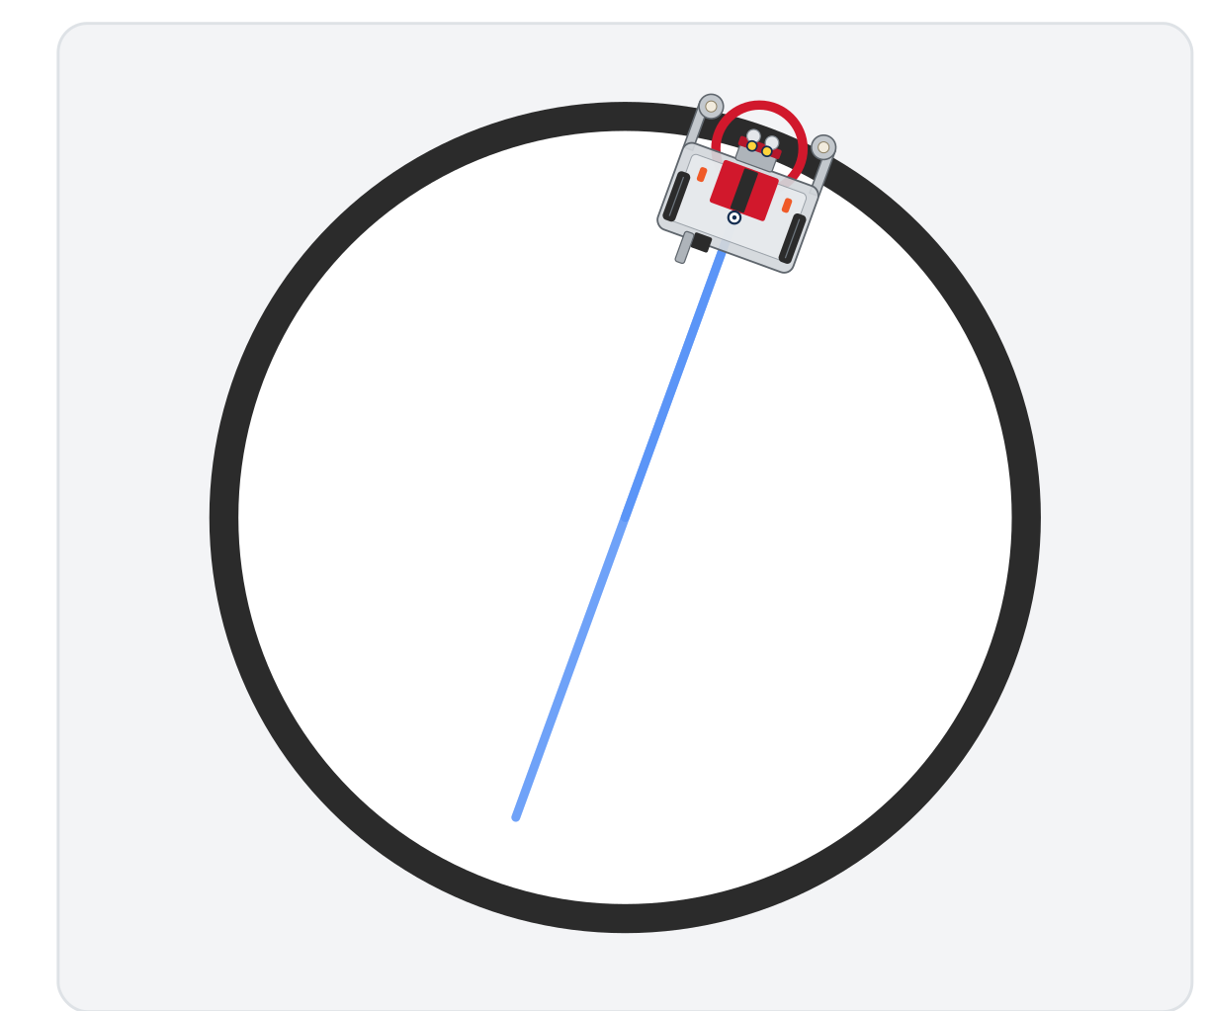
Notice anything?
Bounce 1
Bounce 2
Bounce 3
It bounces between the same two points and never explores the rest of the circle
Notes:
Plant the seed for Lesson 2-4: that predictability is the problem randomness will fix next. Ask the class what would make it cover the whole circle.

Slide 23
Real-world connections
DRIVING
SAFETY
APPS
Self-driving cars
Smoke alarms
Form validation
"If an obstacle is ahead, brake; otherwise keep going": millions of these checks per second.
If smoke is over the threshold, sound the alarm; else stay quiet.
If the password is too short, show an error; otherwise let you continue.
Notes:
if/else decisions are the backbone of anything that reacts.

Slide 24
Wrap-up
How many branches of an if/else run each time?
What does while True mean, and how do you stop it?
What is the difference between and and or?
Next: random turns, so the robot explores the whole circle
Notes:
Answers: exactly one. Loop forever; stop the robot. and needs both true, or needs at least one. Formative: correct if/else syntax, knowing only one branch runs, reading and/or. Exit ticket: "What happens if you remove drivetrain.stop() before the turn?" (a sloppier pivot; the motors were still driving).

