Slide 1

MODULE 2 · LESSON 2-6
Two-Sensor Line Following
By the end of this lesson you can
Explain why two sensors track better than one
Compute error with two sensors: error = left − right
Predict the sign of the error from the robot's position
Rewrite get_error() for two sensors and see that the loop barely changes
Explain why this follower needs no minus sign in arcade(BASE_EFFORT, correction)
Notes:
50 to 60 minutes. The code gets simpler this lesson, but the idea is subtle: the meaning of a positive error changes, so the minus sign from Lesson 2-5 comes out. Budget real time for that.

Slide 2
From one edge to the center
Last lesson the robot followed one edge of the line with a single sensor
Now you use both sensors together, and the code actually gets simpler
The robot straddles the line and follows its center
Two sensors give smoother, more reliable tracking

Slide 3
The difference is the error
With two sensors straddling the line, you don't need a setpoint anymore
Just subtract one reading from the other
Both read the same: the difference is zero, and the robot drives straight
One drifts onto the line: the difference says how much and which way
error = left − right
Notes:
Contrast with Lesson 2-5: there the error was SETPOINT minus one reading. Here equal readings already mean zero, so there is nothing to aim for but balance.

Slide 4
Work out the direction, don't memorise it
A high reading means that sensor is over the line
If the left sensor is on the line, the line is off to the robot's left
So the robot has wandered to the right of it
The sensor that finds the line points back toward where the robot should be
Notes:
Have students reason it out rather than learn the table by heart. Stand at the front and act it out: "the line is on my left, so I must be to its right."

Slide 5
Reading the two-sensor error
Position | left | right | error = L − R | Which way to steer
Centered | 0.5 | 0.5 | 0.0 | drive straight
Drifted right | 0.8 | 0.2 | +0.6 | steer left, back toward the line
Drifted left | 0.2 | 0.8 | −0.6 | steer right, back toward the line
Both on white | 0.1 | 0.1 | 0.0 | straight (lost line)
Both on black | 0.9 | 0.9 | 0.0 | straight (an intersection!)
Zero error can mean centered, lost, or at a crossing line
Notes:
The last two rows both give zero error for very different reasons. Point at the bottom row: both sensors on black is a crossing line, and next lesson gets a function that detects it.

Slide 6
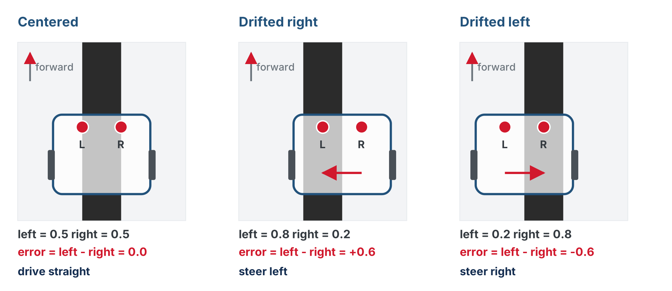
Two sensors straddle the line
The sensor that finds the tape is on the side the line is on, so the robot has drifted the other way, and steers back toward the high reading.

Slide 7
Check your understanding
The left sensor reads 0.8 and the right reads 0.2. What is the error, and which way has the robot drifted?
A. error +0.6, drifted right
B. error +0.6, drifted left
C. error 0.0, centered
D. error 1.0, at an intersection
Notes:
Answer: A. error = 0.8 − 0.2 = +0.6. The high reading is on the LEFT, so the line is off to the robot's left: the robot has drifted right of the line and needs to steer left to get back.

Slide 8
Answer
The left sensor reads 0.8 and the right reads 0.2. What is the error, and which way has the robot drifted?
A. error +0.6, drifted right
B. error +0.6, drifted left
C. error 0.0, centered
D. error 1.0, at an intersection
error = 0.8 − 0.2 = +0.6. The high reading is on the LEFT, so the line is off to the robot's left: the robot has drifted right of the line and needs to steer left to get back.

Slide 9
The payoff for a one-line function
test_follow() reads get_error(), scales it, steers
Switching to two sensors means rewriting get_error()
The loop that calls it barely notices
Two changes to robot.py, both in place
This is why the error went behind a function last lesson
Notes:
Say this out loud now and again after step 2: the loop did not change, only the function did. It is the first time the course shows why a one-line function is worth having.

Slide 10
Change 1 · The LINE SENSOR section
Replace the body of get_error() so it returns get_left() - get_right(), and delete SETPOINT: two sensors don't need one.
def get_error():
# return the left reading minus the right reading
pass
Same name, new body: everything that calls get_error() keeps working

Slide 11
Change 2 · The minus sign comes out
In test_follow(), the minus sign in front of the correction comes out.
# Lesson 2-5, one sensor:
drivetrain.arcade(BASE_EFFORT, -correction)
# Lesson 2-6, two sensors:
drivetrain.arcade(BASE_EFFORT, correction)
That's the only change to the loop. Why? A positive error now means something different.
Notes:
Do not let this slide pass as a typo fix. The next slide is the reason, and it is the subtle point of the lesson.

Slide 12
Why no minus now?
A positive error now means the robot drifted right of the line
So it must steer left to get back
In arcade(), a positive turn steers left
The math already lines up with the robot, so there's nothing to flip
In Lesson 2-5 a positive error meant "drifted onto white, steer right". The meaning of a positive error changed, so the sign changed.
Notes:
Spend real time here. Walk both cases: one sensor, positive error, needs a right steer, which is a negative turn, hence the minus. Two sensors, positive error, needs a left steer, which is already a positive turn.

Slide 13
Check your understanding
Why does the minus sign from Lesson 2-5 come out of arcade() here?
A. The meaning of a positive error flipped, so the steer direction has to flip too
B. Two sensors never need a sign change
C. It makes the robot go faster
D. It fixes a bug in arcade()
Notes:
Answer: A. In Lesson 2-5 a positive error meant "drifted onto white, steer right", a negative turn, so the correction was negated. Now a positive error means "drifted right, steer left", already a positive turn in `arcade()`.

Slide 14
Answer
Why does the minus sign from Lesson 2-5 come out of arcade() here?
A. The meaning of a positive error flipped, so the steer direction has to flip too
B. Two sensors never need a sign change
C. It makes the robot go faster
D. It fixes a bug in arcade()
In Lesson 2-5 a positive error meant "drifted onto white, steer right", a negative turn, so the correction was negated. Now a positive error means "drifted right, steer left", already a positive turn in arcade().

Slide 15
Step 1 · Explore the error by hand
Activity
Rewrite get_error() first, and test it before anything drives
1
Add " Error:", round(get_error(), 2) to the print in test_sensors(), and set the run line to test_sensors()
2
Slide the robot across the line by hand. Watch the error go positive, then zero, then negative
3
Say out loud which way the robot has drifted each time, and check against the table
4
Notes:
Do not skip this step. Sliding the robot by hand while the error goes positive, zero and negative is the physical intuition that makes the sign change click.

Slide 16
Step 2 · Run the follower
Activity
Take the minus sign out of test_follow() and set the run line back to it
1
Put the robot with the line running between the sensors, press the button, and watch it track the circle
2
Steers away from the line as soon as it drifts? The sign is backwards: go back to step 1 and work out which way a positive error should steer
3
The loop is the same three lines it was with one sensor. The function changed; its caller didn't.
Notes:
Expect to re-tune KP: the two-sensor error has a different range from the one-sensor version.

Slide 17
Step 3 · Compare with one sensor
Activity
Temporarily put the one-sensor get_error() back (and SETPOINT), with its minus sign
1
Run test_follow() again right after. Which is smoother? Which handles the curves and higher speeds better?
2
Restore the two-sensor version: that's the one the rest of the course uses
3

Slide 18
Step 4 · Challenge: push the speed
Challenge
Turn BASE_EFFORT up to 0.4 to 0.5 for both versions and watch what happens to each
1
Which one degrades first?
2
What does that tell you about how much information one sensor gives the robot?
3
Notes:
One sensor only knows "more white" or "more black"; it cannot tell which side of the line it lost. Two sensors always know which way back is.

Slide 19
Real-world connections
AUDIO
NAVIGATION
ROBOTICS
Stereo & hearing
Differential GPS
Sensor arrays
You locate a sound from the tiny difference between your two ears: the same differential idea.
Comparing two receivers cancels error and pins a position down to centimeters.
Advanced line followers use 5 to 8 sensors, but the principle is the one you just learned.

Slide 20
Wrap-up
What's the two-sensor error formula, and why no setpoint?
Positive error means the robot drifted which way?
Why did the minus sign come out?
Next: finish the sensor toolkit with is_at_cross()
Notes:
Answers: left − right, since equal readings already mean zero. Right: the left sensor found the line, so the line is left of the robot. A positive error now needs a left steer, already a positive turn in arcade(). Exit ticket: "Both sensors read 0.9: what is the error, and what might it physically mean?" (about 0; an intersection). Next lesson adds is_at_cross(), which detects that intersection.

