Slide 1

MODULE 2 · LESSON 2-8
Detecting Intersections
By the end of this lesson you can
Test is_at_cross() on a moving robot, with no line following in the program
Write track_to_intersection(): follow the line until is_at_cross() says stop
Explain why the cross is detected in the loop condition, not inside the loop body
Program a response to the cross (stop, turn around, follow back)
Notes:
50 to 60 minutes. Students finished the sensor toolkit last lesson and tested it by hand. Today the robot drives on it. The big idea is a sensor-ended loop: the loop condition does the looking, the body does the following.

Slide 2
A reason to stop
Last lesson you tested all five sensor functions by sliding the robot by hand
Your follower in test_follow() runs forever
This lesson gives it a reason to stop: the cross
First is_at_cross() gets one more test, with the robot moving. Then it goes in charge of the follower's loop
The stopping is done by a function you already trust

Slide 3
Add to robot.py: this lesson's skeleton
Paste it above RUN, at the end of LINE TRACKING. The outline's body is the body of test_follow(): the difference is all in the while line.
# --- Lesson 2-8: follow to a cross ---
# track_to_intersection() is the follower from test_follow()
# with a reason to stop: it follows until is_at_cross() says
# the robot is on a crossing line. Lesson 2-9 adds the
# functions that park on the cross and turn to the next line.
def track_to_intersection():
# until is_at_cross():
# correction = get_error() * KP
# steer with arcade(BASE_EFFORT, correction)
# then stop the motors
pass
Notes:
The same paste also holds three test functions: test_cross_moving(), test_track() and test_reverse(). The next slides show each one where it is used. This is the first real driving function, placed next to the test that has been doing the job so far.

Slide 4
One more test, moving this time
Sliding by hand showed is_at_cross() reads the tape. Does a driving robot get a clean reading when both sensors arrive on the strip?
def test_cross_moving():
# robot 20-30 cm from a straight line, square on: drive
# until the cross check fires
while not is_at_cross():
drivetrain.set_effort(0.3, 0.3)
drivetrain.stop()
print("Cross!")
It is Lesson 2-2's drive-to-the-edge program with the condition swapped for a function call. No line following in it yet.

Slide 5
Reading the moving test
What the robot does | What it means
Stops with both sensors on the tape | is_at_cross() works at driving speed. Anything that goes wrong later is not its fault
Drives straight through | The sensors crossed the tape faster than the loop read them (drop the effort to 0.2), or the threshold is too high
Stops before the tape | Something lighter than the floor counted as black

Slide 6
Check your understanding
Why test is_at_cross() with a straight drive before using it in the line follower?
A. Because line following cannot be tested on a cross
B. So that if the test fails, the only thing that can be wrong is the cross check
C. Because set_effort() is faster than arcade()
D. It makes no difference; either order is the same
Notes:
Answer: B. One new piece at a time. With only `is_at_cross()` and a straight drive, a failure points at exactly one place. Inside the follower, it could be in either.

Slide 7
Answer
Why test is_at_cross() with a straight drive before using it in the line follower?
A. Because line following cannot be tested on a cross
B. So that if the test fails, the only thing that can be wrong is the cross check
C. Because set_effort() is faster than arcade()
D. It makes no difference; either order is the same
One new piece at a time. With only is_at_cross() and a straight drive, a failure points at exactly one place. Inside the follower, it could be in either.

Slide 8
Follow until the cross
test_follow() is while True:, so it follows forever
Change the condition: the looking is done by the loop condition, the following is done inside the loop
The body is the two lines you already have
When both sensors reach the cross, is_at_cross() returns True, the loop ends, and the robot stops
Read the while line as a sentence: while not at a cross, follow
Notes:
An earlier version of this lesson did the cross check and the following in one if/else inside a while True. Students got it working but could not say which half was broken when it was not. Now the sensor functions arrive tested, and track_to_intersection() is test_follow()'s loop with the condition replaced. Keep that separation visible: every function in Lesson 2-9 follows it.

Slide 9
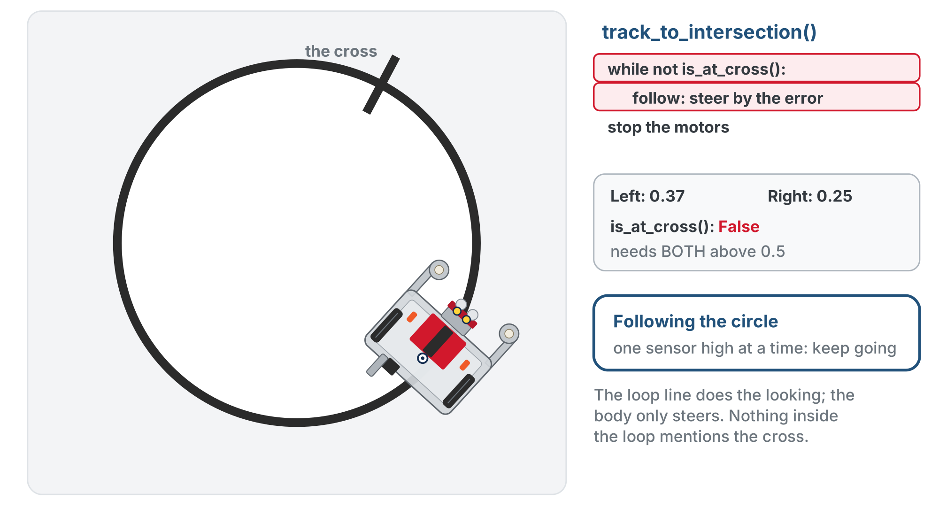
test_track() from above: following
Watch the is_at_cross() line: following the line only ever puts one sensor on the tape at a time, so it stays False the whole way round.
Notes:
On the lesson page this is one animation of test_track(); these two slides are two moments of it. The readout shows the live left and right readings: at most one is high while following.

Slide 10
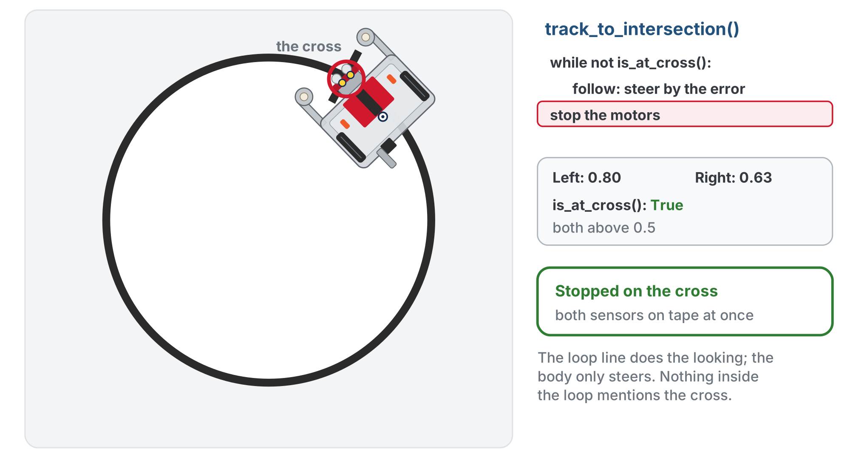
test_track() from above: the cross
Both sensors reach the cross strip and read high. is_at_cross() becomes True, the loop ends, and the robot stops with its sensors on the cross.
Notes:
On tight curves both sensors can briefly go high (a false positive); a wide, crisp taped cross and a little tuning handle it.

Slide 11
Check your understanding
What makes track_to_intersection() stop?
A. A fixed number of loop passes
B. is_at_cross() becoming True: both sensors see the cross
C. The error reaching exactly zero
D. A timer
Notes:
Answer: B. The while condition is `not is_at_cross()`. The moment both sensors see the tape of a cross, the loop ends and the robot stops, however long that took.

Slide 12
Answer
What makes track_to_intersection() stop?
A. A fixed number of loop passes
B. is_at_cross() becoming True: both sensors see the cross
C. The error reaching exactly zero
D. A timer
The while condition is not is_at_cross(). The moment both sensors see the tape of a cross, the loop ends and the robot stops, however long that took.

Slide 13
Check your understanding
In track_to_intersection(), where is the intersection detected?
A. In an if/else inside the loop body
B. In the while condition: the body only steers
C. After the loop, by checking the last error
D. In arcade()
Notes:
Answer: B. The loop condition asks `is_at_cross()` every pass. The body reads, computes, steers. Each part has one job, which makes each one testable.

Slide 14
Answer
In track_to_intersection(), where is the intersection detected?
A. In an if/else inside the loop body
B. In the while condition: the body only steers
C. After the loop, by checking the last error
D. In arcade()
The loop condition asks is_at_cross() every pass. The body reads, computes, steers. Each part has one job, which makes each one testable.

Slide 15
The two tests that drive it
Both are in the skeleton. The run block still waits for the button before every test.
def test_track():
# robot on the circle, pointed along it: follow to the
# cross and stop
track_to_intersection()
print("Done!")
def test_reverse():
# follow to the cross, turn around, follow back to it
track_to_intersection()
drivetrain.turn(180)
track_to_intersection()
print("Done!")

Slide 16
Step 1 · is_at_cross(), moving
Activity
Set the run call to test_cross_moving()
1
Robot 20 to 30 cm from a straight line, square on. It should stop with both sensors on the tape
2
Try it from three distances
3
Don't go on until it does

Slide 17
Step 2 · track_to_intersection()
Activity
Write the body: start by copying the loop out of test_follow()
1
Set the run call to test_track(). Put the robot on the circle, pointed along it
2
It should follow the line around and stop at the cross
3
Weaves? Same gain you tuned in Lesson 2-6. Stops somewhere else? Step 1 already cleared the cross check, so look at where the follower put the sensors.
Notes:
The check on the lesson page is a closed reveal; do not show it before students have tested their own on the circle. If theirs reads the error a different way and passes the test, they keep theirs. Class-track students write track_to_intersection() as a plain function this lesson, calling their sensor object (sensor.is_at_cross(), sensor.get_error()); the LineTrack class comes in Lesson 2-9's extension.

Slide 18
Step 3 · Follow, reverse, follow
Activity
Set the run call to test_reverse()
1
The robot follows to the cross, turns around, and follows back the other way to the same cross
2
Where are the sensors after the turn? Watch closely: it matters next lesson
3
Notes:
When track_to_intersection() stops, the sensors are on the cross and the wheels are about 9 cm short of it. That is why the reverse works with no extra move: turn(180) pivots on the wheels and swings the sensors back onto the circle behind, clear of the cross, so the next track does not fire at once. Lesson 2-9 makes the gap explicit with drive_past_intersection(); do not pre-teach it here.

Slide 19
Step 4 · Challenge: count the crossings
Activity
Write test_count(): the robot reverses at the cross four times and stops
1
At each cross, print the count: "Cross # 1", "Cross # 2", and so on, then "Done!"
2
You know a loop that runs a fixed number of times
3
This is a direct preview of the Module 2 final project
Notes:
test_count() is hand-in work; the solution is in the teacher copy only. More support: have the straight-drive test print get_left() and get_right() each pass, so students see both readings climb as the tape arrives. More challenge: turn 90 degrees to take the perpendicular path; give different crossings different behaviors (beep on 1, blink on 2); or write track_for_crosses(n), which needs the robot to get past each cross first, the problem Lesson 2-9 solves.

Slide 20
Real-world connections
TRANSIT
FACTORIES
WEARABLES
Rail junctions
Conveyor triggers
Step & tap detection
Trains detect track sensors at switches to decide which way to route.
A sensor spots each item passing a point and triggers a sort, stamp, or count.
Your watch watches a constant sensor stream for the pattern that means "a step" or "a tap."
Notes:
The common thread: watching a continuous stream for a specific event.

Slide 21
Wrap-up
Why test is_at_cross() with a straight drive first?
Where does track_to_intersection() look for the cross?
What ends track_to_intersection()?
Next: park on the cross and turn to the next line
Notes:
Answers: so a failure can only be the cross check. In the while condition; the body only steers. Both sensors on the cross, not a timer, not a count. Exit ticket: "Write track_to_intersection() from memory using the toolkit functions." Lesson 2-9 adds the three driving functions that park the wheels on the cross and turn until a sensor finds the next line.

