Slide 1

MODULE 2 · LESSON 2-9
Line-Tracking Functions
By the end of this lesson you can
Say what ends each of the four driving functions, and why none of them is a timer
Explain why the robot drives a fixed distance after the sensors reach a cross, and write drive_past_intersection()
Write turn_clockwise() and turn_counterclockwise() as sensor-ended turns
Drive a follow, turn, follow course with four function calls
Notes:
60 minutes. This lesson finishes the driving toolkit. The rule to say out loud: nothing here stops because a clock ran out. The names learned today are used through Module 5.

Slide 2
Finish the driving toolkit
Last lesson the robot followed the line to a cross and stopped
Today: three more functions that park the wheels on the intersection and turn until a sensor finds the next line
Built on the five sensor functions from Lesson 2-7, written one at a time, each tested before the next
With track_to_intersection(), that's four driving functions. They drive every robot program for the rest of the course.

Slide 3
Add to robot.py: one setting, three outlines
TURN_EFFORT = 0.25 # spin speed during a turn
def drive_past_intersection():
# drive straight forward by exactly the sensor-to-axle
# distance
pass
def turn_clockwise():
# 1. blind turn, about 60 deg: get BOTH sensors off this line
# 2. keep spinning in place (no forward speed, only turn)
# 3. wait until a sensor sees a line
# 4. stop
pass
def turn_counterclockwise():
# the mirror image: same four moves, opposite direction
pass
Notes:
Paste the whole skeleton above RUN, at the end of the LINE TRACKING section. It opens with a section comment: track_to_intersection() stops with the SENSORS on the cross, drive_past_intersection() moves the WHEELS onto it, and the two turns spin until a LINE SENSOR function sees the next line, so no turn depends on a timer. The slide leaves that comment out to fit; the tests are on the next slide and on the Step 5 slide.

Slide 4
Add to robot.py: the tests
Also in the skeleton, under the outlines (test_course() comes in Step 5). One more change, in the LINE TRACKING settings: raise BASE_EFFORT to 0.4.
def test_park():
# follow to the cross, then put the wheels on it
track_to_intersection()
drive_past_intersection()
def test_turn():
# park on the cross, then turn until a sensor finds a
# line: on the circle, that is all the way around
track_to_intersection()
drive_past_intersection()
turn_clockwise()
Notes:
BASE_EFFORT goes up because the steering is now tuned and the robot can go a little faster. If a robot weaves at 0.4, drop it back (Step 1 checks this).

Slide 5
Four functions, and what ends each one
For each: what it does, and what makes it stop. The design is the lesson; the typing is yours.
Function | What it does | What ends it
track_to_intersection() | follows the line (you have it) | a cross
drive_past_intersection() | moves the wheels onto the cross | a distance
turn_clockwise() | spins until a sensor finds a line | a line
turn_counterclockwise() | the mirror image | a line
Each one ends on something the robot can sense or measure. None is a timer.

Slide 6
The one you have: following the line
track_to_intersection() is the control loop with is_at_cross() as the exit condition
Until you're at a cross, steer toward the line; then stop
All the sensor arithmetic is behind get_error() and is_at_cross()
Nothing in the function reads the hardware directly
It ends on a cross. Keep that pattern in mind: the next three each end on something the robot can sense.

Slide 7
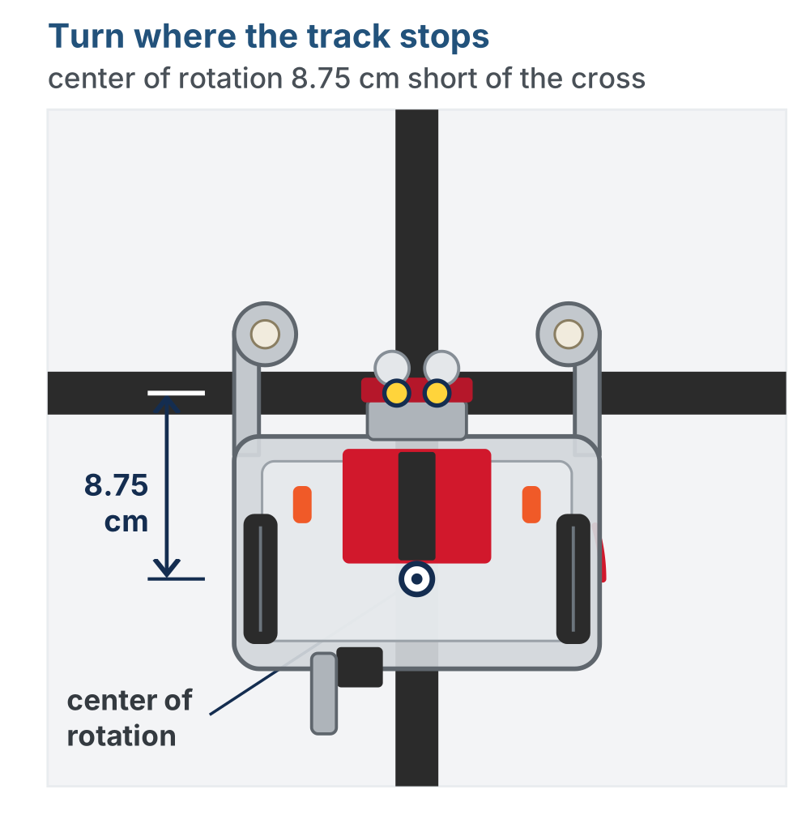
The wrinkle: the sensors get there first
When track_to_intersection() stops, both sensors are over the cross
The sensors are under the rangefinder at the very front
The robot turns about its center of rotation: the hole between the drive wheels where a pen goes
That is 8.75 cm further back
Notes:
The figure is the left panel of the next slide's animation, at its first moment: the robot where track_to_intersection() left it. 8.75 cm is sensor-to-axle on an XRP; measure it if the robot's mounting differs.

Slide 8
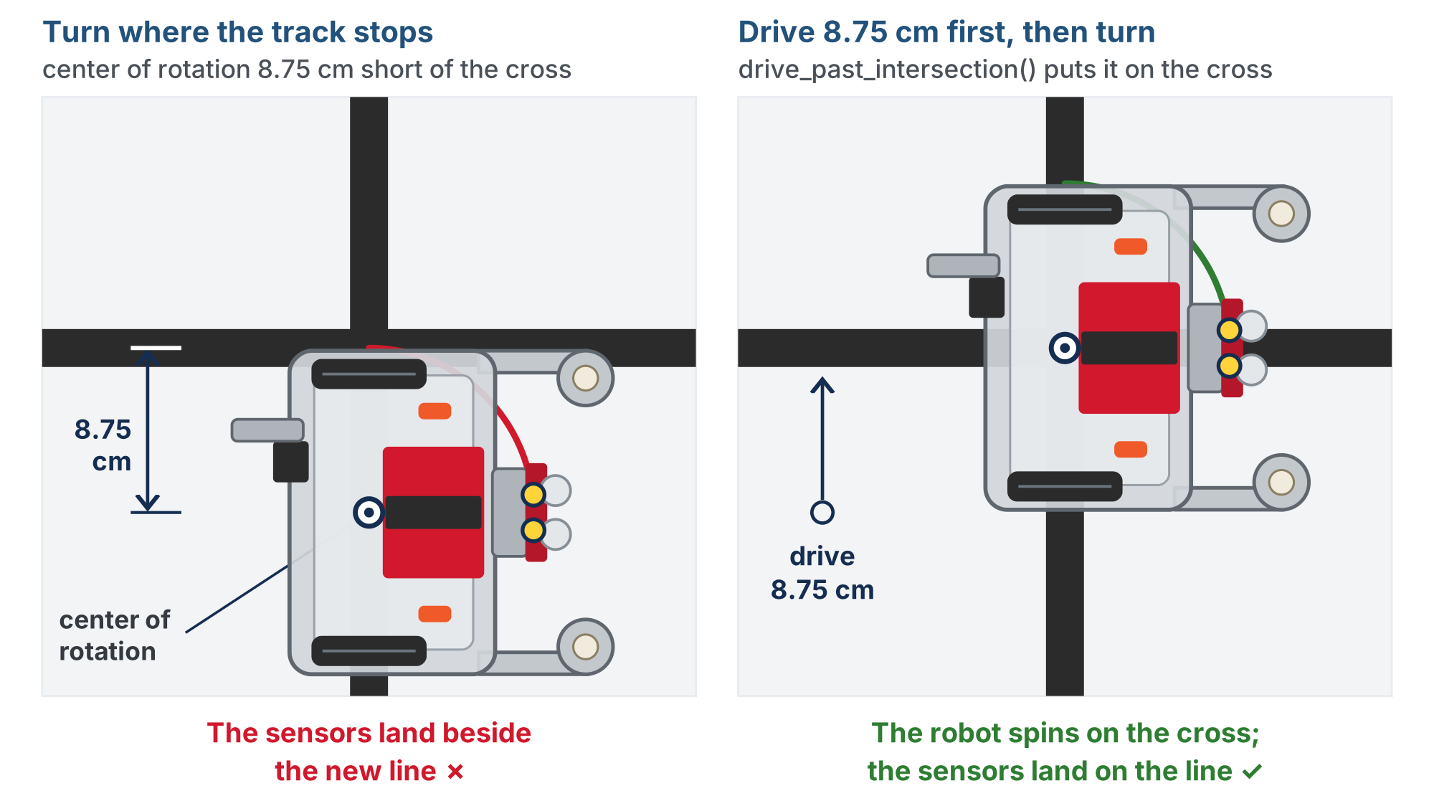
Turn now, or drive 8.75 cm first?
Left: turns right away and swings about a point short of the cross. Right: drives 8.75 cm first, spins on the cross, and its sensors find the new line.
Notes:
On the lesson page both robots animate side by side from the same start. This is the end state: the left robot's sensors land beside the new line, the right robot's land on it.

Slide 9
drive_past_intersection()
After every track, drive forward 8.75 cm: the center of rotation ends up where the sensors were
Second job: it carries the sensors past the cross, so the next track_to_intersection() doesn't stop instantly
A distance, not a time.sleep(), on purpose
Eight and three-quarter centimeters is the same with a full battery or a flat one; half a second is not. You know the drivetrain call that drives a distance: Lesson 1-8.

Slide 10
Check your understanding
Why does drive_past_intersection() use a distance rather than driving for half a second?
A. straight() is easier to spell
B. A distance is the same on a full or flat battery and any floor; a time needs re-tuning
C. time.sleep() cannot be used with motors
D. Because 8.75 is a magic number
Notes:
Answer: B. The course avoids timing-based movement everywhere. Distances and sensor readings describe the world; a duration describes a guess about the motors.

Slide 11
Answer
Why does drive_past_intersection() use a distance rather than driving for half a second?
A. straight() is easier to spell
B. A distance is the same on a full or flat battery and any floor; a time needs re-tuning
C. time.sleep() cannot be used with motors
D. Because 8.75 is a magic number
The course avoids timing-based movement everywhere. Distances and sensor readings describe the world; a duration describes a guess about the motors.

Slide 12
Turning until a sensor says stop
How far should a turn go?
On the grid in Module 3: a quarter turn, onto the cross street
On your circle the cross is too short for the sensors to touch while the robot spins, so the next line is the circle behind: all the way around
You could time either one, and it would be right until the battery dropped
Instead, turn until the sensors find the next line, wherever it is
turn_counterclockwise() is the mirror image: swap the sign on both the blind turn and the spin

Slide 13
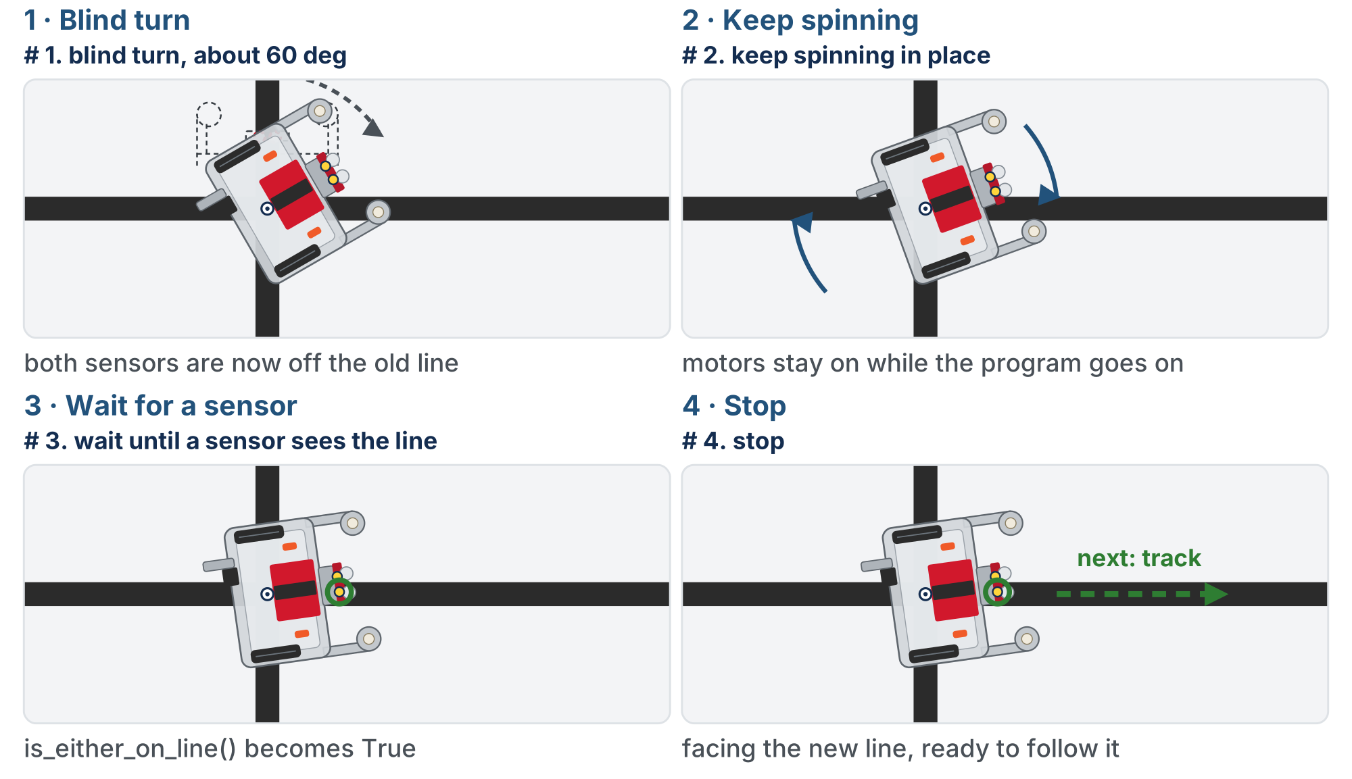
The four moves of turn_clockwise()
Drawn on a grid intersection. On your circle the same four moves carry on round to the circle behind. A sensor, not a clock, ends the turn.
Notes:
Walk the four panels in order: the blind turn clears the old line, the motors stay on while the program goes on, is_either_on_line() becomes True, stop.

Slide 14
Why a blind turn, and why pass?
The turn starts with the sensors on the line: without the blind turn, is_either_on_line() is already True and the wait ends before the robot moves
Move 2 is arcade() with no forward speed, only a turn value
The waiting loop has nothing to do: the motors are already running. Python needs something in the body, so you write pass
def turn_clockwise():
# 1. blind turn, about 60 deg:
# get BOTH sensors off this line
# 2. keep spinning in place
# (no forward speed, only turn)
# 3. wait until a sensor sees a line
# 4. stop
pass
Notes:
pass is the same word as in the outlines, with the same meaning: nothing to do here. The outline comments are wrapped onto two lines on this slide to fit.

Slide 15
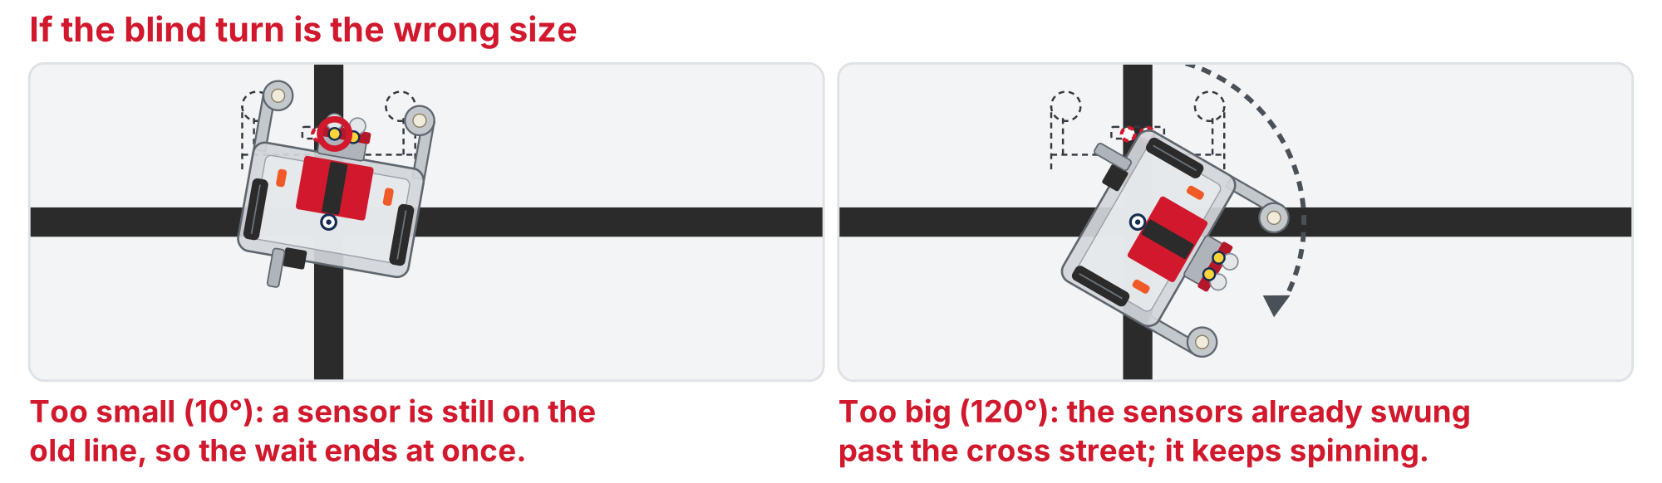
Why 60° and not 90°?
The sensor finishes the turn, so the blind part only has to clear the old line. Too small: the wait ends at once. Too big: the sensors swing past the new line.
Notes:
The bottom row of the lesson figure. Not so little that a sensor is still on the old line, not so much that the sensors swing past the new one. The two functions are mirror images: swap the sign on both the blind turn and the spin, and the direction swaps.

Slide 16
Check your understanding
Why does turn_clockwise() start with a blind 60-degree turn before the while loop?
A. To make the turn faster
B. Both sensors start on the old line, so is_either_on_line() is already True
C. Because 60 + 30 = 90
D. To recharge the battery
Notes:
Answer: B. The sensor-ended loop needs a moment when neither sensor is on tape. The blind turn provides it; the loop then finishes the turn on the next line it finds.

Slide 17
Answer
Why does turn_clockwise() start with a blind 60-degree turn before the while loop?
A. To make the turn faster
B. Both sensors start on the old line, so is_either_on_line() is already True
C. Because 60 + 30 = 90
D. To recharge the battery
The sensor-ended loop needs a moment when neither sensor is on tape. The blind turn provides it; the loop then finishes the turn on the next line it finds.

Slide 18
Check your understanding
What does pass do inside the while loop?
A. Skips the turn
B. Nothing: a placeholder; the loop re-checks is_either_on_line() while the motors run
C. Pauses the program
D. Passes the robot to the next line
Notes:
Answer: B. `pass` is a do-nothing statement. The motors were already told to spin; the loop's body has nothing to add, and Python needs something there.

Slide 19
Answer
What does pass do inside the while loop?
A. Skips the turn
B. Nothing: a placeholder; the loop re-checks is_either_on_line() while the motors run
C. Pauses the program
D. Passes the robot to the next line
pass is a do-nothing statement. The motors were already told to spin; the loop's body has nothing to add, and Python needs something there.

Slide 20
Step 1 · track_to_intersection(), at the new speed
Activity
Every step: robot on the circle-with-cross, pointed along the circle. The run block waits for the button.
Nothing to write, but the speed went up: set the run call to test_track()
1
It should follow the line and stop with both sensors on the cross
2
If it weaves at the new speed, drop BASE_EFFORT back to 0.3
3
Don't go on until the function you're building on works
Notes:
Expect the class to spread out: some pairs will be tuning a turn while others are still on the first follow. Nothing in step 3 depends on a neighbor's step 2. The cross must be clearly perpendicular to the circle and short, about 10 cm: long enough for both sensors at once, short enough that they swing clear when the robot spins on it.

Slide 21
Step 2 · drive_past_intersection()
Activity
Write the body: one line
1
Run test_park(). The robot should end with its wheels on the cross
2
Put a finger on the tape beside the robot: the axle should sit over the line, the sensors past it
3

Slide 22
Step 3 · turn_clockwise()
Activity
Write the four moves, with TURN_EFFORT at 0.25 to start, and run test_turn()
1
Watch the blind part: it should carry both sensors clear of the circle
2
Then the spin carries on until a sensor meets the circle again, the robot facing back the way it came
3
Notes:
The check on the lesson page is a closed reveal; students write and test all three functions before opening it. If theirs differs and still works, they keep it; if it differs and does not, compare the two signs in each turn first.

Slide 23
Step 3 · Two things to fix
What you see | Why | Fix
The turn stops at once, barely moving | The blind part was too small: a sensor was still on the old line | Increase the 60°
The turn stops a quarter of the way round, facing along the cross | The cross is too long: the sensors found it during the spin | Trim it to about 10 cm

Slide 24
Step 4 · turn_counterclockwise()
Activity
Mirror step 3: same four moves, both signs flipped
1
Change test_turn() to call it instead, and run it from the cross
2
Confirm it also turns all the way around, this time the other way
3

Slide 25
Step 5 · Four lines to drive a course
With all four working, run test_course(). The part that actually drives is four calls.
def test_course():
# follow, park, turn around, follow the circle back to
# the cross: the whole lesson in four calls
track_to_intersection()
drive_past_intersection()
turn_clockwise()
track_to_intersection()
print("Done!")
All the sensor reading and motor control lives in the sections above. Compare it to the wall of code this was back in Lesson 2-6.

Slide 26
Challenge: turn_around()
Add turn_around() to the section, and a test_turn_around() for it
On your circle its body is one call: turn_clockwise() already ends facing back the way it came
Why write a function for one call?
The name says what you mean
On a grid, turning around takes two calls: turn_around() is the one place that would change
Notes:
More support: give the finished sensor toolkit and have students write only the driving functions, starting with drive_past_intersection(). More challenge: a timeout so a turn that never finds a line gives up (count loop passes, not seconds), or a track_for_distance() using the drivetrain encoders rather than a timer.

Slide 27
Check your understanding
In the four-line program, why is drive_past_intersection() called between track_to_intersection() and turn_clockwise()?
A. To give the motors a rest
B. So the wheels are over the cross when the turn pivots, and the sensors are clear of it
C. It is optional; the turn works the same without it
D. To reset the error to zero
Notes:
Answer: B. The sensors reached the cross first. `drive_past_intersection()` moves the wheels onto it, so the turn pivots on the intersection and the next track does not start on the same tape.

Slide 28
Answer
In the four-line program, why is drive_past_intersection() called between track_to_intersection() and turn_clockwise()?
A. To give the motors a rest
B. So the wheels are over the cross when the turn pivots, and the sensors are clear of it
C. It is optional; the turn works the same without it
D. To reset the error to zero
The sensors reached the cross first. drive_past_intersection() moves the wheels onto it, so the turn pivots on the intersection and the next track does not start on the same tape.

Slide 29
Real-world connections
ROBOTS
CARS
SOFTWARE
Skill stacks
Sensor-ended actions
Libraries on libraries
Perception feeds motion feeds planning: each layer built on the one below, as driving is built on sensing.
Parking assist stops when the sensors say the space is reached, not after a set number of seconds.
Almost every library is built on another one, calling its functions rather than re-reading the hardware.
Notes:
Layered toolkits are how robot software is organized.

Slide 30
Wrap-up
What ends each of the four driving functions?
Why drive_past_intersection() after every track?
Why the blind 60° at the start of a turn?
Next: the final project: lap the circle, reversing at the cross
Notes:
Answers: a cross, a distance, a line, a line. The sensors reach the cross before the wheels do. To get the sensors off the old line so the loop can end on the new one. Exit ticket: "Write track_and_turn_clockwise() that follows to a cross, parks on it, and turns."

Slide 31
Optional: the LineTrack class
Optional extension
Built LineSensor in Lesson 2-7? The driving toolkit can become a class too
A car has an engine. LineTrack has a LineSensor and has a drivetrain, and coordinates them: composition
Same four methods, same names, with tracker. in front
From here on, use your class. Lesson 3-1 says track_to_intersection(): you write tracker.track_to_intersection()
tracker = LineTrack()
tracker.track_to_intersection()
tracker.drive_past_intersection()
tracker.turn_clockwise()
tracker.track_to_intersection()
Notes:
Optional extension, for students who built the LineSensor class. The lessons ahead are written with the function names; class-track students use the same names with tracker. in front. LineTrack makes the LineSensor it uses, so the separate sensor = LineSensor() line is no longer needed; keep it for test_sensors() or delete it. Solution file: lesson-09-linetrack-class-addon.py.

Slide 32
Optional: move your four bodies in
Optional extension
Put self. in front of every sensor call, drivetrain call and setting: get_error() becomes self.sensor.get_error(), KP becomes self.kp.
class LineTrack:
def __init__(self):
self.sensor = LineSensor() # has-a LineSensor
self.drivetrain = DifferentialDrive.get_default_differential_drive()
self.base_effort = 0.4
self.kp = 0.5
self.turn_effort = 0.25
def track_to_intersection(self):
# your function, with self. in front of the sensor,
# the drivetrain and the settings
pass
# drive_past_intersection(), turn_clockwise() and
# turn_counterclockwise(): the same, each with self
tracker = LineTrack()
Notes:
The class-track skeleton replaces the section's settings and four functions; the test functions stay. On the lesson page all four methods are pass outlines and there is a header comment; the slide folds the last three methods into one comment to fit. __init__ is the new idea, so it is given. Each test call gets tracker. in front, and test_course() is the check that nothing else changed. The finished methods are behind a reveal on the lesson page and are not shown here.

