Slide 1

MODULE 4 · LESSON 4-0
The Big Picture
By the end of this lesson you can
Describe the problem Module 4 solves: drive to a destination on its own, then to several in a row
Split a complex problem into simpler parts: plan the route first, test it with no robot, then drive it
Name the planner (compute_manhattan_path), the driver (drive_path), and the list of tuples between them
Notes:
20 to 25 minutes, problem decomposition, a class discussion, no coding yet. The lesson opens with the whole problem, leads a class discussion to the split this module uses: plan first, test the plan with no robot, then drive it. After that it is an advance organizer: the point is the shape, not the detail. If students ask how compute_manhattan_path works, the answer is "that is exactly Lessons 4-4 and 4-5". Tell them plainly they are not meant to understand every line yet: by Lesson 4-9 they will, because they will have built each piece.

Slide 2
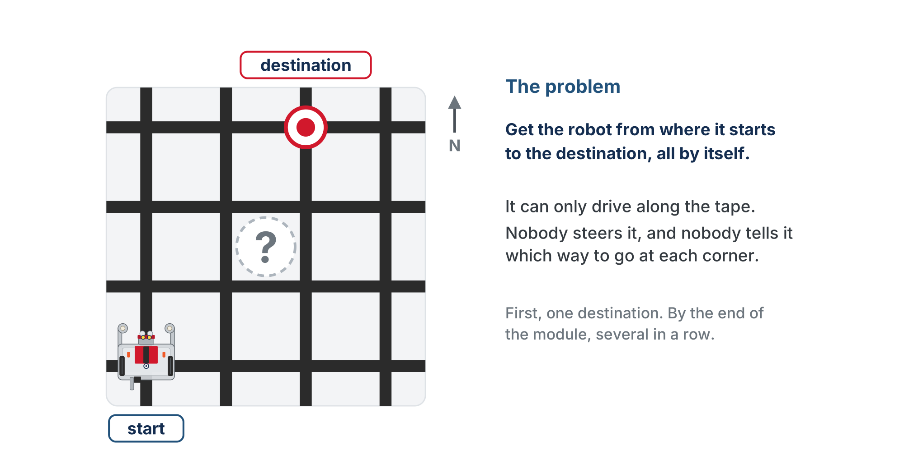
The problem
From here to there, on its own. Where would you even start?
Notes:
Let the question hang for a moment. The robot can only drive along the tape, nobody steers it, and nobody tells it which way to go at each corner. One destination for now; several in a row comes at the end of the module.

Slide 3
Harder than it sounds
"Drive over there" sounds like one job, but it is a somewhat complex problem
Too much to get right in one go
One way to tackle it: break it into simpler sub-problems, and solve each one
That is called problem decomposition (or top-down design)

Slide 4
How would you split it?
Class discussion
Before the robot moves, could you write down every intersection it will drive through?
1
How could you check that list is right, without the robot?
2
Once the list is right, what's left for the robot to do?
3
Notes:
5 to 8 minutes, teacher-led. Ask in order; draw the grid on the board. 1: Yes. Expect "two right, then three up"; mark each intersection on the board grid. If someone says the robot should decide as it goes, ask "Does it need to? Nothing on the grid changes." 2: Trace it on the grid by hand, or have the computer print it and compare. Steer to: no robot needed, so the route can be tested on a laptop. 3: Just drive it: at each intersection, face the next one and follow the tape there. It does not decide anything. Then name the split: plan the route, drive the plan, with the list passed between them. Ideas about motors, sensors or turning belong to the driving half.

Slide 5
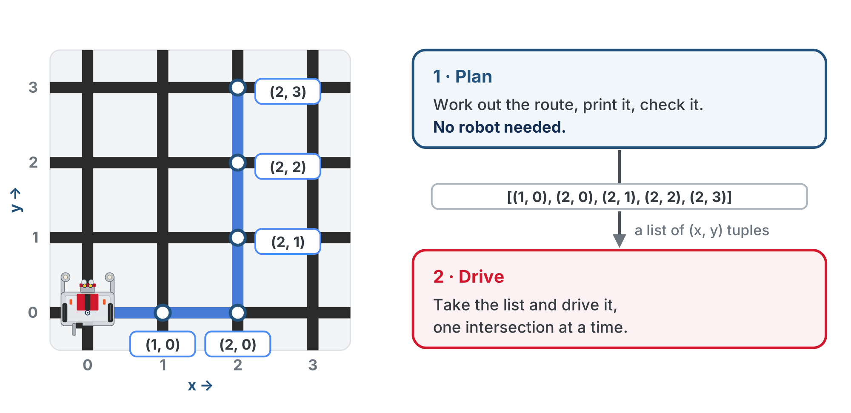
Plan first, then drive
The plan is a list of (x, y) tuples. One function makes it; another drives it.
Notes:
That is one way to split the problem, and the one this module uses. The planning function never moves the robot, so it can be tested with no robot: print the route and check it against the grid. Once the plan is right, a second function takes the plan and drives it; it decides nothing. Each intersection is an (x, y) pair, stored as a tuple, so the plan is a list of tuples, the one thing the two functions share. Tuples come properly in Lesson 4-2 and lists in Lesson 4-3.

Slide 6
Planner and driver
Planner: compute_manhattan_path returns the list of tuples. Never moves the robot.
Driver: drive_path drives the list, then reports where the robot ended up. Never decides the route.
One job each is called separation of concerns
A wrong route is a planner problem
A wrong turn is a driver problem

Slide 7
Check your understanding
Why plan the whole route first, as its own function, before writing the code that drives?
A. Because the robot can only run one function at a time
B. Because the plan can be checked with no robot, and the driver then follows a route you trust
C. Because planning makes the robot drive faster
D. Because the driving function has to be written last in the file
Notes:
Answer: B. The planning function never moves the robot, so you can test it on screen and check its list of tuples on paper. Once you trust the plan, a wrong move on the floor can only be a driving problem.

Slide 8
Answer
Why plan the whole route first, as its own function, before writing the code that drives?
A. Because the robot can only run one function at a time
B. Because the plan can be checked with no robot, and the driver then follows a route you trust
C. Because planning makes the robot drive faster
D. Because the driving function has to be written last in the file
The planning function never moves the robot, so you can test it on screen and check its list of tuples on paper. Once you trust the plan, a wrong move on the floor can only be a driving problem.

Slide 9
How the planner computes the route
Go across until x is right. Then go up or down until y is right.
That's the whole algorithm
It's called the Manhattan algorithm, after a real place

Slide 10
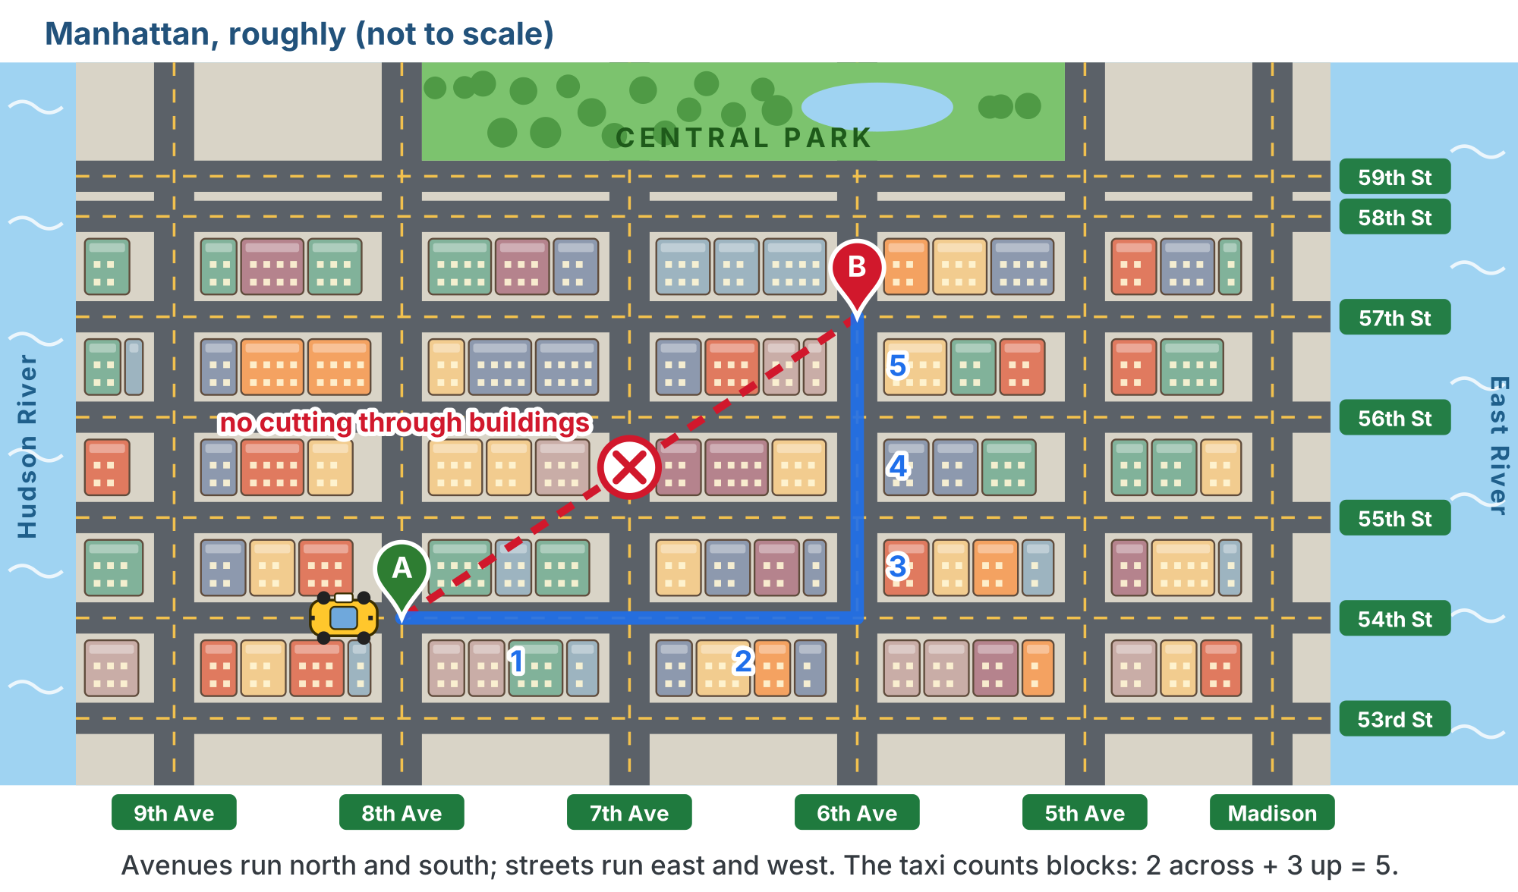
Why "Manhattan"?
A taxi can't cut through the buildings, so every trip is blocks across plus blocks up or down.
Notes:
Most of Manhattan is a rectangular grid: long avenues run north and south, shorter numbered streets cross them east and west, and every block is packed with buildings. New Yorkers give directions this way: "two blocks east, then three up." The robot is in exactly the same situation, because it can only drive along the tape. Lesson 4-4 builds the algorithm properly. For the curious: the grid comes from the Commissioners' Plan of 1811; it is turned roughly 29 degrees from true north, so "Manhattan north" is a local convention; and the same distance is called taxicab distance in mathematics. The map is a hook, not a lesson. Lesson 4-4 opens with "Why Manhattan?" and assumes students have seen this. (This slide uses a copy of the lesson figure with its text halos redrawn for the slide renderer.)

Slide 11
The big assumption: every street is clear
The algorithm assumes nothing is in the way, so it never needs a detour
Module 5 adds obstacles; Module 6 (optional) adds slow streets

Slide 12
From one destination to several
Several destinations is just a loop: plan, drive, repeat. The whole program, seven lines:
position = (0, 0)
heading = 0 # facing North
destinations = [(2, 0), (2, 3), (0, 3)]
for dest in destinations:
path = compute_manhattan_path(position, dest)
print("Path:", path)
position, heading = drive_path(path, position, heading)
It is short because the functions do all the work
Notes:
In plain English: start at corner (0, 0) facing North; for each destination, compute the path from where we are, print it, drive it, and remember where we ended up. Students do not need to understand compute_manhattan_path or drive_path yet. Consider printing these seven lines on a card students keep and revisit at the start of each lesson, highlighting the piece they build that day.

Slide 13
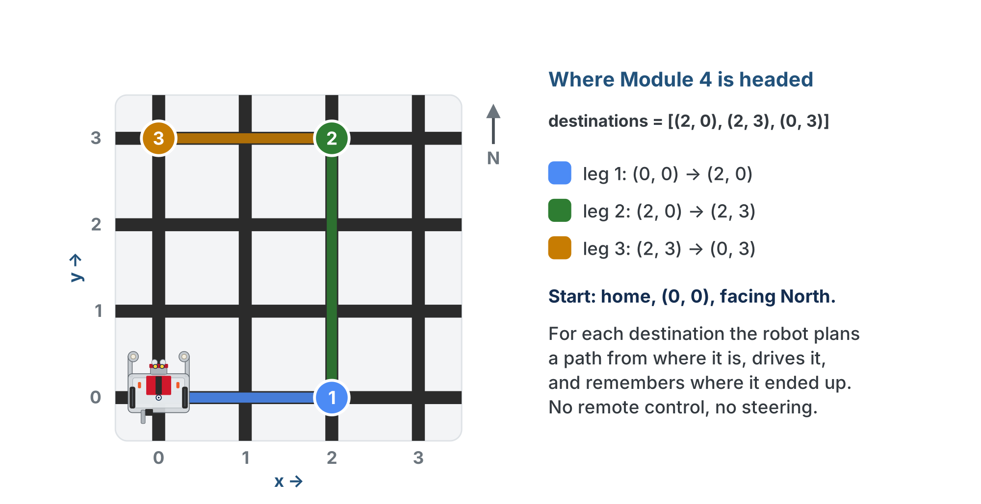
The seven lines, on the floor
Three destinations, three legs, each planned from where the last one ended.

Slide 14
What's next
4-1 to 4-3: the background: coordinates, tuples and lists
4-4 to 4-6: write and test the planner
4-7 and 4-8: write and test the driver
4-9: put them together

Slide 15
Wrap-up
What problem does Module 4 solve?
Why plan the route first, before writing the code that drives?
What are the two halves, and what is each one's job?
Next: coordinates: a name for every spot on the grid
Notes:
Answers: drive from where it starts to a destination on its own, then to several in a row. The planner never moves the robot, so its list of tuples can be printed and checked with no robot; then the driver only follows a plan you trust. compute_manhattan_path plans; drive_path drives. Open each lesson with "remember the big picture? Today we build this piece." Return to the seven-line program in Lesson 4-9.

