Slide 1

MODULE 4 · LESSON 4-5
The Challenge of Turning
By the end of this lesson you can
Break driving a path into two steps, turn then drive, as in Lesson 4-0
Write get_desired_heading(position, next_pos): coordinate change to heading 0 to 3, and test it on screen
(Optional) Catch a mistake early by raising an error when a function cannot answer
Design a turn: clockwise quarter turns, (heading + 1) % 4
Notes:
30 minutes, design on paper. Only one function is written today, get_desired_heading(), and it runs on the desk. turn_to() is designed here; Lesson 4-6 writes it and drive_path(). Resist jumping to the driving code.

Slide 2
Facing the right way
The robot drives over a list of intersections, one to the next
Somewhere in that list the path turns: that's the corner of the "L"
So before it drives from one intersection to the next, the robot has to be facing the right way
That's what this lesson is about.
Notes:
The lesson opens here: the planner hands the driver a list of intersections, and the path bends at the corner of the L, so the robot has to face each next intersection before it drives to it.

Slide 3
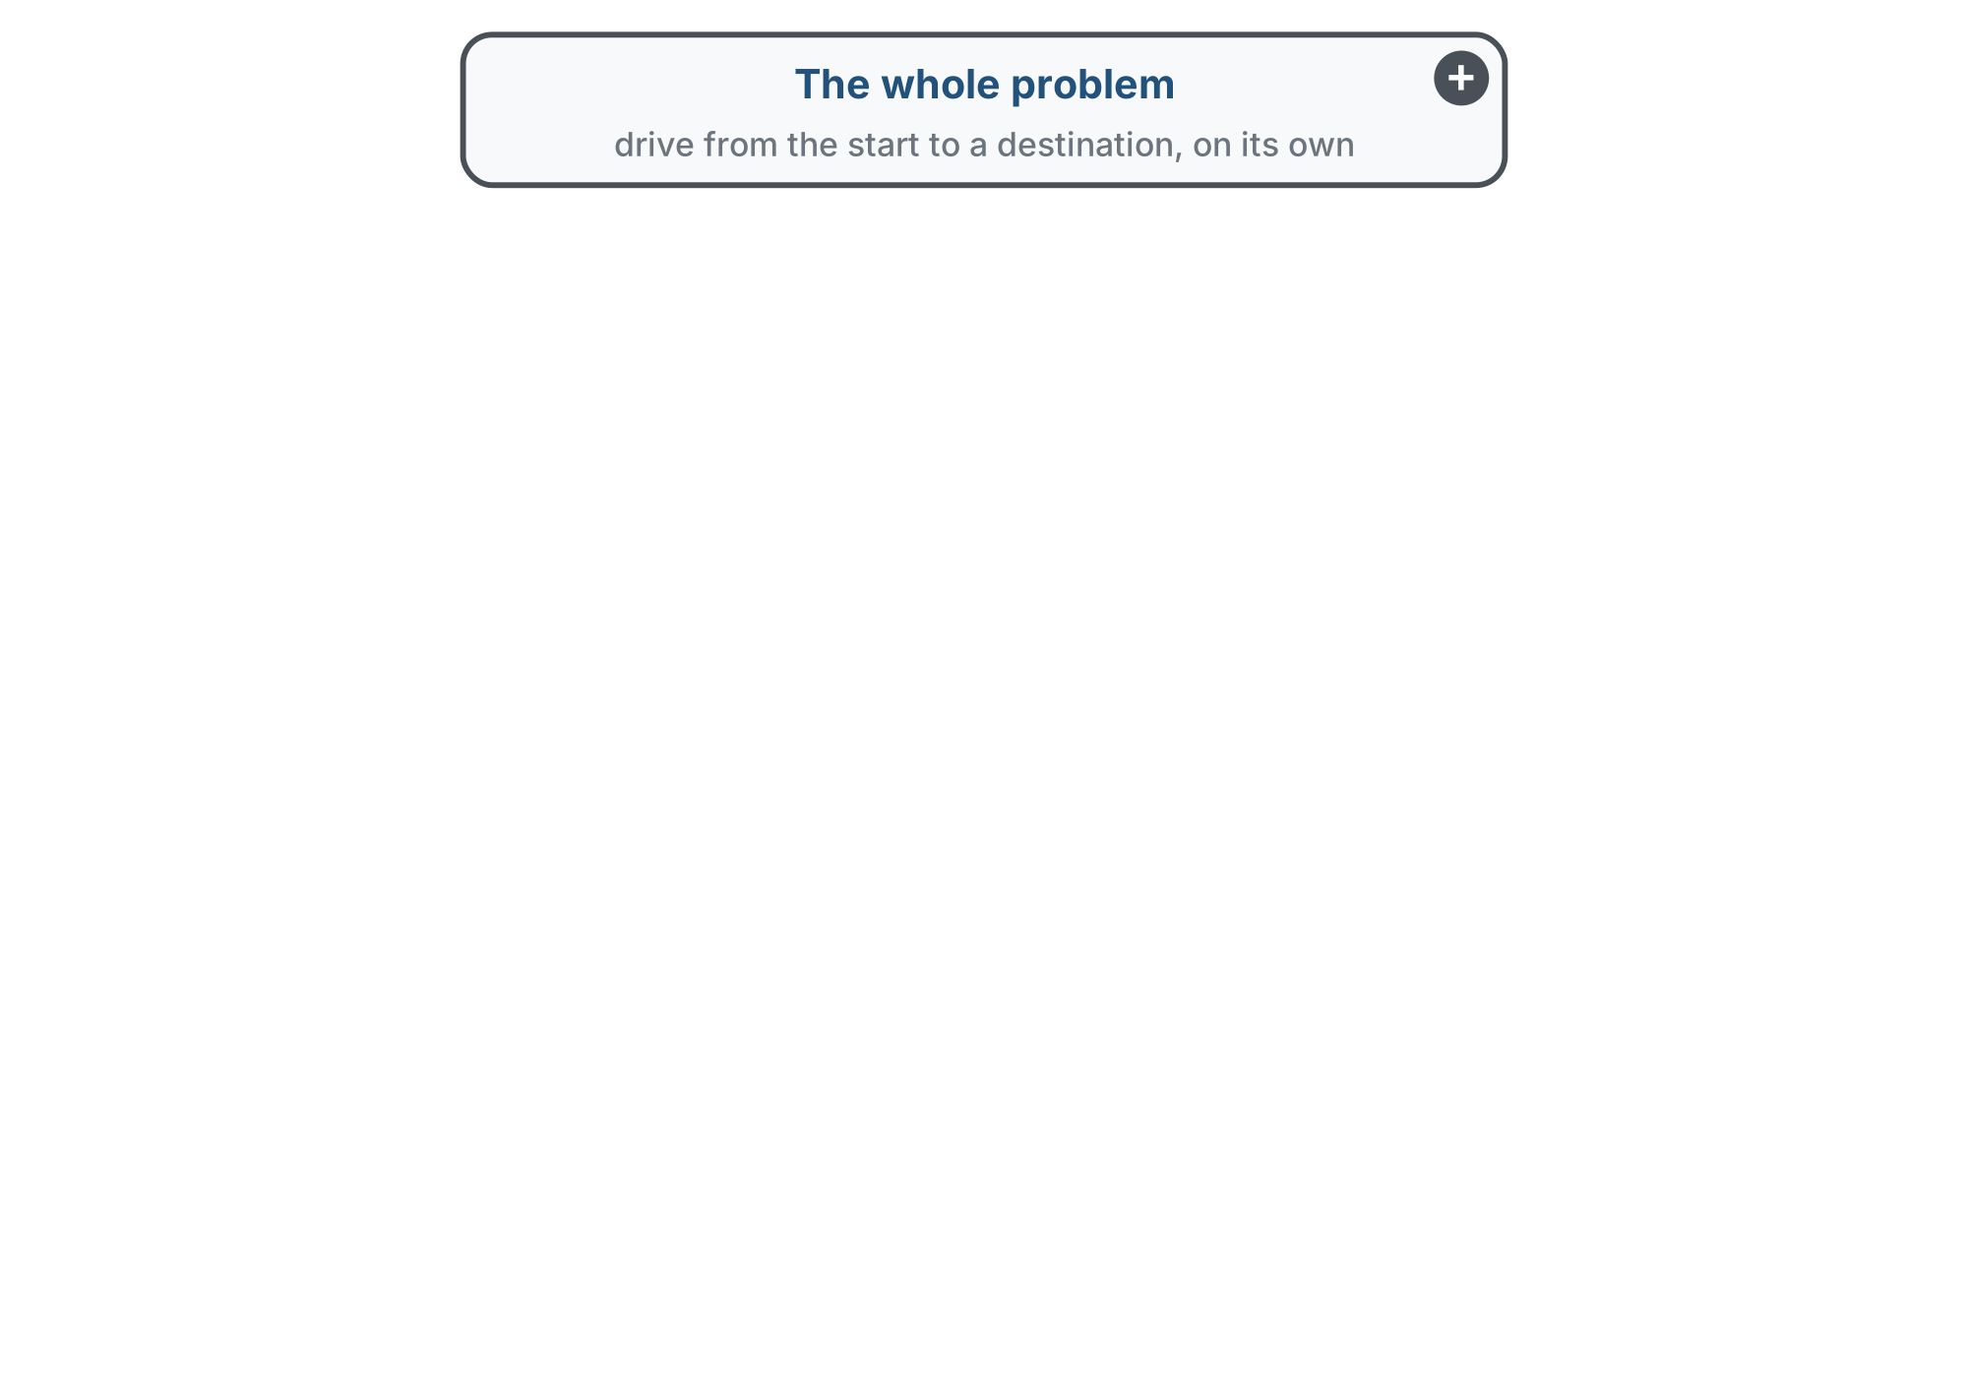
Decompose further, like 4-0
The whole problem, as in Lesson 4-0. What are its parts?
Notes:
Four slides, one level each: click through as the class answers. Ask what the parts are before each click.

Slide 4
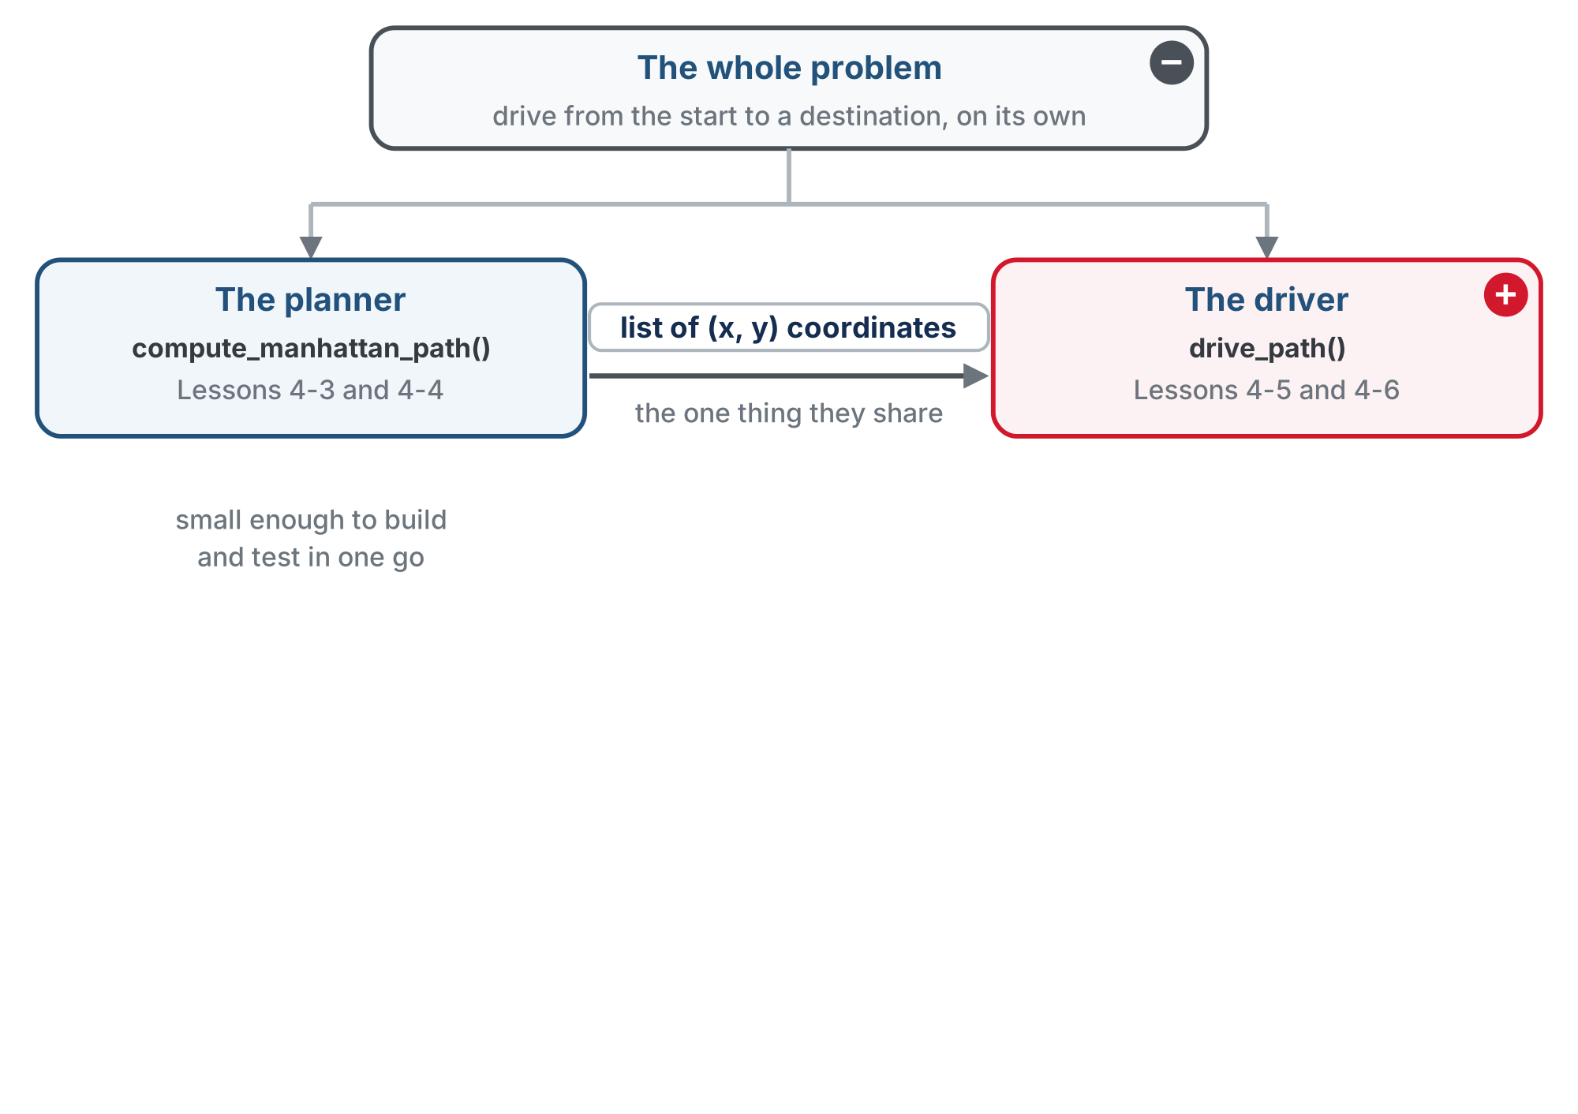
Decompose further, like 4-0
Lesson 4-0's split: the planner is built and tested. Now the driver.
Notes:
Recap of 4-0. The planner is small enough to build and test in one go; the driver still needs breaking down.

Slide 5
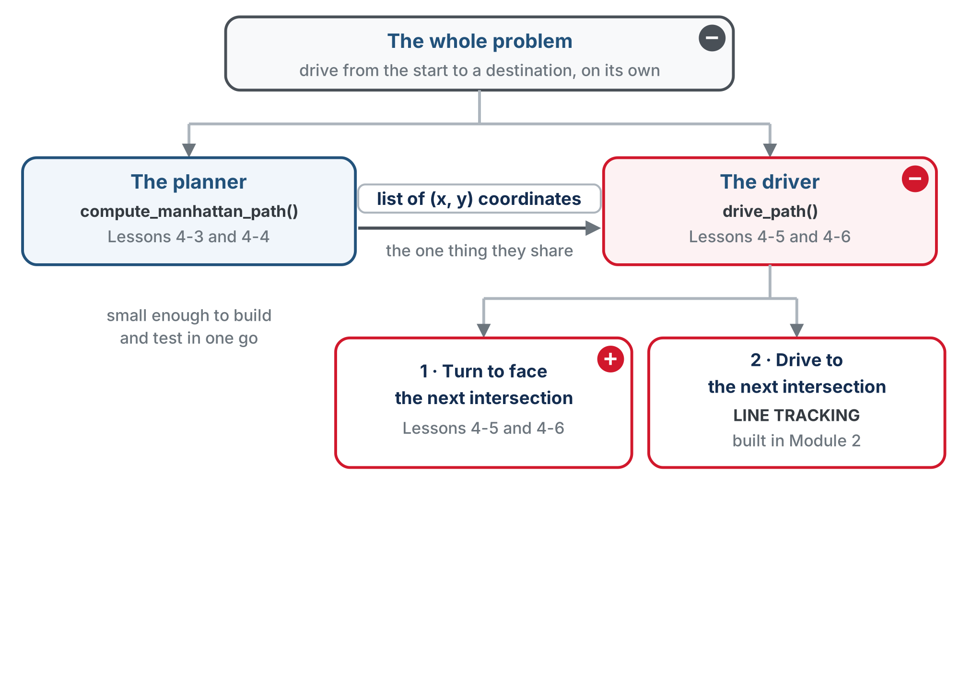
Decompose further, like 4-0
Driving a planned path breaks into two steps at each intersection: turn to face the next one, then drive to it.
Notes:
Same move as 4-0, one level down. The robot has a heading and only drives forward, so it has to turn to face each next intersection before it drives. Driving is Module 2 line tracking, already built.

Slide 6
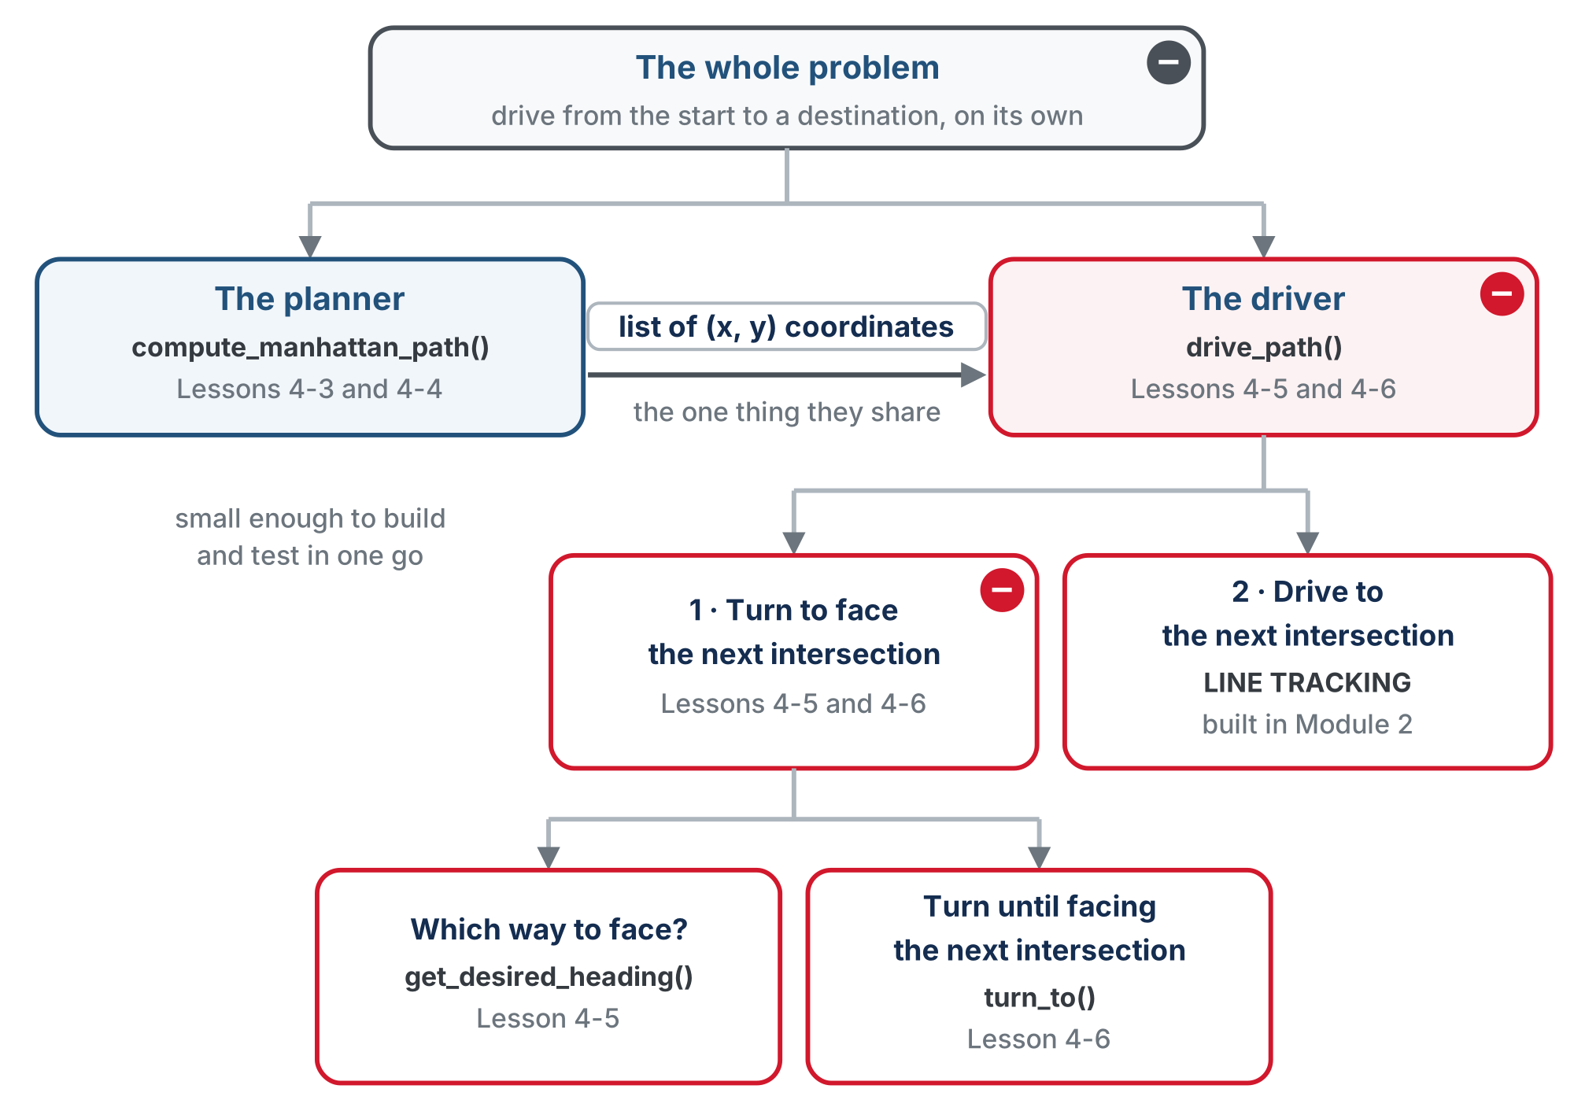
Decompose further, like 4-0
And turning breaks into two: work out which way to face, then turn until facing it.
Notes:
Today: write get_desired_heading() and test it on screen; design turn_to() on paper. Lesson 4-6 writes it and drive_path().

Slide 7
Where we are
The robot has an (x, y) position and a heading (0 = North, 1 = East, 2 = South, 3 = West). Together they are the robot's pose
The robot only moves in the direction it is facing, and only one intersection at a time
Every clockwise turn adds one to the heading, and every counterclockwise turn subtracts one. If the heading hits 4, it wraps around to 0; if it goes below 0, it wraps around to 3
Notes:
A recap before the new work: position plus heading is the pose, the robot moves one intersection at a time in the direction it faces, and the heading wraps both ways.

Slide 8
One change at a time
We need a function that gives the desired heading to reach the next intersection: get_desired_heading(). You write it in this lesson
For every move, the robot has to decide which way to go
That decision depends on its current position and the desired, or next, position on the path
Notes:
This sets up the function students write today, before the table that defines it.

Slide 9
One change, four directions
Between adjacent intersections, either x changes by one or y changes by one. Never both: that would be a diagonal.
Coordinate change | Desired heading | Heading number
y +1 (up, away from you) | North | 0
x +1 (right) | East | 1
y −1 (down, toward you) | South | 2
x −1 (left) | West | 3
x increases by one, so the robot moves East: desired heading 1. Four if statements find which value changed and set the heading.
Notes:
The grid orientation (x first in the tuple, but North is +y, away from you) is the number one confusion of this lesson. Draw it, point at it, quiz it. Read the callout as the bridge to get_desired_heading(): one if per row of this table.

Slide 10
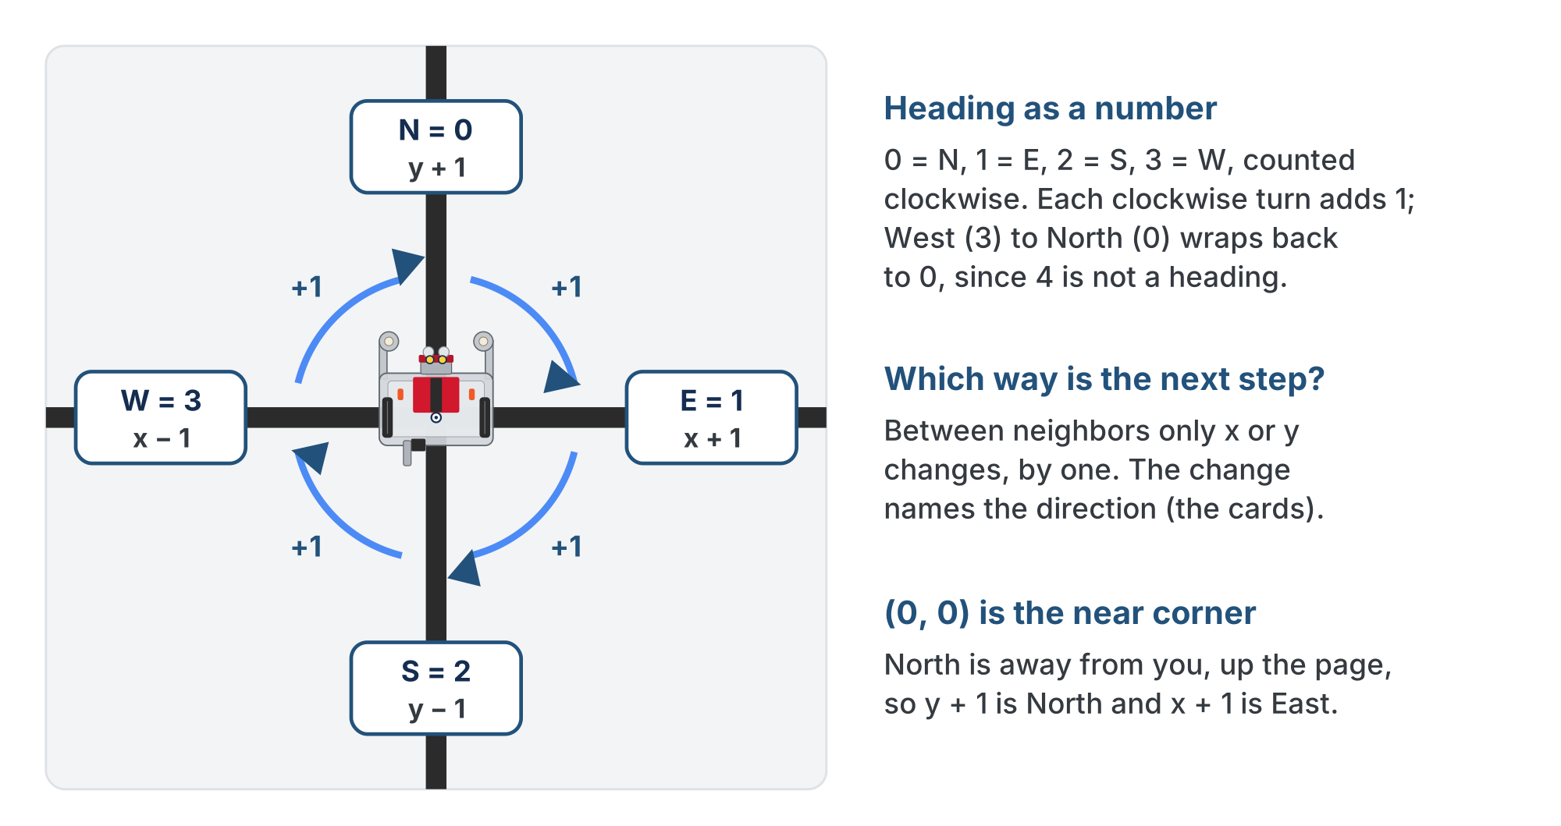
Four neighbors, four headings
The coordinate change that reaches each neighbor, and its heading number. Clockwise adds 1.
Notes:
The lesson figure, with its card labels redrawn as plain text: the slide renderer overlapped the bold letter and the "= 0" in the original. Get students standing and turning clockwise a quarter at a time, calling out 0, 1, 2, 3, 0. The kinesthetic bit cements the wrap. The numbers count clockwise from North, so each clockwise turn adds 1. Adding 1 isn't enough from West to North: 3 + 1 is 4, and 4 isn't a heading. It has to wrap back to 0.

Slide 11
Check your understanding
The robot moves from (2,3) to (3,3). Which direction is that, and what heading number?
A. North, heading 0
B. South, heading 2
C. East, heading 1
D. West, heading 3
Notes:
Answer: C. x went 2 → 3 (x +1) and y stayed 3. Increasing x means moving right across the grid, which is East: heading 1.

Slide 12
Answer
The robot moves from (2,3) to (3,3). Which direction is that, and what heading number?
A. North, heading 0
B. South, heading 2
C. East, heading 1
D. West, heading 3
x went 2 → 3 (x +1) and y stayed 3. Increasing x means moving right across the grid, which is East: heading 1.

Slide 13
Add to robot.py: the NAVIGATOR section
The last section of the file. Paste it above RUN, after the MANHATTAN PLANNER section: the heading names, then the one function you write today.
# ===== NAVIGATOR =====
# Drives a planned path. The MANHATTAN PLANNER section says
# WHERE to go (a list of intersections); this section works
# out which way to face at each one and does the driving with
# the LINE TRACKING functions. It is the only code that knows
# the robot's position and heading, and it hands both back.
HEADING_NAMES = ["N", "E", "S", "W"] # HEADING_NAMES[2] -> "S"
Notes:
The section comment sets up the whole module's split: the planner says where, the navigator works out which way to face and drives. The function outline is on the next slide; it goes straight under HEADING_NAMES.

Slide 14
Add to robot.py: get_desired_heading()
def get_desired_heading(position, next_pos):
"""Return the heading (0-3) that points from position to
next_pos, which must be one step away."""
# 1. x_diff and y_diff: next_pos minus position
# 2. one if per direction, from the table above; each
# checks BOTH differences, because the other one is 0
# 3. (optional) none matched: raise ValueError, naming
# both positions -- see "Catching mistakes early"
pass
Step 2 is the table as four if lines. North means y went up by one and x didn't move at all: the "one change at a time" rule, written down.
Notes:
Why both differences: a version that checks only one (if y_diff == 1: return 0) looks equivalent and is not. From (2,1) to (3,3), x_diff is 1, so it returns East and never reaches the raise. A check with a hole in it is worse than no check. Good thing to show a fast finisher.

Slide 15
Check your understanding
Going from (1,3) to (1,2), what does get_desired_heading return?
A. 0 (North)
B. 1 (East)
C. 2 (South)
D. 3 (West)
Notes:
Answer: C. x is unchanged; y went 3 → 2 (y −1). Decreasing y is moving toward you, which is South: heading 2.

Slide 16
Answer
Going from (1,3) to (1,2), what does get_desired_heading return?
A. 0 (North)
B. 1 (East)
C. 2 (South)
D. 3 (West)
x is unchanged; y went 3 → 2 (y −1). Decreasing y is moving toward you, which is South: heading 2.

Slide 17
Optional: catching mistakes early
Optional extension
A good program catches its own mistakes early
get_desired_heading() only makes sense when the next intersection is adjacent to the current one, one step away
If none of the four if lines matched, the two positions aren't neighbors and there is no right answer
When would that happen? Make a guess first.
Notes:
Optional: open it if you have time. Nothing later depends on it. Answer to the question (a closed reveal on the page): only when there's a bug in the planner. A correct planner only ever lists adjacent steps, so a pair that isn't adjacent means the path itself is wrong.

Slide 18
Optional: stop at once, and say why
Optional extension
Without a check, get_desired_heading() quietly returns None, turn_to waits forever for a heading of None, and the robot spins with no message. With a check, the program stops at once and says which two positions caused it:
raise ValueError(str(position) + " and " + str(next_pos) + " are not neighbors")
raise stops the program on the spot and prints your message. ValueError is Python's name for "the values I was given make no sense". str(position) turns a tuple into text.
Notes:
raise is new here, but nothing about it needs teaching beyond "the program stops and prints your message"; students never write try/except to benefit from it. Don't turn this into a detour on exception handling. The code that's spinning without the check isn't even the code that's wrong.

Slide 19
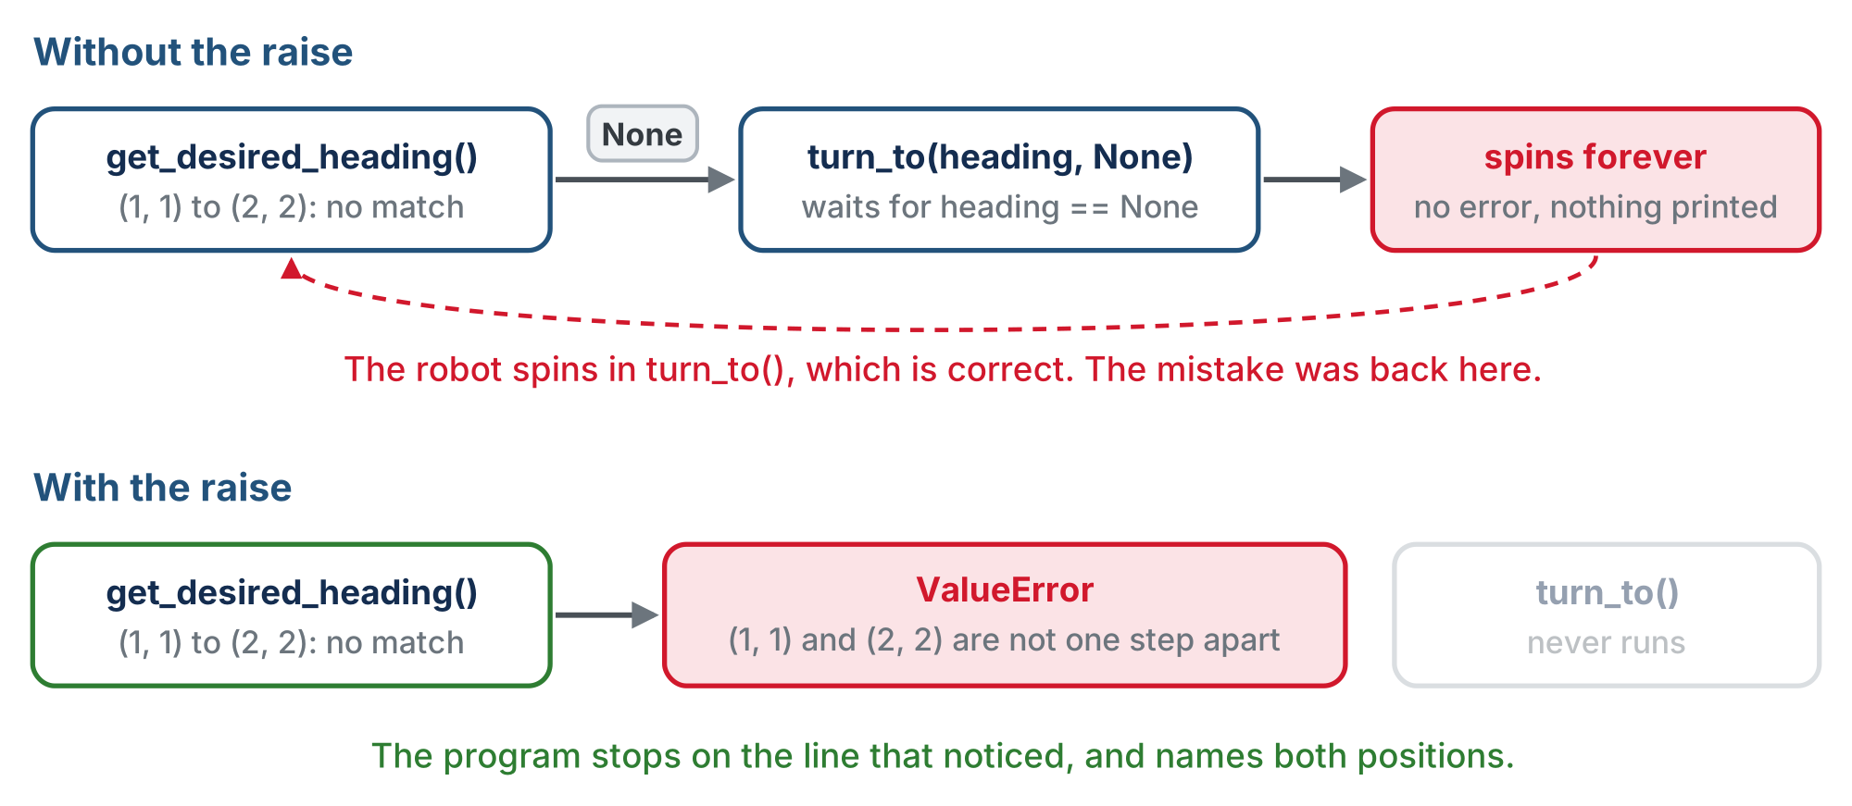
Same bad input, two programs
Optional extension
Without the raise the program never even stops; with it, it stops where the mistake is.
Notes:
Top row: no match, the function silently returns None, turn_to waits forever for a heading of None, and the robot spins with no message. Bottom row: ValueError at get_desired_heading, turn_to never runs. Worth ten minutes: ask the class to predict what they would see without the raise, and how they would go about finding the cause ("a robot spinning forever, and the first place you'd look is the one piece of code that's right"). This is the first time the course asks students to write a line whose only job is to make a future problem easier to find.

Slide 20
Check your understanding
Why end get_desired_heading with raise, instead of just letting Python return None?
A. Because None uses more memory
B. To stop at the line that found the problem, not break later somewhere else
C. Because every Python function has to end with raise
D. To make the robot turn faster
Notes:
Answer: B. Without it, get_desired_heading hands back None, turn_to waits forever for a heading of None, and the robot spins in correct code with nothing printed. Raising reports the problem where it was found.

Slide 21
Answer
Why end get_desired_heading with raise, instead of just letting Python return None?
A. Because None uses more memory
B. To stop at the line that found the problem, not break later somewhere else
C. Because every Python function has to end with raise
D. To make the robot turn faster
Without it, get_desired_heading hands back None, turn_to waits forever for a heading of None, and the robot spins in correct code with nothing printed. Raising reports the problem where it was found.

Slide 22
Optional · Try it
Optional extension
Add step 3 to get_desired_heading()
1
Add one more call at the end of test_headings(): (1, 1) to (2, 2), a diagonal
2
Run it. The four answers print as before, then the program stops with your message, naming both positions
3
Why the diagonal goes last: nothing after it runs
Notes:
This is the raise doing its job, on purpose, in a test.

Slide 23
Activity · Write it, then ask it the four questions
Activity
Write the body of get_desired_heading() from the outline
1
Write a paper test, test_headings(). It calls get_desired_heading() from (1, 1) to each neighbor, (0, 1), (1, 2), (2, 1) and (1, 0), and prints one line for each: the neighbor, the heading number, and its name from HEADING_NAMES
2
Work out the four answers from the table first
3
Set the run line to test_headings() and run it with the robot on the desk. Correct output is four lines that match your four answers
4
Notes:
The check for get_desired_heading is a closed reveal on the lesson page; students run test_headings() first. Push them to predict all four on paper before running.

Slide 24
Turning until you face it
Now we know both the current heading and the desired heading. So the robot can simply turn clockwise, adding one to the heading for each turn, while it isn't facing the desired heading.
# while current_heading is not desired_heading:
# one turn_clockwise()
# current_heading goes up by 1, wrapping 3 back to 0
heading = (heading + 1) % 4
West (3) to North (0): the remainder % (Lesson 2-5) makes it easy. For 1, 2 and 3 the remainder is the number itself; 4 % 4 is 0, so after West comes North.
Notes:
The top three lines are the loop design; the last line is the wrap: when the robot is facing West (3) and turns clockwise to North (0), % makes it easy, and the heading is never 4.

Slide 25
Trace it: from South (2) to East (1)
Pass | Heading before | Turn | Heading after, (h + 1) % 4 | Facing East?
1 | 2 (S) | clockwise | 3 (W) | no
2 | 3 (W) | clockwise | 0 (N) | no
3 | 0 (N) | clockwise | 1 (E) | yes, the loop ends
Three passes. The loop never asks which way is shorter: from South it spins three quarters round to face what is a quarter turn to its left.
Notes:
The long way round is on purpose: it is the simplest turn that always works. In Lesson 4-6 students watch the robot spin 270 degrees, and an optional challenge there makes it turn whichever way is fewer turns. If someone spots the problem today, agree and point them at that challenge. An earlier version taught turns = (desired_heading - current_heading) % 4, which leans on % with a negative number (-1 % 4 is 3) and surprises nearly everyone.

Slide 26
The design of turn_to()
Already facing the right way? The condition is false on the first check, so the loop does nothing: no special case
turn_clockwise() is the Module 2 function that turns until the sensors find the next line
It returns current_heading at the end, which by then equals desired_heading
So the caller writes heading = turn_to(heading, desired_heading) and keeps its own record up to date
turn_to(current_heading, desired_heading): you write it next lesson.
Notes:
Three sensor-ended turns take three times as long as one and give the line sensors three chances to miss. That is the reason the optional challenge in 4-6 is worth doing for those who want it.

Slide 27
Check your understanding
The robot faces West (3) and makes one clockwise turn. What does (heading + 1) % 4 give?
A. 4
B. 0, North: 4 % 4 is 0, so the heading wraps around
C. 3, because West is the last heading
D. An error, because there is no heading 4
Notes:
Answer: B. 3 + 1 is 4, and the remainder of 4 divided by 4 is 0. One clockwise turn from West faces North, and the heading never becomes 4.

Slide 28
Answer
The robot faces West (3) and makes one clockwise turn. What does (heading + 1) % 4 give?
A. 4
B. 0, North: 4 % 4 is 0, so the heading wraps around
C. 3, because West is the last heading
D. An error, because there is no heading 4
3 + 1 is 4, and the remainder of 4 divided by 4 is 0. One clockwise turn from West faces North, and the heading never becomes 4.

Slide 29
Next: the whole problem
You have the planner, a way to pick a heading, and a design for the turn
Next lesson pulls the turning and planning code together
Result: drive from the start to a destination, on its own

Slide 30
Real-world connections
AVIATION
GAMES
ROBOTICS
Compass headings
Facing and rotation
Rovers and drones
Pilots fly numbered headings (0 to 360°). "Turn to heading 090" is exactly this idea at finer resolution.
Game characters store a facing direction and rotate toward targets, often with the same wrap-around math.
Every autonomous vehicle tracks its heading to know which way "forward" actually points.
Notes:
Tracking heading and turning to a target direction is core to real navigation.

Slide 31
Wrap-up
Between adjacent intersections, what can change, and how many cases result?
Why store heading as a number?
How does turn_to know when to stop?
Next: driving the path: turn_to() and drive_path() become real code
Notes:
Answers: x or y, four cases. Each clockwise turn adds 1, and % 4 wraps 4 back to 0. Its loop runs until the heading equals the one it wants; already facing it means zero turns. Exit ticket: "Heading 3 (W), desired 1 (E): which headings does the loop step through, and how many turns?" (W, N, E: two clockwise turns, a turn-around.)

