Slide 1

MODULE 2 · LESSON 2-0
The Robot Starts to Sense
By the end of this lesson you can
Describe what the robot will do by the end of Module 2
Explain the difference between a move that ends after a set distance and a move that ends when a sensor sees something
Name the one program file you'll start in Lesson 2-1 and keep for the rest of the course
Say what each lesson in the module adds to the robot
Notes:
15 to 20 minutes, no coding yet. This is an advance organizer: the destination and the shape of the file, not any one technique. Do not name or explain the constructs the lessons are built to make students need (the while loop in 2-2, if/else in 2-3, the error and gain in 2-5). If students ask how the robot will follow the line, "that is Lesson 2-5" is the whole answer.

Slide 2
Module 1: told in advance
In Module 1 your robot did exactly what it was told: drive 20 cm, turn 90°, repeat
It never found out where it actually was
Nudge it, or put it on a slippery floor, and it carries on with the plan anyway
And ends up somewhere else
This module changes that

Slide 3
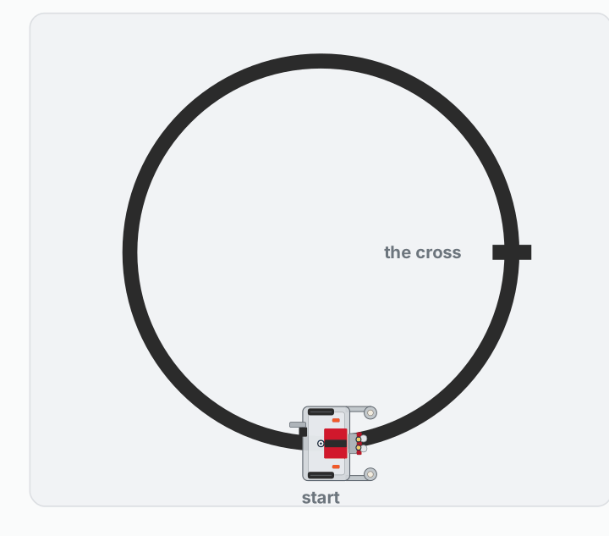
Where this module ends up
Follow the circle, turn around at the cross, four times, then stop. Nothing is measured in centimeters or seconds.
Notes:
This is the Lesson 2-10 project. Every stop and every turn ends because the robot saw something. Show it now, and come back to it at the start of Lesson 2-10.

Slide 4
Sense, think, act
In Lesson 1-0 you decided a robot has to sense, think and act
In Module 1 your XRP mostly acted: every decision was yours, made in advance
Module 2 adds the first sense: two reflectance sensors at the front, facing the floor
They tell a white floor from a strip of black tape
Over and over: what do my sensors see right now, and what should I do about it?

Slide 5
Two ways to end a move
MODULE 1
MODULE 2
Told in advance
Ended by a sensor
Drive 20 cm, then turn 90°. The robot finishes the move whatever happens.
Drive until the sensors see the tape. The move ends where the tape is.
Notes:
The rule for the rest of the course: the robot stops on something it senses, not on a clock or a distance. It is why the same program still works with low batteries or on a different floor. Students who watched the timed program misbehave on two surfaces in Lesson 1-6 already know why.

Slide 6
Check your understanding
Your Module 1 program drives 50 cm to reach a line of tape. Someone moves the tape 10 cm further away. What happens, and what would a Module 2 program do instead?
A. Both programs stop at the tape, because the robot can see it
B. The Module 1 program stops 10 cm short; a program that drives until the sensors see the tape still stops on it
C. Both programs stop 10 cm short
D. The Module 2 program needs the new distance typed in
Notes:
Answer: B. A move measured in centimeters ends where the numbers say. A move that ends on a sensor reading ends where the tape actually is.

Slide 7
Answer
Your Module 1 program drives 50 cm to reach a line of tape. Someone moves the tape 10 cm further away. What happens, and what would a Module 2 program do instead?
A. Both programs stop at the tape, because the robot can see it
B. The Module 1 program stops 10 cm short; a program that drives until the sensors see the tape still stops on it
C. Both programs stop 10 cm short
D. The Module 2 program needs the new distance typed in
A move measured in centimeters ends where the numbers say. A move that ends on a sensor reading ends where the tape actually is.

Slide 8
One file, all year: robot.py
SECTION 1
SECTION 2
LINE SENSOR
LINE TRACKING
Small functions that read the tape: what each sensor sees, on the line or at a cross.
Functions that drive on the tape: follow to the next cross, park, turn onto the next line.
Notes:
From Lesson 2-1 every student keeps one file, robot.py, and every lesson adds to it. These two sections drive the robot for the rest of the course: around the grid in Module 3, and along the routes it plans itself in Modules 4 and 5.

Slide 9
Your roadmap (1 of 2)
Lesson | What the robot learns to do
2-1 Reflectance Sensor | Read its two sensors; tell the tape from the floor. robot.py is born.
2-2 Drive to the Edge | Drive forward and stop the moment it reaches the line
2-3 Bounce Driving | Turn back every time it meets the line
2-4 Random Turns | Turn a different amount each bounce, and explore
2-5 Proportional Control | Actually follow the line, steering a little all the time

Slide 10
Your roadmap (2 of 2)
Lesson | What the robot learns to do
2-6 Two-Sensor Following | Follow the center of the line with both sensors
2-7 Sensor Toolkit | Finish LINE SENSOR, and test it all by hand
2-8 Intersections | Notice a cross in the tape, and stop there
2-9 Line-Tracking Functions | Park on the cross and turn onto the next line
2-10 Final Project | Lap the circle, reversing at the cross, four times
Notes:
The final project needs almost no new code: by then it is a short list of calls to functions written and tested earlier. The optional class extensions are in Lessons 2-7 and 2-9.

Slide 11
Wrap-up
What will the robot do by the end of the module?
What ends each move in this module?
What is robot.py, and what are its first two sections?
Next: meet the reflectance sensors, and start robot.py
Notes:
Answers: follow the circle, reverse at the cross four times, and stop. Something the sensors see, never a distance or a timer. The one file kept all year; LINE SENSOR reads the tape, LINE TRACKING drives on it. Materials: Lesson 2-1 needs a strip of black tape on a white surface; from 2-2 a taped circle; from 2-7 the short strip across it that makes the cross.

