Slide 1

MODULE 1 · LESSON 1-9
Variables & Expressions
By the end of this lesson you can
Explain what = does: work out the right side, then store the result in the named memory location on the left
Reassign a variable, including using its own old value
Name variables the way Python programmers do, and say why Rangefinder and rangefinder are different things
Predict the value of an arithmetic expression using operator precedence, and use parentheses to change it
Notes:
50 to 60 minutes, and no robot needed. Everything runs in the XRP Code terminal with print(), so this is the lesson to use when robots are unavailable or batteries are flat. It is also the best diagnostic before Module 2.

Slide 2
The = nobody explained
You've already written this line without anyone explaining the =. That single character is doing something specific, and once you see what, a lot of Python stops being mysterious.
drivetrain = DifferentialDrive.get_default_differential_drive()
Today: the value on the right, and the place it gets stored on the left
Notes:
That single character is doing something specific, and once students see what, a lot of Python stops being mysterious. No robot today: everything is checked with print() in the terminal.

Slide 3
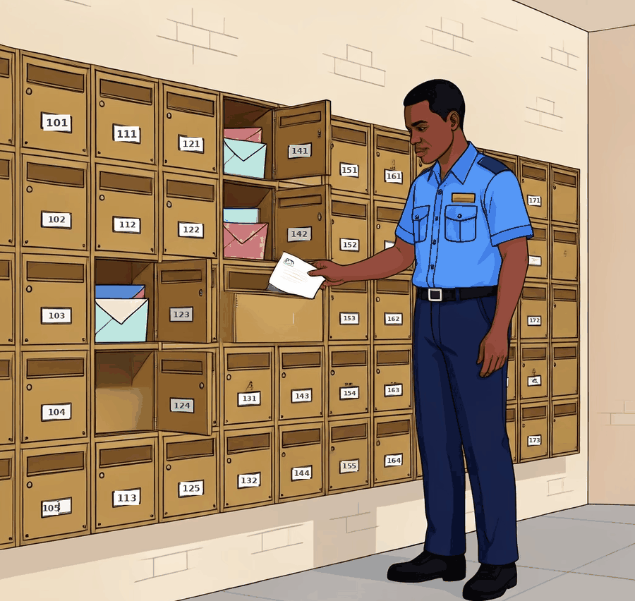
A named place in the robot's memory
The controller has memory: physical storage on the board
Memory is a long bank of locations; each holds one value
A variable is a location with a name you chose
Like post office boxes: each has its own number on the front
Only the clerk reaches in. Here the clerk is the processor
Notes:
You can look in a box, put something in it, or replace what is there. Nothing goes into a location or comes out of one except through the processor, the chip that runs your program.

Slide 4
Claim a location: a name, =, a value
side_length = 30
robot_name = "Bolt"
threshold = 0.5
After these three lines, memory has three named locations: one holding 30, one holding "Bolt", one holding 0.5

Slide 5
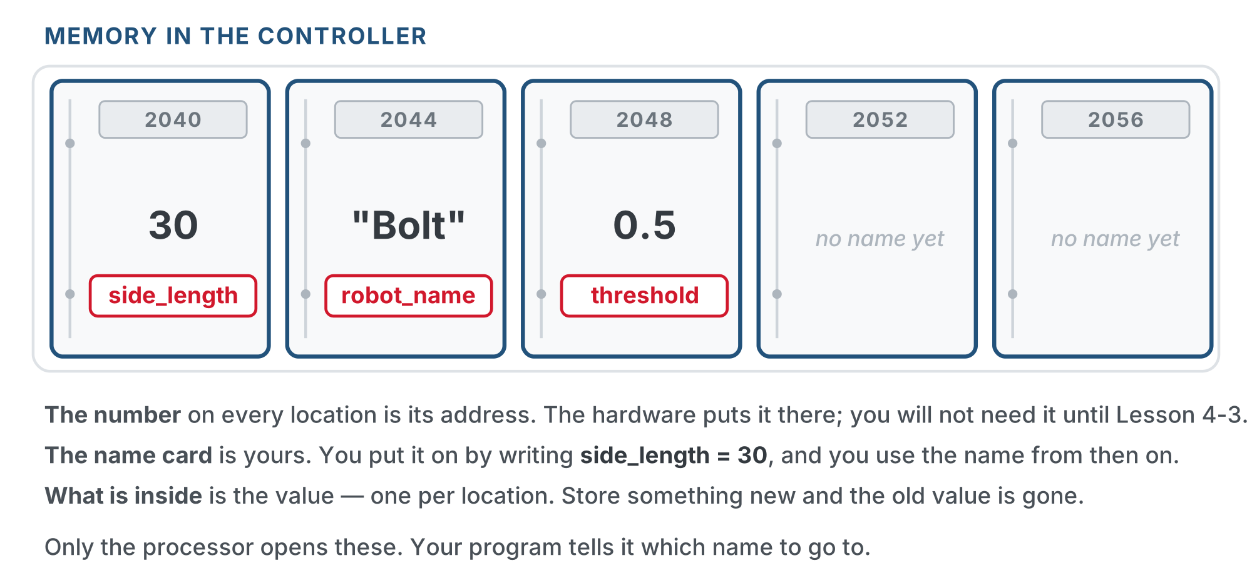
Three named locations
Three named locations, and two that no program has claimed yet.
Notes:
The numbers on the plates are real: every location has an address, whether or not anything is stored there. Students use the name, not the address, for a long time; addresses come back in Lesson 4-2 with lists. Leave the address alone unless asked. If someone asks: that is how the processor finds the box, and you get to use the name instead.

Slide 6
= is an instruction, not a claim
In math, x = 5 is a claim that two things are the same
In Python it's an instruction: store this here
It runs in a specific order: right side first, every time
In side_length = 20 + 5, Python works out 25, then stores 25 in side_length
The location doesn't hold "20 + 5". It holds 25.
Work out whatever is on the right. Then store that result in the location named on the left.
Notes:
The one sentence that prevents a month of confusion. Say it, write it on the board, and have students say it back. Nearly every later confusion (the accumulator in 2-7, error = setpoint - sensor_value in 2-5, the distances updates in Module 5) dissolves if they hold onto the order. Name the math-class collision out loud. Some teachers say "gets" or "becomes" for = all year.

Slide 7
Check your understanding
What is the difference between = in math and = in Python?
A. There is no difference
B. It's an instruction: work out the right side, then store it in the named memory on the left
C. In Python it means "is approximately equal to"
D. In Python it only works with whole numbers
Notes:
Answer: B. Math's = states that two things are equal. Python's = does something: it works out the right-hand side and stores that result in the variable named on the left.

Slide 8
Answer
What is the difference between = in math and = in Python?
A. There is no difference
B. It's an instruction: work out the right side, then store it in the named memory on the left
C. In Python it means "is approximately equal to"
D. In Python it only works with whole numbers
Math's = states that two things are equal. Python's = does something: it works out the right-hand side and stores that result in the variable named on the left.

Slide 9
Storing something new overwrites what was there
A location holds exactly one value: a new one takes the old one's place. That makes the strangest-looking line in programming straightforward:
side_length = 30
side_length = 45 # the 30 in that location is overwritten; it now holds 45
count = 0
count = count + 1 # read count (0), add 1, store 1 back in count
count = count + 1 # read count (1), add 1, store 2 back in count
Read it as "count becomes count plus one". The same location is read on the right, then written on the left.
Notes:
The word variable means it can vary. Draw the location: a rectangle with 2040 above it, a name card under it and a number inside. Step through count = count + 1: read the 0 out, add 1 beside it, rub out the 0, write the 1 in. The physical erase is the point; students who think both values coexist are the ones who get stuck. Students will write this exact pattern in Module 2 to count intersections.

Slide 10
Check your understanding
After total = 10, then total = total + 5, then total = total + 5, what is total?
A. 10
B. 15
C. 20
D. It causes an error because total is used to define itself
Notes:
Answer: C. If someone asks about drivetrain = ...: the location holds the address of where the drivetrain object lives, not the object itself, because something that can grow does not fit in a fixed-size location. Lesson 4-2 makes it precise.

Slide 11
Answer
After total = 10, then total = total + 5, then total = total + 5, what is total?
A. 10
B. 15
C. 20
D. It causes an error because total is used to define itself
Each line reads what is currently in total, works out the right side with it, and stores the result back: 10, then 10+5 = 15, then 15+5 = 20.
Notes:
Answer: C. If someone asks about drivetrain = ...: the location holds the address of where the drivetrain object lives, not the object itself, because something that can grow does not fit in a fixed-size location. Lesson 4-2 makes it precise.

Slide 12
Choosing names: snake_case
All lowercase, words joined by underscores. Code gets read far more often than it gets written.
side_length = 30 # yes
base_effort = 0.5 # yes
sideLength = 30 # works, but not the Python style
SideLength = 30 # works, but this looks like a class (see below)
s = 30 # works, but what is it?
Descriptive beats short: threshold says what the number means, t doesn't. The exception is a loop counter like i.
Notes:
side_length in the Blockly function was chosen in Lesson 1-4 to be the name they would want in Python later. The loop counter i arrives next lesson.

Slide 13
Capital letters mean something
Python cares about capitals: Rangefinder and rangefinder are two different names. That's not a nuisance, it's a convention doing real work:
from XRPLib.rangefinder import Rangefinder # Rangefinder -- the class
rangefinder = Rangefinder.get_default_rangefinder() # rangefinder -- your variable
Capitalized is the class, the "book on the shelf" from Lesson 1-8. lowercase is your variable, the one actual thing you use.
Notes:
Once students see this pattern they can read the three-step XRPLib code for any device and tell at a glance which name is which.

Slide 14
Check your understanding
In the line reflectance = Reflectance.get_default_reflectance() what is the difference between the two spellings?
A. Nothing: Python ignores capital letters
B. Reflectance (capitalized) is the class; reflectance is the variable holding your sensor
C. The capitalized one is a typo that Python fixes
D. Capitalized names are for numbers, lowercase for text
Notes:
Answer: B. Python is case-sensitive, and the convention is Capitalized for classes, lowercase snake_case for your own variables. Both names are needed and they mean different things.

Slide 15
Answer
In the line reflectance = Reflectance.get_default_reflectance() what is the difference between the two spellings?
A. Nothing: Python ignores capital letters
B. Reflectance (capitalized) is the class; reflectance is the variable holding your sensor
C. The capitalized one is a typo that Python fixes
D. Capitalized names are for numbers, lowercase for text
Python is case-sensitive, and the convention is Capitalized for classes, lowercase snake_case for your own variables. Both names are needed and they mean different things.

Slide 16
Working out the value: expressions
Anything Python can work out into a single value is an expression
25 is an expression. So is 20 + 5, and so is side_length * 2
Expressions go wherever a value belongs:
on the right of an =
inside the parentheses when you call something
anywhere else a value belongs
Naming a value and working out a new one is most of what any program does

Slide 17
The arithmetic operators
7 + 2 # 9
7 - 2 # 5
7 * 2 # 14
7 / 2 # 3.5
7 % 2 # 1 (the remainder after dividing)
Multiply is * and divide is /: no × or ÷ on a keyboard. % is remainder, not percent.
Notes:
7 % 2 is what is left over when 2 goes into 7. Students won't need % until Module 2, where it is the trick for doing something every 50th time around a loop.

Slide 18
Variables in expressions
A variable can appear anywhere a number can: by the time Python does the arithmetic, the variable has already been replaced by its value.
sides = 6
turn_angle = 360 / sides # right side: 360 / 6 = 60.0
Why 60.0 and not 60? Whole numbers are integers, decimals are floats, and / always hands back a float, even when it comes out even.
Notes:
This almost never matters for driving: drivetrain.turn(60.0) turns exactly as far as drivetrain.turn(60). It matters for reading output, so that when a print() shows 60.0, students know nothing has gone wrong.

Slide 19
Precedence: which operator goes first
Same rule as math: * and / happen before + and -. Here's a line you'll write next lesson, to make each square in a nest bigger than the last:
20 + 2 * 5 # 30, not 110 -- the 2 * 5 happens first
size = 20 + square * 5 # square counts 0, 1, 2, 3 -> size is 20, 25, 30, 35
It only works because square * 5 is worked out first. Strictly left to right, 20 + square would come first and the sizes would be wrong.
Notes:
Resist teaching PEMDAS as a rule to memorize; they have it already. Teach it as a thing that silently produces wrong numbers. A precedence mistake raises no error, so the robot drives confidently and wrongly, and students hunt for the bug in their motors.

Slide 20
Parentheses beat everything
(20 + 2) * 5 # 110 -- now the addition goes first
threshold = (white_reading + black_reading) / 2
Drop the parentheses and only the black reading is halved. The robot still runs; it just reads the line wrong.
Notes:
The threshold line is from Module 2: the value that tells line from floor is the midpoint of two readings. A wrong number is a far more annoying mistake than a crash. Professionals add parentheses they don't strictly need: 20 + (square * 5) behaves identically and reads better.

Slide 21
Check your understanding
What is the value of 10 + 4 * 2 ?
A. 28
B. 18
C. 80
D. 16
Notes:
Answer: B. Multiplication goes before addition: 4 * 2 = 8 first, then 10 + 8 = 18. To get 28 you would need parentheses: (10 + 4) * 2.

Slide 22
Answer
What is the value of 10 + 4 * 2 ?
A. 28
B. 18
C. 80
D. 16
Multiplication goes before addition: 4 * 2 = 8 first, then 10 + 8 = 18. To get 28 you would need parentheses: (10 + 4) * 2.

Slide 23
Check your understanding
Your white reading is 0.2 and your black reading is 0.8, and you want the midpoint (0.5). Which line gives it?
A. threshold = white + black / 2
B. threshold = (white + black) / 2
C. threshold = white + black // 2
D. Both of the first two work
Notes:
Answer: B. Without parentheses, only black is divided: 0.2 + 0.4 = 0.6, not the midpoint. The parentheses force the addition first: (0.2 + 0.8) / 2 = 0.5.

Slide 24
Answer
Your white reading is 0.2 and your black reading is 0.8, and you want the midpoint (0.5). Which line gives it?
A. threshold = white + black / 2
B. threshold = (white + black) / 2
C. threshold = white + black // 2
D. Both of the first two work
Without parentheses, only black is divided: 0.2 + 0.4 = 0.6, not the midpoint. The parentheses force the addition first: (0.2 + 0.8) / 2 = 0.5.

Slide 25
Activity · Predict, then print
Activity
No robot. Write your prediction next to each line on paper first, then type them into XRP Code, run, and compare.
print(3 + 4 * 2)
print((3 + 4) * 2)
print(10 / 4)
print(10 - 2 - 3)
print(2 * 3 + 4 * 5)
print(100 / 10 / 2)
Got one wrong? Work out why before moving on: write out the order Python used, one step at a time.
Notes:
Answers for the teacher: 11, 14, 2.5, 5, 26, 5.0. The two same-precedence cases (10 - 2 - 3 and 100 / 10 / 2) are there deliberately: students over-apply the rule and decide some hidden precedence must reorder them. Equal operators simply run left to right. A student who can predict these six has the mental model for proportional control.

Slide 26
Activity · Keep predicting
Activity
Predict, then check the accumulator: count = 0, then count = count + 3, then count = count * 2, then print(count)
3
Set sides = 8 and write one line that prints the turn angle for an eight-sided shape (you did this in Lesson 1-5 with blocks)
4
Challenge: white = 0.25 and black = 0.75. Write one line that prints the midpoint. This is the real calculation you'll make in Module 2.
5
Notes:
Step 3 of the activity on the page (the accumulator) gives 6: 0 + 3 is 3, then 3 * 2 is 6. Circle back to the challenge in Lesson 2-1, when students compute a real threshold from their own robot's readings.

Slide 27
Real-world connections
GAMES
MONEY
SCIENCE
Score and health
Totals and tax
Sensor math
score = score + 100 after a pickup is the same accumulator you just wrote.
Checkout code is a stack of expressions: subtotal, discount, tax, total, each named so the next line can use it.
Every instrument converts a raw reading into a real measurement with arithmetic like this, parentheses and all.
Notes:
Naming a value and working out a new one is most of what any program does.

Slide 28
Wrap-up
What are the two steps Python takes on a line like size = 20 + 5?
How can count = count + 1 make sense?
Which happens first in 3 + 4 * 2, and how would you change it?
What's the difference between Rangefinder and rangefinder?
Next: Python for loops, the text version of the Repeat block
Notes:
Answers: work out the right side, then store it in size. Read what is in the location, add 1, store it back, overwriting. The multiplication; use parentheses. Capitalized is the class, lowercase is your variable. Exit ticket: "Write one line that sets perimeter to the distance around a square whose side is side_length" (perimeter = side_length * 4). Next lesson's nested squares use size = 20 + square * 5, straight out of today's precedence section.

