Slide 1

MODULE 4 · LESSON 4-1
Coordinates and Tuples
By the end of this lesson you can
Name any intersection with an (x, y) pair, and tell x (across) from y (away from you)
Create a tuple to hold an (x, y) coordinate
Read its parts: the x coordinate is position[0], the y coordinate is position[1]; or unpack both at once
Explain immutability and why it suits coordinates
Compare positions with ==
Notes:
60 to 70 minutes: the grid on paper first, then tuples in Python. Practice code goes in a new file; nothing goes into robot.py until Lesson 4-3. When students ask "when do we code?" during the paper part, answer "once you can name every spot: that is the map the code will use."

Slide 2
A name for every spot
To tell the robot where to go, you need a way to name every spot on the grid
Today: that system, (x, y) coordinates
On paper first, then stored in Python as a tuple
A solid mental model here makes tuples, lists and the Manhattan algorithm click later

Slide 3
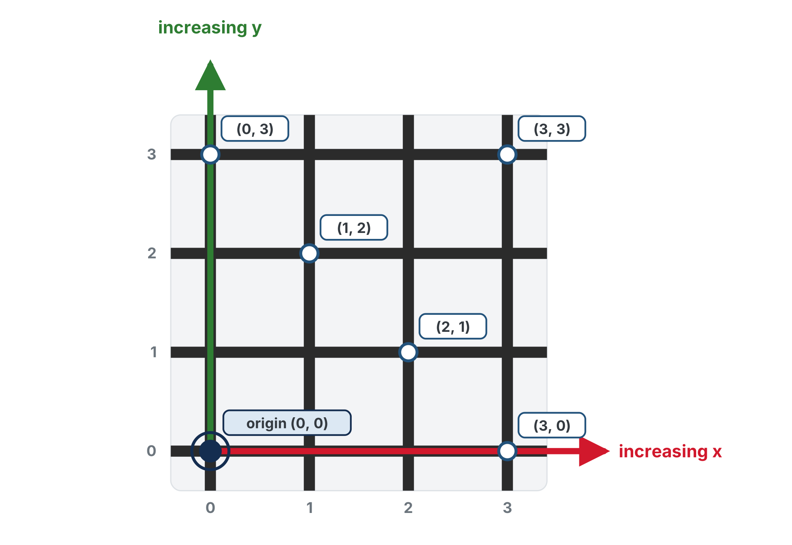
Two numbers name any spot
x increases to the right and y increases up.
Notes:
One paragraph on the page: like Battleship ("B4") or a spreadsheet cell ("A1"), two numbers name every intersection, counted from (0, 0), the corner nearest you. x counts across to the right, y counts up, away from you, both from zero. Order matters: (2, 3) and (3, 2) are different spots. Getting x and y in the right order is the number one stumble; what is new for most students is counting from zero, so name why: Python indexes from 0. If you can, have students stand at the near edge, walk the grid and call out their coordinates.

Slide 4
Check your understanding
In the coordinate (2, 3), what does the 2 mean?
A. The y: 2 steps away from you
B. The x: 2 steps right from the left edge
C. The total number of steps
D. Nothing: the order is flexible
Notes:
Answer: B. x comes first. (2, 3) means x = 2 (two right), y = 3 (three away from you, up the page).

Slide 5
Answer
In the coordinate (2, 3), what does the 2 mean?
A. The y: 2 steps away from you
B. The x: 2 steps right from the left edge
C. The total number of steps
D. Nothing: the order is flexible
x comes first. (2, 3) means x = 2 (two right), y = 3 (three away from you, up the page).

Slide 6
Activity · Map it
Activity
Grab a blank grid and label every intersection with its (x, y). Check yourself: the top-right of a 4×4 grid, the far corner, should be (3, 3). Then answer:
1
What's the bottom-right corner's coordinate?
2
If the robot is at (2, 1), what's directly to its left? Directly below it, toward you?
3
From (1, 1) to (3, 0): how many steps across, how many up or down?
Printable worksheet, grid and questions: learningpython.bradhouse.com/printables/lesson-4-1-blank-grid.pdf
Notes:
The answers are in the lesson's "Check your answers" box; students answer all three first. More support: start on a 3×3 grid, color-code each column, or hand out a partially filled grid. More challenge: an 8×8 grid; how many intersections on an N×N grid; and the teaser, how many different shortest paths from (0,0) to (2,3)? There are many equal-length paths; the Manhattan algorithm will pick one specific route, across first, then up or down.

Slide 7
Check your understanding
The robot is at (3, 1) and needs to get to (3, 3). Which way does it go?
A. Two steps east, to the right
B. Two steps north, away from you
C. Two steps south, toward you
D. It is already there
Notes:
Answer: B. x is the same, so it doesn't move across at all. y goes from 1 to 3, so it moves 2 steps away from you, which is north.

Slide 8
Answer
The robot is at (3, 1) and needs to get to (3, 3). Which way does it go?
A. Two steps east, to the right
B. Two steps north, away from you
C. Two steps south, toward you
D. It is already there
x is the same, so it doesn't move across at all. y goes from 1 to 3, so it moves 2 steps away from you, which is north.

Slide 9
From the grid to Python
You can name any grid spot with (x, y)
Now you'll store one in Python, using a tuple: a single value that packages two numbers
Try this lesson's code in a new file, not robot.py

Slide 10
One value, two numbers
You could use two variables, x = 2 and y = 3, but ten positions would need twenty variables. A tuple packs both into one value, written with parentheses:
position = (2, 3)
start = (0, 0)
destination = (3, 2)

Slide 11
Pull the pieces out by index
Python counts from zero, just like our grid: index 0 is x and index 1 is y.
position = (2, 3)
print(position[0]) # 2 -> x, across
print(position[1]) # 3 -> y, away from you
The x coordinate is position[0]; the y coordinate is position[1]

Slide 12
Check your understanding
Given position = (3, 1), what does position[0] return?
A. 1
B. 3
C. (3, 1)
D. An error
Notes:
Answer: B. Index 0 is the first element, x, so position[0] is 3. position[1] would be y, 1.

Slide 13
Answer
Given position = (3, 1), what does position[0] return?
A. 1
B. 3
C. (3, 1)
D. An error
Index 0 is the first element, x, so position[0] is 3. position[1] would be y, 1.

Slide 14
Unpacking: both numbers at once
Indexing pulls out one part at a time. Often you want both, as ordinary variables, in one line:
position = (2, 3)
x, y = position # x is 2, y is 3
That's tuple unpacking: the first variable gets index 0, the second gets index 1

Slide 15
It does exactly what two lines do
The variable names are yours to choose: dest_x, dest_y = destination works the same way
There must be exactly as many variables as parts
Two variables and a three-part tuple, or three variables and a two-part tuple: Python stops with a ValueError
x = position[0]
y = position[1]

Slide 16
Check your understanding
After start = (3, 2) and then a, b = start, what is b?
A. 3
B. 2
C. (3, 2)
D. An error
Notes:
Answer: B. The variables take the parts in order: a gets index 0, which is 3, and b gets index 1, which is 2. The variables don't have to be called x and y.

Slide 17
Answer
After start = (3, 2) and then a, b = start, what is b?
A. 3
B. 2
C. (3, 2)
D. An error
The variables take the parts in order: a gets index 0, which is 3, and b gets index 1, which is 2. The variables don't have to be called x and y.

Slide 18
Tuples can't change
Try to modify a tuple and Python stops you:
position = (2, 3)
position[0] = 5 # TypeError: 'tuple' object does not support item assignment
Tuples are immutable: once made, they can't be altered

Slide 19
A new spot is a new tuple
That's right for a coordinate: (2, 3) should always mean x = 2, y = 3. To represent a new spot, you make a new tuple:
old_position = (2, 3)
new_position = (3, 3) # one step east -- a brand-new tuple
Like a street address: move, and you get a new address. You don't edit the old one.
Notes:
Expect [0] versus [1] confusion for a few exercises: post "the x coordinate is position[0], the y coordinate is position[1]" on the wall. Flag the bracket rule early: tuples are made with parentheses; square brackets are only for indexing (and, next lesson, for lists). The immutability payoff is not obvious yet; the street-address analogy is enough for now. It really pays off once tuples live inside lists and the algorithm.

Slide 20
Check your understanding
What happens when you run position[0] = 5 on a tuple?
A. x changes to 5
B. You get a TypeError: tuples cannot be modified
C. It creates a new tuple automatically
D. Nothing happens
Notes:
Answer: B. Tuples are immutable, so item assignment raises a TypeError. To "change" a position, create a new tuple.

Slide 21
Answer
What happens when you run position[0] = 5 on a tuple?
A. x changes to 5
B. You get a TypeError: tuples cannot be modified
C. It creates a new tuple automatically
D. Nothing happens
Tuples are immutable, so item assignment raises a TypeError. To "change" a position, create a new tuple.

Slide 22
Comparing positions
== checks whether two tuples are the same position: both parts must match, in order.
current = (1, 2)
target = (1, 2)
print(current == target) # True
other = (2, 1)
print(current == other) # False -- order matters!
Later the algorithm asks "have we reached the destination yet?" by comparing tuples

Slide 23
Check your understanding
Does (1, 3) == (3, 1) evaluate to True?
A. Yes: they contain the same numbers
B. No: the parts must match in order, and these are swapped
C. Yes: tuples ignore order
D. It causes an error
Notes:
Answer: B. Two tuples are equal only if every element matches in order. (1, 3) is 1 for x and 3 for y; (3, 1) is 3 for x and 1 for y: different, so False.

Slide 24
Answer
Does (1, 3) == (3, 1) evaluate to True?
A. Yes: they contain the same numbers
B. No: the parts must match in order, and these are swapped
C. Yes: tuples ignore order
D. It causes an error
Two tuples are equal only if every element matches in order. (1, 3) is 1 for x and 3 for y; (3, 1) is 3 for x and 1 for y: different, so False.

Slide 25
Real-world connections
NAVIGATION
COMPUTERS
GRAPHICS
GPS & maps
Screens & spreadsheets
Colors
Latitude and longitude are two numbers naming any spot on Earth, passed around as one unit.
Every pixel and every cell is addressed by a row/column pair, counted from zero.
Colors (r, g, b) and screen points (x, y) are stored exactly like coordinate tuples.

Slide 26
Wrap-up
Which number comes first, and what does it mean?
How do you get x and y out of a tuple?
What does immutable mean, and why is it good for coordinates?
Why is (2, 3) == (3, 2) False?
Next: a whole path, many tuples, in a list
Notes:
Answers: x, how far across to the right. The x coordinate is position[0] and the y coordinate is position[1], or unpack both. It can't change; a position should stay fixed. The elements must match in order. Formative: name coordinates from pointed positions, always x first; correct tuple syntax, the right index for x versus y, and reading ==. Exit ticket: "Write the tuple for the spot 3 across and 1 up, then the line that gets its y" (spot = (3, 1), spot[1]).

