Slide 1

MODULE 5 · LESSON 5-9
Capstone Project
By the end of this lesson you can
Integrate the BFS planner, Module 4's driving toolkit and rangefinder detection into one program
Visit four or more destinations while detecting and avoiding obstacles
Start a run from the obstacles a previous run discovered, and report what this one found
Demonstrate learning: Run 2 outperforms Run 1, with numbers to prove it
Debug integration issues where individually-working parts don't cooperate
Notes:
Multi-day: for 50-minute periods this spans 2 to 3 days (assembly and simulation, robot testing, demos). This is the module's graduation project.

Slide 2
Every piece, one system
The robot visits several destinations, plans with BFS, senses obstacles with the rangefinder, and reroutes on the fly
It starts the next run knowing what this one found
You won't write much new code. The challenge is integration: making working parts work together
That's exactly what real software engineers do
Notes:
Students underestimate how hard connecting working parts is. Say so up front.

Slide 3
The mission
Your robot is an autonomous delivery vehicle. It visits four or more grid destinations in sequence. For each leg:
plan a path
drive it while watching for obstacles
reroute whenever the rangefinder finds one
Everything you need already exists in robot.py. Today you connect it.
Notes:
Where each piece came from: the planner (Lessons 5-4 and 5-5) and its paper tests (5-6), detection (5-7), the drive-until-you-arrive function and carrying knowledge between runs (5-8).

Slide 4
Two runs
Run 1 starts with an empty blocked list, discovers obstacles the hard way, and prints what it found
Run 2 starts with that list typed in, so it plans around them and reroutes less
The drop in step count between runs is the learning

Slide 5
Check your understanding
What is the main challenge of the capstone?
A. Inventing a new pathfinding algorithm
B. Integrating components you already built so they work together as one system
C. Building a new robot from parts
D. Rewriting BFS from scratch
Notes:
Answer: B. Every component already exists and was tested in earlier lessons. The capstone is about connecting them correctly: integration, not new algorithms.

Slide 6
Answer
What is the main challenge of the capstone?
A. Inventing a new pathfinding algorithm
B. Integrating components you already built so they work together as one system
C. Building a new robot from parts
D. Rewriting BFS from scratch
Every component already exists and was tested in earlier lessons. The capstone is about connecting them correctly: integration, not new algorithms.

Slide 7
Add to robot.py: this lesson's skeleton
At the end of the OBSTACLES section, above RUN. No new function is defined: one setting, a paper test, and the project itself.
# --- Lesson 5-9: capstone, the delivery run ---
# The module project: visit CAPSTONE_DESTINATIONS in order,
# each leg with navigate_with_detection(), starting from what
# the last run found (KNOWN_OBSTACLES) and printing what this
# run found for the next one. Nothing new is defined; the
# sections above did the work, and this test connects them.
CAPSTONE_DESTINATIONS = [(1, 3), (3, 3), (3, 0), (0, 0)]
def test_capstone_paper():
# no robot: hand KNOWN_OBSTACLES to add_blocked(), then
# from (0, 0) plan each leg with the BFS planner, print it
# with its step count, and move position on to that
# destination for the next leg
pass
Notes:
The name is CAPSTONE_DESTINATIONS because DESTINATIONS is already in the file: Lesson 4-7's delivery run still reads it, and a finished section is not edited from another one. test_capstone() is the rest of the skeleton, on the next slide.

Slide 8
The project is a test: test_capstone()
Like every program in this course, it is a test function. The outline is the whole program's shape:
def test_capstone():
# 1. hand KNOWN_OBSTACLES to add_blocked()
# (empty on Run 1, last run's list on Run 2)
# 2. position (0, 0), heading 0; both totals at 0
# 3. print the plan for leg 1; wait for the button
# 4. for each destination, with its leg number:
# navigate_with_detection() -- plan, follow,
# re-plan until arrived (Lesson 5-8)
# ... keeping position and heading up to date
# add its steps and reroutes to the totals
# 5. print the blocked list -- what you type in next run
# 6. print the totals: steps, reroutes
pass

Slide 9
The blocked list is the thread
Step 1 fills it
The planner reads it on every call
Detection adds to it
Step 5 hands it to the next run
Every one of those goes through add_blocked(). The planner never knows which.

Slide 10
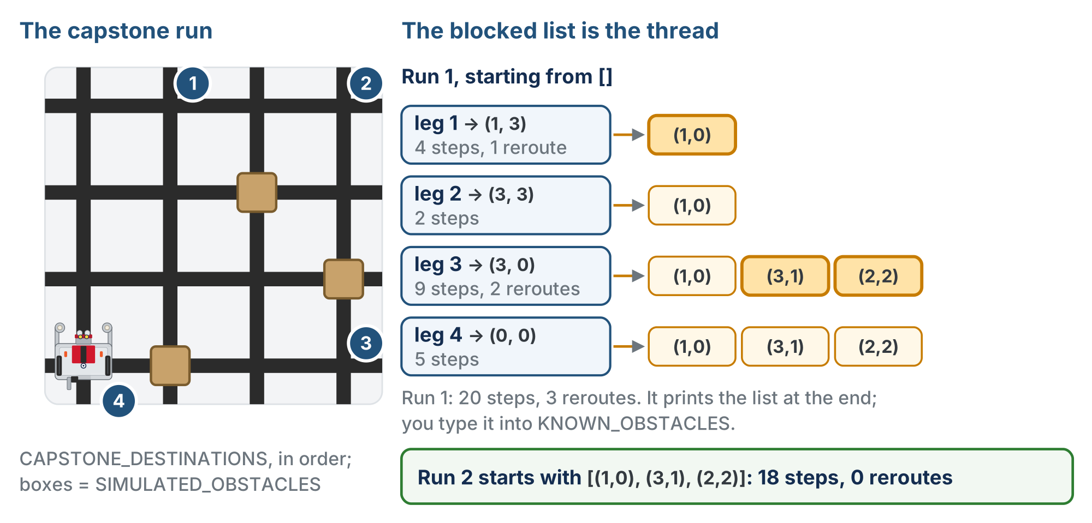
One list, leg by leg
The dry run with SIMULATED_OBSTACLES = [(1, 0), (2, 2), (3, 1)]. One list grows across the run and starts the next.
Notes:
Left: the robot at home, the four destinations numbered in order, and the three pretend boxes. Right: leg 1 adds (1, 0); leg 3 adds (3, 1) and (2, 2). Run 1 totals 20 steps and 3 reroutes and prints the list; Run 2 starts with all three and takes 18 steps with 0 reroutes. Useful numbers to have when a team's dry run looks off.

Slide 11
Check your understanding
What single data structure connects the start of the run, pathfinding, detection, and what you carry into the next run?
A. The previous dictionary
B. The blocked list: filled at the start, planned from, added to on detection, then printed
C. The to_visit list
D. The heading number
Notes:
Answer: B. `BLOCKED` flows through every stage: start, planner, detection, the next run. If it doesn't flow correctly, the whole system breaks.

Slide 12
Answer
What single data structure connects the start of the run, pathfinding, detection, and what you carry into the next run?
A. The previous dictionary
B. The blocked list: filled at the start, planned from, added to on detection, then printed
C. The to_visit list
D. The heading number
BLOCKED flows through every stage: start, planner, detection, the next run. If it doesn't flow correctly, the whole system breaks.

Slide 13
The destination loop
navigate_with_detection() already handles one trip. The new code is the loop that calls it once per destination, feeding each trip's end position and heading into the next:
position, heading, steps, reroutes = navigate_with_detection(
position, heading, dest, rangefinder, OBSTACLE_CM
)
The call from your Lesson 5-8 test, with the leg's destination dest in place of a fixed one

Slide 14
Two details that are easy to get wrong
The pose, position and heading, must be assigned from the return value
Forget the position, heading, ... = part and leg 2 plans from (0, 0) while the robot sits somewhere else
Only the first leg is printed before the button
Later legs are planned from wherever the robot actually ends up, including around obstacles it hasn't found yet
Notes:
Class track: with the Navigator class there is no position, heading line to get wrong. navigate_with_detection() is a method that updates navigator.position and navigator.heading itself and returns the two counts. With the BFS class, the planner calls are planner.compute_path() and planner.add_blocked(), and the list printed at the end is planner.blocked.

Slide 15
Check your understanding
Why can the program print the plan for leg 1 before the button, but not for legs 2 to 4?
A. compute_bfs_path only works once per program
B. Later legs depend on where leg 1 ends and what it finds on the way: neither is known yet
C. Printing more than one path would overflow the screen
D. The button only allows one print
Notes:
Answer: B. Each leg is planned when it starts, from the robot's real position and the current `BLOCKED` list. Leg 1 is the only one whose inputs are known before the robot moves.

Slide 16
Answer
Why can the program print the plan for leg 1 before the button, but not for legs 2 to 4?
A. compute_bfs_path only works once per program
B. Later legs depend on where leg 1 ends and what it finds on the way: neither is known yet
C. Printing more than one path would overflow the screen
D. The button only allows one print
Each leg is planned when it starts, from the robot's real position and the current BLOCKED list. Leg 1 is the only one whose inputs are known before the robot moves.

Slide 17
Check your understanding
A team's robot drives leg 1 correctly, then on leg 2 turns the wrong way and tracks off the grid. The most likely cause?
A. The rangefinder threshold is too low
B. They didn't assign the returned position and heading, so leg 2 was planned from the start
C. BFS found a non-shortest path
D. The destinations list is too long
Notes:
Answer: B. If `position` and `heading` are not updated from the return value, the planner thinks the robot is still at (0, 0) facing north. The path it produces is right for that spot and wrong for where the robot is.

Slide 18
Answer
A team's robot drives leg 1 correctly, then on leg 2 turns the wrong way and tracks off the grid. The most likely cause?
A. The rangefinder threshold is too low
B. They didn't assign the returned position and heading, so leg 2 was planned from the start
C. BFS found a non-shortest path
D. The destinations list is too long
If position and heading are not updated from the return value, the planner thinks the robot is still at (0, 0) facing north. The path it produces is right for that spot and wrong for where the robot is.

Slide 19
Activity · Test in three levels
Activity
Do not jump straight to the full run on the robot. One test on the run line at a time:
Planner alone (no robot). Write test_capstone_paper(): the four paths on screen, with their step counts. Then type a pretend KNOWN_OBSTACLES list and watch the legs bend around it
1
Dry run on the grid. Write test_capstone() with the simulated sensor and SIMULATED_OBSTACLES = [(1, 0), (2, 2), (3, 1)]. No boxes. Does the blocked list grow across all four legs?
2
The real thing. Back to rangefinder.distance(), boxes on the grid. Run 1 with KNOWN_OBSTACLES = [], then Run 2 with the printed list typed in
3
Notes:
If something breaks in the full run, you won't know which piece. Level 1 is Lesson 4-7's paper test on today's destinations with the BFS planner; with nothing blocked the four legs are 4, 2, 3 and 3 steps (the page has that in a closed reveal). Level 2: the simulated sensor goes in navigate_with_detection()'s look-ahead line (Lesson 5-8, step 1); verify paths compute, pretend obstacles register, and the list printed at the end is the one to start the next run with. Insist everyone gets the dry run working before a box touches the grid: logic first, hardware second.

Slide 20
Watch for the classic integration bugs
The blocked list reset between destinations
One BLOCKED for the whole run: never call clear_blocked() between legs
position and heading not assigned from the return value
A destination that is itself in KNOWN_OBSTACLES
The planner returns [] and the leg is skipped with "No path"
Check these first when parts that worked on their own don't cooperate

Slide 21
Check your understanding
Which is a classic capstone integration bug to watch for?
A. Using too few comments
B. Resetting the blocked list between destinations, so the robot forgets obstacles mid-run
C. Naming the robot
D. Printing the path
Notes:
Answer: B. test_capstone() is the graded work, and there is no student reveal for it; the teacher copy of the solution is for unsticking a team, not a handout.

Slide 22
Answer
Which is a classic capstone integration bug to watch for?
A. Using too few comments
B. Resetting the blocked list between destinations, so the robot forgets obstacles mid-run
C. Naming the robot
D. Printing the path
BLOCKED must persist across all destinations in a run. Clearing it for each leg throws away everything learned so far. (Also common: not assigning position and heading from the return value.)
Notes:
Answer: B. test_capstone() is the graded work, and there is no student reveal for it; the teacher copy of the solution is for unsticking a team, not a handout.

Slide 23
The rubric
You're graded on the integrated system, component by component:
Category | Points | What it takes
BFS pathfinding | 10 | Correct shortest paths; the Lesson 5-6 tests pass
Driving integration | 10 | Robot physically drives the computed paths, leg after leg
Obstacle detection | 10 | Rangefinder detects and add_blocked() updates the list
Re-planning | 10 | Reroutes correctly around discovered obstacles
Experience | 10 | Run 1 prints what it found; Run 2 starts from that list
Demonstration | 5 | Run 1 discovers & reroutes; Run 2 avoids known obstacles
Code quality | 5 | Readable, uses functions, meaningful comments
Notes:
Use the rubric as a self-assessment checklist: each row maps to a lesson. Students who did the class extensions run the capstone with their Navigator and BFS objects; nothing in the rubric changes.

Slide 24
The demo, and finished early?
Run twice and have your numbers ready:
"Run 1 took X steps with Y reroutes; Run 2 took A steps with B reroutes."
Finished early? Try an extension:
visit the nearest destination next
obstacle expiration: re-check old obstacles after a few runs
a print_grid() map of the rings after each leg
a Navigator object that owns position and heading (if you did the class extensions)
Notes:
At the demo, ask why Run 2 is better and listen for "better data," not "the robot is smarter." With a Navigator object the destination loop has nothing to pass back and forth.

Slide 25
Check your understanding
In the demo, what evidence shows the robot "learned"?
A. It drives faster
B. Run 2 has fewer reroutes and/or steps, because it started out knowing the obstacles
C. It makes a sound at each intersection
D. Run 2 visits fewer destinations
Notes:
Answer: B. The measurable improvement from Run 1 to Run 2 (fewer reroutes and steps) is the evidence. Same algorithm, better data to start from.

Slide 26
Answer
In the demo, what evidence shows the robot "learned"?
A. It drives faster
B. Run 2 has fewer reroutes and/or steps, because it started out knowing the obstacles
C. It makes a sound at each intersection
D. Run 2 visits fewer destinations
The measurable improvement from Run 1 to Run 2 (fewer reroutes and steps) is the evidence. Same algorithm, better data to start from.

Slide 27
Real-world connections
ROBOTICS
VEHICLES
ENGINEERING
SLAM
Self-driving
System integration
Real robots build and reuse maps of their environment: the grown-up version of your obstacle memory.
Sense, plan, act, and learn from fleet data: the same loop at massive scale.
Connecting tested components into a reliable whole is the core of professional software work.
Notes:
You've built, in miniature, what real autonomous systems do.

Slide 28
Wrap-up
What connects all the components?
Why test in simulation before the robot?
What proves the robot learned?
Next: Module 6 · Dijkstra's Algorithm (optional)
Notes:
Answers: the blocked list (filled at the start, planned from, added to on detection, printed for the next run); to separate logic bugs from hardware bugs; Run 2's measured improvement over Run 1. Course wrap-up: take a moment to trace the arc. Module 1 Python foundations, Module 2 sensors and functions, Module 3 the grid, Module 4 Manhattan pathfinding and turning at intersections, Module 5 graphs, BFS, sensing and learning, and one file, robot.py, that grew a section at a time from Lesson 2-1. The plan-vs-drive split and the shared planner interface are ideas they will meet again in any serious software work. From "Hello, World" to an autonomous robot that navigates, senses and learns is a real accomplishment. If there is time, Module 6 adds Dijkstra's algorithm as a third planner behind the same interface.

