Slide 1

MODULE 6 · LESSON 6-0
The Same Algorithm, One Upgrade
By the end of this lesson you can
Measure a slow segment and turn it into a number: its weight
Add a cost check to the Module 5 test harness, and show BFS failing it
Turn your compute_bfs_path() into compute_dijkstra_path() by making two changes to a copy
Read a cost grid and explain every number on it
Run three planners through one harness and say exactly where they agree and disagree
Notes:
15 to 20 minutes. Optional module, 1 to 2 weeks, after Module 5. The course is complete at the end of Module 5 and nothing later depends on this, so it can be dropped cleanly. It needs a physical change to the grid: one segment has to be genuinely slow, something students can time. The leading candidate is a winding tape detour between two adjacent intersections; try it on your grid before scheduling the module. Pacing: weeks 19 to 20 of an 18-week course, or a second semester.

Slide 2
Fewest steps, or least time?
Module 5 ended with a robot that finds its own way around blocked intersections
It uses breadth-first search, which finds the path with the fewest steps
On a grid where every block takes the same time, that is also the fastest path
But suppose one segment takes a long, winding detour, so that driving it takes as long as five ordinary blocks
The map still says it is one step. BFS will happily send the robot down it, because BFS only counts steps.
Dijkstra's algorithm is your BFS with two changes. It finds the path that takes the least time, not the fewest steps.

Slide 3
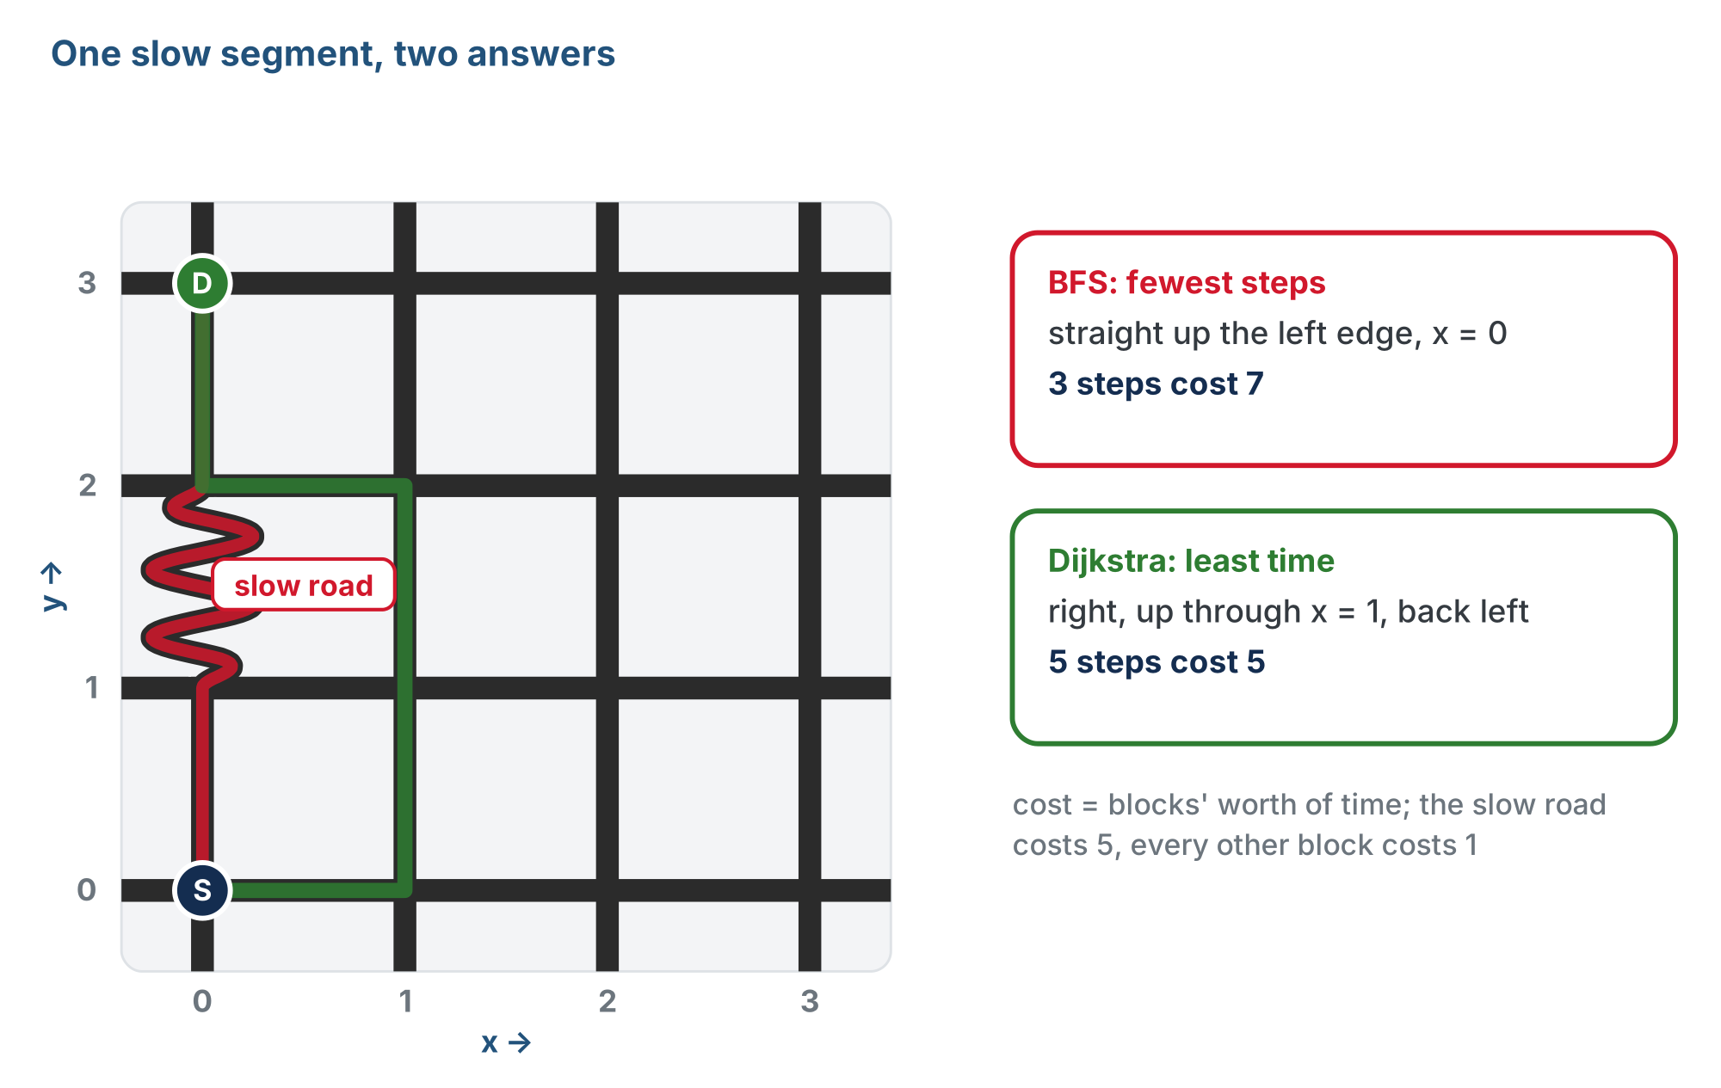
The same trip, two planners
BFS counts steps and takes the slow road; Dijkstra adds up time and goes around it.
Notes:
BFS goes straight up the left edge, x = 0, through the slow segment between (0, 1) and (0, 2): 3 steps, cost 7. Dijkstra goes right, up through x = 1 and back left: 5 steps, cost 5. Cost here means blocks' worth of time.

Slide 4
What this module is not
It is not a new kind of programming: there is no new Python syntax in it
The graph, add_blocked(), the previous dictionary, the walk-back and the harness are all the ones you built in Module 5, in the same robot.py
The harness gains one case
The file gains two sections above RUN: WEIGHTED GRAPH and DIJKSTRA PLANNER
The two changes are in the middle of one function

Slide 5
The two changes
CHANGE 1
CHANGE 2
Closest, not oldest
Add the weight
Take the closest intersection off the to-visit list instead of the oldest one.
Add the segment's weight instead of counting one step, and keep the cheaper total if you reach the same place a second time.
Notes:
That's it. The rest of the module is about seeing why those two changes matter.

Slide 6
The lessons
Lesson | What happens
6-1 · When Fewest Steps Isn't Fastest | Time a normal block and the slow segment with a stopwatch. Work out, on paper, which of two routes is really faster.
6-2 · Weights in the Graph | Start WEIGHTED GRAPH: the slow list, weight(), path_cost() and a cost check. Run the check on BFS, and watch it fail.
6-3 · From BFS to Dijkstra | Start DIJKSTRA PLANNER: copy your BFS, rename it, make the two changes. Print the cost grid. Run Manhattan, BFS and Dijkstra through the same harness.
6-4 · Drive It | The robot on the slow-segment grid: a BFS run, then a Dijkstra run, one test and one changed name.
6-5 · Three Planners, One Harness (optional extension) | The Dijkstra class, and all three planners as objects through the Module 5 class harness.
Notes:
Lesson 6-5 is for students on the class track (the Manhattan and BFS classes from Lessons 4-4 and 5-5).

Slide 7
Check your understanding
On a grid where every segment takes the same time, how do BFS and Dijkstra's algorithm compare?
A. Dijkstra finds a shorter path
B. They find paths of the same length: Dijkstra only differs when segments have different costs
C. BFS finds a shorter path
D. Dijkstra cannot run on a grid
Notes:
Answer: B. With every segment costing 1, fewest steps and least cost are the same thing, so the two agree on every test. The slow segment is what separates them.

Slide 8
Answer
On a grid where every segment takes the same time, how do BFS and Dijkstra's algorithm compare?
A. Dijkstra finds a shorter path
B. They find paths of the same length: Dijkstra only differs when segments have different costs
C. BFS finds a shorter path
D. Dijkstra cannot run on a grid
With every segment costing 1, fewest steps and least cost are the same thing, so the two agree on every test. The slow segment is what separates them.

Slide 9
Wrap-up
What does BFS find, and when is that also the fastest path?
What are the two changes that turn BFS into Dijkstra?
What stays the same from Module 5?
Next: time the slow segment, and turn it into a weight
Notes:
Answers: the fewest steps, which is the fastest path only when every block takes the same time. Closest first instead of oldest first; add the weight instead of counting one step, and keep the cheaper total. The graph, add_blocked(), the previous dictionary, the walk-back, the harness and robot.py itself. Before Lesson 6-1, re-tape the slow segment on the grid.

