Slide 1

MODULE 6 · LESSON 6-3
From BFS to Dijkstra
By the end of this lesson you can
Add the cost check to run_all_tests() as its seventh case
Duplicate compute_bfs_path() as compute_dijkstra_path() and keep the parts that don't change
Make change 1: take the closest intersection off to_visit, not the oldest
Make change 2: add the segment's weight, and keep the cheaper total when an intersection is reached again
Read a print_grid() of costs and explain each number
Run Manhattan, BFS and Dijkstra through the same harness and say where they agree and disagree
Notes:
60 minutes. No robot needed. The lesson's shape is the point: a working thing, copied, changed in two marked places, tested after each. Students who try to write Dijkstra fresh get lost in to_visit bookkeeping; students who copy BFS and change two lines have it working in twenty minutes and can explain both changes.

Slide 2
Not a new algorithm: your BFS, upgraded
BFS fails the cost check because it never looks at a weight
The fix is your BFS, copied, renamed, and changed in two places in the middle
Everything else stays exactly as you wrote it in Module 5: the graph, add_blocked(), the previous dictionary, the walk-back
The result is Dijkstra's algorithm
By the end of the lesson: three planners running through one harness

Slide 3
Skeleton, paste above RUN (1 of 3)
It starts the DIJKSTRA PLANNER section: a helper, the planner, the function that draws its costs, and one given printer.
# ===== DIJKSTRA PLANNER =====
# The third planner, made by copying the BFS PLANNER's
# function and changing two things in the middle: take the
# CLOSEST waiting intersection, not the oldest, and add the
# WEIGHTED GRAPH's weight() instead of counting a step,
# keeping the cheaper total when a place is reached twice.
# Same shape, same promises; the 5-6 harness tests all three.
def closest(intersections, distance):
"""Return the entry of intersections with the smallest
value in distance: a plain find-the-minimum loop."""
pass

Slide 4
Skeleton (2 of 3): the planner's outline
def compute_dijkstra_path(start, destination):
"""Cheapest path from start to destination around
BLOCKED, by weight(), as the intersections to drive to."""
# SETUP: as compute_bfs_path(), plus
# distance = {start: 0} cheapest cost so far
# SEARCH
# while to_visit is not empty:
# CHANGE 1: current = the closest() one; remove it
# if current is the destination: stop looking
# for each neighbor of current in the graph:
# CHANGE 2: new cost = distance to current
# + weight(current, neighbor)
# if neighbor has no cost yet, or this is less:
# record the new cost and where it came from
# add it to to_visit if it is not already on
# WALK-BACK: unchanged from compute_bfs_path()
pass
Notes:
The outline is only the two changes, and the walk-back is "unchanged": the BFS body goes in first, and the comments are a checklist, not a second algorithm.

Slide 5
Skeleton (3 of 3): the cost map, the printer
def dijkstra_distances(start):
"""Cheapest cost to every reachable intersection, as a
dictionary -- the search with no break, like bfs_rings()."""
pass
def compare(start, destination):
"""Print BFS's and Dijkstra's answers for one trip:
steps, cost and path, one line each."""
for (name, planner) in [("BFS", compute_bfs_path),
("Dijkstra", compute_dijkstra_path)]:
path = planner(start, destination)
print(" ", "{:<9}".format(name), "steps:", len(path),
" cost:", path_cost(position, path), " ", path)
compare() is given: a print, not a planner. Its for line unpacks each pair as it loops (Lesson 4-1): a label, and the planner function to call with it.
Notes:
"{:<9}".format(name) is "this name, left-aligned in nine spaces", the same trick as print_grid()'s "{:>3}".

Slide 6
First, the harness learns to count cost
Three edits to run_all_tests() in the BFS PLANNER section. None of them touches the six cases it already runs.
clear_blocked()
clear_slow_edges() # 1. open grid, no slow edges
... # the six cases, as they are
clear_blocked()
add_slow_edge((0, 1), (0, 2), 5) # 2. the seventh case: slow grid
path = planner((0, 0), (0, 3))
if check_cost("slow grid: (0,0) to (0,3)", (0, 0), (0, 3), path, 5):
passed = passed + 1
clear_slow_edges()
print(name + ":", passed, "of 7 passed") # 3. seven now
Run Module 5's test_harness(): Manhattan drops to 4 of 7 and BFS to 6 of 7, each failing the new case
Notes:
The slow edge is cleared at the start as well as the end for the same reason the blocked list is: a harness has to set up its own grid, not trust whatever ran before. The harness edit comes first deliberately: a copy that fails 6 of 7 exactly as BFS does is the proof that the copy is faithful.

Slide 7
Start by copying
Copy the body of compute_bfs_path() into compute_dijkstra_path(), in place of pass and under the comments: the comments are your checklist. Change nothing else yet. Then test_three_planners(): Lesson 5-6's test_harness() with a third line.
run_all_tests("Manhattan", compute_manhattan_path)
run_all_tests("BFS", compute_bfs_path)
run_all_tests("Dijkstra", compute_dijkstra_path)
The copy passes everything BFS passes and fails the same cost check. Now you have a safe place to make two changes.
Notes:
Set the run line to test_three_planners(). Identical code, identical results: that is what students should expect, and see.

Slide 8
Change 1 · Closest first, not oldest first
BFS takes intersections off to_visit in the order they went on: to_visit.pop(0)
That works because every step costs the same: the oldest entry is always one of the closest
With weights that is no longer true
An intersection reached by a cheap detour may be closer, in cost, than one that went on the list earlier by a slow road
So Dijkstra takes the waiting intersection that is cheapest so far, whenever it went on the list

Slide 9
Change 1 · distance and closest()
A second dictionary, distance: the cheapest cost found so far to each intersection
It starts as {start: 0}, because the start costs nothing to reach
Each time round the loop: closest(to_visit, distance)
Assume the first entry is best, loop over the rest, keep any entry whose distance is smaller
Finding the biggest number in a list (Module 1), with the comparison turned round
pop(0) did two jobs, choosing and removing. closest() only chooses, so the line after it has to remove() the chosen one from to_visit.
Notes:
closest() is a linear scan. Real implementations use a priority queue, and the old version of this material taught one; don't. For a 4 by 4 grid the scan is instant, and the queue is machinery that hides the two ideas. If a student asks: "a priority queue is a faster way to do what closest() does" is the whole answer.

Slide 10
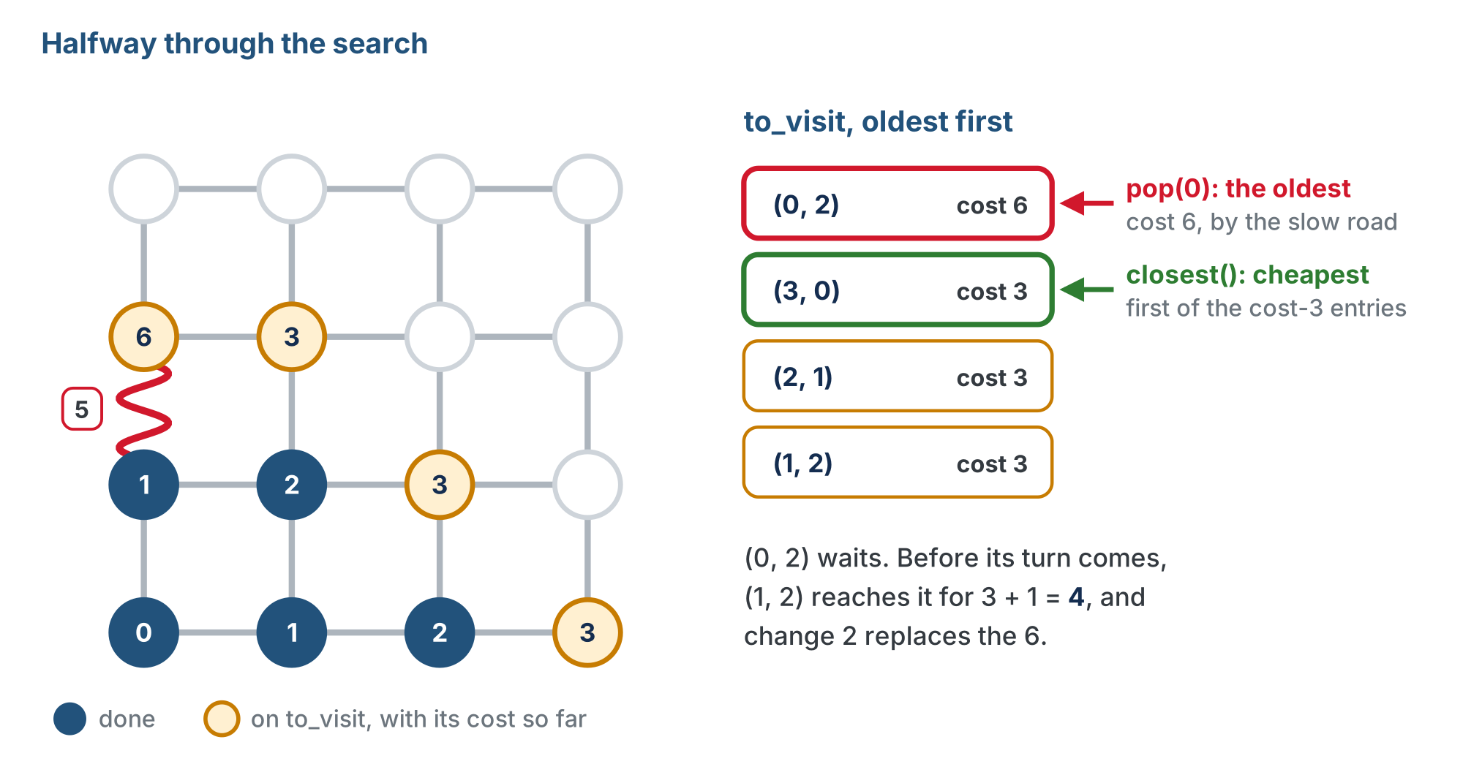
The moment the two choices differ
Taking the oldest would settle (0, 2) at 6; taking the closest leaves it waiting long enough for a cheaper way to turn up.
Notes:
Dijkstra partway through on the slow grid. to_visit holds (0, 2) at cost 6, the oldest, then three intersections at cost 3. pop(0) would take (0, 2); closest() takes (3, 0). Before (0, 2) comes up, (1, 2) reaches it for 4. (This slide uses a copy of the lesson figure widened slightly so its right-hand notes are not cut off.)

Slide 11
Check your understanding
Why can BFS get away with taking the oldest intersection off to_visit, and Dijkstra cannot?
A. BFS lists are shorter
B. Every step costing 1 keeps the oldest among the closest; with weights, a later entry reached cheaply can be closer than an earlier one reached by a slow road
C. Dijkstra uses a dictionary and BFS uses a list
D. It can; the change is only for speed
Notes:
Answer: B. BFS's rings are rings of steps and rings of cost at once. Weights break that: cost no longer grows in step with order of discovery, so the planner has to look up which waiting intersection is cheapest.

Slide 12
Answer
Why can BFS get away with taking the oldest intersection off to_visit, and Dijkstra cannot?
A. BFS lists are shorter
B. Every step costing 1 keeps the oldest among the closest; with weights, a later entry reached cheaply can be closer than an earlier one reached by a slow road
C. Dijkstra uses a dictionary and BFS uses a list
D. It can; the change is only for speed
BFS's rings are rings of steps and rings of cost at once. Weights break that: cost no longer grows in step with order of discovery, so the planner has to look up which waiting intersection is cheapest.

Slide 13
Change 2 · Add the weight, keep the cheaper way
BFS marks a neighbor the first time it sees it and never reconsiders
That is safe for BFS: the first way to reach it is always a shortest way, in steps
Dijkstra adds the edge's weight to get the cost of reaching the neighbor this way
If that beats what it already had, it updates
A neighbor reached again by a cheaper route gets a new cost and a new came-from
Notes:
Lesson heading: "Change 2 · Add the weight, and keep the cheaper way". The next slide compares the pencil versions of the two neighbor loops.

Slide 14
The two neighbor loops, in pencil
BFS (Module 5) Dijkstra
# for each neighbor of current: # for each neighbor of current:
# only if it has no entry yet: # this way costs: current's cost
# write where it came from # + weight(current, neighbor)
# put it on the END of the list # if no cost yet, OR this is cheaper:
# write the cost
# write where it came from
# put it on the list, if not on it
Notes:
On the lesson page these are two blocks side by side; the slide sets them in two columns of one block.

Slide 15
Three things to notice
"Has no entry yet" was not in previous in BFS. Now it is not in distance: distance says whether a cost has been found.
The or is the whole of change 2: a neighbor that already has a cost is reconsidered, and loses its old cost and old came-from if this way is cheaper
"If not on it" matters now: a neighbor can be reached a second time while still waiting on to_visit, and must not be listed twice
previous[neighbor] = current still remembers the path, and the walk-back is untouched. New: previous can be overwritten when a cheaper way turns up.
Notes:
The "if not on it" check is the line students skip. Without it the open-grid cases still pass but to_visit fills with duplicates, so ask them why BFS never needed it.

Slide 16
Check your understanding
In Dijkstra, what happens when the planner reaches an intersection it has already recorded, by a cheaper route?
A. Nothing: the first way found is kept, as in BFS
B. distance and previous for that intersection are overwritten with the cheaper total and the new way in
C. The planner stops and returns the path
D. The intersection is added to BLOCKED
Notes:
Answer: B. That is change 2. BFS never reconsiders because its first discovery is already shortest in steps. Dijkstra may find a cheaper way later and must keep it, including the previous pointer that the walk-back will follow.

Slide 17
Answer
In Dijkstra, what happens when the planner reaches an intersection it has already recorded, by a cheaper route?
A. Nothing: the first way found is kept, as in BFS
B. distance and previous for that intersection are overwritten with the cheaper total and the new way in
C. The planner stops and returns the path
D. The intersection is added to BLOCKED
That is change 2. BFS never reconsiders because its first discovery is already shortest in steps. Dijkstra may find a cheaper way later and must keep it, including the previous pointer that the walk-back will follow.

Slide 18
Activity · Make the two changes
Activity
Work on your copy, in order. Run test_three_planners() after each step, and don't go on until the result matches.
Write closest(). Add distance = {start: 0} to the setup and swap to_visit.pop(0) for closest() + remove(). Harness: still 6 of 7: the cost case still fails, because nothing adds a weight yet.
1
Replace the neighbor loop with the weighted version. Harness: 7 of 7. The cost check passes, with a five-step path where BFS printed three.
2
Read all three planners' results. Manhattan fails the two blocked cases and the cost case; BFS fails only cost on the slow grid; Dijkstra passes everything.
3
Notes:
On the open grid with no slow edges, all three agree on every path length. Watching the seventh case flip to PASS at step 2 is the lesson's payoff. Class track: if you built the BFS class in Lesson 5-5, the copy is of the class. Lesson 6-5 is this lesson's class-track version, with the same two changes inside compute_path(), and can be done now in place of the function version.

Slide 19
Last test: test_cost_grid()
Add the slow segment and call compare((0, 0), (0, 3)):
BFS steps: 3 cost: 7 [(0, 1), (0, 2), (0, 3)]
Dijkstra steps: 5 cost: 5 [(1, 0), (1, 1), (1, 2), (0, 2), (0, 3)]
Your Dijkstra path may go round a different way, back left at (0, 2) or on to (1, 3) first, and still be right. Cost 5 is what matters.

Slide 20
Check your understanding
On a grid with no blocked intersections and no slow edges, how do the three planners' paths compare?
A. Dijkstra's paths are shorter
B. All three are the same length; the planners only disagree when a wall or a slow segment gives them a reason to
C. Manhattan fails
D. BFS and Dijkstra return []
Notes:
Answer: B. Without obstacles, every planner finds a shortest Manhattan route. Walls separate Manhattan from the other two; weights separate BFS from Dijkstra. Each upgrade earns its keep on exactly the grid that needs it.

Slide 21
Answer
On a grid with no blocked intersections and no slow edges, how do the three planners' paths compare?
A. Dijkstra's paths are shorter
B. All three are the same length; the planners only disagree when a wall or a slow segment gives them a reason to
C. Manhattan fails
D. BFS and Dijkstra return []
Without obstacles, every planner finds a shortest Manhattan route. Walls separate Manhattan from the other two; weights separate BFS from Dijkstra. Each upgrade earns its keep on exactly the grid that needs it.

Slide 22
The cost grid
dijkstra_distances() is to compute_dijkstra_path() what bfs_rings() was to compute_bfs_path() in Lesson 5-5: the setup and the search, with no break and no walk-back, returning distance itself. Write it, then add one line to test_cost_grid():
print_grid(ROWS, COLS, BLOCKED, dijkstra_distances((0, 0)))
Dijkstra's distance dictionary is a map of how far everything is, in cost, from the start

Slide 23
Read up the left edge, x = 0
(0, 1) costs 1, then (0, 2) costs 4, not 2
The slow segment would make it 1 + 5 = 6
Over to (1, 1), up to (1, 2) and back left costs 1 + 1 + 1 + 1 = 4, so 4 is kept
That one cell is change 2 doing its job
Everywhere else, the numbers are Module 5's BFS rings
3 | 5 4 5 6
2 | 4 3 4 5
1 | 1 2 3 4
0 | 0 1 2 3
-------------
0 1 2 3
Notes:
The cost grid is where the understanding shows. Ask students to point at the one cell that differs from BFS and say why before they look at the explanation.

Slide 24
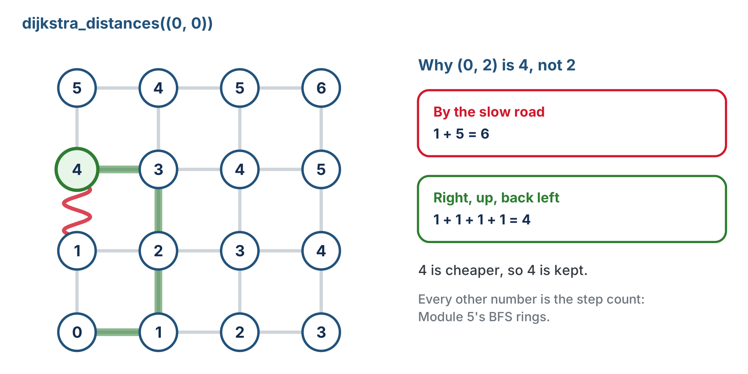
Why (0, 2) is 4, not 2
The one cell that is not a BFS ring, and the two ways of reaching it.

Slide 25
Check your understanding
In the cost grid, why is (0, 2) a 4 rather than a 2?
A. A typo in the grid
B. Straight up the left edge costs 1 + 5 = 6 because of the slow segment; the detour through x = 1 costs 4, and Dijkstra keeps the cheaper total
C. Because (0, 2) is blocked
D. Because the grid is 4 wide
Notes:
Answer: B. Every other cell matches the BFS ring numbers. (0, 2) is the one place the slow segment is on the direct route, and the printed 4 is the cheaper way round it.

Slide 26
Answer
In the cost grid, why is (0, 2) a 4 rather than a 2?
A. A typo in the grid
B. Straight up the left edge costs 1 + 5 = 6 because of the slow segment; the detour through x = 1 costs 4, and Dijkstra keeps the cheaper total
C. Because (0, 2) is blocked
D. Because the grid is 4 wide
Every other cell matches the BFS ring numbers. (0, 2) is the one place the slow segment is on the direct route, and the printed 4 is the cheaper way round it.

Slide 27
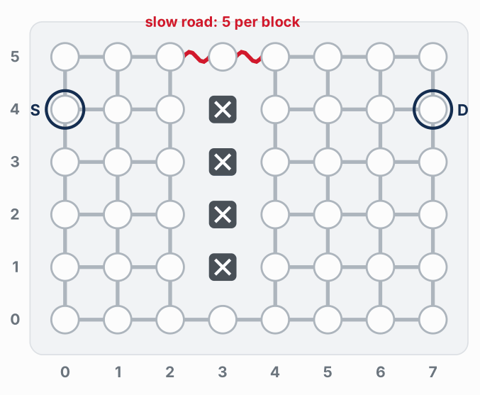
A bigger grid: how the two searches spread
Watch it run. The next slide picks out the key moments.
Notes:
On the lesson page this is an animation with two buttons, on the 8 by 6 grid from Lesson 5-3: a wall of four blocked intersections at x = 3, a slow road (5 per block) across the top gap, S at (0, 4) and D at (7, 4). These are its two end states: BFS finished and Dijkstra finished. Midway through the Dijkstra run the wave has raced along the bottom to cost 11 while the slow road has only reached the top middle, at 8. On the 4 by 4 floor grid one slow segment changes one number; a bigger grid shows what change 1 does to the shape of the search.

Slide 28
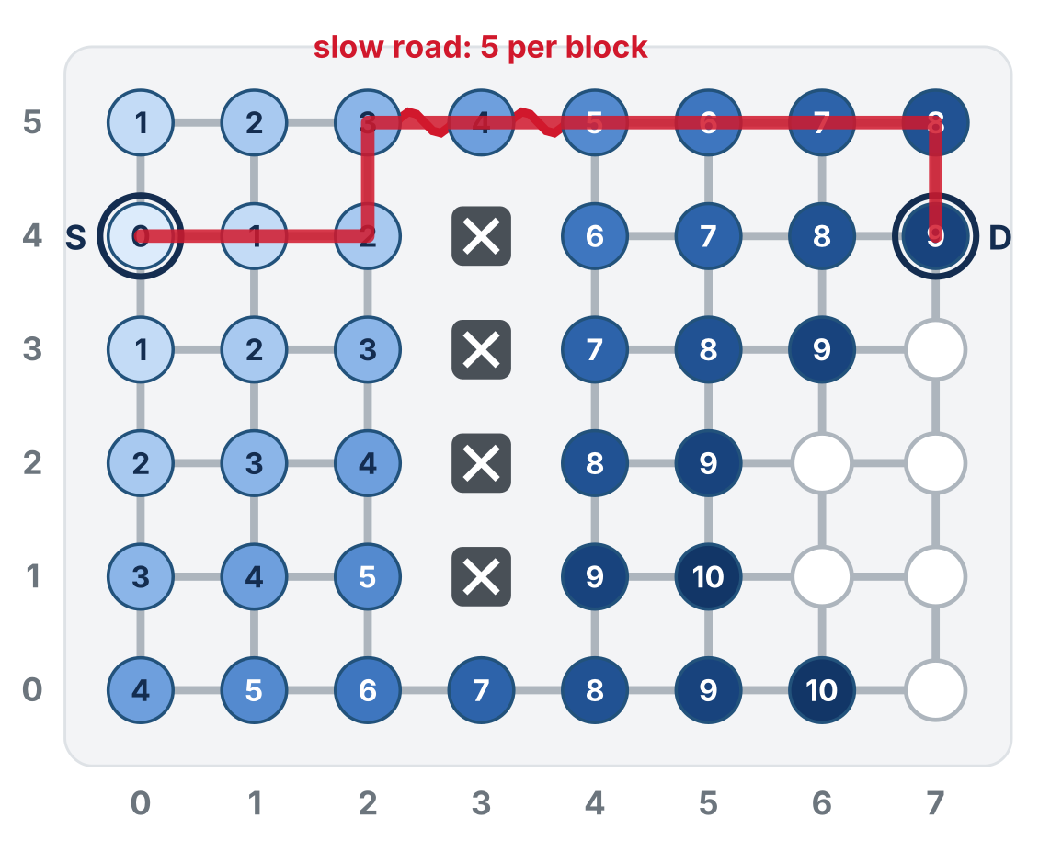
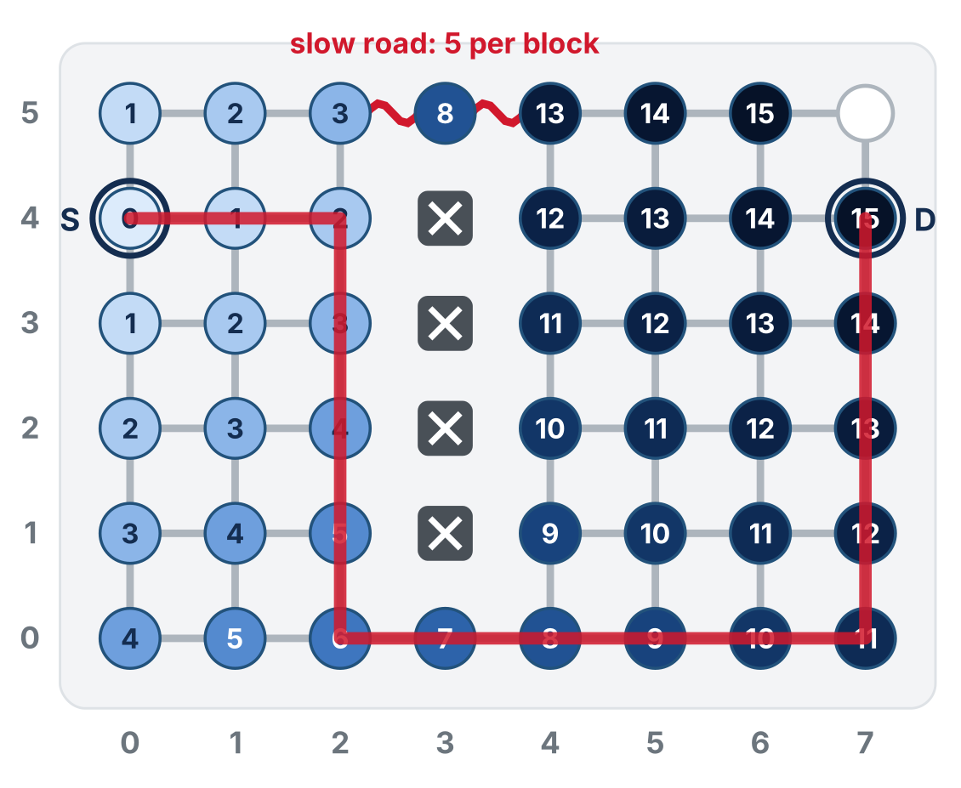
A bigger grid: how the two searches spread
BFS, by steps: over the top, 9 steps, cost 17
Dijkstra, by cost: round the bottom, 15 steps, cost 15
BFS spreads by steps, so the slow road looks like any other street. Dijkstra spreads by cost, so its wave slows down where the road is slow.
Notes:
On the lesson page this is an animation with two buttons, on the 8 by 6 grid from Lesson 5-3: a wall of four blocked intersections at x = 3, a slow road (5 per block) across the top gap, S at (0, 4) and D at (7, 4). These are its two end states: BFS finished and Dijkstra finished. Midway through the Dijkstra run the wave has raced along the bottom to cost 11 while the slow road has only reached the top middle, at 8. On the 4 by 4 floor grid one slow segment changes one number; a bigger grid shows what change 1 does to the shape of the search.

Slide 29
Real-world connections
HISTORY
MAPS
ENGINEERING
1956
Under every route
Upgrade by diff
Edsger Dijkstra designed this in about twenty minutes, in his head, in a cafe, as a demonstration for a new computer. It is still the standard.
Map apps run Dijkstra's algorithm (and descendants of it) over road networks with millions of weighted edges.
Changing two lines of tested code and re-running the tests is how most real improvements ship. The copy you kept is the rollback.

Slide 30
Wrap-up
What are the two changes?
What is distance?
Where do the three planners disagree?
Next: the robot drives the slow grid twice, and the class times both runs
Notes:
Answers: closest first; add the weight and keep the cheaper total. The cheapest cost found so far to each intersection. Walls split off Manhattan; weights split BFS from Dijkstra. Formative: point to the two changed regions in the copy; explain closest(); explain one cell of the cost grid. Exit ticket: "Why does Dijkstra sometimes overwrite previous[neighbor], when BFS never does?" Next: a BFS run and a Dijkstra run on the slow grid, timed.

