Slide 1

MODULE 3 · LESSON 3-2
Driving Multiple Intersections
By the end of this lesson you can
Drive through one intersection to reach the next
Use a for loop to drive a chosen number of intersections
Write drive_intersections(count) from its docstring, test it, and use it
Notes:
40 to 50 minutes. The loop itself is short: the heart of the lesson is tracing where the robot is after each pass.

Slide 2
From the first intersection to the third
Reaching the first intersection is easy
Reaching the third is the same call, three times
That is what a for loop is for
Today "arrive at an intersection" becomes a building block you can repeat a chosen number of times
The first real function in the GRID DRIVING section

Slide 3
Add to robot.py: this lesson's skeleton (1 of 2)
Paste it above RUN, at the end of the GRID DRIVING section. First, one function outline:
# --- Lesson 3-2: a run of intersections ---
# drive_intersections(count) is track_to_intersection() in a
# loop.
# It ends parked on the count-th intersection, so Lessons 3-3
# and 3-4 build every path out of it and the two turns.
def drive_intersections(count):
"""Arrive at count intersections in a row, printing
which one it is each time. Ends parked on the last one
with the sensors past it, ready to turn or to go on."""
pass
Notes:
The skeleton on the lesson page is one block: this slide and the next split it in two to fit.

Slide 4
Add to robot.py: this lesson's skeleton (2 of 2)
Then two tests, right under the function:
def test_two_by_hand():
# track_to_intersection() written out twice, no loop: the
# robot should end parked on the SECOND intersection
pass
def test_drive_run():
# drive_intersections(3), then print that it is done
pass
One function outline and two tests

Slide 5
A docstring, not step comments
The function has a docstring (Lesson 1-12) instead of step comments
The string under the def line says what the function does and what ends it
That's all the help you get: the steps are yours to work out
Keep the docstring when you write the body: it belongs to the function
This lesson tells you enough to write it

Slide 6
Drive a set number with a for loop
Two calls in a row reach two intersections: each one ends with the sensors past the tape (Lesson 2-8), so the next has a line to follow
Writing the call out by hand for each intersection is repetitive, and wrong the moment you want a different number
A for loop over range(count) repeats it a chosen number of times
Same shape as polygon() in Module 1: a loop and a count, packaged into a function with the count as its parameter
Nothing in the loop body changes from pass to pass. The loop variable is only good for the print ("Intersection 1 of 3"), and it starts at 0
No special case for the last intersection: each call ends with the robot's center on the cross, exactly where you want to be

Slide 7
Check your understanding
After two track_to_intersection() calls in a row, where is the robot?
A. Halfway between the second and third intersections
B. Parked with its center on the second intersection, sensors just past it
C. On the first intersection
D. It depends on the battery
Notes:
Answer: B. Older versions of this lesson taught a timed nudge after each intersection, with an if i < count - 1 guard to skip it on the last one. track_to_intersection() now ends with the robot's center on the cross, so there is nothing to skip. Walk the loop with i = 0, 1, 2 on the board and have students say where the robot is after each pass.

Slide 8
Answer
After two track_to_intersection() calls in a row, where is the robot?
A. Halfway between the second and third intersections
B. Parked with its center on the second intersection, sensors just past it
C. On the first intersection
D. It depends on the battery
Each call ends with the robot's center on the cross the sensors just found. Two calls, two intersections, and the robot is sitting on the second one, which is why there is no special case for the last intersection.
Notes:
Answer: B. Older versions of this lesson taught a timed nudge after each intersection, with an if i < count - 1 guard to skip it on the last one. track_to_intersection() now ends with the robot's center on the cross, so there is nothing to skip. Walk the loop with i = 0, 1, 2 on the board and have students say where the robot is after each pass.

Slide 9
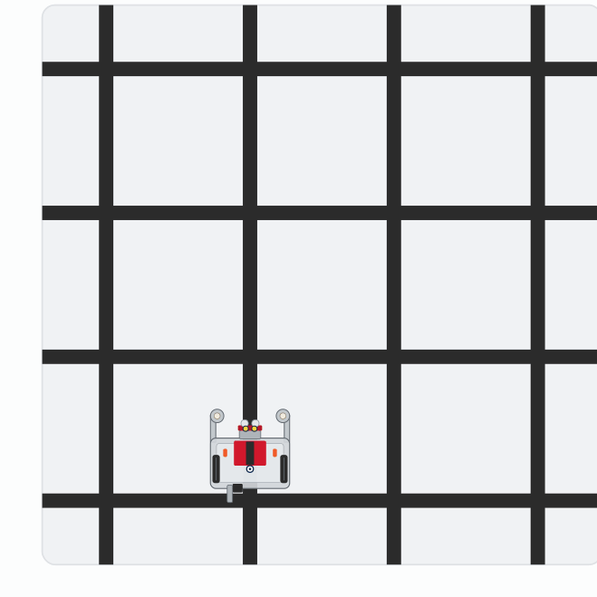
Activity · Two by hand, then the helper
Activity
Watch it run. The next slide picks out the key moments.
Notes:
On the lesson page this is one animation of both tests, with the step running highlighted beside the grid. These are the end of each step.

Slide 10
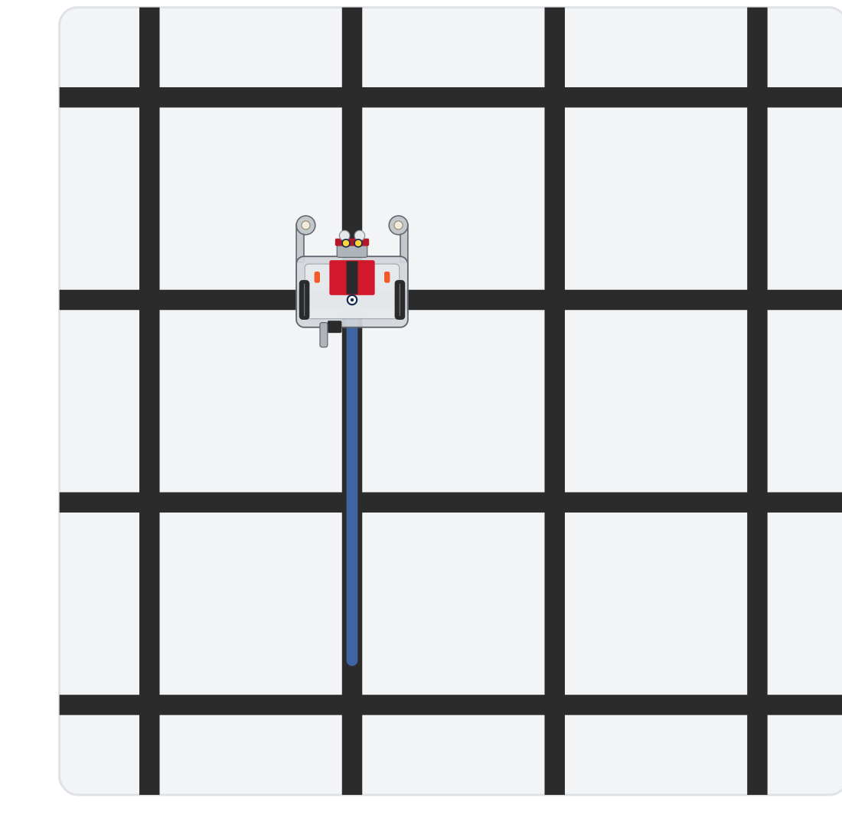
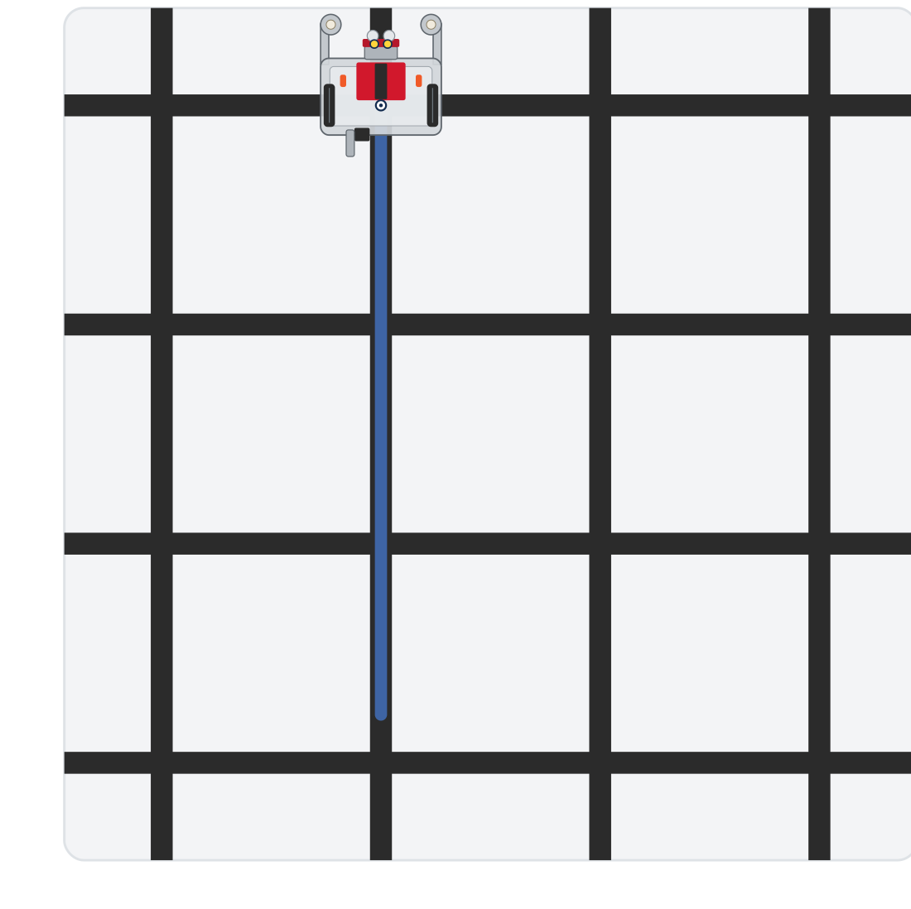
Activity · Two by hand, then the helper
Activity
Step 1: two calls reach the second intersection
Step 2: drive_intersections(3) reaches the third
Every step starts on a line segment, facing the next intersection, with at least three intersections ahead
Notes:
On the lesson page this is one animation of both tests, with the step running highlighted beside the grid. These are the end of each step.

Slide 11
Step 1 · test_two_by_hand()
Activity
Write the body: track_to_intersection() twice, no loop, and a print at the end
1
Set the run line to test_two_by_hand() and run
2
It should end parked on the second intersection. Don't go on until it does
3
Notes:
More support: step 1 already has students write two intersections by hand, two calls, before the loop; some will need to trace it on the board with i = 0, 1, 2 before they write the function.

Slide 12
Step 2 · drive_intersections(count)
Activity
Write the function from its docstring: one parameter, a for loop over it, track_to_intersection() inside, and a print so you can follow along
1
Write the body of test_drive_run(): one call, drive_intersections(3), and a print
2
Set the run line to test_drive_run() and run. It should arrive three times, printing each one, and end parked on the third intersection
3
Then drive_intersections(4) drives four segments in one clean line: the building block of the next two lessons
Notes:
The lesson has a closed reveal with the function; students write and test theirs first. If a student's version has an if in it, ask what it is guarding against. Class-track students call the tracker inside the helper; the helper itself stays a plain function in this section. More challenge: a speed parameter that changes BASE_EFFORT before the loop and restores it after (needs global, Lesson 2-7), or a running count checked against the grid.

Slide 13
Real-world connections
ELEVATORS
MANUFACTURING
TRANSIT
Floor counting
Indexing lines
Counting stops
An elevator counts floor sensors as it rises and stops on the Nth: same detect-and-count idea.
Assembly lines advance a fixed number of steps between stations, clearing each position.
Automated shuttles track how many stops they've passed to know when to pull over.

Slide 14
Wrap-up
What loop drives a set number of segments?
Where is the robot after the last pass?
Next: turns, and L-shaped paths across the grid
Notes:
Answers: a for loop over range(count), with track_to_intersection() inside. Parked on the last intersection: every track ends with the robot's center on the cross. Formative: drive exactly N intersections with a loop. Exit ticket: "Why is there no special case for the last intersection?" (every track ends with the robot's center on the cross, not past it).

