Slide 1

MODULE 3 · LESSON 3-3
Turning on the Grid
By the end of this lesson you can
Sequence drive and turn operations into a path
Turn at intersections with turn_clockwise() and turn_counterclockwise(), and say why the turn pivots on the intersection
Navigate an L-shaped path, as a test function written from a description
Plan a path on paper before you write the code
Notes:
40 to 50 minutes. Sequencing and planning. There is no new function this lesson: a path is calls to what students already have.

Slide 2
Turning corners
You can drive straight along the grid
Now you'll turn corners, sequencing drives and turns to trace an L-shaped path
Any route across a grid is really just a sequence of "drive some segments, turn, drive some more"
A path is a list of drives and turns

Slide 3
Add to robot.py: this lesson's skeleton
Paste it above RUN, at the end of GRID DRIVING. No new function this time: two tests.
# --- Lesson 3-3: turning on the grid ---
# No new function: a path is drive_intersections(), a turn,
# drive_intersections() again. The turn works because the
# helper leaves the wheels parked on the intersection.
def test_l_shape():
# drive 2 intersections, turn right, drive 2 more, then
# print that the L is complete
pass
def test_my_path():
# the path you planned on paper, one leg per line
pass

Slide 4
Drive, turn, drive
Turning a corner on the grid is just like walking city streets
Go to the intersection, then turn
In code: drive_intersections(), then a turn, then drive_intersections() again
Three lines for an L: one per leg or corner

Slide 5
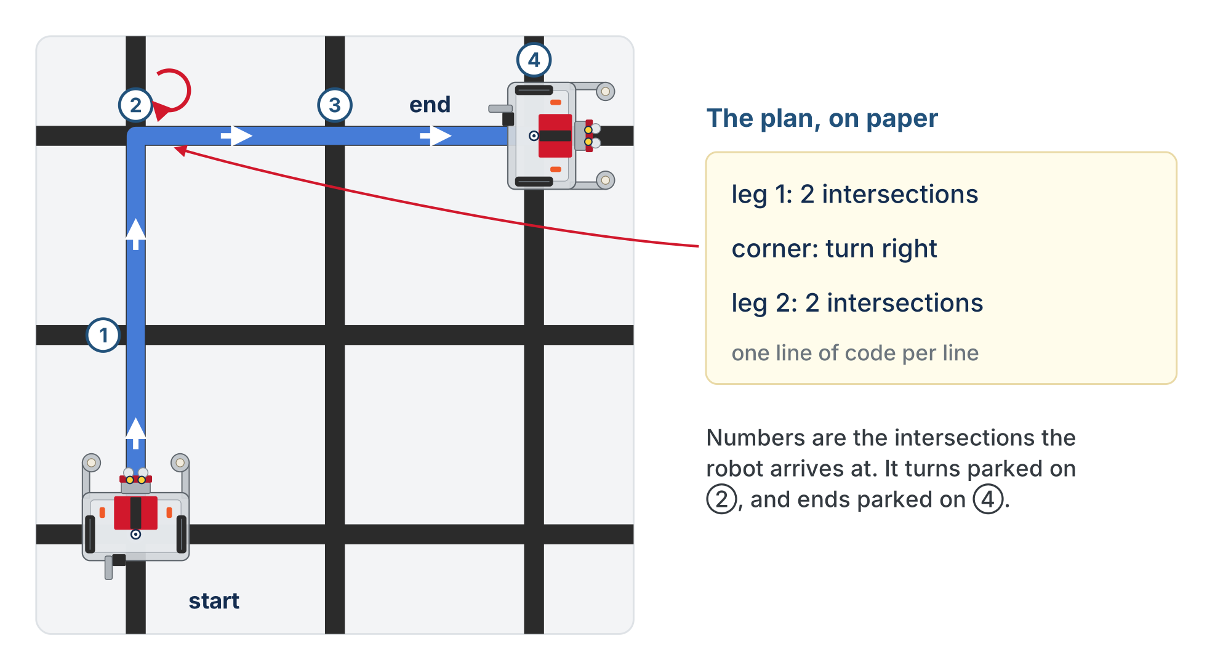
An L-shape
Two intersections, a right turn, two more. The plan beside it is the paper sketch from Step 2.
Notes:
The robot starts parked on the bottom-left intersection, the corner nearest you, facing away from you. The numbers are the intersections it arrives at: it turns parked on 2 and ends parked on 4.

Slide 6
Check your understanding
Which sequence drives an L-shape: two segments, a right turn, then two more segments?
A. First turn_clockwise(), then drive_intersections(2), then drive_intersections(2)
B. First drive_intersections(2), then turn_clockwise(), then drive_intersections(2)
C. drive_intersections(4)
D. turn_clockwise(); turn_clockwise()
Notes:
Answer: B. The lesson writes the first two options as one line of calls separated by semicolons; the slide spells them out with "then" so they fit.

Slide 7
Answer
Which sequence drives an L-shape: two segments, a right turn, then two more segments?
A. First turn_clockwise(), then drive_intersections(2), then drive_intersections(2)
B. First drive_intersections(2), then turn_clockwise(), then drive_intersections(2)
C. drive_intersections(4)
D. turn_clockwise(); turn_clockwise()
Drive to the corner, turn, then continue: the drive/turn/drive order is what makes the L.
Notes:
Answer: B. The lesson writes the first two options as one line of calls separated by semicolons; the slide spells them out with "then" so they fit.

Slide 8
Why the turn lands on the new line
drive_intersections() leaves the robot parked with its center over the last intersection, sensors just past it
That is exactly the position a turn needs
The robot pivots about its center of rotation (Lesson 2-8), so it spins on the intersection
The blind 60° plus the sensor-ended finish from Lesson 2-9 bring the sensors down on the crossing line
After the turn, the next drive_intersections() starts with a line to follow: no extra step in between

Slide 9
Check your understanding
After turn_clockwise(), what has to happen before the next drive_intersections()?
A. A short drive forward to clear the cross
B. Nothing: the turn ends with a sensor on the new line, and the next track follows it
C. A short time.sleep()
D. A second turn to straighten up
Notes:
Answer: B. The rule that trips students up: the robot must be parked on an intersection to turn. You cannot turn mid-segment, and drive_intersections() always leaves it parked.

Slide 10
Answer
After turn_clockwise(), what has to happen before the next drive_intersections()?
A. A short drive forward to clear the cross
B. Nothing: the turn ends with a sensor on the new line, and the next track follows it
C. A short time.sleep()
D. A second turn to straighten up
The turn finishes when is_either_on_line() sees the crossing line. The robot is on the intersection, facing the new direction, with a sensor on tape: ready to track.
Notes:
Answer: B. The rule that trips students up: the robot must be parked on an intersection to turn. You cannot turn mid-segment, and drive_intersections() always leaves it parked.

Slide 11
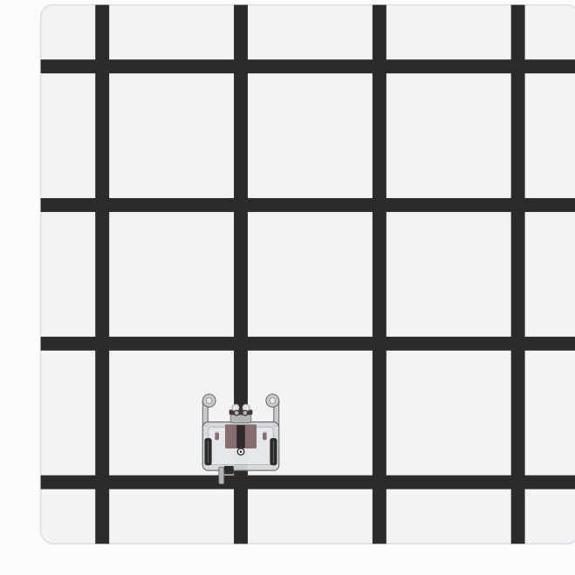
Activity · The L, then a path of your own
Activity
Watch it run. The next slide picks out the key moments.
Notes:
On the lesson page this is one animation: the L from step 1, then the example plan from step 2 from a different start. These are the end of each run.

Slide 12
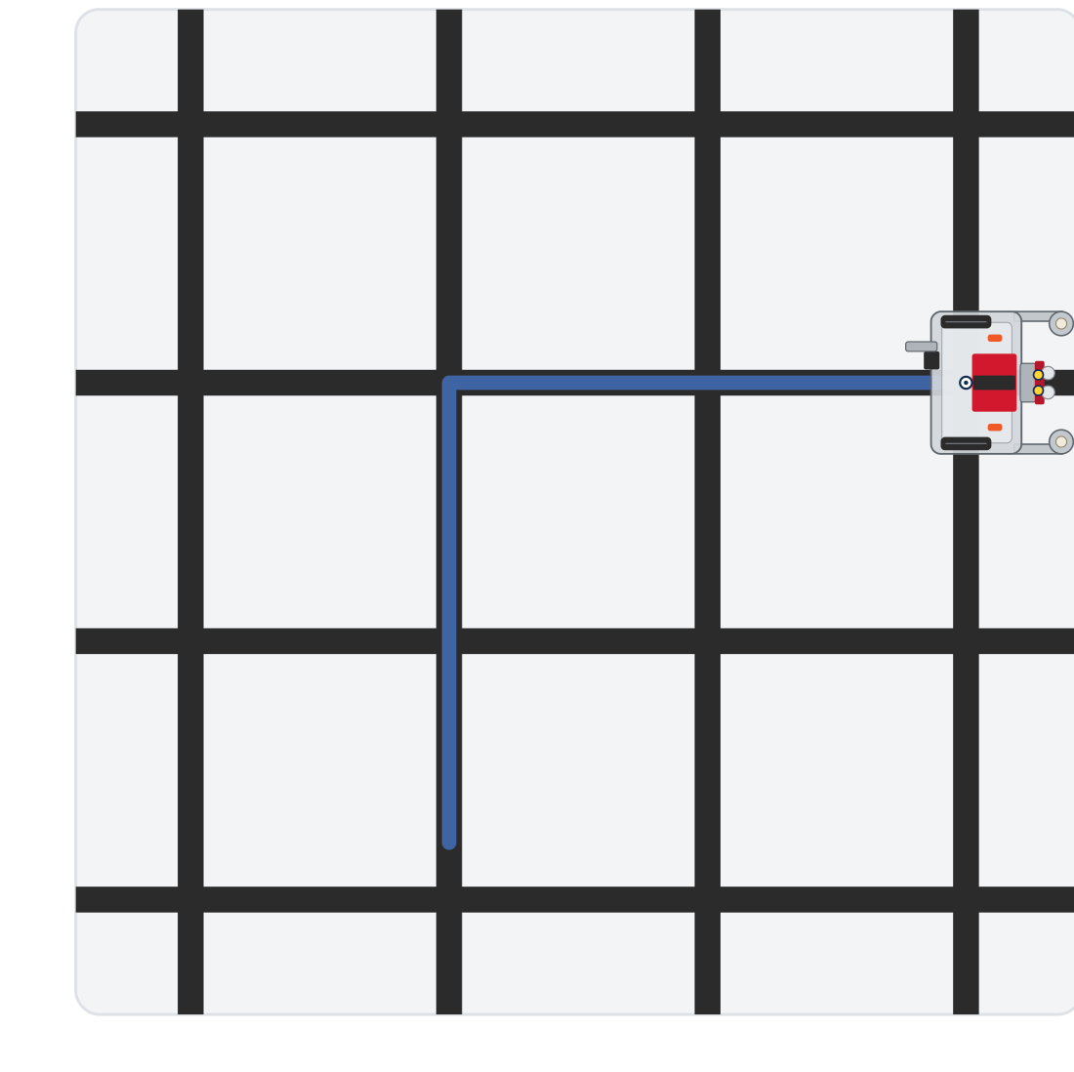
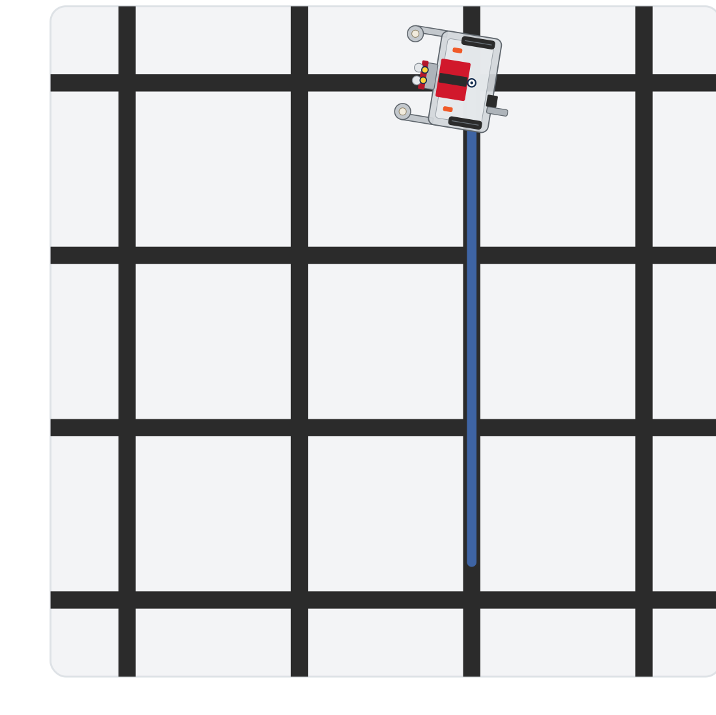
Activity · The L, then a path of your own
Activity
Step 1: the L, parked on the fourth intersection
Step 2 example: three, a left turn, one more
Your own plan in Step 2 will draw something else
Notes:
On the lesson page this is one animation: the L from step 1, then the example plan from step 2 from a different start. These are the end of each run.

Slide 13
Step 1 · test_l_shape()
Activity
Write the body from its comment: three calls and a print
1
Start the robot on a line segment with at least two intersections ahead and room to the right. Set the run line to test_l_shape() and run
2
It should drive two segments, pivot on the second intersection, drive two more, and stop parked on the fourth. Don't go on until it does
3
Notes:
The lesson has a closed reveal with the L; students run theirs first. Class-track students call the turns on the tracker; the helper call is the same for everyone.

Slide 14
Step 2 · Plan on paper, then test_my_path()
Activity
A plan reads like directions: leg 1: three segments; corner: left; leg 2: one segment.
Sketch the path: mark the start, the direction the robot faces, how many segments each leg is, and where the turns go
1
Translate it into test_my_path(), one leg or corner per line, with a comment saying which is which
2
Set the run line to test_my_path() and run. Did the robot end where your sketch says?
3
If not, the sketch and the code disagree somewhere: find the line
Notes:
test_my_path() is the student's own, so there is nothing to check it against but their sketch. Planning on paper first prevents most sequencing mistakes. More support: give students a drawn path and have them write the matching sequence. More challenge: a test_u_turn() (drive, turn right, drive one, turn right, drive), a good reminder that two right turns only reverse direction if you drive a segment between them.

Slide 15
Check your understanding
Starting at the bottom-left corner facing away from you, the robot runs: drive_intersections(3), turn_clockwise(), drive_intersections(2). Where does it end up?
A. Back at the start
B. 3 intersections up from the start, then 2 intersections to the right from there
C. 2 up, then 3 to the right
D. It never turns
Notes:
Answer: B. It drives 3 up, away from you, turns right (now facing right), and drives 2 to the right: an L ending 3 up and 2 across.

Slide 16
Answer
Starting at the bottom-left corner facing away from you, the robot runs: drive_intersections(3), turn_clockwise(), drive_intersections(2). Where does it end up?
A. Back at the start
B. 3 intersections up from the start, then 2 intersections to the right from there
C. 2 up, then 3 to the right
D. It never turns
It drives 3 up, away from you, turns right (now facing right), and drives 2 to the right: an L ending 3 up and 2 across.

Slide 17
Real-world connections
MAPS
WAREHOUSES
MANUFACTURING
Turn-by-turn directions
Pick routes
Toolpaths
"Go 3 blocks, turn right, go 2 blocks" is the same drive/turn sequence you just wrote.
A warehouse robot's route is a list of segment-drives and turns between shelf intersections.
CNC and pick-and-place machines follow planned sequences of moves and direction changes.

Slide 18
Wrap-up
What's the basic shape of any grid path?
What has to come before a turn?
What comes after a turn?
Next: the final project: four drive-and-turn legs in a loop, a complete square
Notes:
Answers: a sequence of drives and turns. An arrival: the robot parked on the intersection. The next drive: a sensor is already on the new line. Formative: sequence drives and turns for a described path, and explain why the turn must wait until the robot is parked on the intersection. Exit ticket: "Write the calls for drive 2, turn left, drive 1."

