Slide 1

MODULE 3 · LESSON 3-4
Final Project
By the end of this lesson you can
Design a test function that drives a closed square path on the grid
Use a for loop to repeat a drive-and-turn sequence
Test and tune a real robot until the path closes
Verify the robot returns to its starting position
Notes:
50 to 60 minutes. The capstone of Module 3 and its summative assessment. Treat it as plan, build, test, present.

Slide 2
Tie the module together
Your robot will drive a complete square on the grid
Two intersections per side, a right turn at each corner, four times
It ends up right back where it started
Same robot.py, no new Python: just your sections, put to work
Everything you need is already in the file

Slide 3
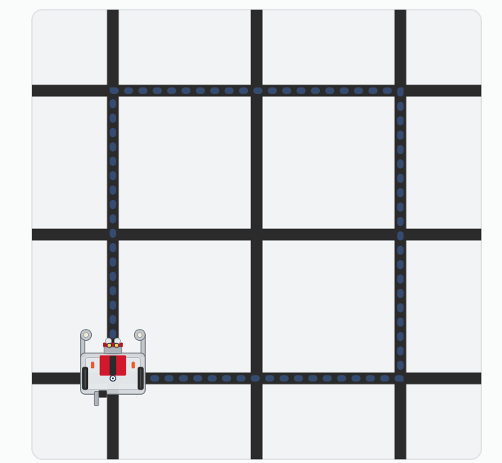
The mission
Watch it run. The next slide picks out the key moments.
Notes:
On the lesson page this is one animation of the whole run, with a panel naming each step: Ready, Side N of 4, Turning right, Square complete. The robot starts parked on the bottom-left corner, nearest you, facing away, and ends there facing the way it began.

Slide 4
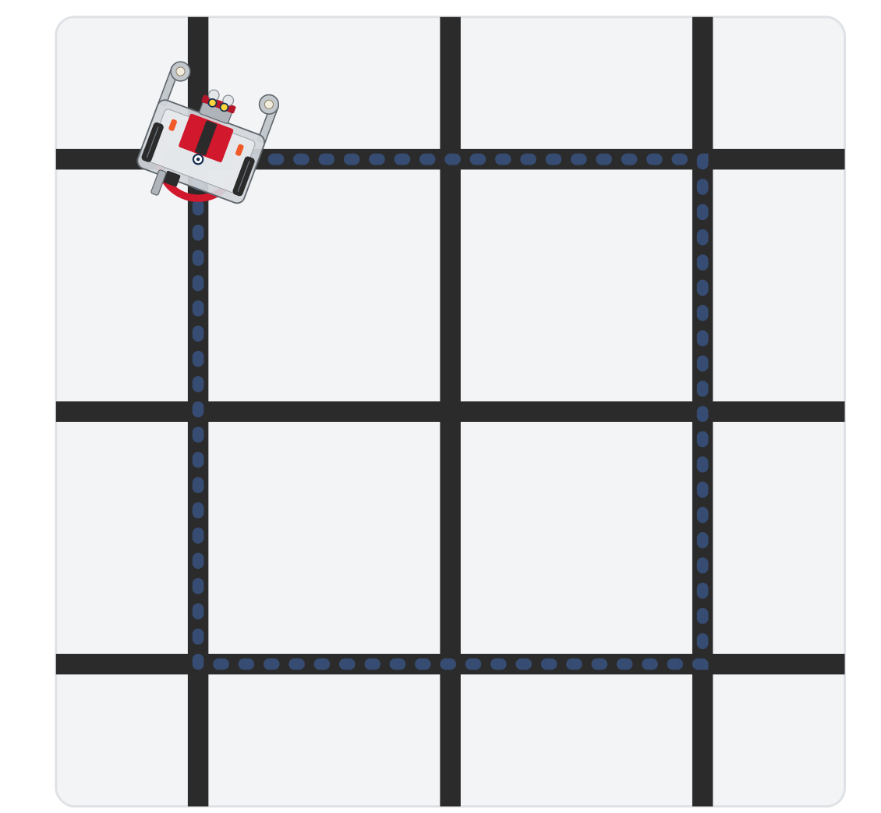
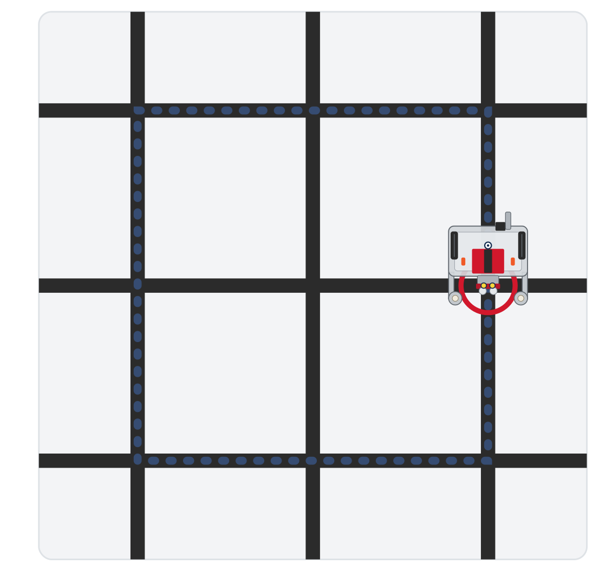

The mission
Side 1 done: turning right at the corner
Side 3 of 4
Square complete: back at the start
Each side is two arrivals at an intersection; each corner is one right turn
Notes:
On the lesson page this is one animation of the whole run, with a panel naming each step: Ready, Side N of 4, Turning right, Square complete. The robot starts parked on the bottom-left corner, nearest you, facing away, and ends there facing the way it began.

Slide 5
Your program must
Use the LINE TRACKING section and drive_intersections() unchanged
Drive the square with a for loop (not four copied blocks)
Print progress
Return to start
These four are what the project is graded on
Notes:
A 50-point rubric works well: using the earlier sections unchanged, using a loop, completing four sides, returning to start, and progress prints.

Slide 6
Add to robot.py: this lesson's skeleton
Paste it above RUN, at the end of GRID DRIVING. One setting and two tests; the second test is the project.
# --- Lesson 3-4: final project, the square ---
# The module project: four sides of SIDE intersections with a
# right turn at every corner, back to the start. Built from
# drive_intersections() and one turn; nothing new is defined.
SIDE = 2 # intersections per side
def test_one_side():
# one side of the square: drive SIDE intersections, then
# turn right
pass
def test_square():
# the project. A for loop that runs one side per pass,
# printing which side it is on; then the finish message
pass
Notes:
`SIDE` is a setting, in capitals like the others, so the size of the square is one number at the top of the sub-section and not a literal buried in a loop.

Slide 7
One loop, four sides
The whole square is a four-iteration loop: each pass drives one side, then turns the corner
The piece that drives a side is drive_intersections(count), built and tested in Lesson 3-2
Sketch the loop body in English first: what happens once per side?
The loop body is two calls and a print or two. If yours is longer, ask what the extra lines are for
Nothing goes between the drive and the turn: the helper leaves the robot parked on the corner, and the turn ends on the next side's line
Notes:
The teacher copy of the solution is on the lesson page, to unstick a team. The loop is the graded work, and there is no student reveal for it. Class-track students call the turn on the tracker.

Slide 8
Four right turns
Each right turn is 90°
Four of them add up to a full 360°
That is why the robot comes back to its starting heading as well as its starting intersection
Back on the start corner, facing the way it began

Slide 9
Check your understanding
The square loop runs turn_clockwise() once per side, four times. How many total degrees does the robot turn?
A. 90°
B. 180°
C. 360°
D. 270°
Notes:
Answer: C. Four right turns × 90° each = 360°: one full rotation, which is why a four-sided loop returns the robot to its starting heading.

Slide 10
Answer
The square loop runs turn_clockwise() once per side, four times. How many total degrees does the robot turn?
A. 90°
B. 180°
C. 360°
D. 270°
Four right turns × 90° each = 360°: one full rotation, which is why a four-sided loop returns the robot to its starting heading.

Slide 11
Activity · Test one side at a time
Activity
Don't run all four sides first. Build up, one test at a time:
One side. Write test_one_side() and set the run line to it. It should drive SIDE intersections, pivot on the corner, and stop facing along the next side. Don't go on until it does
1
Two sides. Write test_square() with range(2) for now. What shape should that give you? Predict, then run
2
Full square. Change it to range(4). Does it close back to the start?
3
Notes:
The lesson has a closed reveal with an animation of what each test should look like; it is left off the slides because it shows the loop running. Insist on incremental testing: one side, then two, then four.

Slide 12
Check your understanding
A student wrote for leg in range(3): and added drivetrain.straight(8.75, 0.5) right before turn_clockwise(). What are the two bugs?
A. Nothing is wrong
B. range(3) makes only 3 sides (needs 4), and the extra drive moves the center of rotation 8.75 cm past the corner
C. turn_clockwise() should be turn_counterclockwise(), and sides should be 4
D. The loop should be a while loop, and print is missing
Notes:
Answer: B. The common fixes are all tuning: turns that aren't quite 90° (the blind part of the turn too long, or TURN_EFFORT too high, so the sensor-ended finish spins past the line), an 8.75 cm distance in track_to_intersection() that doesn't match the robot's sensor-to-axle gap, or too much BASE_EFFORT. Frame that as real engineering. Returning approximately to start is success; a perfectly closed square on real tape is a bonus. Two clean sides already show mastery.

Slide 13
Answer
A student wrote for leg in range(3): and added drivetrain.straight(8.75, 0.5) right before turn_clockwise(). What are the two bugs?
A. Nothing is wrong
B. range(3) makes only 3 sides (needs 4), and the extra drive moves the center of rotation 8.75 cm past the corner
C. turn_clockwise() should be turn_counterclockwise(), and sides should be 4
D. The loop should be a while loop, and print is missing
A square needs range(4). And drive_intersections() already ends with the robot's center on the corner; an extra 8.75 cm moves it off, so the turn pivots in the wrong place.
Notes:
Answer: B. The common fixes are all tuning: turns that aren't quite 90° (the blind part of the turn too long, or TURN_EFFORT too high, so the sensor-ended finish spins past the line), an 8.75 cm distance in track_to_intersection() that doesn't match the robot's sensor-to-axle gap, or too much BASE_EFFORT. Frame that as real engineering. Returning approximately to start is success; a perfectly closed square on real tape is a bonus. Two clean sides already show mastery.

Slide 14
Activity · Extend it
Activity
Once the square works, try a variation:
Variation | What to try
Bigger: 3-per-side square | Set SIDE = 3 for a larger square. Does it still close?
Rectangle: alternating legs | Write test_rectangle(): a list [2, 3, 2, 3] indexed by the loop variable, so opposite sides differ
Mirror: left-turn square | Swap in turn_counterclockwise() to drive the square the other way around
Each variation changes one thing
Notes:
For teams whose square works. On the lesson page these are three cards; the slide makes them a table so the function names fit on one line.

Slide 15
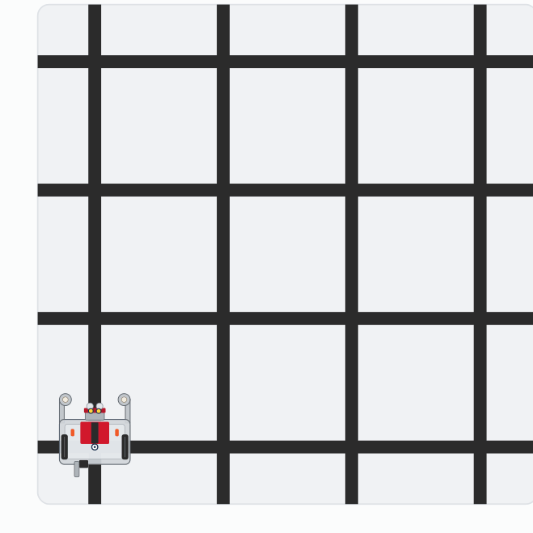
The three extensions
Activity
Watch it run. The next slide picks out the key moments.
Notes:
On the lesson page this is one animation of the three runs. The mirror square starts from the bottom-right corner and goes round counterclockwise.

Slide 16
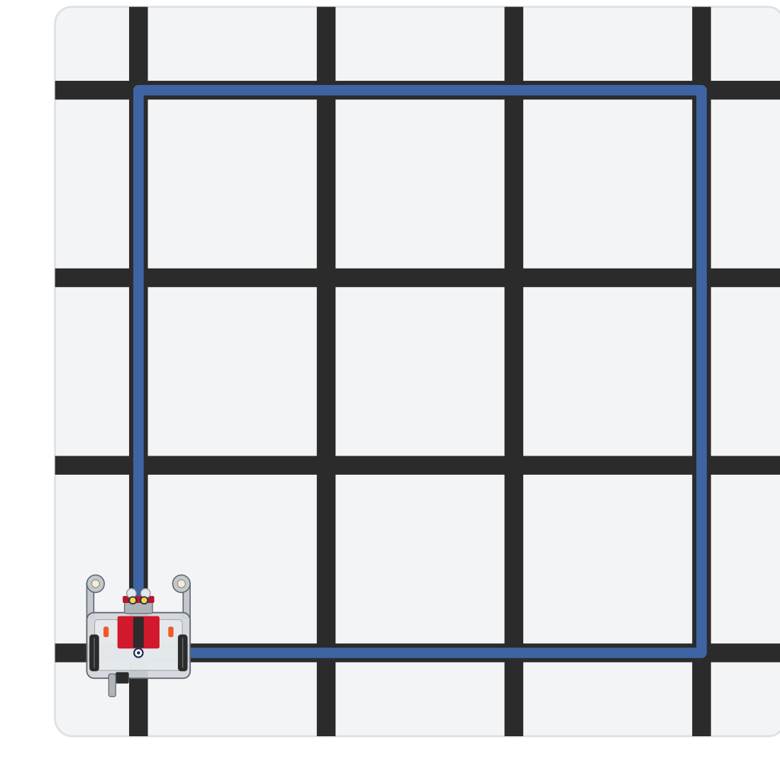
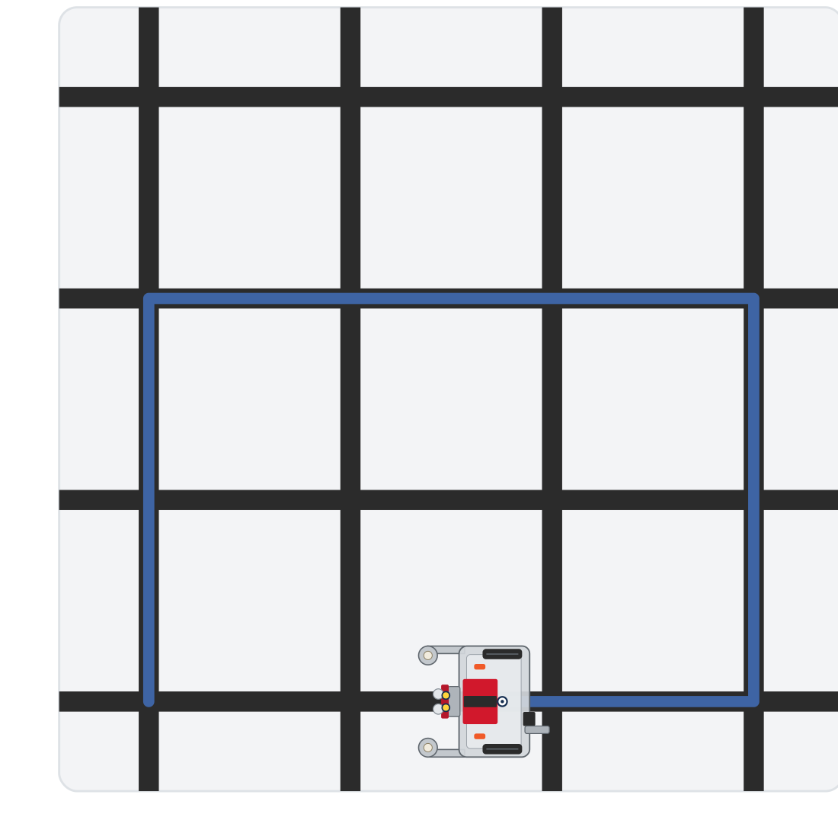
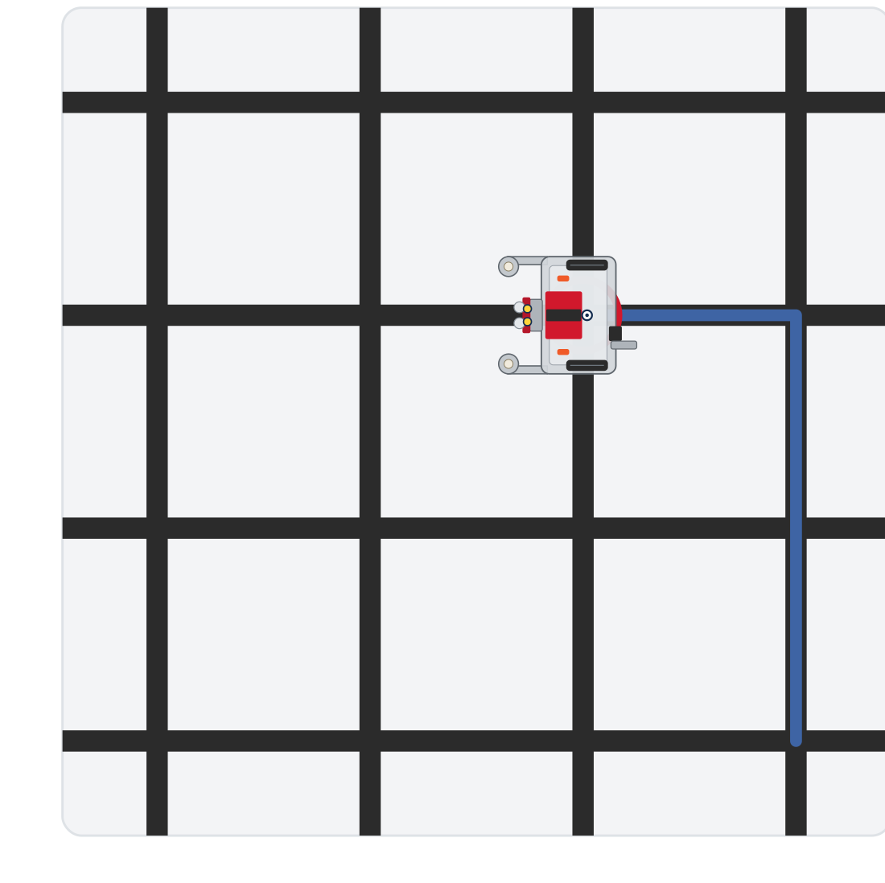
The three extensions
Activity
Bigger: SIDE = 3
Rectangle: 2, 3, 2, 3
Mirror: left turns
Each changes one thing, and still closes on its start corner
Notes:
On the lesson page this is one animation of the three runs. The mirror square starts from the bottom-right corner and goes round counterclockwise.

Slide 17
Activity · Reflect
What was hardest to get working, and how did you fix it?
Why is the for loop better than copying the side code four times?
How is this different from the polygon function in Module 1?
Notes:
Demo the square, then reflect. On the polygon question: there you set distances and angles; here you count intersections and follow real lines.

Slide 18
Nice work: Module 3 done
You reused functions you wrote weeks ago on a brand-new surface
You learned to count intersections, and sequenced drives and turns into real paths
robot.py grew a GRID DRIVING section with one function and a record of every test it passed
Every route here was one you planned and hard-coded. That's about to change.
Notes:
Coming in Module 4, Manhattan Navigation: instead of students hard-coding the path, the computer calculates it. "Go to (2, 3)" means two across and three up from the corner nearest you, and the robot works out the drives and turns itself, using coordinates, tuples and lists, in new sections of the same file. Reward the tuning process in the assessment.

