Slide 1
UrbanFootprint
Module 3: Base Data Preparation and Updating
Materials prepared with funding support from the California Governor’s Office of Planning and Research, and the California Strategic Growth Council, and are copyright 2015 by the California Strategic Growth Council
This Material is Licensed as: Creative Commons Attribution-ShareAlike 4.0.
UrbanFootprint has been developed by and is copyrighted by Calthorpe Analytics

Slide 2
Goals
Describe the required fields for base data
Walk through the steps used for SACOG’s base data preparation.
Work through an example of preparing data for a county.

Slide 3
Base Data Schema: SACOG
The structure and field names are critical.
There is a base land use table, and many supporting tables
Which will be uploaded to PostGIS
For convenience the discussion of fields in the base land use table will be divided into groups
Metadata and Geography
Paint Configuration
Parcel Areas/Types
Residential/Housing
Employment
Building Square footage
Outdoor Irrigated Area

Slide 4
Fields: Metadata and Geography
Field Name | Description
id | UF unique id
geography_id | original geometry id (from SACOG)
wkb_geometry | PostGreSQL geometry field (will not be visible in ArcGIS)
region_lu_code | SACOG land use code
built_form_key | identifier (name of) for building type or place type key
created | date of data creation/import into UF system
updated | date of data change or modifiction within UF system

Slide 5
Fields: Paint Configuration
These fields are not used in the base features dataset, but are included to maintain an identical structure to the End State data.
Field Name | Description
dev_pct | development percent - proportion of geography receiving building type or place type application
density_pct | density percent - proportional intensity of building type or place type application
gross_net_pct | gross-to-net percent - proportion of developed acreage that receives building type or place type application
clear_base_flag | bullion field to indicate clearance of development program (removal of all base year dwelling units and employees)
redevelopment_flag | bullion field to indicate/track redevelopment on geography
dirty_flag | used internally by UF during paint application

Slide 6
Fields: Parcel Area/Type
Field Name | Description
intersection_density_sqmi | density of walkable street intersections in the geography (calculated as a weighted square mile density)
acres_gross | gross/total acreage of the geography
acres_parcel | gross/total acreage of the parcel(s)
sqft_parcel | parcel square footage
acres_parcel_res | residential acreage of the parcel
acres_parcel_res_detsf_sl | acreage of parcel with single family small lot detached homes (<5500sf)
acres_parcel_res_detsf_ll | acreage of parcel with single family large lot detached homes (>5500sf)
acres_parcel_res_attsf | acreage of parcel with single family attached homes/townhomes
acres_parcel_res_mf | acreage of parcel with multifamily housing
acres_parcel_emp | acreage of parcel with employment
acres_parcel_emp_off | acreage of parcel with office employment
acres_parcel_emp_ret | acreage of parcel with retail employment
acres_parcel_emp_ind | acreage of parcel with industrial employment
acres_parcel_emp_ag | acreage of parcel with agricultural employment
acres_parcel_emp_mixed | acreage of parcel with mixed employment uses
acres_parcel_emp_military | acreage of parcel with military employment
acres_parcel_mixed | acreage of parcel with mixed use (residential and employment)
acres_parcel_mixed_w_off | acreage of mixed use parcels with residential and employment (includes office employment)
acres_parcel_mixed_no_off | acreage of mixed use parcels with residential and employment (no office employment
acres_parcel_no_use | acreage of parcel with no use

Slide 7
Fields: Residential/Housing
Field Name | Description
hh | households
du | dwelling units
du_detsf | detached single family dwelling units
du_detsf_sl | detached single family small lot dwelling units
du_detsf_ll | detached single family large lot dwelling units
du_attsf | attached single family dwelling units
du_mf | multifamily dwelling units
du_mf2to4 | units in multifamily buildings with 2 to 4 dwelling units
du_mf5p | units in multifamily buildings with 5 or more dwelling units

Slide 8
Fields: Employment
Field Name | Description
emp | number of employees
emp_ret | number of retail employees
emp_retail_services | number of retail services employees
emp_restaurant | number of restaurant employees
emp_accommodation | number of accommodation employees
emp_arts_entertainment | number of arts and entertainment employees
emp_other_services | number of other services employees
emp_off | number of office employees
emp_office_services | number of office services employees
emp_public_admin | number of public administration employees
emp_education | number of education employees
emp_medical_services | number of medical services employees
emp_ind | number of industrial employees
emp_manufacturing | number of manufacturing employees
emp_wholesale | number of wholesale employees
emp_transport_warehousing | number of transportation and warehousing employees
emp_utilities | number of utilities employees
emp_construction | number of construction employees
emp_ag | number of agricultural/extration employees
emp_agriculture | number of agricultural employees
emp_extraction | number of extraction employees
emp_military | number of military employees

Slide 9
Fields: Building Square Footage
Field Name | Description
bldg_sqft_detsf_sl | building square footage of detached single family small lot homes
bldg_sqft_detsf_ll | building square footage of detached single family large lot homes
bldg_sqft_attsf | building square footage of attached single family homes/townhomes
bldg_sqft_mf | building square footage of multifamily units
bldg_sqft_retail_services | building square footage of retail services
bldg_sqft_restaurant | building square footage of restaurants
bldg_sqft_accommodation | building square footage of accommodation
bldg_sqft_arts_entertainment | building square footage of arts and entertainment
bldg_sqft_other_services | building square footage of other services
bldg_sqft_office_services | building square footage of office services
bldg_sqft_public_admin | building square footage of public administration
bldg_sqft_education | building square footage of education
bldg_sqft_medical_services | building square footage of medical services
bldg_sqft_transport_warehousing | building square footage of transportation and warehousing
bldg_sqft_wholesale | building square footage of wholesale

Slide 10
Fields: Outdoor Irrigated Area
Field Name | Description
residential_irrigated_sqft | residential outdoor irrigated square feet
commercial_irrigated_sqft | commercial outdoor irrigated square feet

Slide 11
Processing Steps

Slide 12
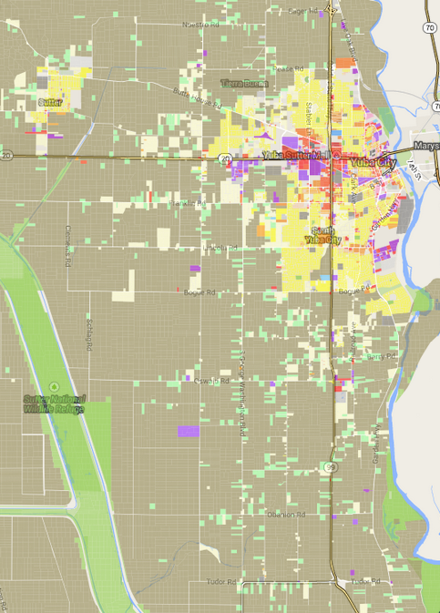
Input Data
SACOG parcel data
SACOG Land Use
Dwelling Units
SACOG TAZ
Census 2010 Blockgroups
Census 2010 Tracts

Slide 13
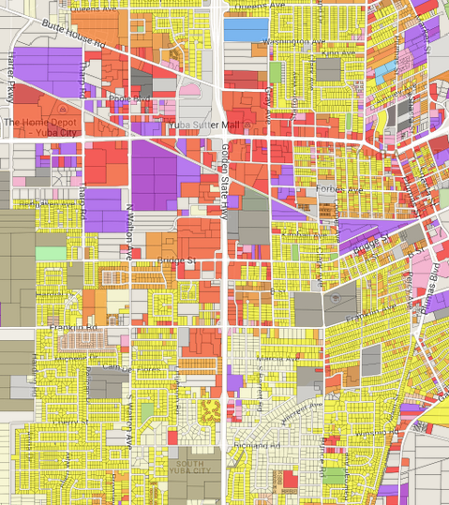
Data Preparation: Topology
Parcels must not overlap
Clip the dataset to the county border
Remove roads and waterbodies

Slide 14
Dwelling Units
Total DU = SACOG Parcel DU
Controlled to TAZ totals
Assign DU type using crosswalk (right), and assign DU totals to du_detsf
Du_detsf_sl and du_detsf_ll based on sf/du calculation.
ACS rates for Attached SF, MF 2-4, and MF 5 plus are applied to all parcels with MF units
TAZ
SACOG Use Code | Dwelling Unit Type
Rural Residential | Single Family
Farm Home | Single Family
Very Low Density Res. | Single Family
Low Density Res. | Single Family
Large Lot Not Farm Home | Single Family
Medium Density Res. | Multifamily
Medium-High Density Res. | Multifamily
High Density Res | Multifamily
Urban Residential | Multifamily
Notes:
Calculation notes:
For each TAZ take the total number of DU (from the TAZ) and divide it by the total number of DU in parcels that intersect the TAZ. This give a per TAZ control value.
Each parcel’s DU total is then multiplied by the control value for that TAZ.
All parcels with Use Codes that translate to Single Family have their DU total assigned to du_detsf.
For all Single Family parcels calculate square feet/du.
If square feet/du > 5500 calculate du_detsf_ll = du_detsf
If square feet/du < 5500 calculate du_detsf_sl = du_detsf
Calculate the ACS rates for Attached SF, Multifamily 2-4, and Multifamily 5+ using ACS data for the block group.
All parcels with Use Codes that translate to Multifamily have their DU total multiplied by the ACS rates to create the du_attsf, du_mf, du_mf2to4, and du_mf5p.

Slide 15
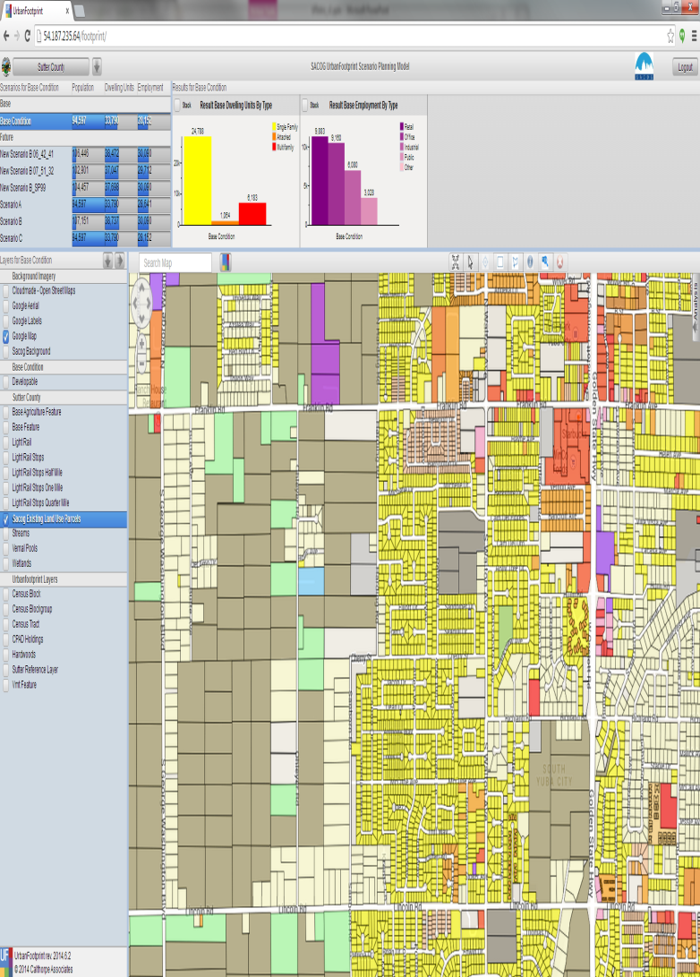
Households
HH from SACOG 2008
DU from Parcel Data
Occupancy rate = HH/DU

Slide 16
Population
Calculate Average HH by block group from census data
Ave. HH size = pop/hh
Then multiply the HH count in each parcel by the Ave. HH size.

Slide 17
Employment
Retail
emp_retail_services | 44‐45: Retail Trade
emp_restaurant | 72*: Food Services (does not include accommodation jobs)
emp_accommodation and Boarding Houses | 7211‐7213: Traveler Accommodation, RV Parks, Rooming
emp_entrec | 71: Arts, Entertainment and recreation
emp_other_services | 81: Other Services
Office
emp_office_services | 51‐56: Information, FIRE, Professional, Management/Admin
emp_education | 61: Education Services
emp_medical_services | 62: Health Care and Social Assistance
emp_public_admin | 92: Public Administration
Industrial
emp_manufacturing | 31‐33: Manufacturing
emp_transport_warehousing | 48‐49: Transportation and Warehousing
emp_utilities | 22: Utilities
emp_wholesale | 42: Wholesale Trade
emp_construction | 23: Construction
Agricultural
emp_agriculture | 11: Agriculture, Forestry, Fishing and Hunting
emp_extract | 21: Mining
Military
emp_military | 9281: National Security and International Affairs
SACOG Category | UrbanFootprint Employment Category
EmpGov | Emp_Public_admin
EmpOfc | Emp_Office_services
EmpMed | Emp_Medical_services
EmpEdu | Emp_Education
EmpRet | Emp_Retail_services
EmpFood | Emp_Restaurant
EmpSvc | Emp_Entrec, Emp_Othe_services, Emp_Accomodation
EmpInd | Emp_Utilities, Emp_Transware, Emp_Warehouse, Emp_Wholesale, Emp_Construction, Emp_Manufacturing, Emp_Agriculture, Emp_Extract
EmpOth | Emp_military
Parcel employment from SACOG 2008
Crosswalk using the table
Use LEHD to disaggregate where needed. (next page)
Accommodation extracted using SACOG Employment Inventory

Slide 18
Employment Source and Processing
UF Employment Sub Category | Method For Spatially Deriving Field at Parcel | SACSIM Category
Emp_Public | Direct Crosswalk from SACSIM Category | EmpGov
Emp_Office | Direct Crosswalk from SACSIM Category | EmpOfc
Emp_Medss | Direct Crosswalk from SACSIM Category | EmpMed
Emp_Educ | Direct Crosswalk from SACSIM Category | EmpEdu
Emp_Retail | Direct Crosswalk from SACSIM Category | EmpRet
Emp_Restaurant | Direct Crosswalk from SACSIM Category | EmpFood
Emp_Entrec | LEHD 2010 Near Imputed Rate (Block) | EmpSvc
Emp_Other | LEHD 2010 Near Imputed Rate (Block) | EmpSvc
Emp_Accommodation | SACOG Employment Inventory | EmpSvc
Emp_Transware | LEHD 2010 Near Imputed Rate (Block) | EmpInd
Emp_Warehouse | LEHD 2010 Near Imputed Rate (Block) | EmpInd
Emp_Whole | LEHD 2010 Near Imputed Rate (Block) | EmpInd
Emp_Constr | LEHD 2010 Near Imputed Rate (Block) | EmpInd
Emp_Manuf | LEHD 2010 Near Imputed Rate (Block) | EmpInd
Emp_Agriculture | LEHD 2010 Near Imputed Rate (Block) | EmpInd
Emp_Extract | LEHD 2010 Near Imputed Rate (Block) | EmpInd
Emp_AF | Direct Crosswalk from SACSIM Category | EmpOth

Slide 19
Disaggregation
Dataset 1 (higher accuracy): 95 employees
Dataset 2: 50 retail, 30 service, and 20 industrial employees.
Concerns: Zeros and Nulls
Total Emp | Ret. % | Ser. % | Ind. % | # Ret. | # Ser. | # Ind
95 | 50 | 30 | 20 | 47.5 | 28.5 | 19
Notes:
This is a complex process, but not one that needs to be a show stopper.
Example:
Dataset 1 says that there are 95 employees. Dataset 2 which has a lower reliability (Like ACS data) says that there are 50 retail, 30 service, and 20 industrial employees in that area. We calculate the proportions of employees by type from dataset 2. 50% of the employees are residential 30% service, and 20% industrial. These percentages are then multiplied by the total number of employees in dataset 1 to get the number of employees in each type (47.5 ret, 28.5 service, and 19 industrial).

Slide 20
Disaggregation
This technique is used several times.
Calculate the proportion of each SACOG category that goes into each UF Employment Category.
Use the LEHD 2010 near imputed rate dataset.
i.e. %emp_entrec = 100*emp_entrec/
(emp_entrec+emp_other_services+emp_accomodation)
Notes:
This is a complex process, but not one that needs to be a show stopper.
Note the table in the previous page.
Many of the employment types are copied across directly. All of these are labeled as “Direct Crosswalk…”
Emp_accommodation is also copied directly from the employment inventory
Other require a little bit of work, but let’s break it down.
Each of the employment types labeled as using the “LEHD 2010 Near Imputed…” may need a little bit of preparation work. Let’s work through an example
Emp_entrec (entertainment and recreation) is represents a percentage of the Emp_services total provided by the SACOG parcels.
That percentage is determined using the LEHD dataset. Emp_entrec = (Emp_services* entrec/(entrec + other + accommodations) where entrec, other, and accommodations are totals from LEHD’s block data.
So, we need to calculate the percentage for each of the needed employment types for each block, which can be accomplished by adding a new field, and using the field calculator to apply the calculation to all of the blocks in the region.
These are then joined spatially to the parcels and applied to the proper employment totals in each parcel.

Slide 21
Building Square Footage
Assessor’s Data
Assumed FAR
Commercial Data Sources

Slide 22
Irrigated square footage
Averages by Place Type
Estimates from other data sources (Remote sensing)

Slide 23
Alternate Method: SANDAG
Base Schema
Expanded compared to SACOG
Includes HH income
Population Educational Attainment
Data Sources
2012 parcels, have DU and land use
2012 EDD employment points with 2-4 digit NAICS codes
MGRA with Pop (by gender and age), and Households by income category
ACS Data (5 year block group and 1 year PUMS)
Notes:
SANDAG’s base condition schema is larger than SACOG’s, They also have some advantages in data availability and consistency. SANDAG is a single county and they have existing substantial countywide data holdings including more detailed employment than is generally available.
Overall, the process is similar to that of SACOG’s. The parcel data serves as the primary spatial unit, and already has Dwelling Units (DU) and land use type associated with it. Employment points from the EDD with detailed employment categories are then spatially joined to the parcels and reclassified.
Master Geographic Area (MGRA) data provided control totals for households and population that were then disaggregated using the ACS’s PUMS and Block Group data.
The PUMS data was used to create county wide proportions of the employment categories for disaggregation.
Block group

Slide 24
Loading Base Data into UrbanFootprint
Load into a staging database (PostGIS)
Upload via ftp (see installation instructions)
Build into UrbanFootprint (see installation instructions)

Slide 25
Keep the Goal in Mind
Data for your region will be unique
This process should serve as a starting point for developing your data, not a fixed recipe.

Slide 26
Exercise
Download XXXX
And unzip it into a folder.
Inside the folder here will be a mxd and folders with data and scripts
We’re going to step through the scripts.

Slide 27

For more information:
http://urbanfootprintcurriculum.readthedocs.org/en/latest/datapreparation.html

