Slide 1
UrbanFootprint
Module 3: Analysis Modules
Materials prepared with funding support from the California Governor’s Office of Planning and Research, and the California Strategic Growth Council
This Material is Licensed as:
UrbanFootprint has been developed by and is copyrighted by Calthorpe Associates

Slide 2
Goals
Review the Analysis Modules and How they work
We will be covering calibration and customization only lightly

Slide 3
Outline
Land Consumption
Energy and Water
Household Costs
Local Fiscal Impacts
Transportation
Public Health
GHG

Slide 4
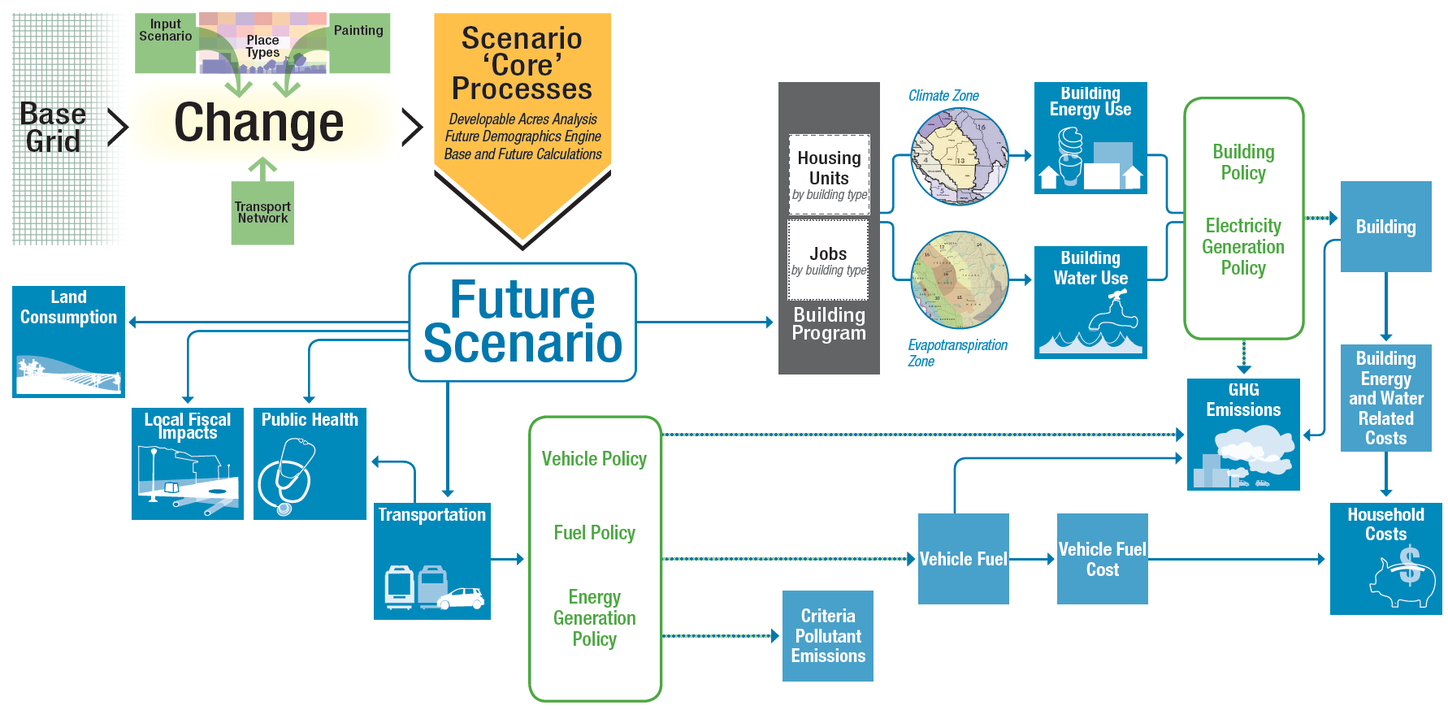
Analysis Modules

Slide 5
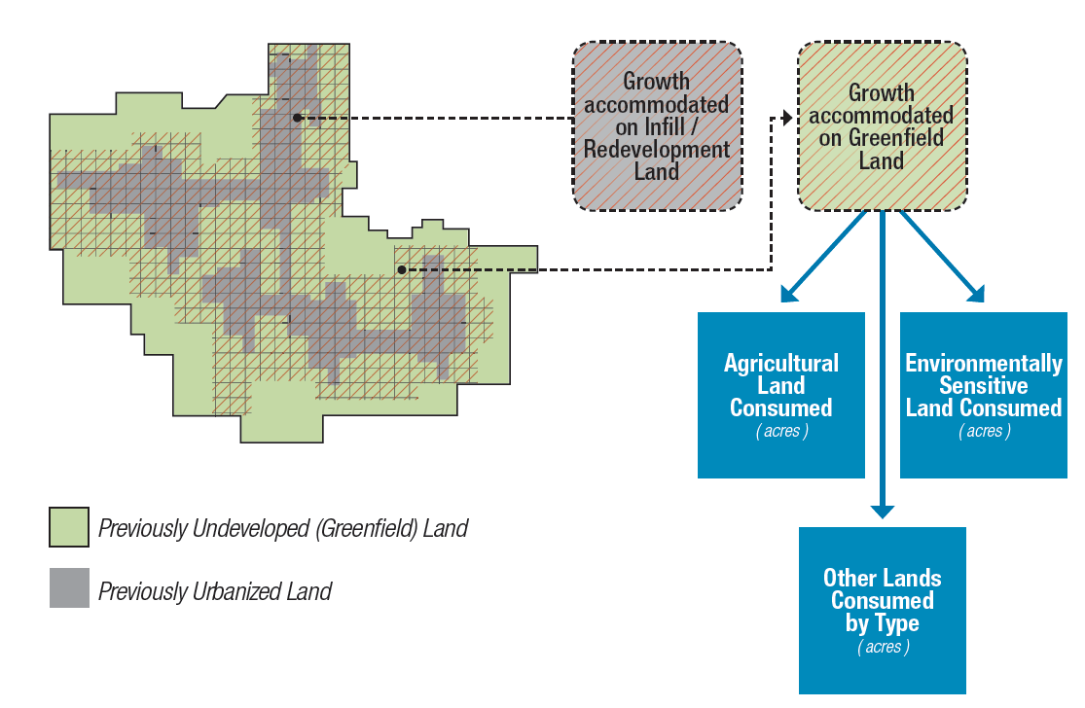
Land Consumption
Notes:
UrbanFootprint identifies the amount of greenfield land consumed based on the base case, and then evaluates that new consumption against environmental constraint, agricultural, or other defined land types.

Slide 6
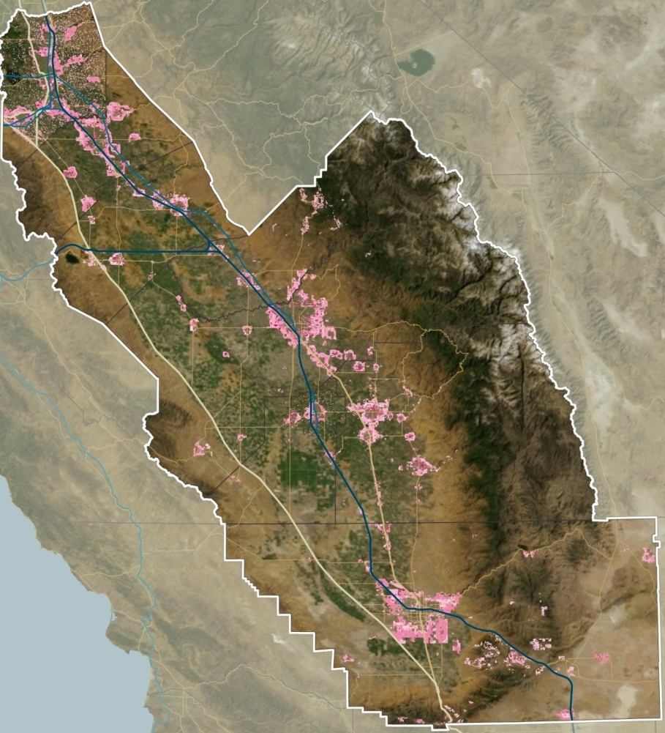
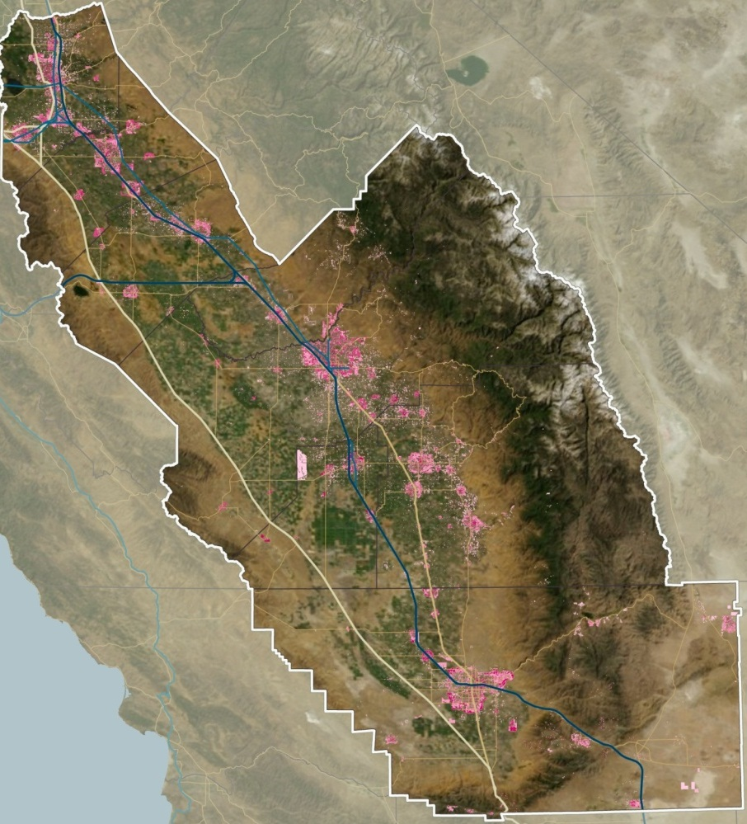


SJV Land Consumption
Business As Usual
Compact Future
Comparison of SJV Blueprint Scenarios A and B+

Slide 7
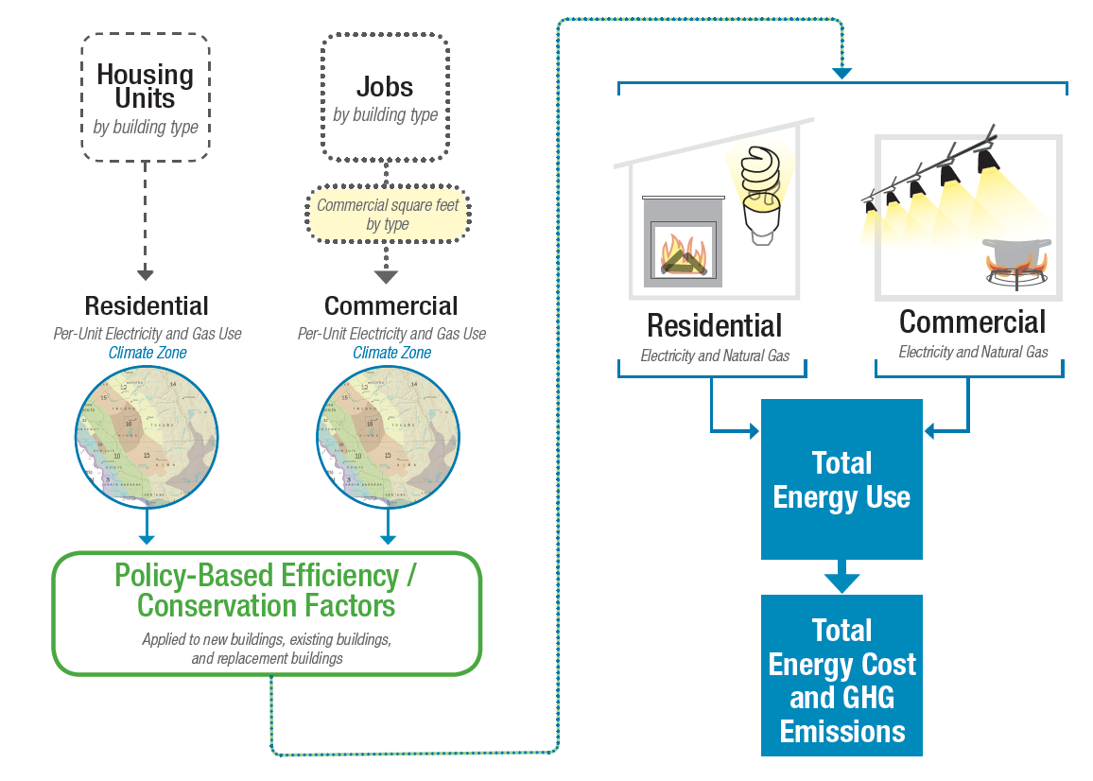
Building Energy Use
Notes:
Each building type in UrbanFootprint consumes a baseline amount of energy based on its location and designated policy factors. Residential energy use is computed based on each dwelling unit, by type, and commercial by their square footage by usage (i.e. retail, office, industrial…).
The location determines which climate zone the building is in, and that determines the baseline energy consumption.
Baseline energy consumption is assumed to be fixed with the exception of an incremental improvement in efficiency over time. Buildings present in at the base line year, can have a rate of retrofitting or replacement (with the same building type) which improve those building’s energy efficiency.
New buildings constructed through the scenario have policy driven baseline improvements in energy efficiency and then are also subject to rates of retrofitting and replacement.
Energy policy options are implemented through applying rates of improvement in baseline efficiency to buildings that are either new construction or are retrofitted, with new construction (or major retrofits) being a full update to the projected energy efficiency at the time of construction and retrofits being a significant improvement over the baseline efficiency that the building had prior to retrofit.
After generating total energy used, assumed costs for electricity and natural gas can be applied allowing the calculation of energy costs.

Slide 8
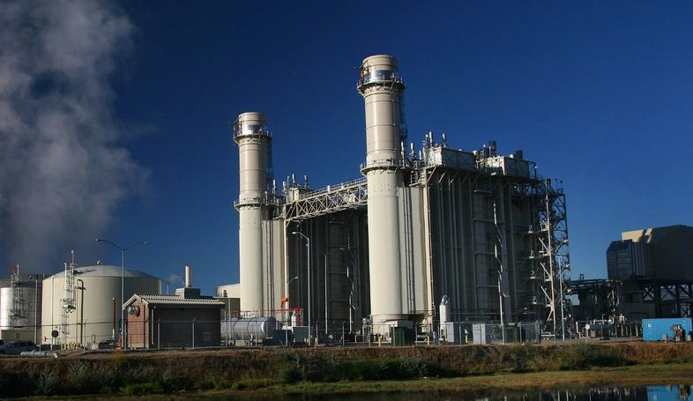
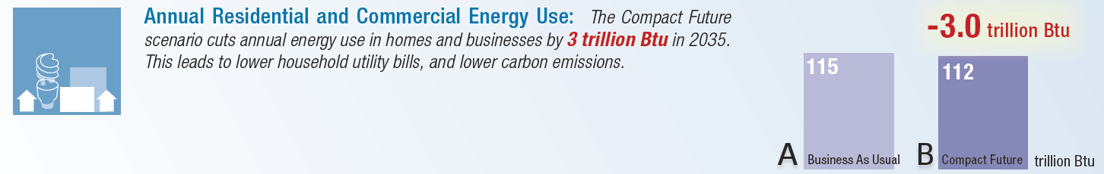
SACOG Building Energy Use

Slide 9
Water
Water impacts follow a very similar path to Energy.
Building type and climate zone determine water used both indoor and outdoor
Indoor water usage is estimated per-capita by building type
Outdoor water usage is estimated per square foot of irrigated outdoor space adjusted by the climate zone.

Slide 10
Water-Energy
Needs Detail

Slide 11
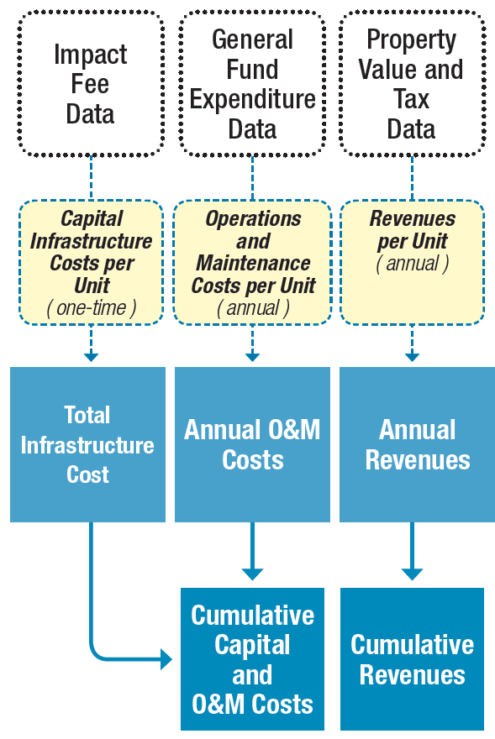
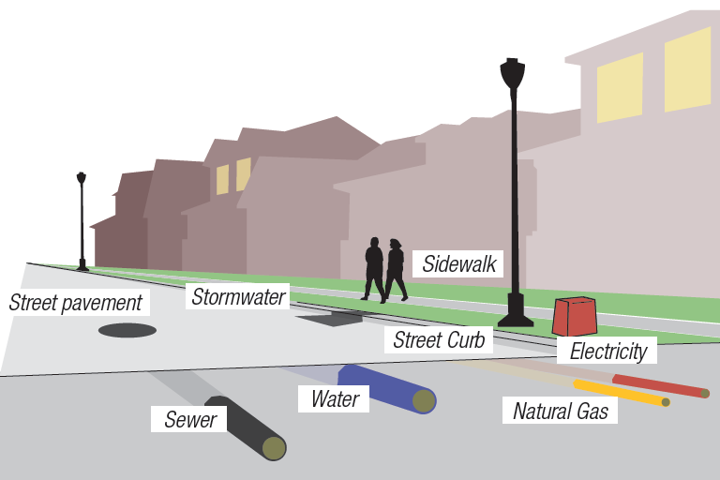
Local Fiscal Impacts
Next Steps
Regional Assumptions Research
IMPACS Model Integration
Notes:
Fiscal impact analysis divides the build landscape across two axes. Urban, compact, or standard developments (Land Development Class or LDC) and refill or greenfield construction.
Urban is high density development characterized by city centers
Compact is a highly walkable, mixed use urban form
Standard includes most suburban, auto-oriented construction.
Infrastructure costs are calculated per residential unit by type, LDC, and greenfield or refill type [and per square foot of commercial by type] Need clarification. Infrastructure costs are assumed to be a one time cost. And include the installation of transportation, water, and wastewater facilities.
Operations & Maintenance costs are long term infrastrucutre related costs assessed over time on a per residential unit basis by building type and LDC.
Local Renues include the projected property tax, property transfer, and vehicle license fees based on the building type and LDC. I.e. Urban areas have lower vehicle ownership and the estimates reflect that in the vehicle license fees.

Slide 12
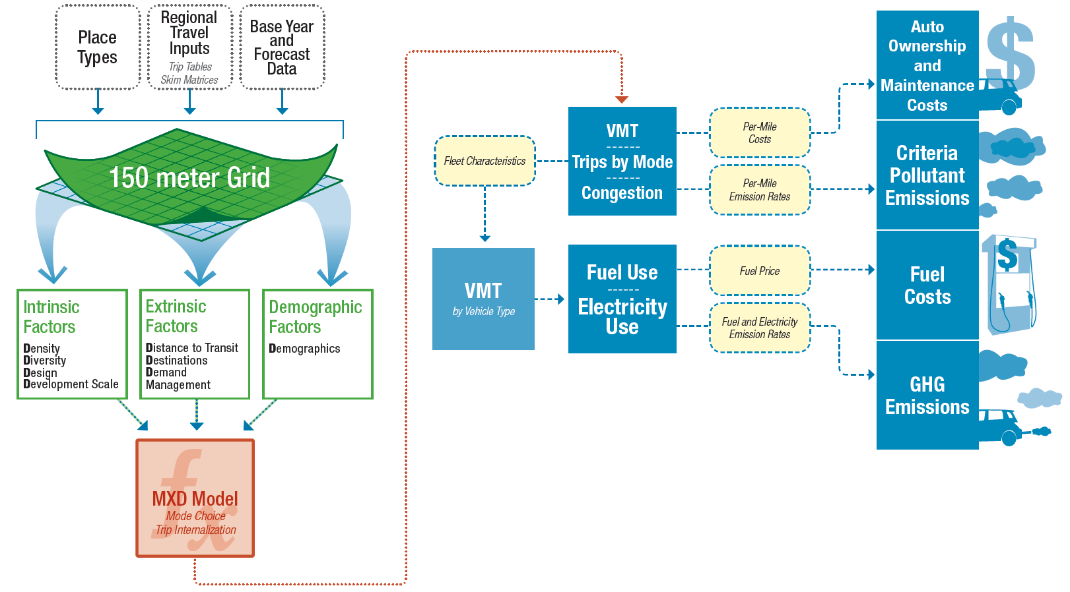
Transportation
‘8-D’ Sketch Travel Model
Notes:
Transportation is the most complex component.
Put simply, UrbanFootprint builds a picture of the land use and accessibility surrounding each housing unit and applies an enhanced version of the MXD model developed by Fehr & Peers with EPA funding to appropriately scale per capita VMT estimates drawn from a local transportation model up or down as the land use mixture changes.
These results are then fed into a secondary model that applies projections of future vehicle fleet mixtures and efficiencies to obtain estimates of the quantity and types of energy used to power the fleet, the number and length of trips made, the pollutants emitted, and the costs both for fuel and vehicle O & M.

Slide 13
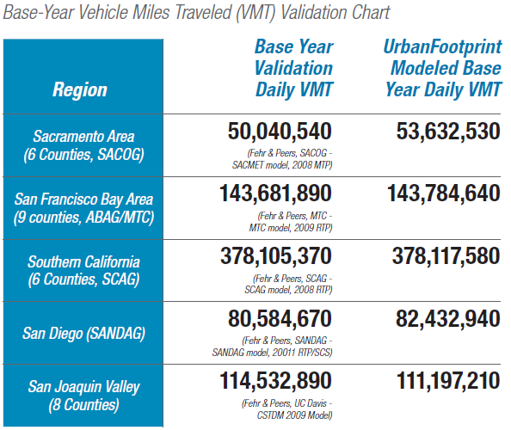
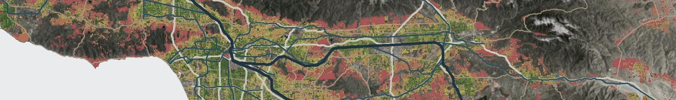

Travel Model Verification
UrbanFootprint

Slide 14
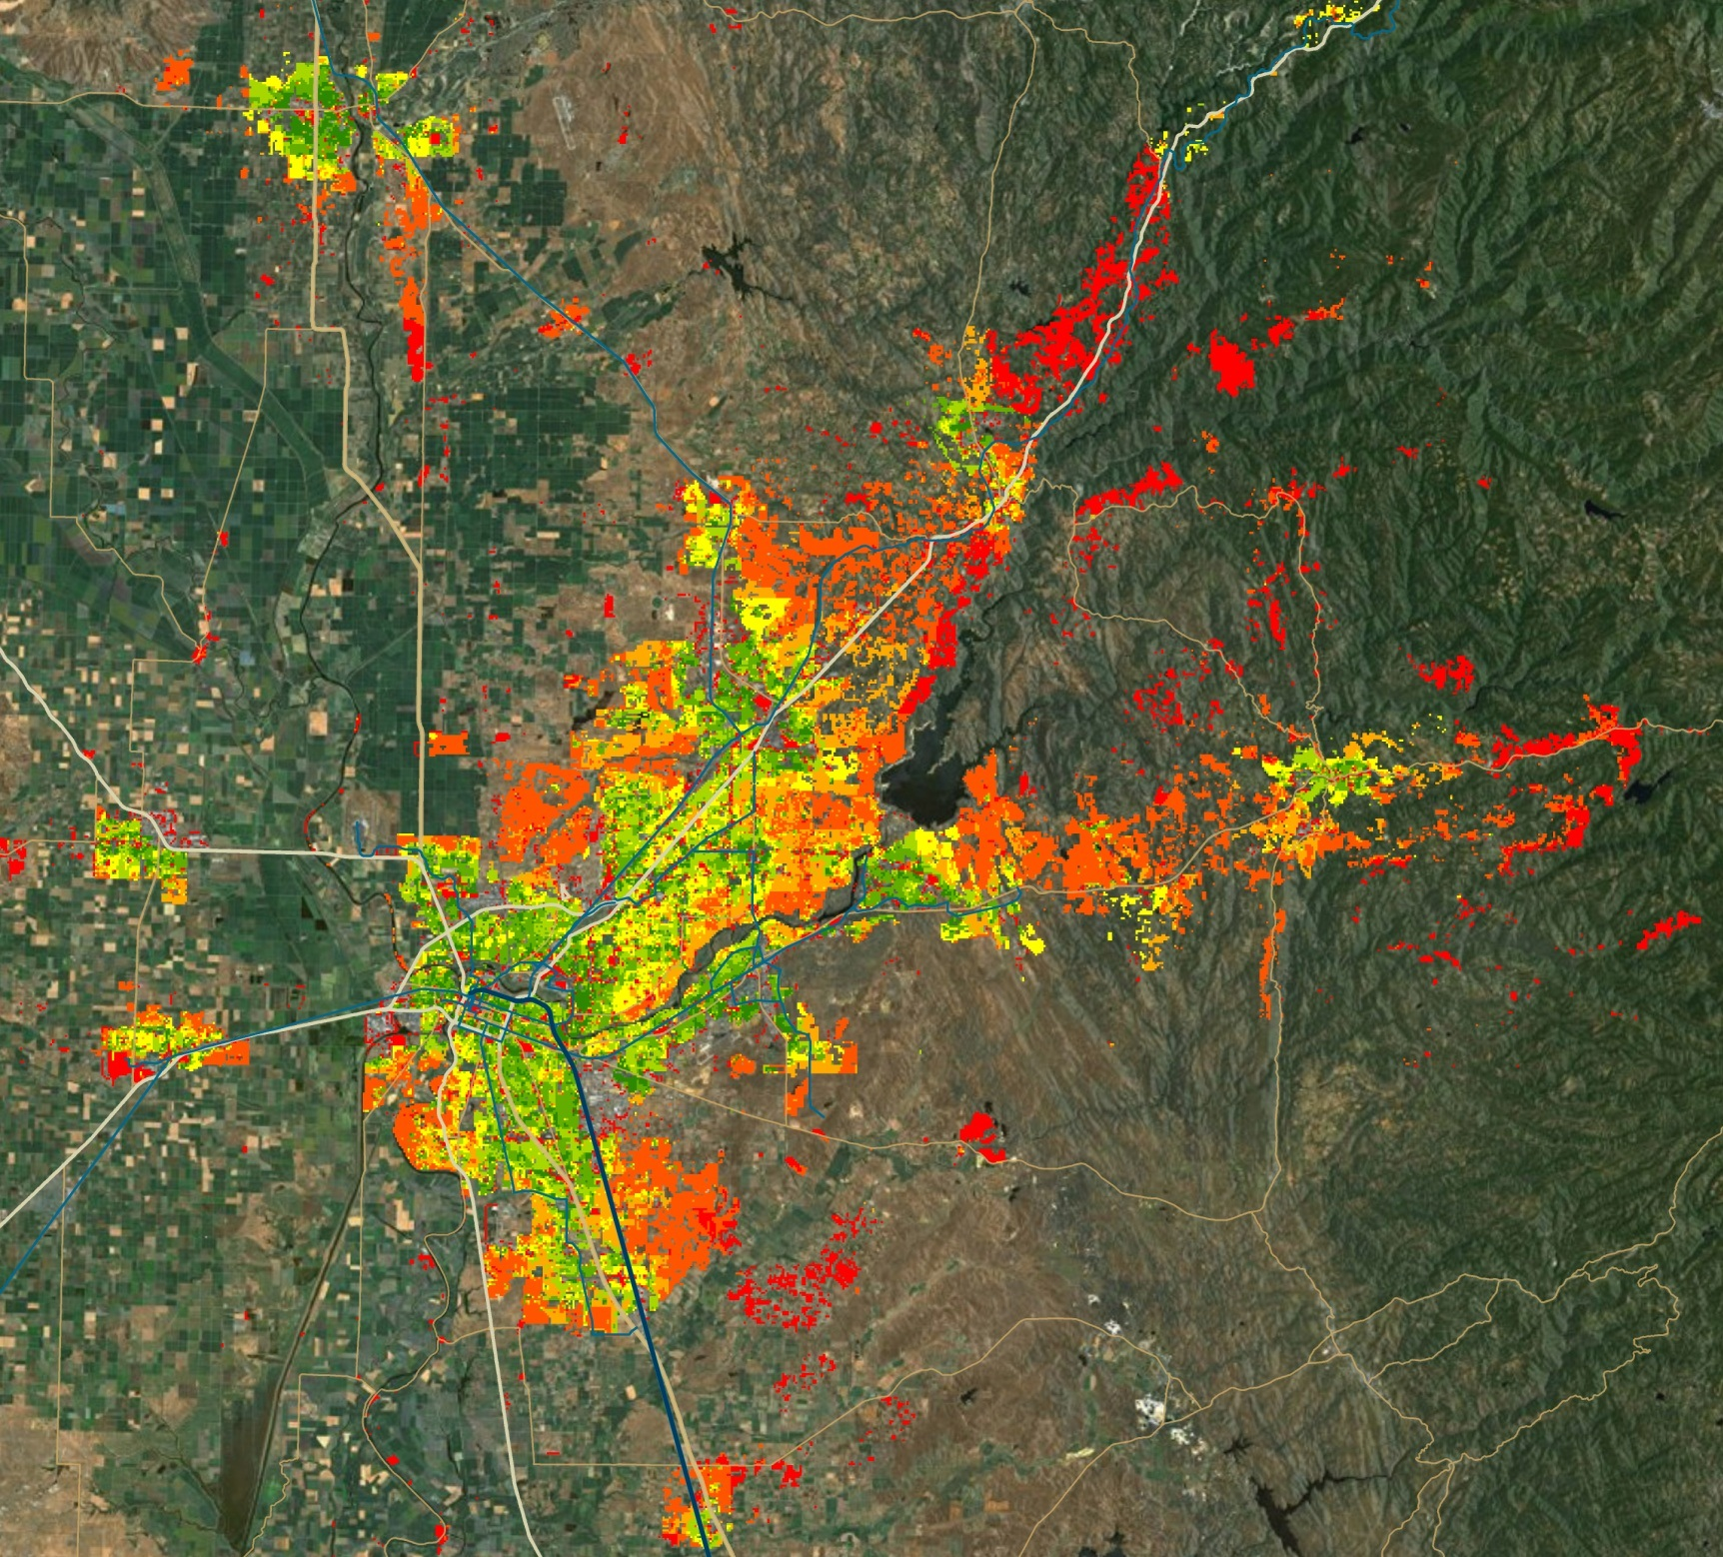
SACOG
2035 VMT/HH
UrbanFootprint

Slide 15
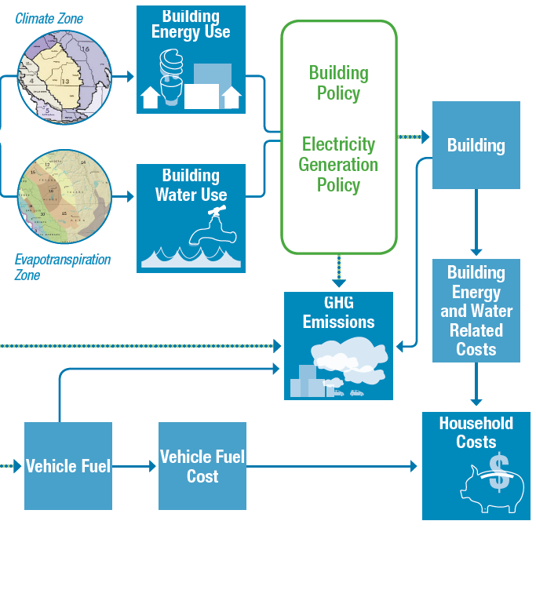
Household Costs
Notes:
Based on the costs estimated per unit for energy and water use, as well as vehicle fuel costs, total household costs are calculated.

Slide 16
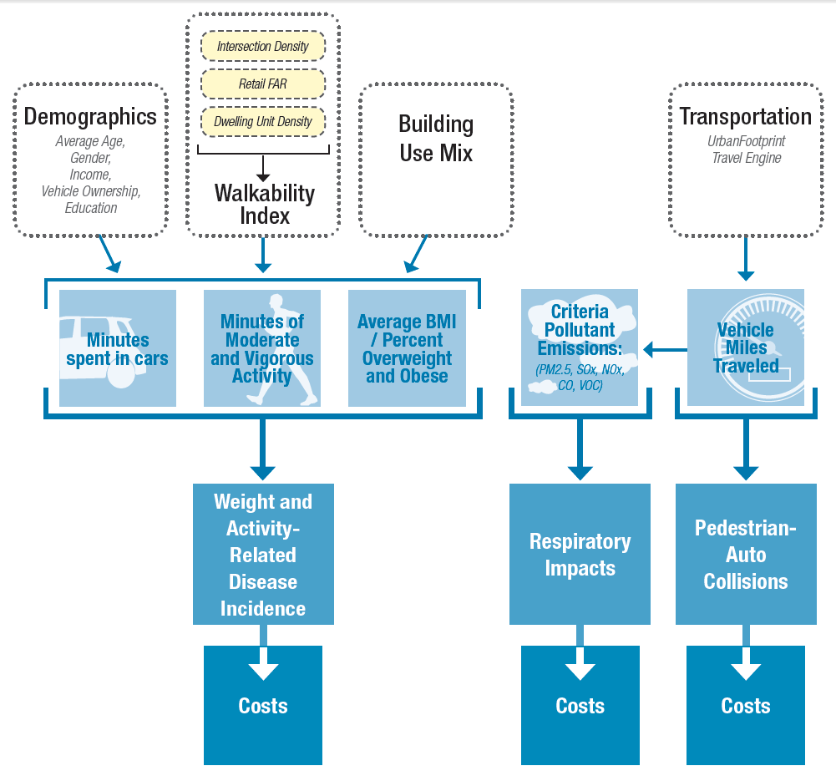
Public Health
Notes:
The public health module builds on the transportation model as well as the baseline scenario. Demographic assumptions combined with the local environment are used to forecast the amount of time spent in moderate and vigorous activity, proportion of the population that is overweight, and time spent in cars. These are then used to identify the incidence of weight and activity related diseases and resulting costs.
The transportation engine provides estimates of VMT and pollutants which are used to estimate pedestrian-auto collisions and respiratory illnesses, and the related costs from each.

