Slide 1
Chatbot with python dataframe
By: Benjamin Yin

Slide 2
Target audience
The chatbot can be used to store user inputted data as well as giving information when it is asked. The chatbot can be used by user based company(such as instagram, Amazon) to store data from the user, or give the user a reply set by the company when the user have questions.

Slide 3
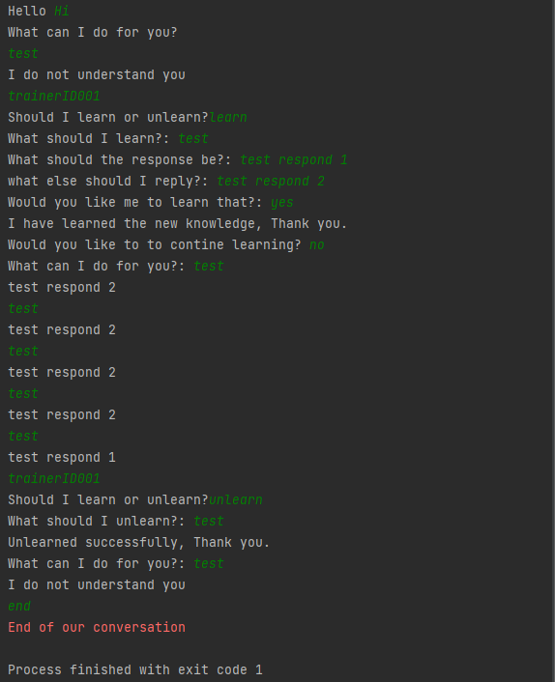
Chatbot in action
As shown on the right, The chatbot can reply to normal conversation or learn any conversation that is desired to be put in. If the chatbot has not learned that input, it will display that it does not understands it. Once the command is learned, it will be able to respond with the desired response that was taught to the chatbot, and can be unlearned at any time.

Slide 4
What is special about the chatbot with data frame?
The chatbot made with dataframe can allow storage of user data as well as storage of commands. The chatbot can be implemented to be a questionnaire for the user or a event reminder for the user while allowing the user to have some fun talking to the chatbot.

