Slide 1
customer data and retention
Springboard Foundations of data science capstone
Brad boldenow

Slide 2
Problem
Telco Telecommunications is concerned with their ability to retain customers.
It costs 10 times more money to sign a new customer than to renew an existing customer.
High retention rates equate to a high level of predictable monthly recurring revenue.
In order to understand retention, it is necessary to analyze churn and its trends throughout the Telco customer base.
Churn is the percent of customers that discontinue their contract during a given time frame.
Telco currently has a 27% churn rate.

Slide 3
Problem
Analyzing patterns in relation to churn throughout the Telco customer base will allow a predictive model to be built.
This model will be used to predict customer behavior in order to maximize retention.
The output will include an early diagnoses of customers at high risk of churning.

Slide 4
Problem
The output of the model will be used for two specific initiatives:
Digital advertising campaigns focused on retention:
Telco will be launching a digital advertising campaign targeted towards customers whom the model classifies as high risk for churn. The advertisements will include exclusive deals related to resigning contracts.
Advanced customer service representative dashboards + notifications:
Customer Service Representatives will notified when a customer is at high risk of churning. Based on the individual’s previous behaviors (in relation to Telco), specific promotions will be offered to aid in reducing the risk of churning.

Slide 5
The Data
The dataset used to create the model includes data on 7,032 customers.
Descriptive Statistics:
5,163 (73%) of these customers did not churn, 1,869 churned (27%).
90% of customers have phone service and 78% have internet service
The average tenure length is 32 months
The average monthly charges are $64.80
55% of all customers have month-to-month contracts, 21% have yearly contracts and 24% have two year.

Slide 6
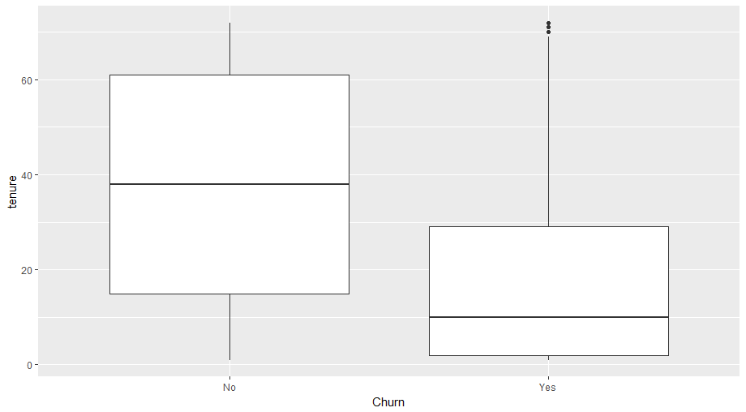
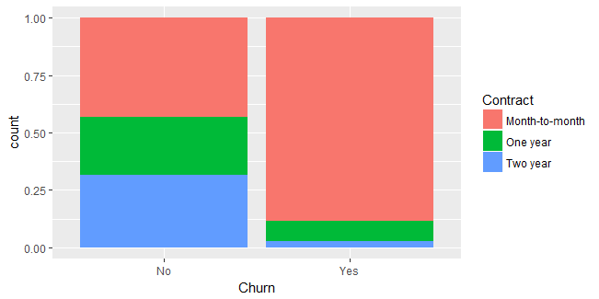
The Data
Some notable discrepancies between churners and non-churners:
Tenure: The average tenure for those who churned is 18 months while the average tenure for those who did not churn is 38 months.
Contract: The proportion of the types of contracts vary greatly between churners and non-churners. For churners, 89% had month-to-month contracts while only 43% of non-churners had month-to-month.

Slide 7
The Models
Logistic regression models were used to predict churn based upon customer behavior.
The baseline comparison used was 73% accuracy (based upon most common class).
Model 1
The first logistic regression model included all original variables from the Telco customer data.
Accuracy rate of 80.9% with training data
Accuracy of 80.6% with test data
Because this model used all variables, overfitting may be prevalent.
Model 2
The second model removed the variables that were least significant in predicting churn.
Accuracy rate of 80.5% with the training data
Accuracy of 80.9% with the test data

Slide 8
The Models
Model 3:
The third model removed the two last variables that were less significant than the others
Accuracy rate of 79.6% with training data
Accuracy rate of 80.3% with test data
The winner – Model 2:
Accuracy rate of 81% (11% improvement over baseline)
Specificity rate of 10%
Sensitivity rate of 55%
Positive predicted value rate of 67%
Negative predicted value rate of 85%

Slide 9
Further Research
Optimize the threshold used based on the business objectives.
For these models, we defined the probability threshold at .5. If Telco were to lower the threshold they would most likely see more customers classified as churners. This would be useful if they were running an inexpensive advertising campaign. If Telco wanted to use this information to run a high cost promotional campaign, they may want to raise the threshold to only classify those with the highest probabilities of churning.
Add rankings based on customer value.
It would be beneficial if Telco could quickly analyze the value of each customer with a high chance of churning. This value metric would primarily be based on the contract, monthly, and total charges for each customer. This information would ensure the customers of highest value to Telco are given priority over lower value contracts.

