Slide 1
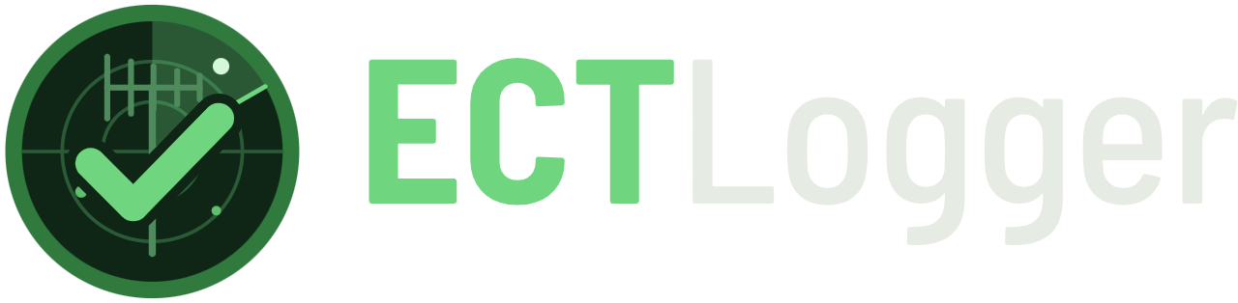
Running nets with ECTLogger
From your first check-in to a multi-frequency ARES net
Wireless Society of Southern Maine · November 12, 2026 · Brad Brown Jr., KC1JMH
Notes:
Welcome, everyone, and thanks for coming out tonight, whether you’re here in the bunker or joining online. If you have a phone or laptop handy, keep it out: we’ll be checking into a live net together in a few minutes.

Slide 2
Hi, I’m Brad, KC1JMH
ABOUT ME
WSSM club secretary
ARES Coordinator, Cumberland County
I take the minutes and read them on 147.09 the Thursday after
With the WSSM Emergency Communications Team, right here at CCEMA
Systems administrator by day
The person behind ECTLogger
Servers, networks, and a lot of scripting to make software play nice
I build it, host it, and read every feedback note you send
Notes:
A quick bit about me. I’m Brad, KC1JMH, from Waterboro. I’m the WSSM club secretary, so you’ve probably heard me reading the minutes on the 147.09 repeater. I’m also the ARES Coordinator for Cumberland County, working with the WSSM Emergency Communications Team, which meets right here in the CCEMA bunker on the fourth Thursday. By day I’m a systems administrator. [Your story: what got you started building ECTLogger.]

Slide 3
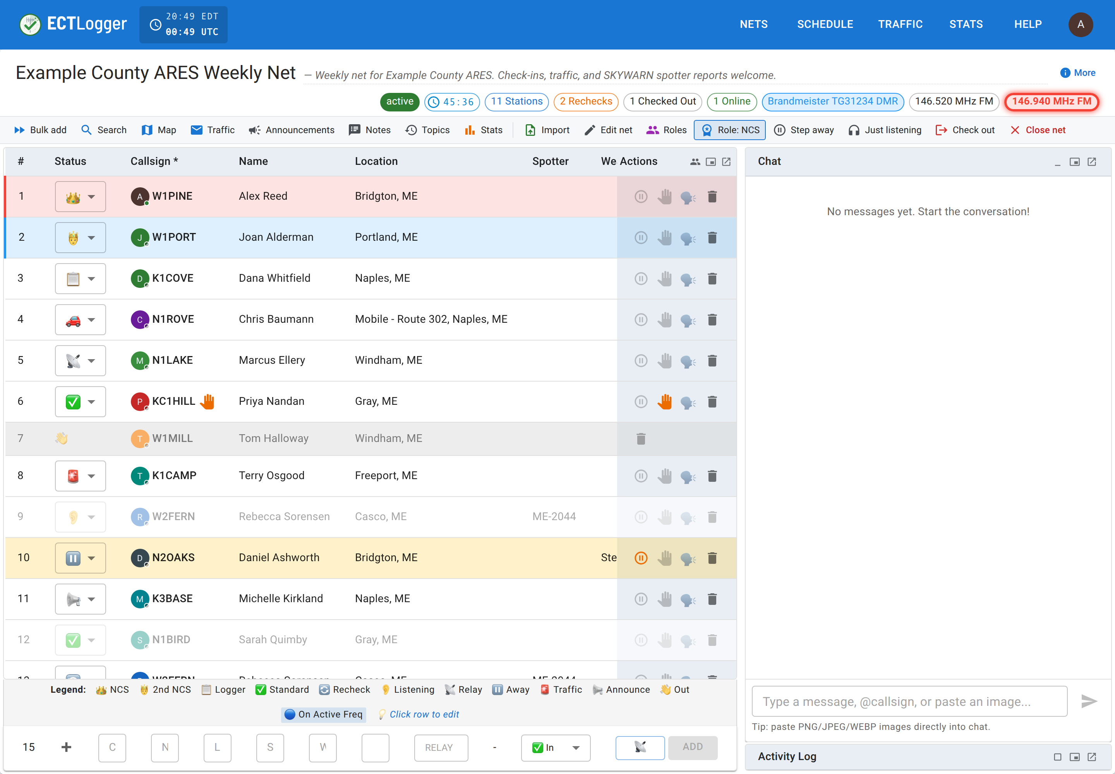
A net log everyone sees, live
THE PRODUCT
One list, on every screen
Check-ins appear for everyone the moment they’re logged
Nothing to install
A web page on your phone, tablet or computer
The paperwork writes itself
Report, ICS-309 and log email when the net closes
Notes:
ECTLogger is a real-time net logger. Net control logs a station, and everybody watching the net sees it at the same moment: who’s checked in, who has traffic, who stepped away. It runs in a web browser, so there’s nothing to install, and when the net closes, the report, the ICS-309 and the log email are ready to go. It’s free and open source, MIT licensed, and the code is on GitHub.

Slide 4
On the air since December 2025
WHERE IT STANDS
123
1,517
330
151
nets logged
check-ins
different operators
accounts
The last 30 days
29 nets
488 check-ins
17 per net, on average
69 new operators
Source: the Stats page at app.ectlogger.us, October 30, 2026
Notes:
Here’s where things stand, straight from the Stats page. Since the first net in December 2025, we’ve logged 123 nets and about 1,500 check-ins from 330 different operators. Net control can log a station that has no account, which is why there are more operators than accounts. In the last 30 days alone, that’s 29 nets, nearly 500 check-ins, and 69 operators who had never checked in before. [Refresh these numbers from the Stats page the day of the talk.]

Slide 5
The busiest nets this month
WHO’S ON IT
Net | Nets | Check-ins
UFB New England Weekly Net | 4 | 127
ME Dirigo Net | 4 | 82
WSSM Simulated Emergency Test (SET) | 1 | 74
Weekly Greater Manchester NH ARES Net | 4 | 58
Office Hours Tech Net | 4 | 49
East Rock ARES Weekly Training Net | 3 | 30
17 active schedules, run by 10 net managers across Maine, New Hampshire and beyond
Source: the Stats page at app.ectlogger.us, last 30 days, October 30, 2026
Notes:
These are the busiest nets on the Stats page over the last 30 days. Our own SET in October put 74 check-ins into a single net, which was a great real-world test. The other nets on the list are clubs and ARES groups around New England, and a lot of the improvements you’ll see tonight came from their feedback. [Refresh this table from the Stats page the day of the talk.]

Slide 6
Three parts, one live net
TONIGHT
1
2
3
Joining a net
Running a club net
ARES and SKYWARN nets
Sign in, find a net, check in, and take part
Schedules, the net control desk, and closing out the log
Several frequencies and modes, several net controls, one log
Notes:
Here’s the plan for tonight. We’ll start with checking into a net, which is all most people ever need. Then running a club net, from the schedule to the log in your inbox. And last, the bigger multi-frequency, multi-mode nets that ARES and SKYWARN teams run. Each part ends with a live demo on the real site, so grab your phone.

Slide 7
Joining a net
PART 1
For everyone who checks in
Notes:
Part one: joining a net as a participant.

Slide 8
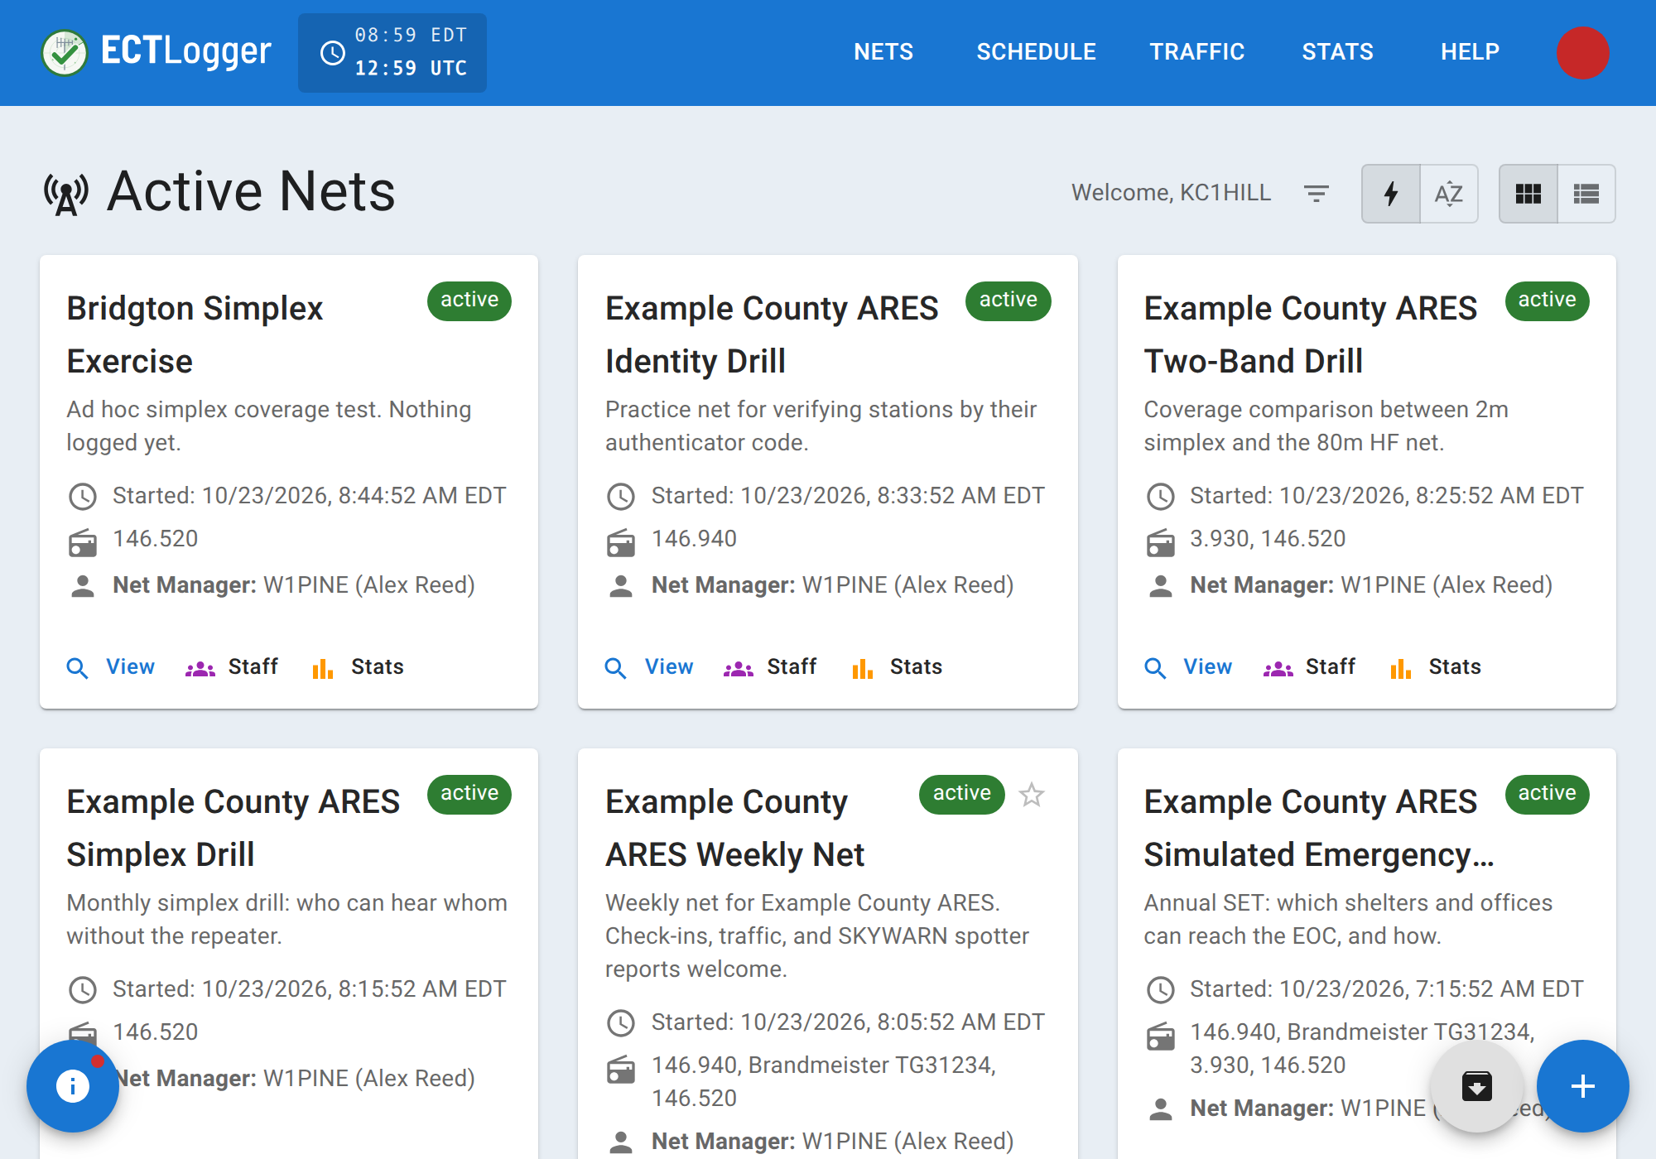
Sign in and find your net
PART 1 · JOINING A NET
No password needed
Enter your email and click the sign-in link we send
Nets shows what’s on
Running now first, then what’s coming up
Star your regulars
Starred schedules stay at the top in Favorites
Notes:
Getting in is easy. Go to app.ectlogger.us, type your email address, and we’ll send you a link. Click it and you’re signed in, with no password to remember. You can set one up later in your profile if you’d rather. The Nets page shows what’s on the air right now and what’s coming up. If there’s a net you check into every week, star its schedule and it stays at the top of the list.

Slide 9
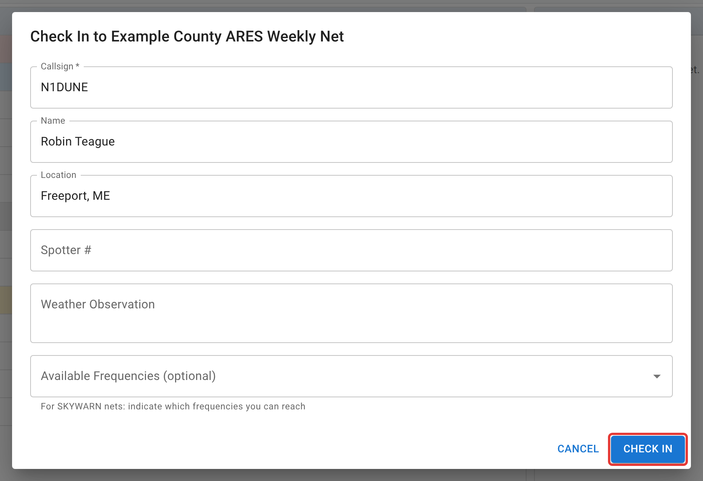
Check in and take part
PART 1 · JOINING A NET
Press Check in
Or answer the prompt when you open a running net
Set your status
Raise hand, Step away, or Just listening
Check out when done
Your row greys out on every screen
Notes:
To check in, open the net and press Check in, or just answer the prompt that pops up when you arrive. Once you’re on the list, you can raise your hand to get net control’s attention, step away for a few minutes, or mark yourself as just listening if you’re only monitoring. When you’re done, press Check out, and your row greys out for everyone.

Slide 10
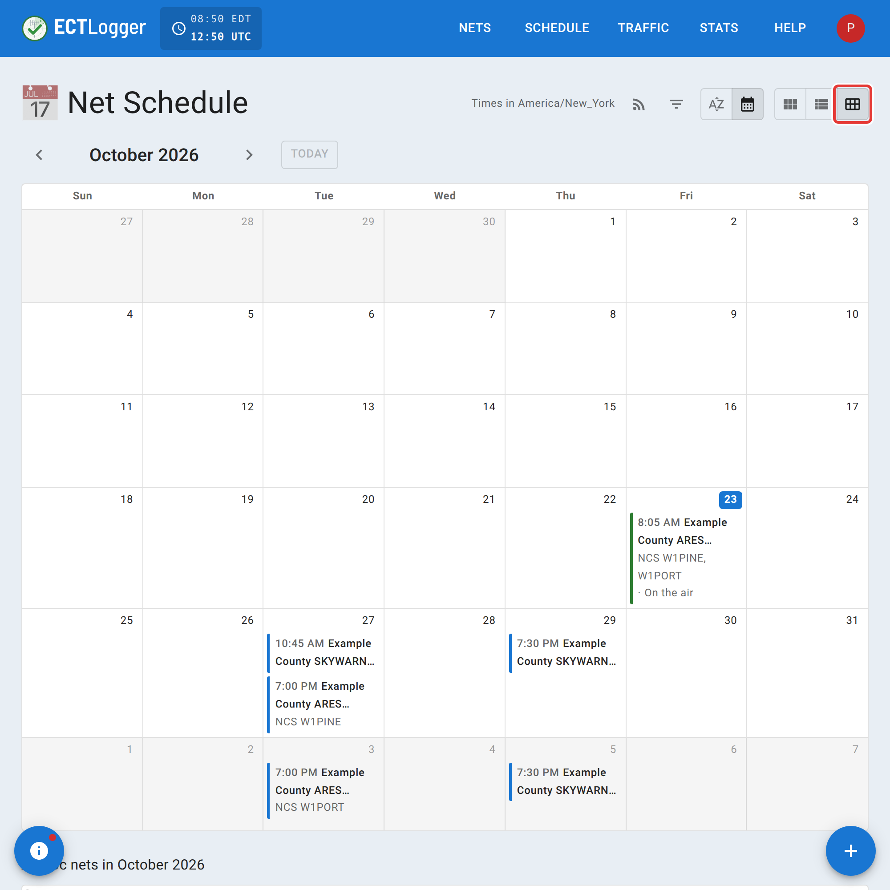
Chat, the map, and reminders
PART 1 · JOINING A NET
Chat alongside the net
Reply, @mention a station, or paste a picture
Put yourself on the map
An address, grid square or coordinates in Location
Never miss a net
Subscribe to a schedule for an email reminder
Notes:
Chat runs right beside the net. You can reply to a message, @mention a station that’s checked in, or paste in a picture. If someone’s getting chatty, you can mute them, and that only changes your own view. Put an address, grid square or coordinates in Location and you’ll show up on the net’s map. The Schedule page has a calendar of every net coming up, and if you subscribe to one, you’ll get an email reminder before each net.

Slide 11
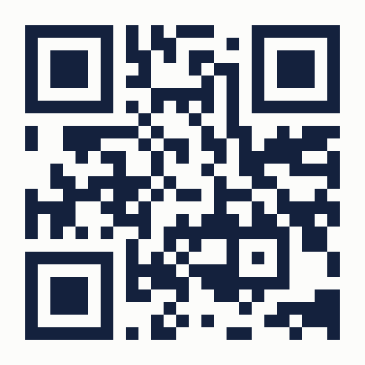
Check in from your phone
LIVE DEMO
Scan the code, or go to app.ectlogger.us
Sign in with your email
Open [demo net name] on Nets
Press Check in, then raise your hand
app.ectlogger.us
Notes:
Demo time! Everyone with a phone, scan the code or type in app.ectlogger.us. Sign in with your email; the link usually shows up within a minute. Then open [demo net name] and press Check in. Once you’re on, try raising your hand, and watch it show up on the big screen. On my screen: show the list filling in live, a raised hand, Step away, and the map. [Before the talk: create the demo net and open its lobby so it’s on the Nets page.]

Slide 12
Running a club net
PART 2
For net control, loggers and net managers
Notes:
Part two: running a club net, from setting up the schedule to the log in your inbox.

Slide 13
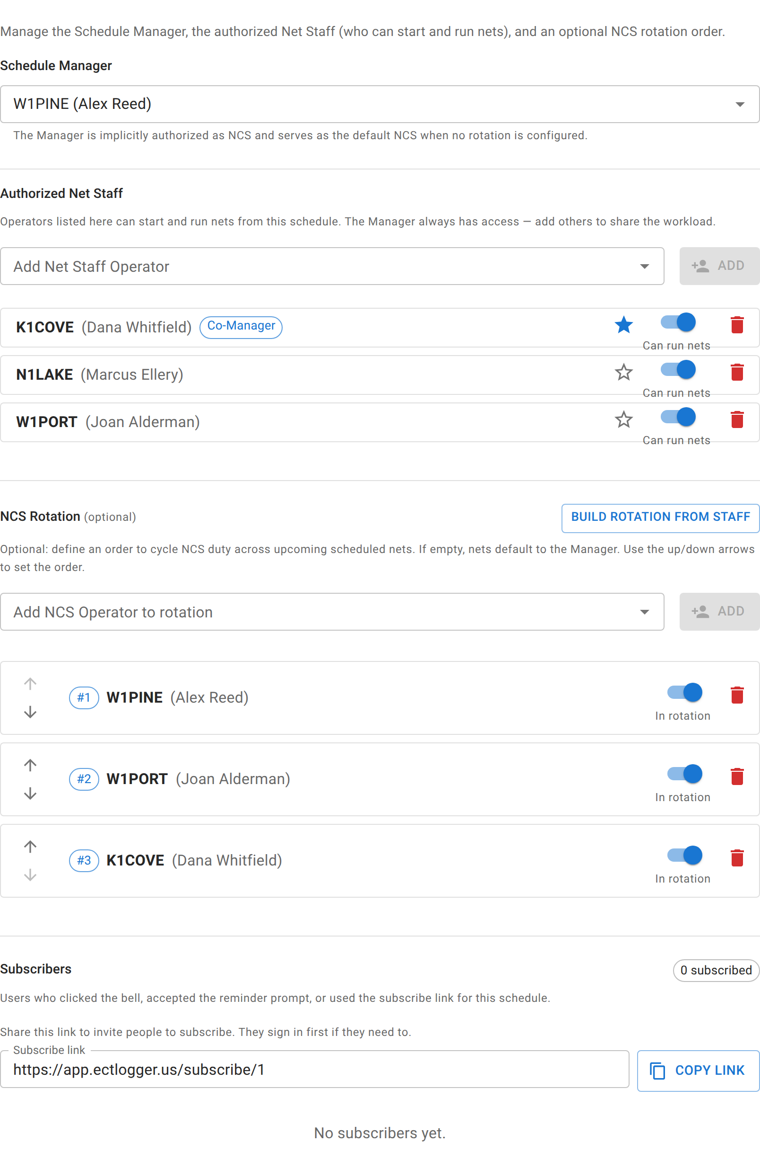
A schedule that runs itself
PART 2 · RUNNING A CLUB NET
Set it up once
Each week’s net is created for you, frequencies and all
Net staff and a rotation
Everyone knows whose week it is, and swaps are easy
Reminders go out
To the NCS on duty, and to anyone subscribed
One-time net?
The + button on Nets sets one up in a minute
Notes:
For a weekly club net, you set up a recurring schedule once, and ECTLogger creates each net for you ahead of time with its frequencies, script and settings. Add your net staff and an NCS rotation, and everyone can see whose week it is. If someone can’t make it, swapping is a couple of clicks. Reminder emails go to the NCS on duty and to anyone who subscribed. And if a net is just a one-time thing, the + button on the Nets page sets it up in about a minute. A new account needs to be around for a bit, and check into a net or two, before it can create one. Just ask me if you need that sooner.

Slide 14
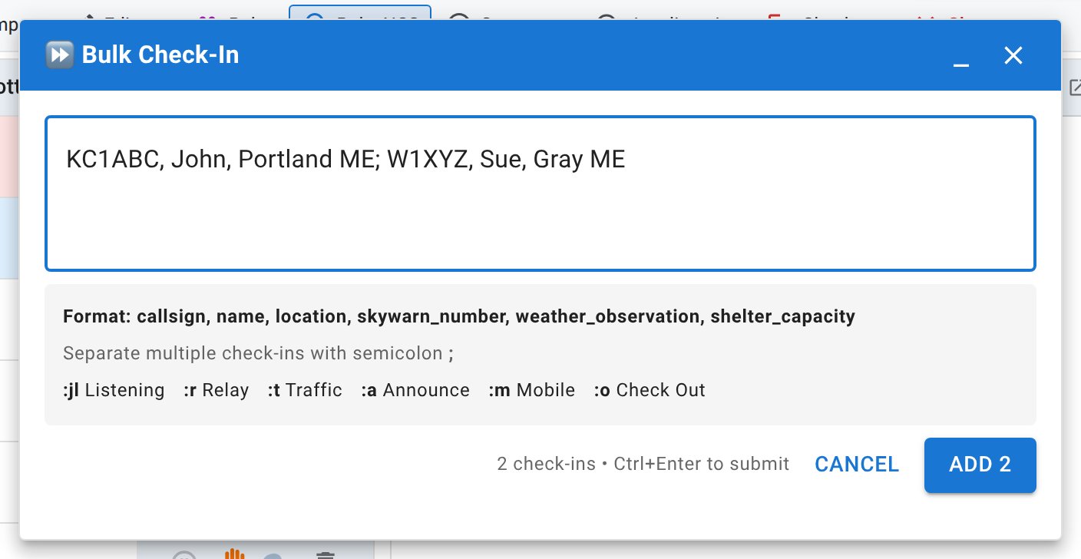
At the net control desk
PART 2 · RUNNING A CLUB NET
Open lobby, then Start net
Stations gather and check in before you begin
Check in as NCS or Logger
Net staff take the desk just by checking in
Log stations fast
Type a callsign and go, or Bulk add a whole list
Notes:
When it’s time, Open lobby lets stations gather and check themselves in before the net begins, and Start net kicks it off. They’re two separate buttons. If you’re on the net’s staff, check in as NCS or as Logger and the desk is yours. A net can have more than one NCS, and stepping away hands off cleanly. For stations calling in on the air, type the callsign and details and press Enter. If a bunch come in at once, Bulk add takes the whole list in one go.

Slide 15
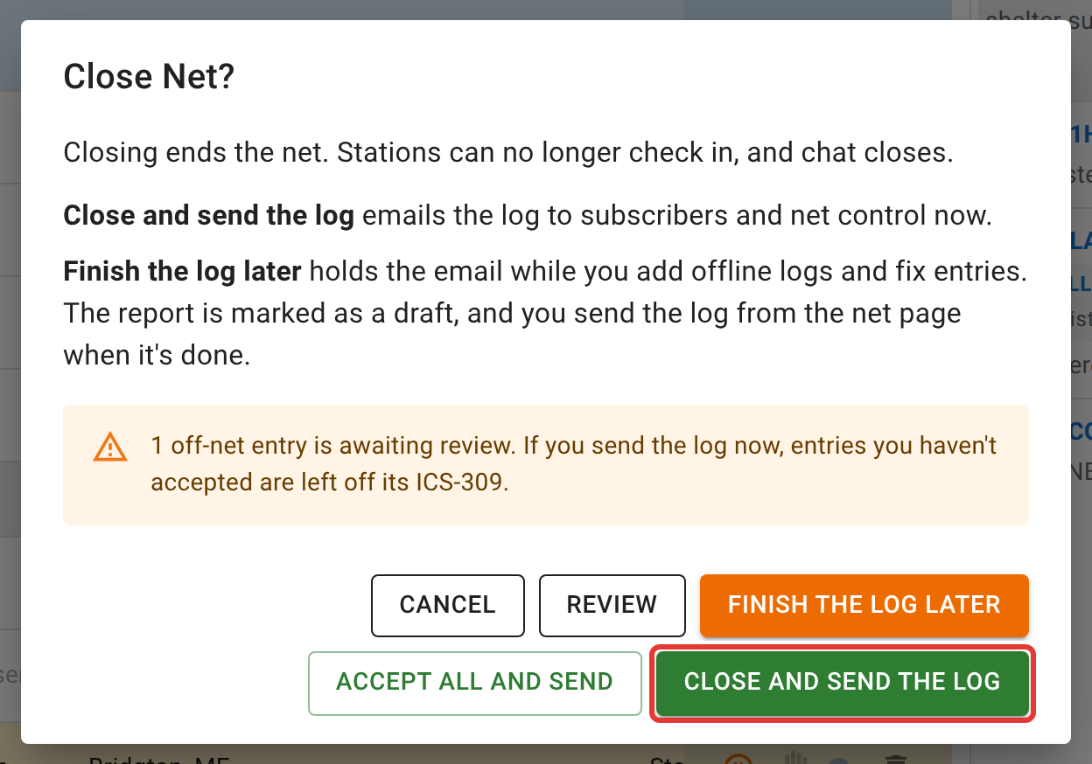
Close the net, keep the log
PART 2 · RUNNING A CLUB NET
Send it now, or later
Finish the log later to add offline logs first
Report and ICS-309
One click each; the report leads with your logo
Trends on Stats
Turnout over time and your regulars, per schedule
Notes:
When the net’s done, Close net stops check-ins and chat. You can send the log right away, or choose Finish the log later if you still have offline logs or paper notes to add. The log isn’t emailed until you say it’s ready. Afterward, the report and the ICS-309 are one click each, and the report leads with your net’s own logo. The Stats page shows how turnout is trending and who your regulars are.

Slide 16
Let’s run a net together
LIVE DEMO
1. Start the net from the lobby
2. Log a few stations by voice
3. Hand the Logger role to a volunteer
4. Close it, and open the report
Notes:
Now let’s run the demo net for real. I’ll start it from the lobby you’re already in, then log a few of you by voice, the way I would on the repeater. [Pick a volunteer] will take the Logger role from Roles so you can see two people working the same list. Then I’ll close the net and we’ll look at the report and the ICS-309 together. [Before the talk: make sure the volunteer has an account and is checked in.]

Slide 17
ARES and SKYWARN nets
PART 3
Several frequencies and modes, several net controls, one log
Notes:
Part three: the bigger nets. Several frequencies and modes, several net control desks, all logging into one net.

Slide 18
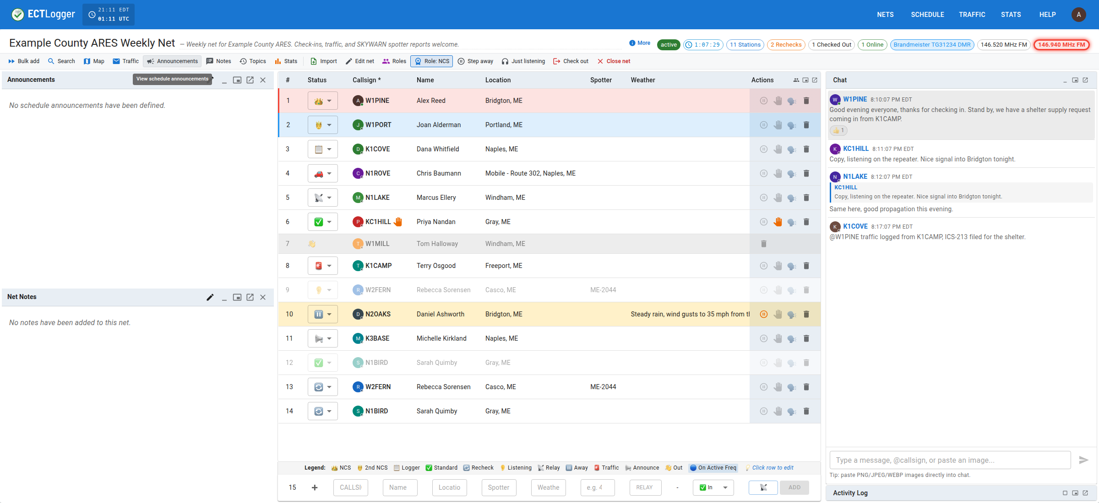
Many frequencies, one net
PART 3 · ARES AND SKYWARN
Claim your frequency
Each NCS takes a repeater, simplex or talkgroup
Every desk, one list
Several NCS log into the same net at once
Room to spread out
Pop panels out onto a second monitor
Notes:
A big ARES or SKYWARN net often runs on more than one frequency or mode at once: the repeater, a simplex frequency, a DMR talkgroup, maybe HF. In ECTLogger, that’s still one net. Each frequency is a chip in the header, and each NCS clicks the one they’re working to claim it. Their color follows them into the check-in list. We do support multiple NCS covering different repeaters or modes, all logged to the same net, event or incident. A Relay can check in the stations net control can’t hear directly. And if you have a second monitor, you can pop the check-in list, chat or map out onto it.

Slide 19
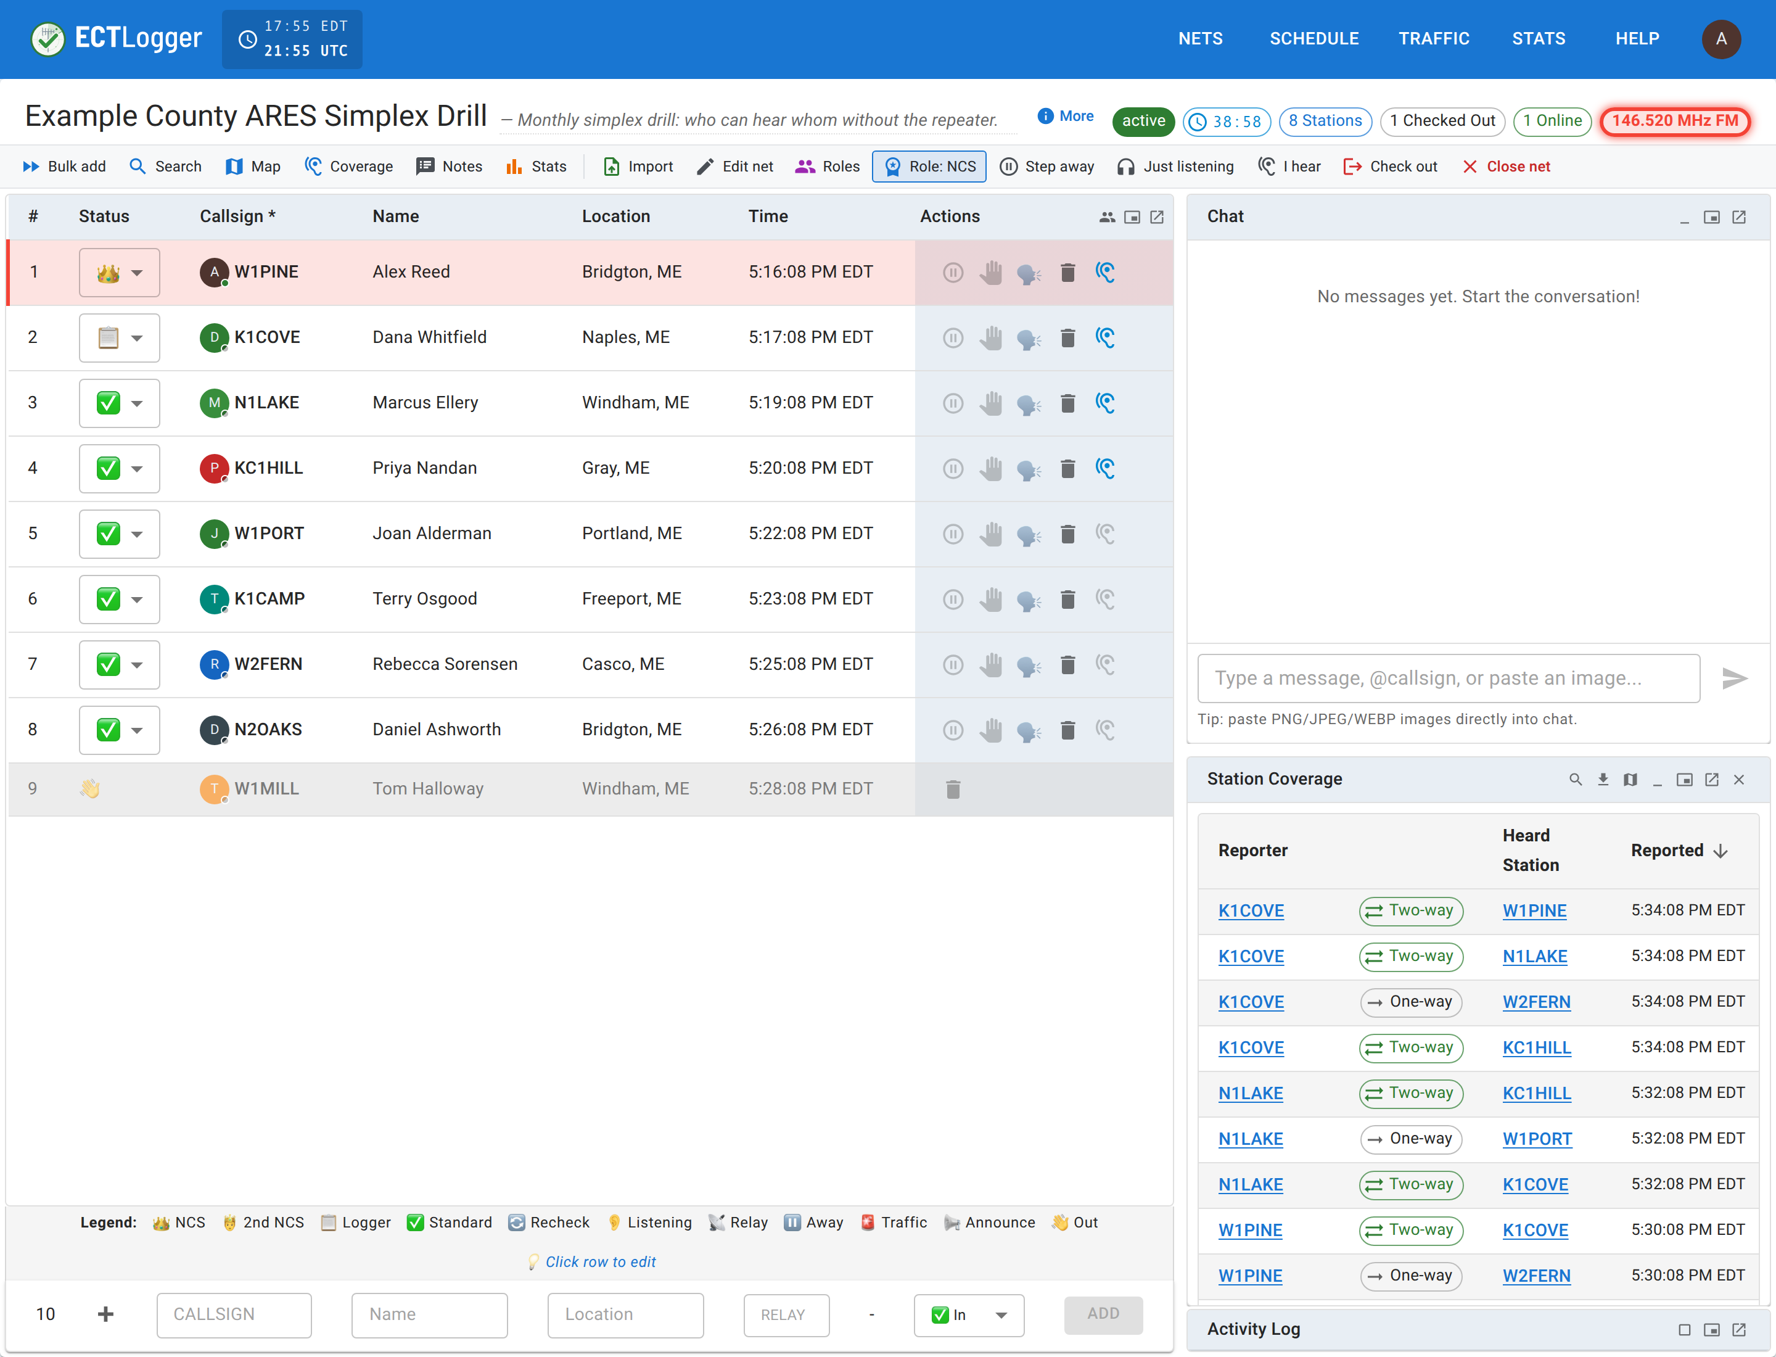
Who can hear whom
PART 3 · ARES AND SKYWARN
Stations press I hear
And pick the stations they can copy
One-way or two-way
Station Coverage sorts it out as reports arrive
Sites, not just stations
Shelters and the EOC, and who’s staffing each
Notes:
For a simplex drill, the big question is who can hear whom without the repeater. Stations press I hear and pick the stations they can copy. The Station Coverage panel works out which paths are one-way and which are two-way as the reports come in, and it can show them on the map. For an exercise like the SET, you can also set up sites, like shelters and the EOC, check stations in at a site, and see at a glance which sites are staffed and which can reach each other.

Slide 20
Built for exercises and real events
PART 3 · ARES AND SKYWARN
Traffic
Off-net log
Your own fields
Write, file and track ICS-213 messages
Contacts away from the net land on the ICS-309
Spotter number, weather, or what your team needs
Verified stations
Drill plans
Moderation
Check an operator’s code from their authenticator app
Plan the exercise and prepare its messages ahead
Mute chat for everyone, or remove a station
Notes:
A few more tools for exercises and real events. Traffic handles formal ICS-213 messages. The off-net log records contacts a station made away from the net, like a Winlink message, so they still land on the ICS-309. Admins can add the check-in fields your team needs, like a SKYWARN spotter number or a weather report. Authenticated nets let net control confirm a station is who they say they are, using the code from their authenticator app. Drill plans let you lay out the exercise and prepare its messages ahead of time. And if a net ever gets unruly, net control can mute a station’s chat for everyone, or remove and block a station.

Slide 21
Two desks, two frequencies
LIVE DEMO
1. A second NCS checks in
2. Each claims a frequency chip
3. You report who you hear
4. Watch Station Coverage fill in
Notes:
For the last demo, [second NCS volunteer] will check in as a second NCS. I’ll claim the repeater and they’ll claim simplex, and you’ll see our colors follow us down the list. Then everyone press I hear and pick a few stations you can hear in the room, and we’ll watch the Station Coverage panel fill in. [Before the talk: give the demo net two frequencies, turn on station coverage, and add the volunteer to its staff.]

Slide 22
Help is in the Help menu
AFTER TONIGHT
User Guide
Training
Step-by-step pages for every role, at ectlogger.us/docs
Upcoming sessions, and videos at youtube.com/@ectlogger
Start Walkthrough
Submit Feedback
A short tour for operators, and one for net control
Found a bug or have an idea? It comes straight to me
Notes:
Everything we covered tonight is in the Help menu. The User Guide has step-by-step pages for operators, net control, net managers and admins. Help, Training lists upcoming sessions like this one, and the training videos will be on the YouTube channel. Start Walkthrough gives you a quick tour any time. And if you find a bug or have an idea, Submit Feedback comes straight to me. A lot of what you saw tonight started as someone’s feedback, so please send it!

Slide 23
Questions?
Thank you, and 73!
Brad Brown Jr., KC1JMH
app.ectlogger.us · ectlogger.us/docs
app.ectlogger.us
Notes:
That’s everything I had. Thanks so much for coming out tonight, and for everyone online, thanks for joining us. I’m happy to take any questions, and if something comes up later, Submit Feedback in the Help menu reaches me directly. 73!

