Slide 1
QUOTED VALUE COST
YEAR TO DATE LOSS BIDS COUNT
YEAR TO DATE BREAKDOWN VALUE COST
CHART NOTE: COMPETITOR AWARDED REPRESENTS THE DOLLAR VALUE AT WHICH THE AWARD WAS ISSUED AND NOT THE OUR COST.

Slide 2
HOVERING OVER THE LINE WILL PROVIDED MORE CONTEXT
VALUE IS IN OUR COST

Slide 3
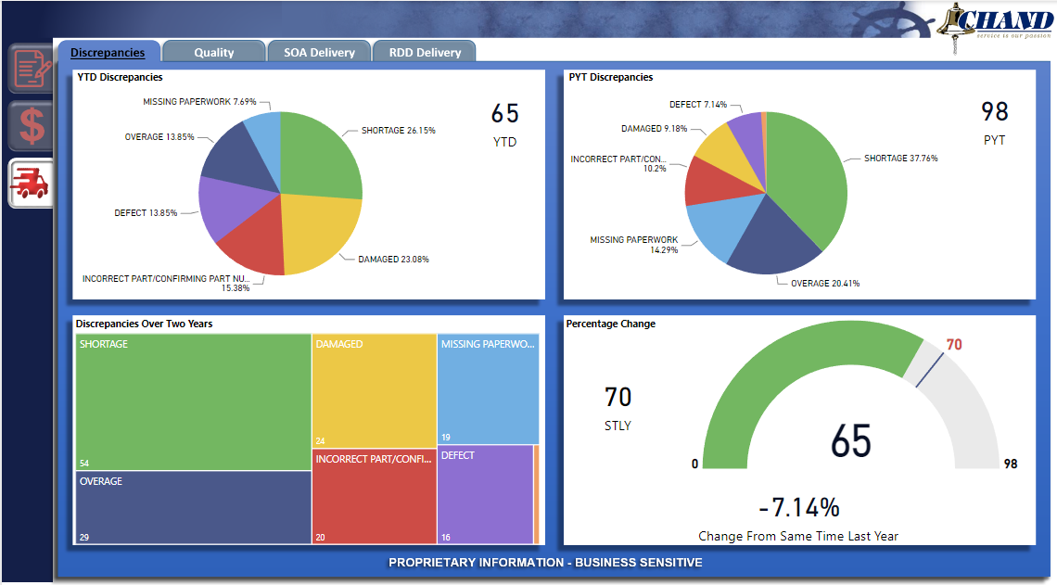
YTD = YEAR TO DATE PYT = PREVIOUS YEAR TOTAL STLY = SAME TIME LAST YEAR
GREEN BAR: YEAR TO DATE DISCREPANCY COUNT
SELECT DISCREPANCY FOR MORE DETAIL
SAME TIME LAST YEAR DISCREPANCY COUNT
PERVIOUS YEAR TOTAL DISCREPANCY COUNT

Slide 4
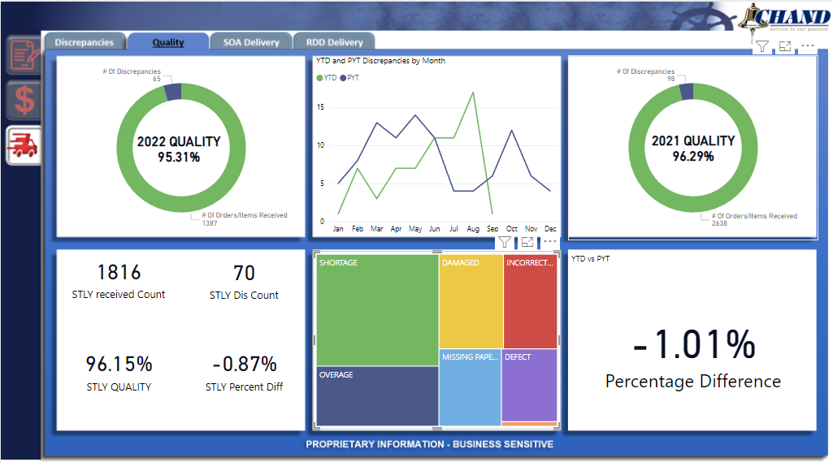
HOVERING OVER THE LINE WILL PROVIDED MORE CONTEXT
YTD = YEAR TO DATE PYT = PREVIOUS YEAR TOTAL STLY = SAME TIME LAST YEAR
SELECT DISCREPANCY FOR MORE DETAIL

Slide 5
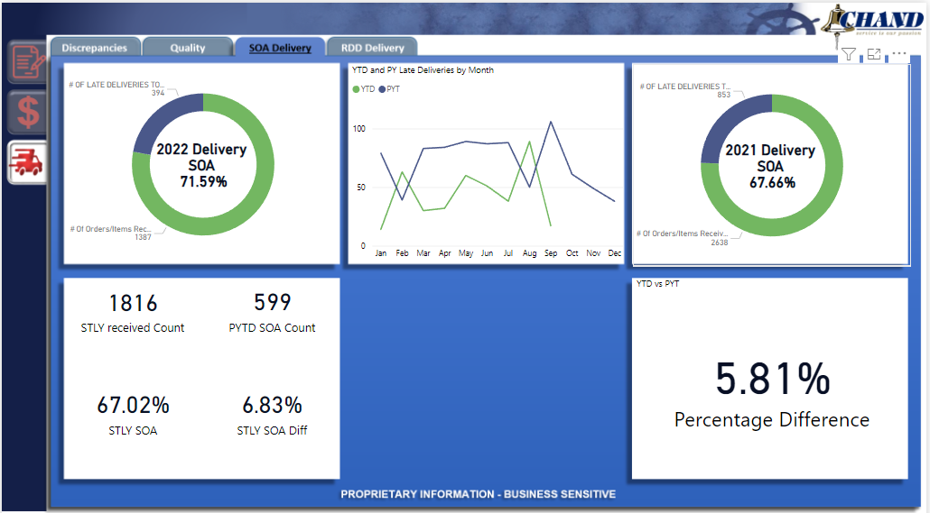
HOVERING OVER THE LINE WILL PROVIDED MORE CONTEXT
YTD = YEAR TO DATE PYT = PREVIOUS YEAR TOTAL STLY = SAME TIME LAST YEAR

Slide 6
HOVERING OVER THE LINE WILL PROVIDED MORE CONTEXT
YTD = YEAR TO DATE PYT = PREVIOUS YEAR TOTAL STLY = SAME TIME LAST YEAR

Slide 7








DLA DEMAND
VALUE
CLICK TO SELECT SLICERS
DLA SOH = DLA STOCK ON HAND
SOH = STOCK ON HAND
SOO = STOCK ON ORDER
EST AVAILABLE = SUM OF ALL ABOVE
CLICK TO RESET SLICERS
DLA DEMAND DATA UPDATED 2ND WEEK OF THE MONTH
PROPRIETARY INFORMATION - BUSINESS SENSITIVE

Slide 8
DLA DEMAND
VALUE
CLICK TO SELECT SLICERS
CLICK TO RESET SLICERS
DLA DEMAND DATA UPDATED 2ND WEEK OF THE MONTH
PROPRIETARY INFORMATION - BUSINESS SENSITIVE

