Slide 1

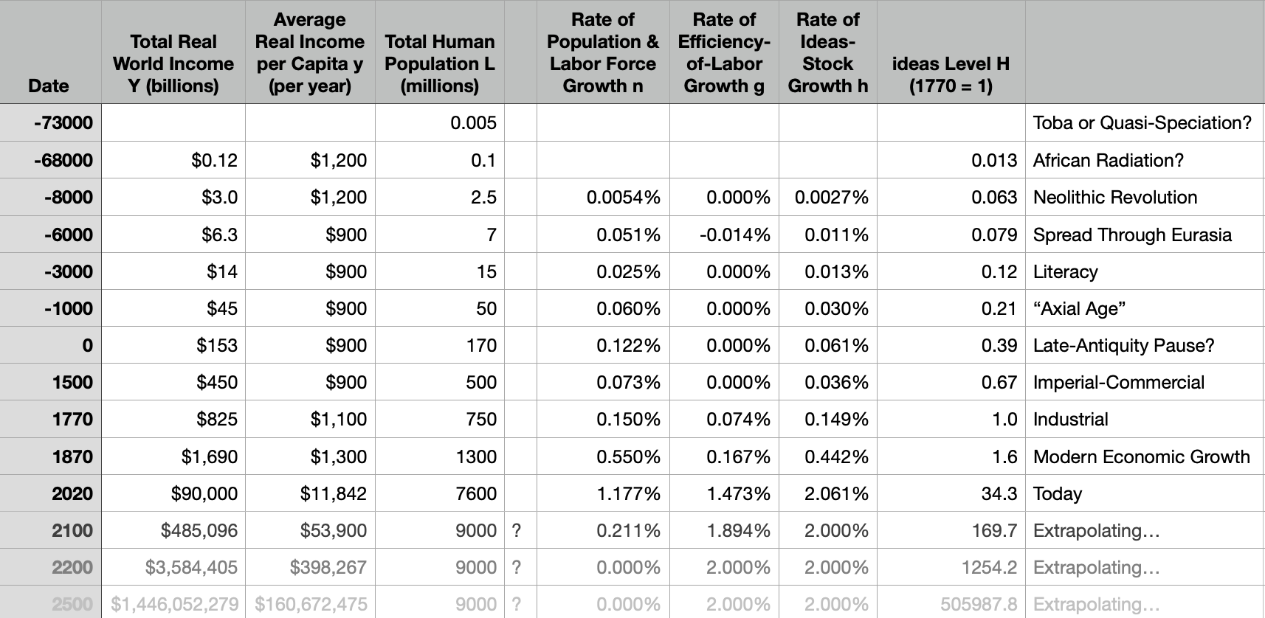
Lecture Background for 2021-04-07: Why Did the Pace of Ideas Growth Use to Be So Slow? & How Fast Is It Now, Really?
The World Economy from Deep Time to the Future
Zoom Room
<https://berkeley.zoom.us/j/97240285431?pwd=VldmeGdtNmR6eklqSGUwMGgza3hIUT09>
Readings:
A set of arithmetic calculations, a think piece, and two modelling exercises (that you have seen before in David Romer’s §§ of macro)…
William D. Nordhaus (1997): Do Real-Output & Real-Wage Measures Capture Reality? The History of Lighting Suggests Not <http://www.nber.org/chapters/c6064>
Moses Finley (1965): Technical Innovation & Economic Progress in the Ancient World <http://www.jstor.org/stable/2591872>
====
Michael Kremer (1993): Population Growth & Technological Change: One Million B.C. to 1990 <http://www.jstor.org/stable/2118405>
Charles Jones (1995): R&D-Based Models of Economic Growth <https://delong.typepad.com/files/jones-r--d.pdf>
<https://www.icloud.com/keynote/08vSAzKv95qbedf-j_DFYvzAA> <https://github.com/braddelong/public-files/blob/master/econ-210a-2021-04-01-background-slow-ideas-growth.pptx> 2021-04-01

Slide 2
Nordhaus: Are These the Right Real Income Numbers?
The World Economy from Deep Time to the Future
How do we construct real income measures across periods when the prices of some commodities are infinite in the first period?
Normally: multiply the price decline by the expenditure share, and add them up
But when the price decline is infinite, and the initial expenditure share is zero?
Nordhaus looks at illumination services as an intersting and informative case
2:40-3:00

Slide 3
Finley: Why Are These Ideas Growth Rates so Slow?
The World Economy from Deep Time to the Future
How do we construct real income measures across periods when the prices of some commodities are infinite in the first period?
Normally: multiply the price decline by the expenditure share, and add them up
But when the price decline is infinite, and the initial expenditure share is zero?
Nordhaus looks at illumination services as an interesting and informative case
2:40-3:00

Slide 4
Kremer & Jones: What Does Economic Modeling Have to Contribute?
The World Economy from Deep Time to the Future
Kremer: Two Heads Are Better than One
  Ideas growth should be STEM labor force raised to some power
  Implies—with demographic transition—an eventual breakthrough
Jones: Low-Hanging Fruit
  Technology growth slows until increase in STEM labor force just offsets the fact that there is less low-hanging fruit to pick
2:40-3:00

Slide 5
Catch Our Breath
Let’s reflect on what we have just heard & seen…
Comments
Questions
Readings
<>

