Slide 1

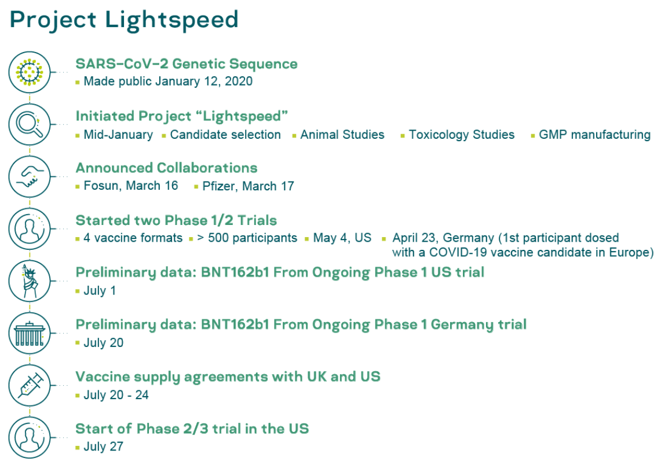
BioNTech 90% Effective Messenger RNA COVID Vaccine?
Little additional information seems to be publicly available right now:
Pfizer and BioNTech (2020-11-09): Announce Vaccine Candidate Against COVID-19 Achieved Success in First Interim Analysis from Phase 3 Study <https://www.businesswire.com/news/home/20201109005539/en/>: ‘Vaccine candidate was found to be more than 90% effective in preventing COVID-19 in participants without evidence of prior SARS-CoV-2 infection in the first interim efficacy analysis. Analysis evaluated 94 confirmed cases of COVID-19 in trial participants. Study enrolled 43,538 participants, with 42% having diverse backgrounds, and no serious safety concerns have been observed; Safety and additional efficacy data continue to be collected. Submission for Emergency Use Authorization (EUA) to the U.S. Food and Drug Administration (FDA) planned for soon after the required safety milestone is achieved, which is currently expected to occur in the third week of November. Clinical trial to continue through to final analysis at 164 confirmed cases in order to collect further data and characterize the vaccine candidate’s performance against other study endpoints…
Bojan Pancevski & Jared S. Hopkins (2020-10-22): How Pfizer Partner BioNTech Became a Leader in Coronavirus Vaccine Race_<https://www.wsj.com/articles/how-pfizer-partner-biontech-became-a-leader-in-coronavirus-vaccine-race-11603359015>: ‘MAINZ, Germany—On a Friday in late January, Ugur Sahin received an email with bad news: A new study of a deadly new coronavirus in China suggested it was more infectious than previously believed. The outbreak, he believed, had the potential to grow into a pandemic. The following Monday, the German scientist and chief executive of biotech firm BioNTech SE summoned his board to announce that the company, which had been developing next-generation cancer treatments, would start work on a Covid-19 vaccine. Human trials would need to start by April, he added, in case Europe and the U.S. had to go into lockdowns. Ugur Sahin, co-founder and chief executive of BioNTech, led the company to focus on coronavirus research early in the pandemic. While much of the world was still oblivious to the danger, BioNTech was scrambling, Dr. Sahin told The Wall Street Journal earlier this month…
BioNTech: “Our vaccine consists of a short segment of… messenger RNA… provid[ing] instructions for a human cell to make a harmless version of a target protein,… which activates the body’s immune response against the SARS-CoV-2 virus. We expect that our vaccination approach will stimulate the immune system to generate protective antibodies. This means the immune systems learns how to recognize the SARS-CoV-2 virus upon exposure and prevent subsequent infection. Unlike other vaccines, mRNA vaccines do not contain the virus itself and therefore pose no risk of infection…
<https://www.businesswire.com/news/home/20201109005539/en/> <https://www.icloud.com/keynote/0aP8gr2_cfSeHzTQEw9OVC6hg> <https://www.bradford-delong.com/2020/11/biontech-90-effective-messenger-rna-covid-vaccine.html>
2020-11-09
Notes:
A big story in the media today is that Glenn Greenwald has bolted from The Intercept. People surely have strong opinions of him, and he is opinionated himself. This post is not about evaluating him—and he can clearly speak for himself—but about what this break-up reveals about the moment we’re in. It shows that our media wars are about attention, not speech. More on that in a bit.
But perhaps more importantly, I do have one agreement with Greenwald: there is a very important aspect of this story that is not being covered appropriately, if at all. But that aspect is not what Greenwald thinks it is. Rather, what all this reveals is that traditional media is, still, terrible at recognizing how these hack-and-leaks are, in fact, as much about blackmailing political candidates as they are about politically relevant allegations.
That’s right, there’s a blatant blackmail attempt right in front of our eyes, and we’re not recognizing it for what it is.
If you missed it, here’s the backstory: Greenwald wanted to publish a lengthy piece about Hunter Biden’s alleged laptop and the allegations swirling around it. His editors asked him to focus his piece on media criticism—why wasn’t Joe Biden being asked more forcefully about the allegations? Greenwald refused and resigned.
Strikingly, it appears that since 2007, in Salon and in the Guardian, and in the seven years since he co-founded The Intercept (funded by a tech billionaire), Greenwald has not been edited. The only exception came in very narrowly defined cases where there were potential issues of legal liability for a publication—which, given the laws in the United States, means he was almost never subject to editorial decisions.
First, let’s deal with the easy stuff at play. Is the Hunter story newsworthy, in the sense that it should be reported on? Yes, of course. Should Joe Biden be asked about some of the allegations? Yes, of course. (Note the some).
But the real questions we need to ask of ourselves are these: what should be asked of Biden? How much media attention should be given, to what parts of the story? What parts of the story are very important,, and not being covered?
This has been an ongoing theme in my work: In the 20th century, it is attention, not speech, that is restricted and of limited quantity that the gatekeepers can control and allocate. In the digital age, especially in countries like ours, there is no effective way of stopping people from publishing or talking about this story through traditional censorship—but there are many ways to regulate how much attention it gets.
This is an especially important consideration in the weeks leading up to a presidential election, with so little time left to allocate our attention to important questions. Given the decreasing time available, what are the important questions, and how much attention should they get, and how?
In 2016, the media got hacked—not in the sense of a computer breach, but that their unreflective habits allowed them to be played. They spent their time giving disproportionate attention to gossip and privacy violations that were illegitimate—ironic, in my view, since they barely covered the newsworthy aspects of that hack.
Before the 2016, election, in a New York Times op-ed, I called this whistle-drowning. Whistle-blowing is designed to focus our attention on something that is being kept from the public, something that is in the public’s interest to know and evaluate. Whistle-drowning is designed to flood the public a flurry of allegations that make it very difficult to concentrate on the important questions facing us.
Mass data releases, like the Podesta emails, conflate things that the public has a right to know with things we have no business knowing, with a lot of material in the middle about things we may be curious about and may be of some historical interest, but should not be released in this manner.
All campaigns need to have internal discussions. Taking one campaign manager’s email account and releasing it with zero curation in the last month of an election needs to be treated as what it is: political sabotage, not whistle-blowing.
These hacks also function as a form of censorship. Once, censorship worked by blocking crucial pieces of information. In this era of information overload, censorship works by drowning us in too much undifferentiated information, crippling our ability to focus. These dumps, combined with the news media’s obsession with campaign trivia and gossip, have resulted in whistle-drowning, rather than whistle-blowing: In a sea of so many whistles blowing so loud, we cannot hear a single one.
To explain how whistle-drowning functions, consider the question Greenwald wants asked of Biden: “are these emails/laptop authentic”? That is not a legitimate question, since the party holding the material in question refused to have the laptop examined, or to let independent investigative journalists look at the contents and report from them.
But whistle-drowning works because what appears in the media is a flurry of releases from the hacks. They include not just Hunter Biden’s attempts at influence-peddling, but pictures of him in compromised, drugged out states—and, crucially, we are told, more videos of him engaged in sex acts and taking drugs—this is part of the first story that the NY Post published:
Other material extracted from the computer includes a raunchy, 12-minute video that appears to show Hunter, who’s admitted struggling with addiction problems, smoking crack while engaged in a sex act with an unidentified woman, as well as numerous other sexually explicit images.
To make the blackmail more potent, the NY Post published some private family photos that were allegedly from the laptop (or whatever was hacked).
Why on earth would he have to “authenticate” material that, we are salaciously told, includes videos of his son engaging in sex acts and drug sprees? Why should he do so without any independent, serious journalists having access to the source materials —as Greenwald’s editors correctly pointed out?
The Podesta hack in 2016, too, included a lot of such material: a campaign staffer’s suicide attempt, for example, was publicized, along with many other personal and intimate moments. Such hack-and-dump operations are designed to blackmail people, and deter people from entering into politics. They say to anyone thinking about entering politics: you and your loved ones will be targeted, not politically, but personally, in the most damaging possible ways. As I wrote back then:
Demanding transparency from the powerful is not a right to see every single private email anyone in a position of power ever sent or received. WikiLeaks, for example, gleefully tweeted to its millions of followers that a Clinton Foundation employee had attempted suicide; news outlets repeated the report.
Wanton destruction of the personal privacy of any person who has ever come near a political organization is a vicious but effective means to smother dissent. This method is so common in Russia and the former Soviet states that it has a name: “kompromat,” releasing compromising material against political opponents. Emails of dissidents are hacked, their houses bugged, the activities in their bedrooms videotaped, and the material made public to embarrass and intimidate people whose politics displeases the powerful. Kompromat does not have to go after every single dissident to work: If you know that getting near politics means that your personal privacy may be destroyed, you will understandably stay away.
Data dumps by WikiLeaks have outed rape victims and gay people in Saudi Arabia, private citizens’ emails and personal information in Turkey, and the voice mail messages of Democratic National Committee staff members. Dissent requires the right to privacy: to be let alone in our vulnerabilities and the ability to form our thoughts and share them when we choose. These hacks undermine that crucial right.
But what about the newsworthy parts of the allegations? Those, of course, should be investigated, as they should have been investigated and reported in the case what may have been revealed that was newsworthy in the Podesta hacks. As Greenwald says, and as I agree: the notion that corruption by Trump and his family invalidates the need to report on potential corruption by Biden is incorrect. But that is not a statement in a vacuum: it has to be in the context of what, how much, when and with what kind of context?
If a story about Hunter Biden deserves attention and not getting it yet, it is this: the Hunter Biden story, as it has happened, is a blatant attempt to blackmail and rattle his father, who is, of course, concerned over his son’s struggles with drug addiction. In that context, and with appropriate diligence, allegations of influence-peddling should be investigated, with proper reporting, not innuendo. The Trump campaign’s associates, apparently, had these alleged materials for many months, if not for a full year. They decided to release the contents with little time for anyone to actually investigate them. Why should that be rewarded with attention and innuendo, instead of being treated properly?
In fact, it’s imperative that attempts by family-members of high-ranking officials to peddle influence be investigated. That is true of both candidates, and it is extra true for the candidate that holds the powerful office. It’s thus also true that the level of attention given to the story has to be in proportion to the credibility, scale and the scope of the allegations of corruption. Fortunately, the Wall Street Journal seems to have done some of this legwork already for the Hunter Biden story. So far, they found that Hunter Biden may have indeed attempted to peddle influence. He was certainly hired for lucrative amounts by foreign companies who hoped he could rope in his father to their interests. But the Journal found no evidence, yet, of anything but a troubled son’s flailings. The investigation should continue with reasonable pace, with the next round of reporting following credible evidence around these allegations.
Given the importance of allocating attention and focus, the “we’re just asking questions” rationale is not an appropriate method of reporting. Remember when President Trump retweeted a claim that Joe Bide had six Navy Seals murdered in an attempt to cover up the fact that Osama Bin Laden was not, in fact, killed by U.S. Navy Seals? “I’ll put it out there. People can decide for themselves,” he said.,In effect: I’m just asking a question
In fact, if we had anything near a responsible reporting environment, the only thing we would be discussing since that tweet would be the president accusing his opponent of murdering US serviceman and openly saying that he wants the justice department to prosecute Biden, and reporting that he’s considering firing the head of the FBI and the Department of Justice because they have not, yet, delivered. Instead, we’re treating one of the most powerful persons on the planet with kid gloves: he retweets that his opponent is guilty of murder of US military personnel, and we move on. He says he’s pressuring the executive branch to jail his opponent, and we shrug.
The media is still under some illusion that fairness and balance means devoting equal attention to allegations about, and stories potentially damaging to, both candidates--rather than devoting proportional attention to allegations and stories according to their credibility, scale, scope and importance.
To understand the blackmail aspect better: imagine a hack-and-leak of Ivanka Trump that claimed, among other things, to show video and pictures of the kind alleged to Hunter Biden? And suppose that there were continuous hints that these materials could be released, with some screenshots being released and circulating even already being published in major newspapers? I think it would be easy to recognize this as blackmail.
Let me end with one part that I do agree with Glenn Greenwald. “Let’s not talk about this because it’s Russian disinformation” is not a valid answer to the questions inspired by the Hunter allegation. That response is largely a distraction from the questions that face us in 2020, and it absolutely could become a form of censorship through a misallocation of attention—oh, it’s the Russians, so let’s not talk about it. That won’t fly.
It’s not that Russian disinformation does not exist. I do believe that there is enough public evidence—without getting into the weeds of claims by US intelligence—that there was foreign meddling in the 2016 US election. Scholars who study such topics should, of course, continue to point these things out. But that meddling is a footnote, in some sense. Russian misinformation is not something that can just be asserted to wave away a story that’s of public interest (though the meddling itself should be a story.)
The attempted rattling and blackmail of Joe Biden is a story in and of itself, and the fact that the attempt is more than likely domestic, that it comes from his political opponents, should be of great concern and covered widely. So should the most powerful person in the country airing claims that his opponent is involved in the murder of US military personnel. So should stories of corruption and nepotism in both families—in proportion to the scale and evidence.
Glenn’s editors asked him to focus his story on media failings, and I agree there is something important there, but it’s not the one I see as the biggest failing. I do agree investigating corruption and nepotism is crucial, and the we should cover this across the political spectrum, in proportion to the credibility, scale and scope of the allegations and the depth of the evidence.
But this remains: we do not have wall-to-wall coverage of the president openly seeking to have his opponent jailed, and openly wondering if he, along with a former president, helped murder American soldiers. These are not things to move on from with just a few news stories. Editors around this country should also cover and investigate the president’s associates’ blatant attempt at blackmail through compromising videos and photos of a family member. These are not things to ignore.
Sometimes, we lose sight of what’s right in front of our noses. Good editors should, indeed, help us focus on what matters.

Slide 2
Catch Our Breath
Let’s reflect on what we have just heard & seen…
Comments
Questions
Readings

Slide 3
========================

