Slide 1

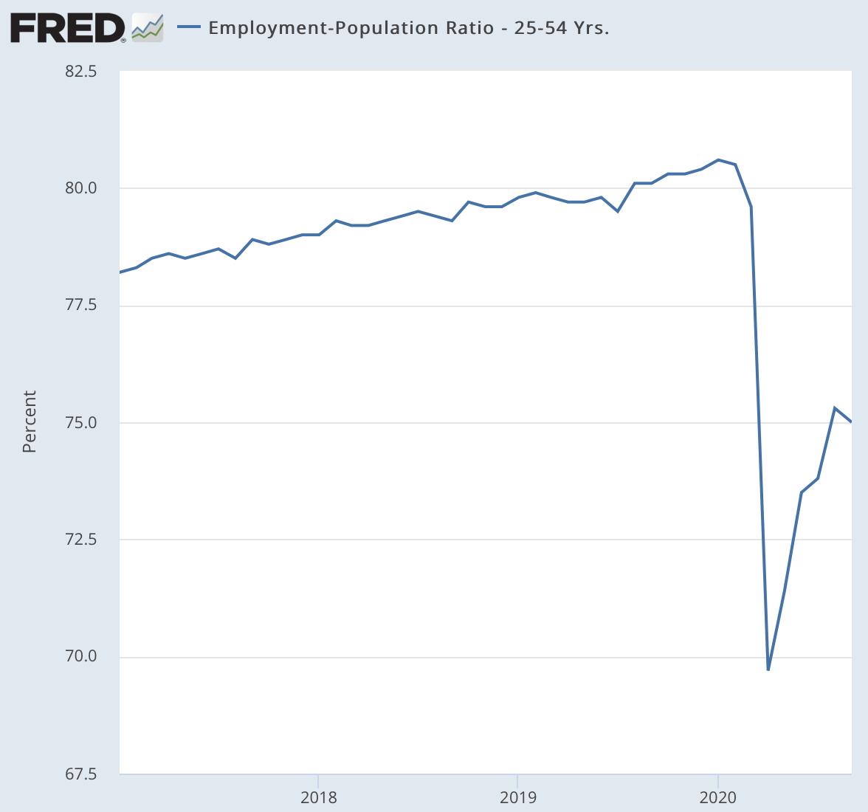
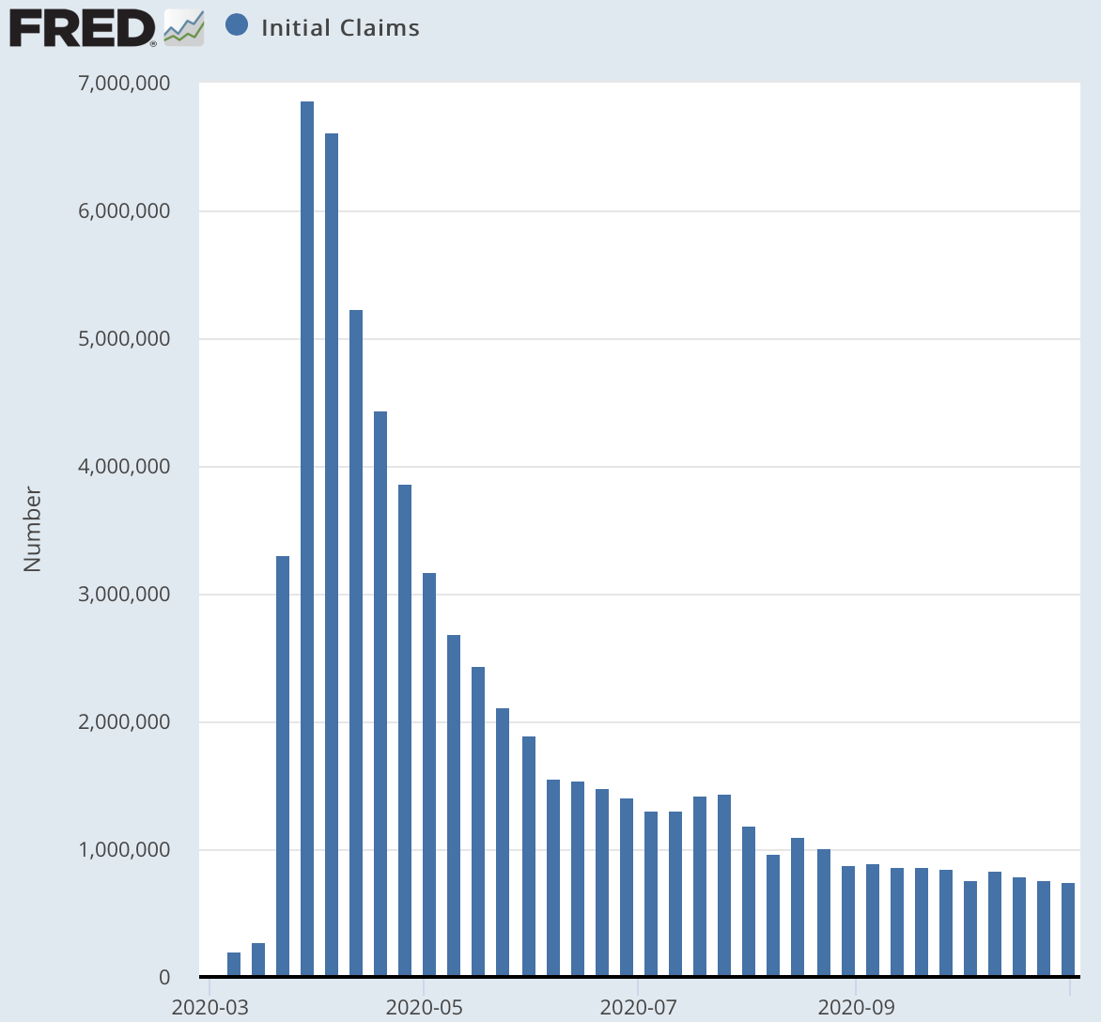
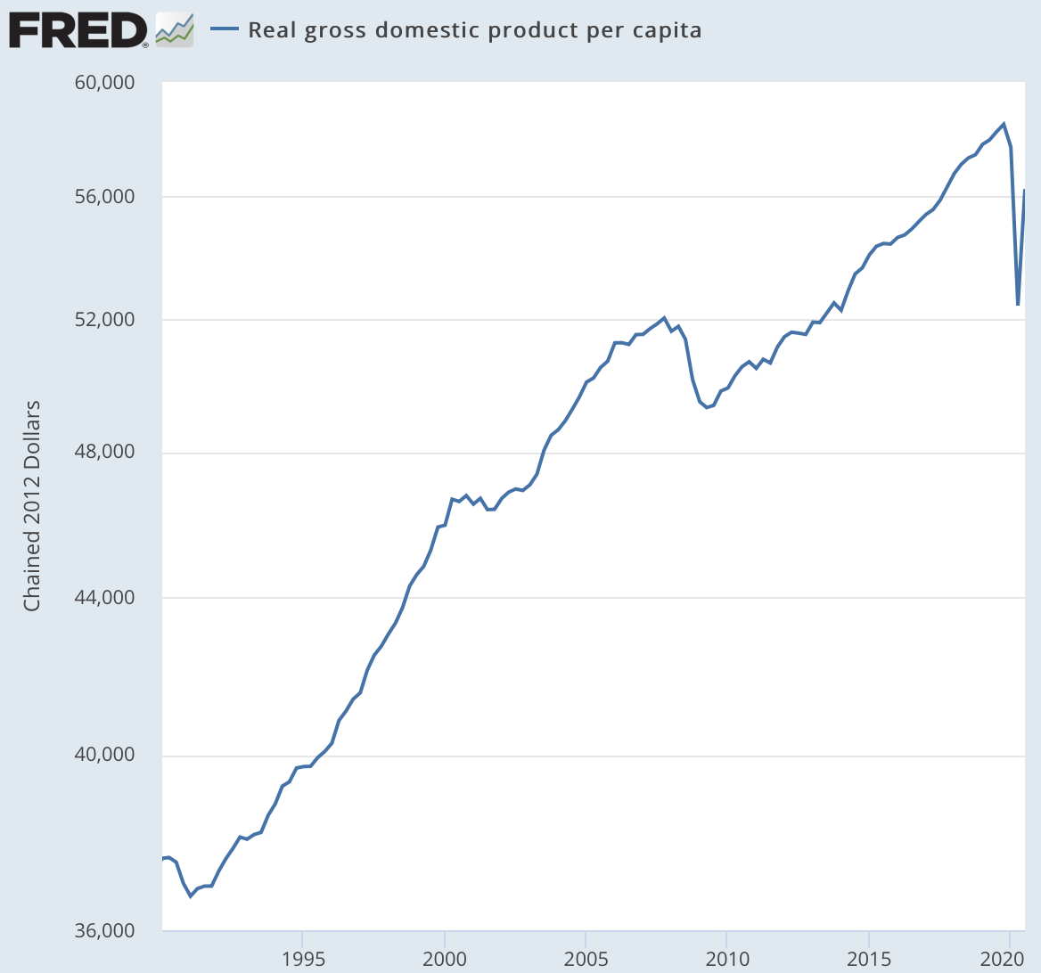
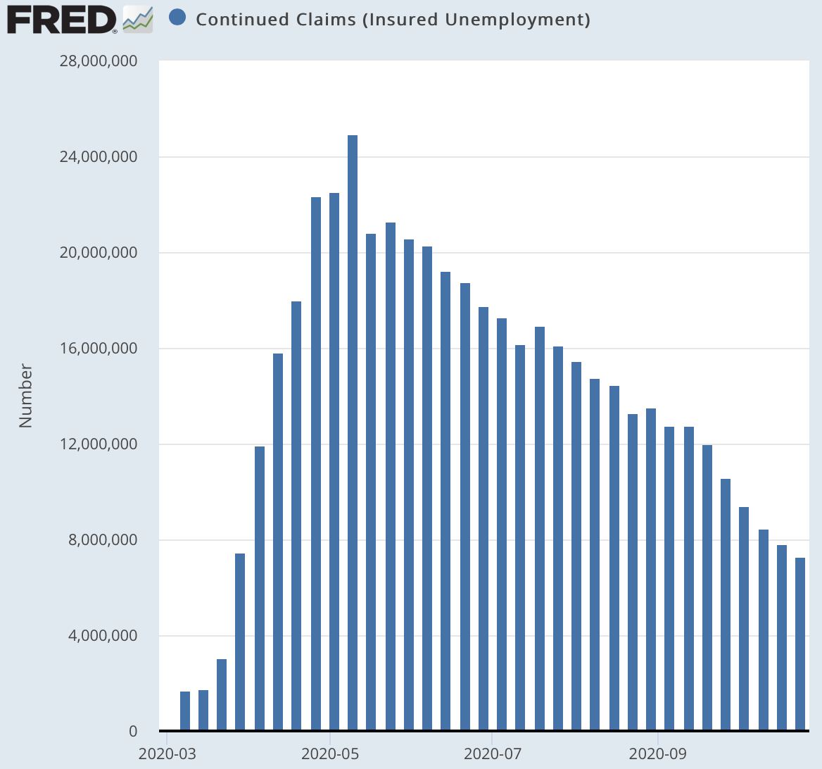
COVID Economic Impact
Five Takeaways:
Recovery bounceback halfway from the April lowpoint
But there it has stalled
Continued huge amounts of apparent churn, with 800,000 new UI applications each week
Decline in continued UI claims half reemployment, half benefits expiration or ration-by-hassle
Pent-up savings? Or depressed incomes? Which will dominate in its effects on demand?
COVID Dashboard (FRED): <https://research.stlouisfed.org/useraccount/dashboard/56322>
<https://www.icloud.com/keynote/0vOsaU6aylqz37jfdq6WfvS5Q>
2020-11-05

Slide 2
Back Shortly…
Brad DeLong’s Office Hours

Slide 3
Catch Our Breath
Let’s reflect on what we have just heard & seen…
Comments
Questions
Readings

Slide 4
========================

