Slide 1
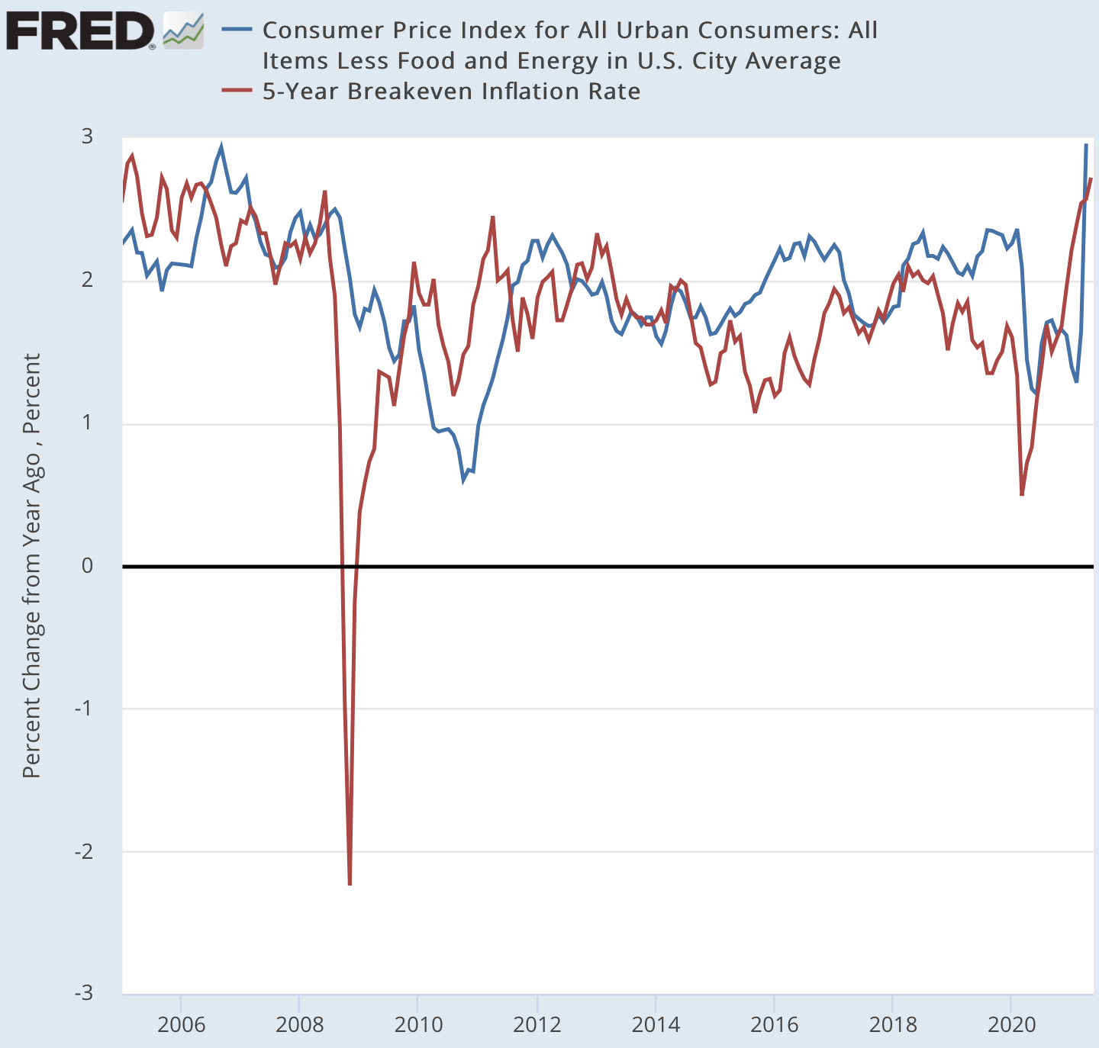
Will There Be Inflation? Yes.
You cannot rejoin traffic at speed without burning rubber…
How much inflation?
  We do not know
    How much to move 4% of the labor force across sectors?
    How much to convince workers to rejoin?
    How much from bottlenecks?
How persistent will the inflation be?
  Unlikely to be a lot: it took a huge number of shocks to de-anchor inflation expectations from 1965 to 1975…
<>
<>
  YYYY-MM-DD
  J. Bradford DeLong @delong For 2021-05-20

Slide 2
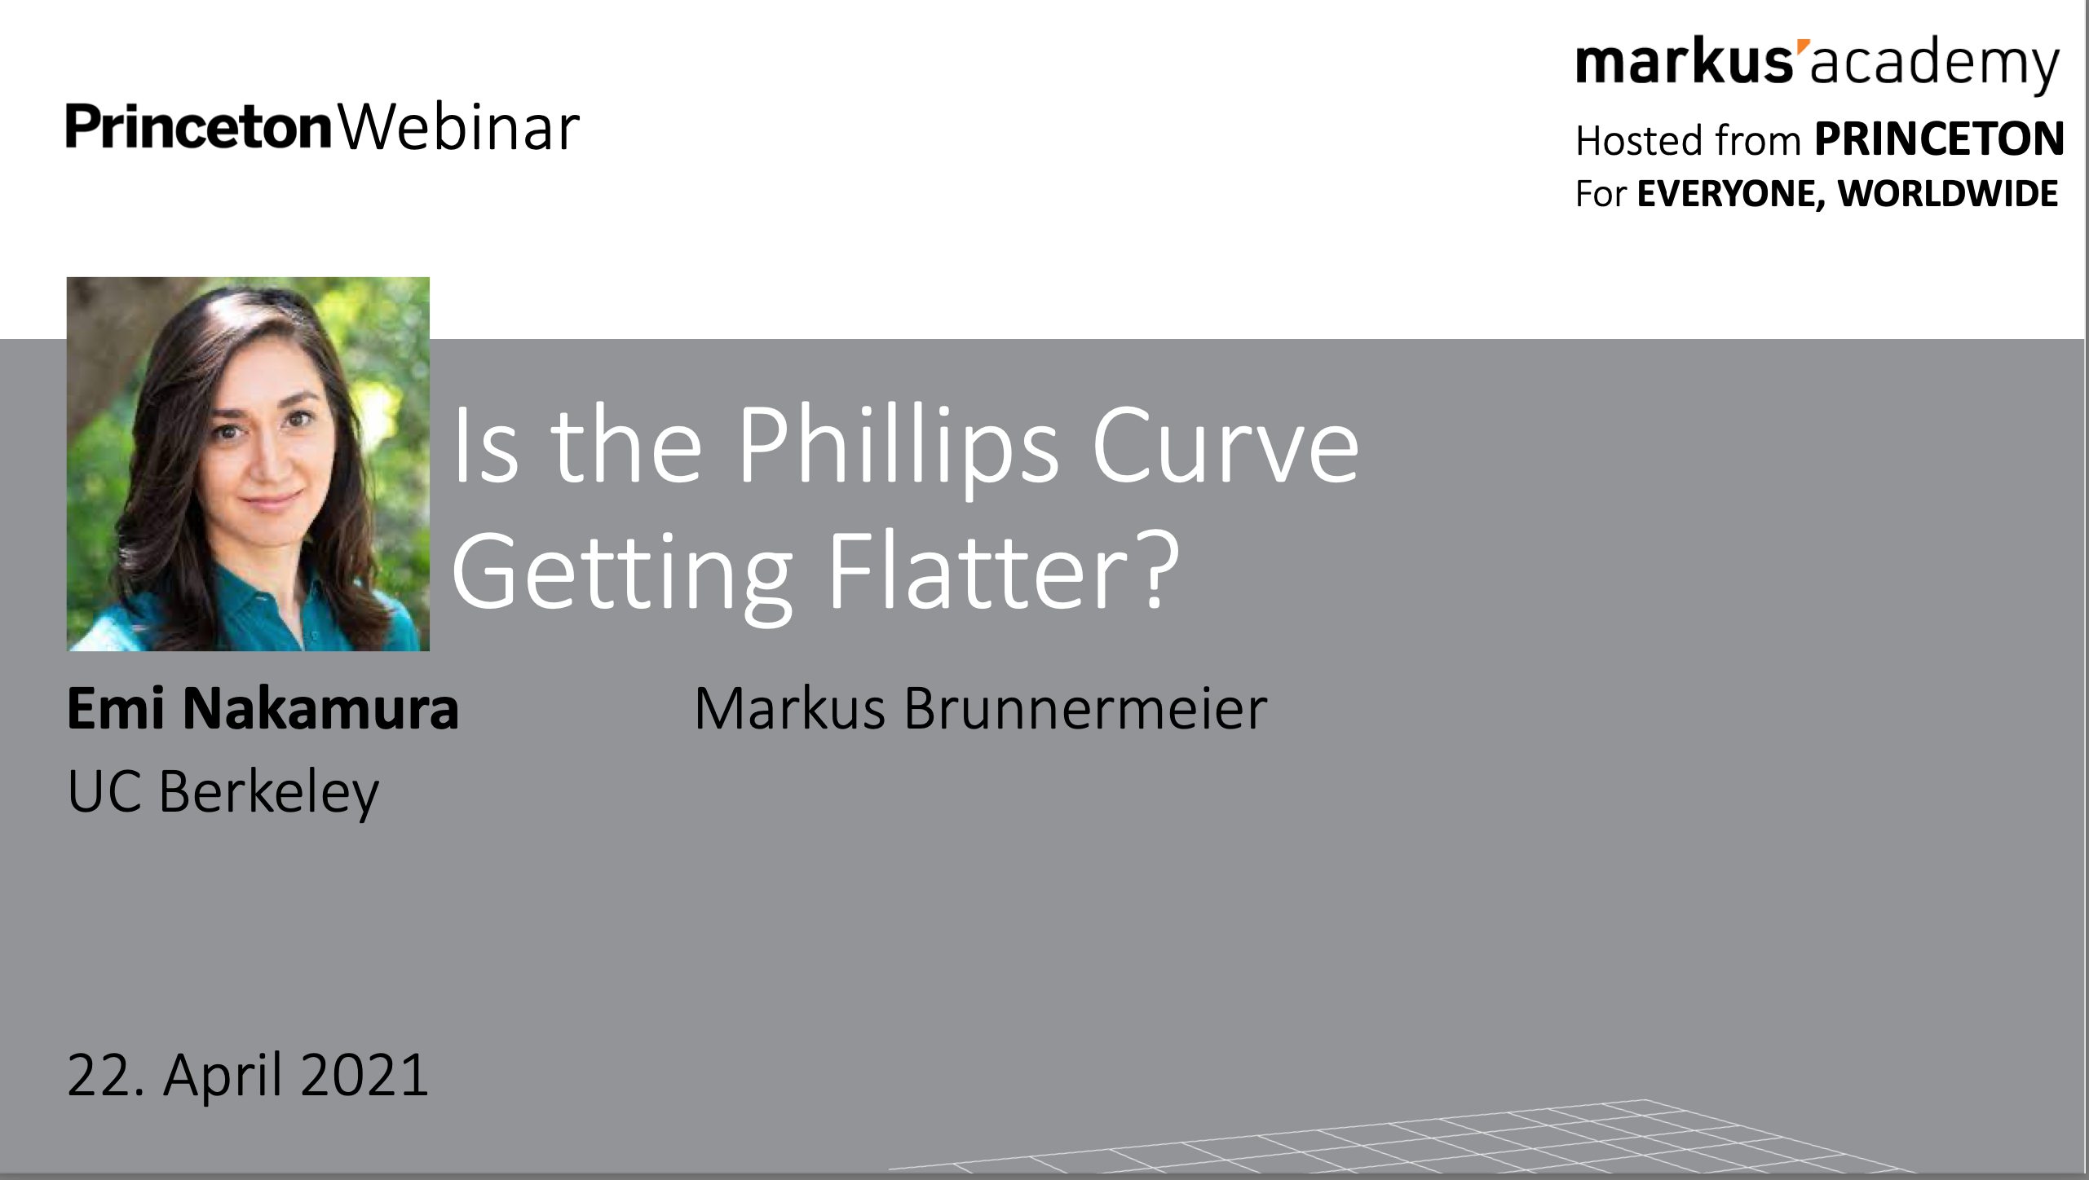
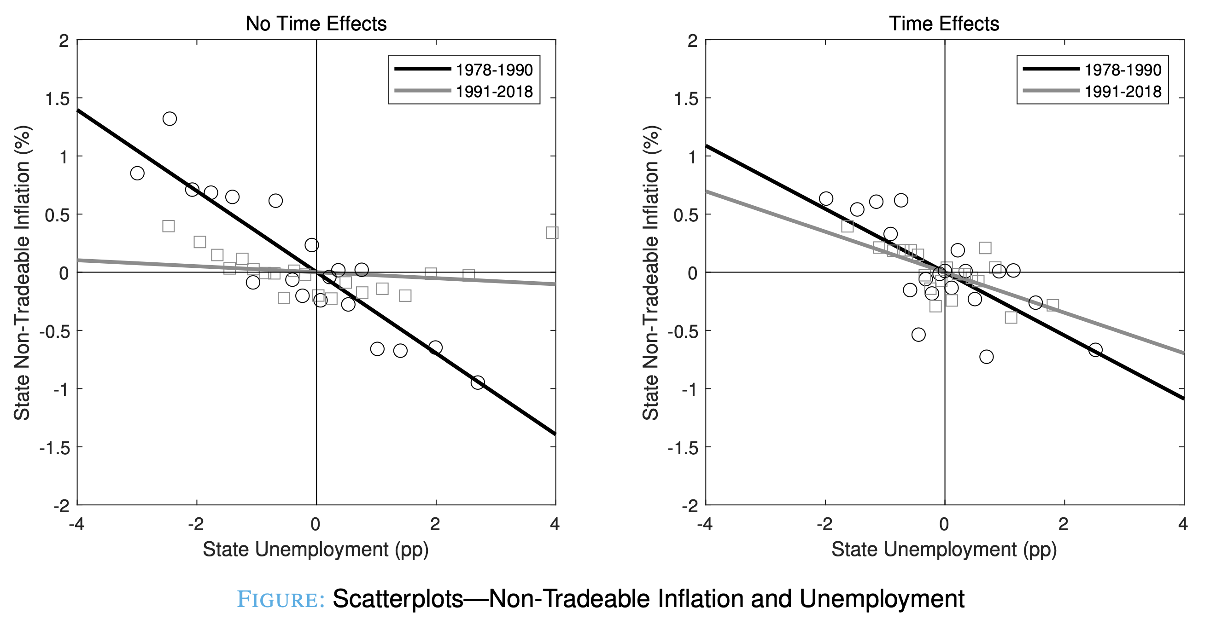
Takeaway: Phillips Curve Always Pretty Flat
<>
<>
  YYYY-MM-DD
  J. Bradford DeLong @delong For 2021-05-20

Slide 3
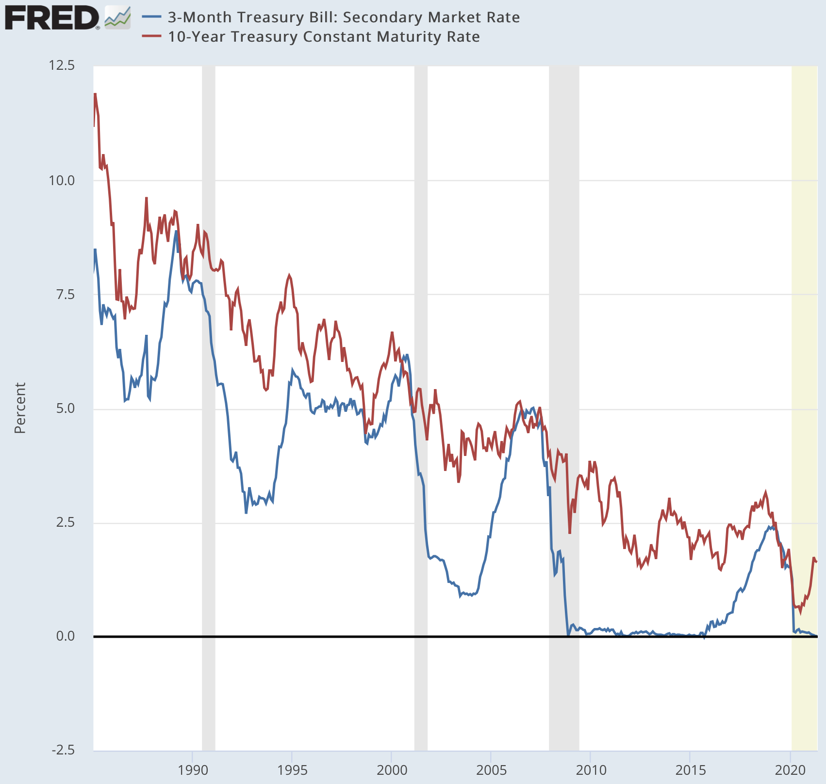
Can the Fed Stop Inflation? Yes
Can Will the Fed stop inflation?
It has, ever since 1979…
It required a very strange concatenation of events for the Fed not to stop it from 1969-79:
  An Arthur Burns, who did not think unions would believe he would…
  An Arthur Burns, who did not think congress would let him…
  A Richard Nixon & a John Connally, who broke Bretton Woods…
  Unions, that did not understand the stakes…
  A 2.5%-point/year productivity slowdown…
  A King Faisal & an Ayatollah Khomeini…
    A blocked response (Simon on Kissinger?)
<>
<>
  YYYY-MM-DD
  J. Bradford DeLong @delong For 2021-05-20

