Slide 1

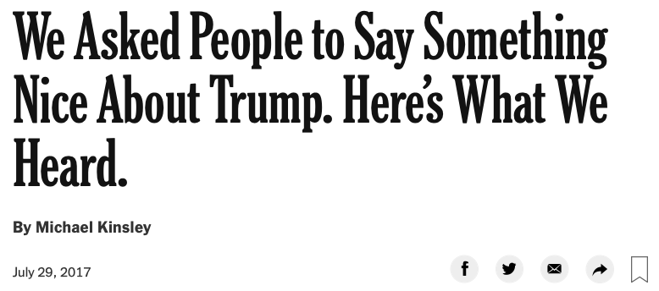
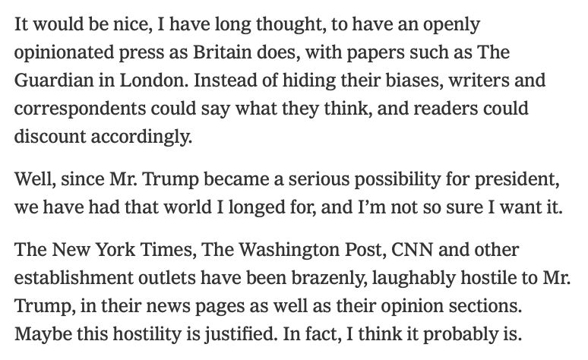
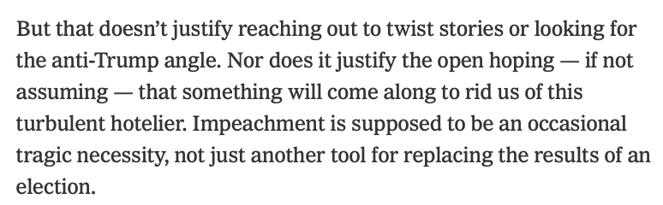
Note to Self: Michael Kinsley
The last thing I read, or ever will read, by Michael Kinsley—commissioned and published by the New York Times on July 29, 2017.
I gave my Kinsley books away to the library after this.
Perhaps that was the wrong thing to do—after all, someone might come along and read them...
Michael Kinsley (2017-07-29): We Asked People to Say Something Nice About Trump. Here’s What We Heard <https://www.nytimes.com/2017/07/29/opinion/sunday/we-asked-people-to-say-something-nice-about-trump-heres-what-we-heard.html>: ‘Yes, it’s true that Hillary Clinton got more votes, but he got the votes of more than 62 million…
‘…The New York Times, The Washington Post, CNN and other establishment outlets have been brazenly, laughably hostile to Mr. Trump, in their news pages as well as their opinion sections. Maybe this hostility is justified. In fact, I think it probably is.
‘But that doesn’t justify reaching out to twist stories or looking for the anti-Trump angle. Nor does it justify the open hoping—if not assuming—that something will come along to rid us of this turbulent hotelier. Impeachment is supposed to be an occasional tragic necessity, not just another tool for replacing the results of an election....
‘There has been endless vilification of the guy and speculation about how we might get rid of him.... Earlier this year, The New York Times allowed me to ask its readers, “Is there nothing nice you can say about the man who, after all, is our president?”...
‘An alarming number of readers demanded that their subscriptions be canceled because this one pro-Trump article appeared in a daily sea of antagonism to him. Should it really count as pro-Trump to say, well, he’s done this one good thing among all the bad things?…
<https://www.icloud.com/keynote/0NS1CC0oX3WwfiGNVGIuNYsGA> <https://www.nytimes.com/2017/07/29/opinion/sunday/we-asked-people-to-say-something-nice-about-trump-heres-what-we-heard.html> 2020-11-01
Notes:
The last thing I read or ever will read by Michael Kinsley. It was July 29, 2017. I gave my Kinsley books away to the library after this. Perhaps that was the wrong thing to do... **Michael Kinsley** (2017-07-29): _We Asked People to Say Something Nice About Trump. Here’s What We Heard_ <https://www.nytimes.com/2017/07/29/opinion/sunday/we-asked-people-to-say-something-nice-about-trump-heres-what-we-heard.html>: ‘Yes, it’s true that Hillary Clinton got more votes, but he got the votes of more than 62 million people.... The New York Times, The Washington Post, CNN and other establishment outlets have been brazenly, laughably hostile to Mr. Trump, in their news pages as well as their opinion sections. Maybe this hostility is justified. In fact, I think it probably is. But that doesn’t justify reaching out to twist stories or looking for the anti-Trump angle. Nor does it justify the open hoping—if not assuming—that something will come along to rid us of this turbulent hotelier. Impeachment is supposed to be an occasional tragic necessity, not just another tool for replacing the results of an election.... There has been endless vilification of the guy and speculation about how we might get rid of him.... Earlier this year, The New York Times allowed me to ask its readers, “Is there nothing nice you can say about the man who, after all, is our president?”... An alarming number of readers demanded that their subscriptions be canceled because this one pro-Trump article appeared in a daily sea of antagonism to him. Should it really count as pro-Trump to say, well, he’s done this one good thing among all the bad things?

Slide 2
Catch Our Breath
Let’s reflect on what we have just heard & seen…
Comments
Questions
Readings

Slide 3
========================

