Slide 1
INET Edinburgh Panel: “Comparative Advantage”: The Advantage of the Comparatively Powerful?
Ricardo’s Big Idea and Its Vicissitudes
J. Bradford DeLong
http://bradford-delong.com
Last edited: 2017-10-19
https://www.icloud.com/keynote/0QMFGpAUFCjqhdfLULfDbLE4g

Slide 2
Overview
The doctrine of “comparative advantage”:
  Solves a particular theoretical problem for Ricardo
    Reconciling the LToV with different relative productivities in different nations
    By using Hume’s “On the Balance of Trade”: specie flow and QToM
  As a bonus, produces “optimal” production specialization
A lot of holes in the optimality argument…
An “esoteric” doctrine: we teach comparative advantage simplicity because
  The real arguments for free trade are too complex
“Esoteric” doctrine more or less convincing, according to taste, ideology, &c….
And neglect the Negishi social welfare weights:
  The market is a machine for satisfying the wealthy
  Because the market maximizes a SWF in which your weight is proportion to your wealth (or the cube of your wealth)

Slide 3
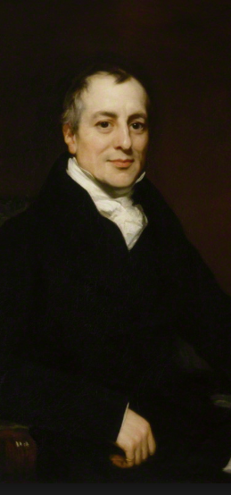
David Ricardo: The Apotheosis of the Market
David Ricardo: Principles of Political Economy and Taxation (1817):
  “Under a system of perfectly free commerce, each country naturally devotes its capital and labour to such employments as are most beneficial to each. This pursuit of individual advantage is admirably connected with the universal good of the whole… distribut[ing] labour most effectively and most economically… increasing the general mass of productions… diffus[ing] general benefit, and bind[ing] together by one common tie of interest and intercourse, the universal society….
  “It is this principle which determines that wine shall be made in France and Portugal, that corn shall be grown in America and Poland, and that hardware and other goods shall be manufactured in England…”

Slide 4
David Ricardo: Trade and Comparative Advantage in Equilibrium
David Ricardo: Principles of Political Economy and Taxation (1817):
  “England may… produce the cloth… [with] the labour of 100 men for one year; and... the wine... 120 men.... England would therefore find it her interest to import wine, and to purchase it by the exportation of cloth. To produce the wine in Portugal.. 80 men... and… the cloth... 90 men.…
  “It would therefore be advantageous for her to export wine in exchange for cloth…notwithstanding that the commodity imported by Portugal could be produced there with less labour than in England…. It would be advantageous to her rather to employ her capital in the production of wine, for which she would obtain more cloth from England, than she could produce by diverting a portion of her capital from the cultivation of vines to the manufacture of cloth…”

Slide 5
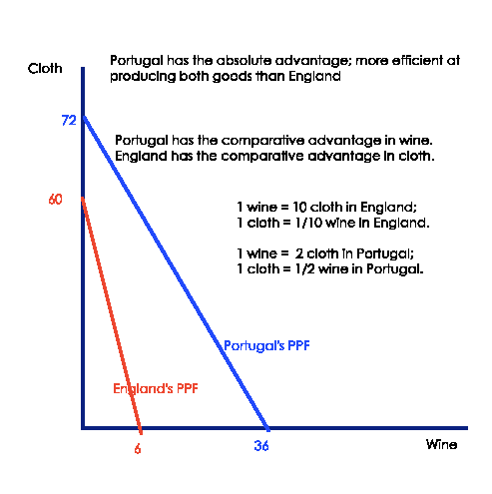
Comparative Advantage Solves an Intellectual Problem for Ricardo
Ricardo’s intellectual problem:
  Wages-fund working-capital theory of production…
  Labor-value prices within each country…
  How then is:
    Trade possible should one country be more productive at making everything than another?
    Shouldn’t all capitalist production move to the more efficient country?
      Leaving only subsistence agriculture in the less efficient?
        Lewis/Harris-Todaro framework in the background?

Slide 6
Comparative Advantage as Ricardo’s Solution
Assume: No international capital mobility
Assume: Specie flow to balance payments in the event of unbalanced trade
Assume: Labor theory of value within each country
Assume: Quantity theory of money driven by specie stocks
Hence
  Local labor value relative prices within each country
  But countries have different overall price levels
  Hence trade profitable to merchants who buy at labor value relative prices in one country and sell at labor value relative prices in the other
  Specialization according to comparative advantage in equilibrium
  And money is a veil: terms of trade are as if barter…

Slide 7
Note: David Ricardo’s “Comparative Advantage” Is a Complex Argument
Ricardo’s assumptions:
  Working-capital-in-advance production technologies
  Labor value prices (within a country)
  Country- and sector-specific labor productivities
  Specie flows to balance international payments
  A nation-level quantity theory of money depending on specie stocks
  No international capital mobility
Ricardo’s conclusions:
  Surplus from trade captured by merchants
  Money a veil
  Optimal international specialization
“Free trade best because comparative advantage” a very stripped-down version…

Slide 8
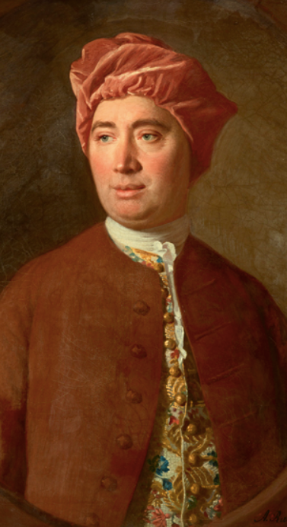
  Note: David Hume: The Demolition[?] of “Mercantilism”
Use reason to dispel prejudice and “superstition”
Systems thinking, emergent properties, and stable equilibrium
Of the Balance of Trade (1752): Conclusion
  “A government has great reason to preserve with care its people and its manufactures. Its money, it may safely trust to the course of human affairs, without fear or jealousy. Or if it ever give attention to this latter circumstance, it ought only to be so far as it affects the former…”

Slide 9
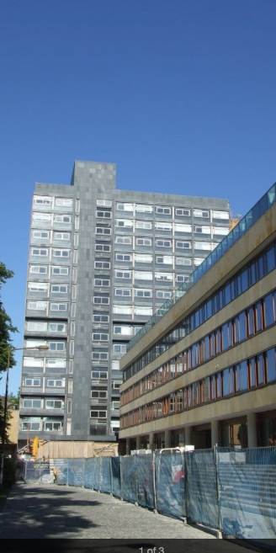
Note: David Hume: The Appeal to Emergent Properties of Equilibrium
Of the Balance of Trade (1752): Argument:
  “Suppose four-fifths of all the money in GREAT BRITAIN to be annihilated in one night…. Must not the price of all labour and commodities sink in proportion, and every thing be sold as cheap as they were in those ages? What nation could then dispute with us in any foreign market?… In how little time, therefore, must this bring back the money which we had lost, and raise us to the level of all the neighbouring nations?…”
Note: not a completely convincing argument:
  Much more an argument that there are powerful limits to “mercantilist” policies that seek to bring specie within the potential control of a government than a refutation
  The refutation comes with Adam Smith’s redefinition of the goal of state policy as a wealthy nation…

Slide 10
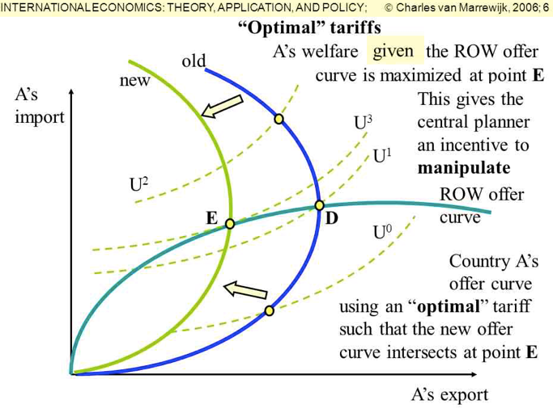
Holes in David Ricardo’s Argument for Free Trade as in Some Sense “Optimal"
Hole 1: Optimal tariff
  Shift the terms-of-trade in your favor
Hole 2: Un- and underemployment
  Exports move workers from subsistence agriculture to capitalist production
  Exports reduce industrial unemployment
Hole 3: Externalities as sources of economic growth
  Economies of scale
  Learning-by-doing
  More broadly, communities of engineering practice
  Focus of inventive activity
Hole 4: Internal distribution
  Market does not seek “greatest good of the greatest number”
    Hence the late 19th C. “social Darwinist” redefinition of the social welfare function

Slide 11
Hence the “Esoteric” Arguments for Teaching Comparative Advantage
Optimal tariff rebuttal: unstable in a game theory sense
Un- and underemployment rebuttal: better macro policy superior tool
Externalities as sources of economic growth rebuttal: industrial policy a trap
  Very few countries have both the administrative competence and the administrative autonomy to successfully conduct industrial policy
Internal distribution rebuttal:
  “social Darwinist” redefinition of the social welfare function
  the same political system that produced unequal wealth distribution cannot be trusted
  ignore…

Slide 12
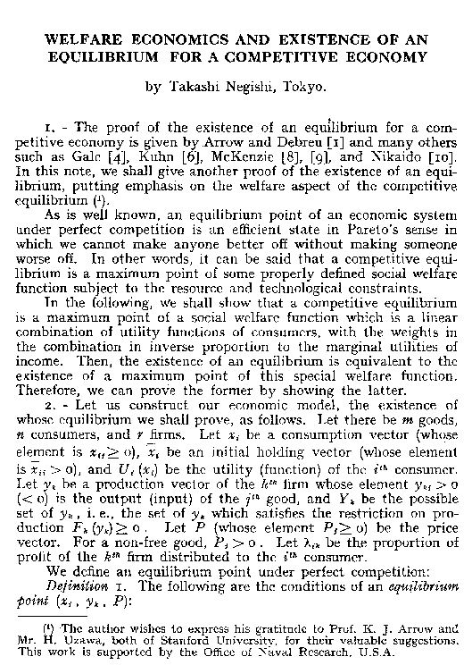
Hole 5: External Distribution
Even if the internal distribution of wealth in each country is acceptable…
Remember: Negishi social welfare weights:
  Market maximizes a social welfare function…
  The market’s social welfare function is a weighted sum of individual utilities…
  Where each individual’s weight ω is the inverse of their individual marginal utility of wealth W:
    [U = ln(W)] ⇒ [ω = W]
    [U = -(W⁻²)/2] ⇒ [ω = W³]
In that sense, “comparative advantage” has to be the advantage of the comparatively well-off. It cannot be otherwise

