Slide 1
Development Engineering 215: Global Poverty Challenges and Hopes: A Perspective for Development Engineers
J. Bradford DeLong
Professor of Economics and Chief Economist Blum Center for Developing Economies, U.C. Berkeley
Th 2020-09-10 12:00 Noon

Slide 2
Joeva Rock Says: GPP 115 Live
From Joeva Rock:
Tu September 22nd, 2-3:30p (Week 5)
Tu October 6th, 2-3:30p (Week 7)
Tu October 20th, 2-3:30p (Week 9)
Tu October 27th, 2-3:30p (Week 10)
Tu November 10th, 2-3:30p (Week 12)

Slide 3
Eight Questions
From Casey Finnerty:
Why do “developed” countries intervene in “developing” countries?
What would happen if "developed" countries stopped?
How could addressing poverty in the US affect poverty abroad?
What metrics should we use to measure inequality?
What would a moral economy (as opposed to a market economy) look like today? What are some modern examples of moral economies?
What role does reparations have in development work?
What tools can we use to identify root causes of inequality, as opposed to symptoms?
How is [our] research entrenched in capitalism? How can [our] research be decoupled from capitalism?

Slide 4
Readings
Required:
Logan: Why Can’t People Feed Themselves? <https://bcourses.berkeley.edu/courses/1497095/files/77911767>
Rodney: How Europe Underdeveloped Africa <https://bcourses.berkeley.edu/courses/1497095/files/77911766>
Hickel: The Divide (chapter 3)
  Commercial Revolution
  “Reversal of fortune”
  Capitalism
    Slavery vs. getting people to enslave themselves
Additional:
Animated Atlas of African History <https://www.brown.edu/Research/AAAH/>
Race: The Power of an Illusion <https://berkeley-kanopy-com.libproxy.berkeley.edu/video/race-power-illusion-0>

Slide 5
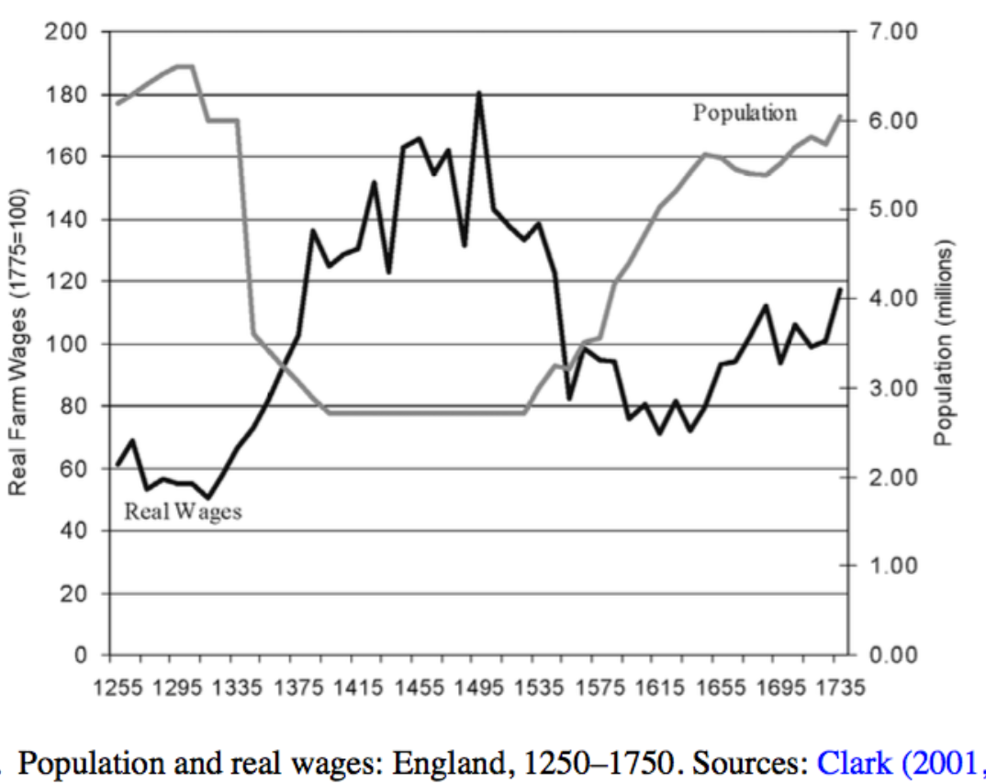
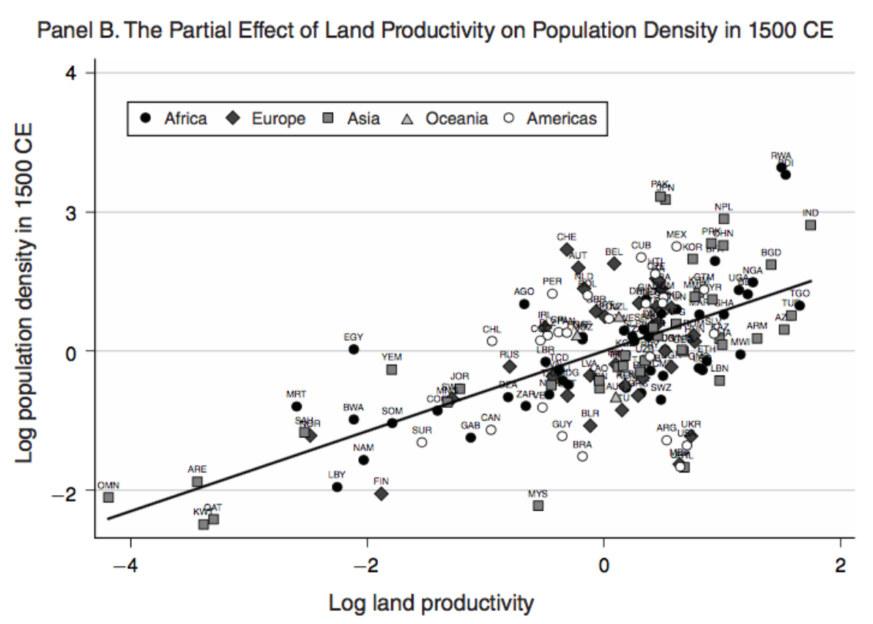
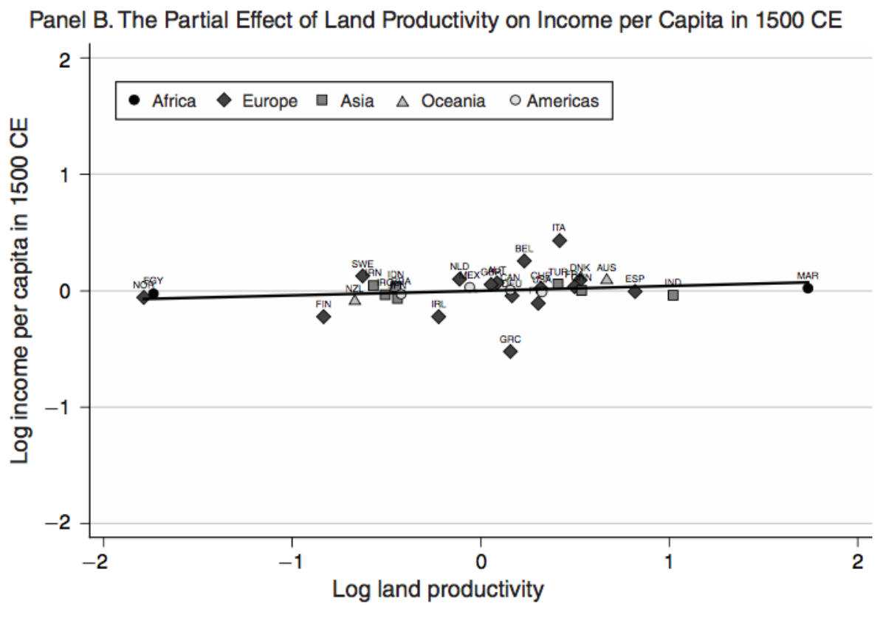
Ca. 1500
Malthusianism?
What limits food insecurity?
What does each society’s upper class do?
Foragers vs. farmers…

Slide 6
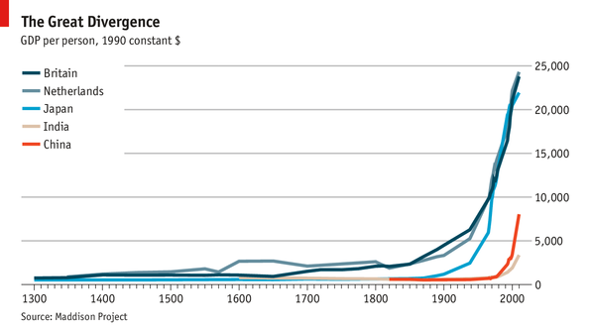
The Great Divergence

Slide 7
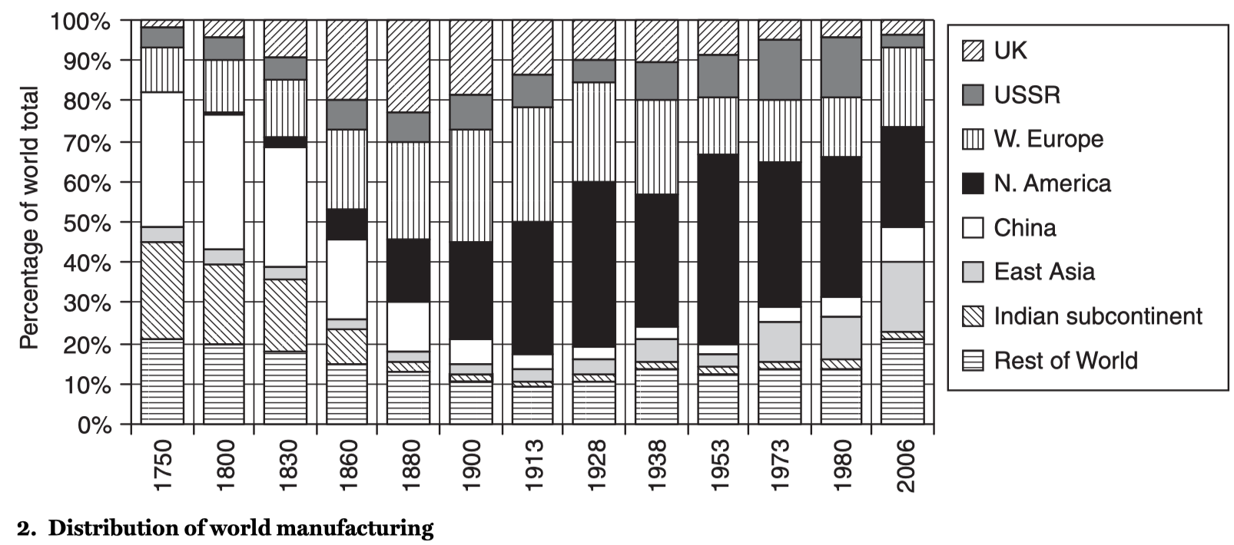
Industrialization & Deindustrialization
World mfg. pdn per capita:
1500: 100
1770: 140
1870: 180
1950: 1100
2020: 4500

Slide 8
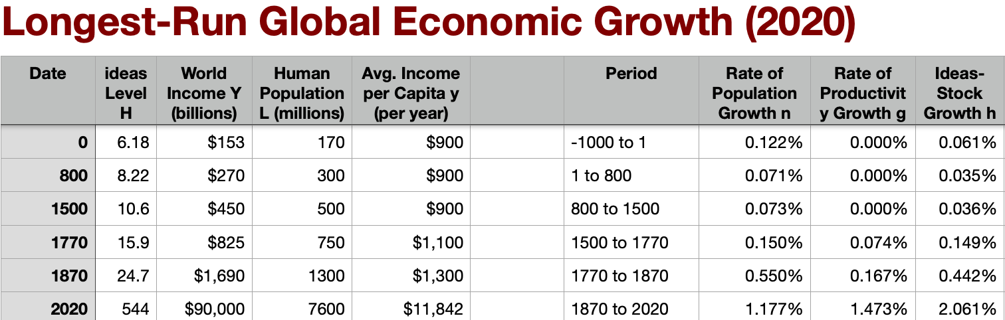
Guesses at Global Growth
Still a Malthusian world in 1500:
What limits food insecurity? What does each society’s upper class do?
Not thereafter:
  How the watersheds of technology generation after 1500?
  How does western Europe become “the core”?
  Markets & free labor in the core structure enslavement at the periphery…

Slide 9
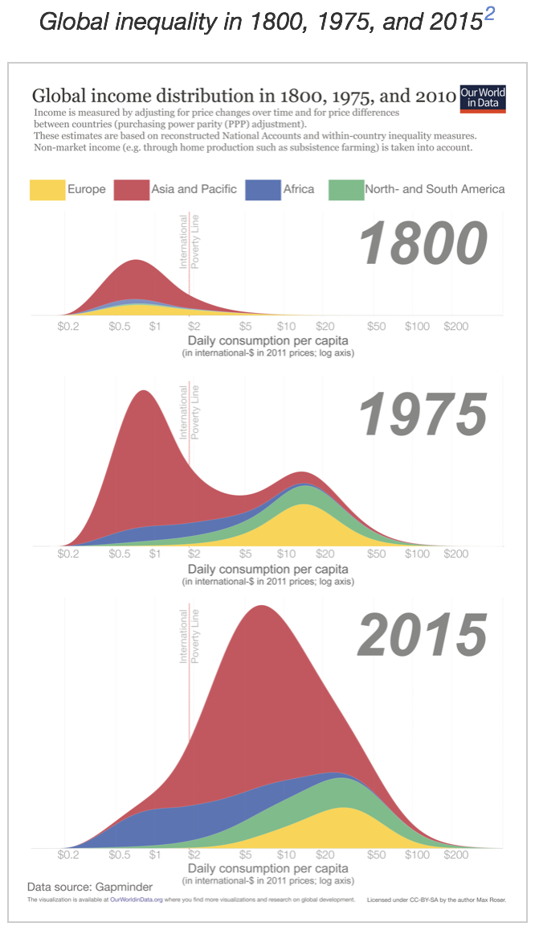
Max Roser et al.: Our World in Data
<https://ourworldindata.org/>
  Stasis at the bottom—people whose lives are still not that distinguishable from all of our pre-industrial ancestors
    How is such an atrocity possible in a world as rich and as connected as ours is?
  1800-1975: Industrial Revolution, Modern Economic Growth—and the creation of the First and Third Worlds
    The “development of underdevelopment”
  1975-2015: China stands up; India gets off the ground—back to one bell-shape
    With a lower African tail…

Slide 10
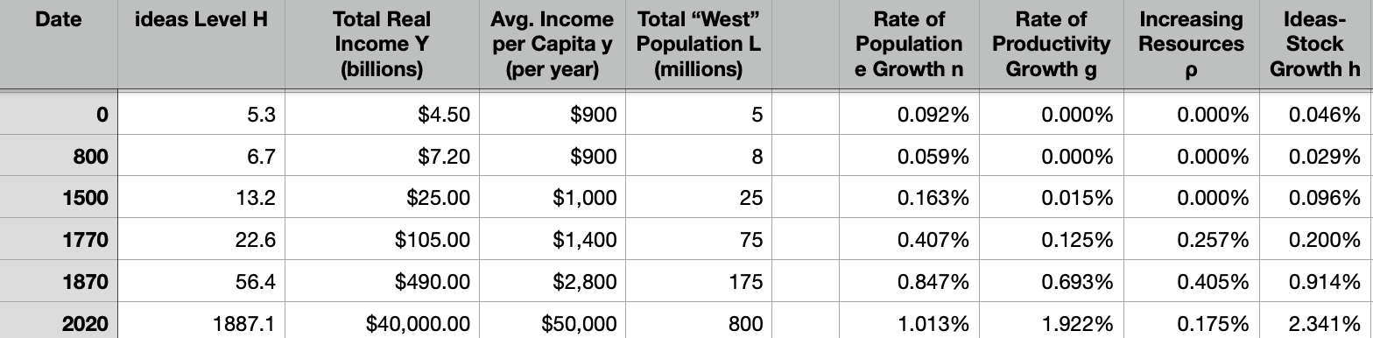
Guesses at “Global North” Growth
What determines who joins the global north?:
Hungary and Portugal and Finland and Korea can and do; Argentina and Sri Lanka and Ghana cannot (do not?)
The Black Death of 1346-8 & subsequent “European” marriage patterns…
Inequality as the big enchilada: global north vs. the rest:
  10% of population, 1.3x SoL in 1870
  15% of population, 2.8x SoL in 1870
  11% of population, 6.3x SoL in 2020
Resource extraction from the global south
Latin America’s internal colonization?

Slide 11
Nineteenth Century Development
Transition from agricultural or handicraft to industrialization:
Problem: extremely cheap machine-made manufactured imports from Great Britain
But you need to industrialize to nurture the communities of engineering practice essential for technological diffusion
Standard development strategy response:
  internal improvements (to deepen the division of labor)
  investment banks (to mobilize savings for entrepreneurship)
  universal education (to create the labor force that can handle the requirements of modern commerce and industry)
  external tariffs (to keep your engineering-supporting industries from being blown away by the gales of English (and later American and German) competition

Slide 12
Need to Adopt the “Standard Package”
Infrastructure, banks, schools, and tariffs:
Colonies could not follow such strategies:
  economic policies subordinated to the interests of the colonizer
  Latin America internally colonized by its Castilian-descended elite
Independent countries could:
  Japan
Elsewhere:
  Handicraft manufacturing vanished and machine-based grew only slowly
  Asian and Middle Eastern labour forces were redeployed into agriculture: underdeveloped exporters of wheat, cotton, rice, and other primary products

Slide 13
The Idea of “Development”
Karl Marx (1867): Capital:
“The physicist either observes physical phenomena where they occur in their most typical form and most free from disturbing influence, or, wherever possible, he makes experiments under conditions that assure the occurrence of the phenomenon in its normality. In this work I have to examine the capitalist mode of production.... Their classic ground is England. That is the reason why England is used as the chief illustration.... If... the German reader... in optimist fashion comforts himself with the thought that in Germany things are not nearly so bad; I must plainly tell him, 'De te fabula narratur!’ [‘It’s the story of you’ – Horace]....
“The natural laws of capitalist production... [are] working with iron necessity towards inevitable results. The country that is more developed industrially only shows, to the less developed, the image of its own future…”

Slide 14
Eras of Development
Post-WWII Truman: “hand up”—technocratic: infrastructure, institutions, technologies
  The “drive to high mass consumption”
  Division of labor depends on the extent of the market; cf.: Adam Smith: Wealth of Nations
  Institutionalization via Bretton Woods macro NGOs (World Bank, IMF) and other institutions (USAID)
Karl Polanyiesque: A “Great Transformation”
  In contrast to a belief in the “system of natural liberty”
  Human institutions and practices need to be transformed for industrialization to take hold
    Market economy/market society/“double movement”
“Washington Consensus” of neoliberalism did not produce hoped-for results. Or did it?
  If a country cannot run a public utility water system in the public interest, why would you think it be able to conduct a privatization auction in the public interest?

Slide 15
People
Brad DeLong delong@econ.berkeley.edu
Tvetene Carlson tjcarlson@berkeley.edu 3034966195 G Civil & Environmental Eng MS, Civil & Environmenta
Casey Finnerty casey.finnerty@berkeley.edu 20956015 G Civil & Environmental Eng PhD
Adrian Hinkle adrian.hinkle@berkeley.edu 3034272154 G Civil & Environmental Eng PhD
Mekhala Hoskote mdhoskote@berkeley.edu 24205468 G Health & Medical Sciences MS
Kelly Conway kelly_conway@berkeley.edu
Haley Wohlever haley.wohlever@berkeley.edu
Hanna Seo hanna_seo@berkeley.edu
Sara Mahmoud sara_mahmoud@berkeley.edu
Margie Lauter margielauter@berkeley.edu
Dana Geffner dana_geffner@berkeley.edu
Notes:
From a cynical perspective the interesting question might be not why was there economic stagnation in much and absolute economic decline in some ofemerging markets, but why there was rapid growth in other portions. Chile, Mexico, southern Brazil, and Panama in Latin America; Algeria in Saharan and Botswana in sub-Saharan Africa; and Hong Kong, Malaysia, Singapore, South Korea, Taiwan, Thailand, and now, of course, China in Asia are countries that have made impressive strides toward closing the relative material prosperity gap vis-a-vis the global north in the post-World War II era. How have they managed to do this? What have been the key factors separating successful from unsuccessful episodes of economic development?
The natural conclusion from emerging-market history is that successful economic development is difficult without either a limited government or a developmental state: the logic of politics is that of favors performed, wealth redistributed, inﬂuence exercised, and taxes collected; that is very different from the logic of economic growth. Only a state that is limited in the amount of damage it can do to the economy, or a state that is secure enough, independent enough, and committed to rapid economic growth can avoid this development trap.
These are the two roads to successful rapid development: “neoliberalism,” on the one hand; and the so-called “developmental state” approach that has been so successful in East Asia on the other. Either insulate the economy from the (semi-predatory) government so that the government’s attempts to tilt the distribution of income in favor of the politically powerful are relatively ineffective and do little harm, or create a government bureaucracy whose first goal is development, and which views interests as its tools to be used in promoting economic growth, rather than as its masters.
These pressures have, in the post-World War II period at least, been strong enough to counteract the natural tendency for poor countries to learn rapidly about technology and catch up to rich ones. There is no clear reason on the horizon for these pressures to diminish. Optimists hope that the record of economic failure provided by much third world experience in the past generation will lead to the creation of intellectual pressures for reform strong enough to overcome the bias for stagnation.
And if ideas truly are the decisive forces making history in the long run, perhaps the optimists are right.
If the optimists are wrong, then we are all in big trouble. Successful handling of the future’s global environmental problems, and successful long-run stabilization of human populations, hinges on successful industrialization in the third world and the consequent—rapid—passage through the demographic transition.
----
One way to read the economic history is as repeated attempts to produce the second: to create a pro-growth “developmental state.” Yet in the last analysis there is nothing worse than state-led development led by an anti-developmental state. And that was what too many post-independence Asian and African and too many post-World War II Latin American states turned out to be.
Thus starting in the 1980s hopes for development—outside of the Pacific Rim, where the successful “developmental state” has been was already clearly a reality— shifted in the direction of “neoliberalism.” It seemed better to try to limit the state’s involvement in the process of development, because its interventions were more likely to be destructive than constructive. Rely, instead, on the world market as a source of demand, and on the requirements for integration into the world market and cooperation with the international agencies set up after World War II as a source of good-enough governance.

