Slide 1
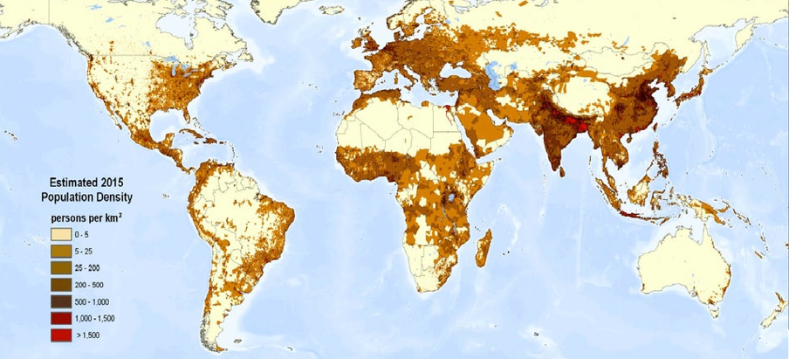
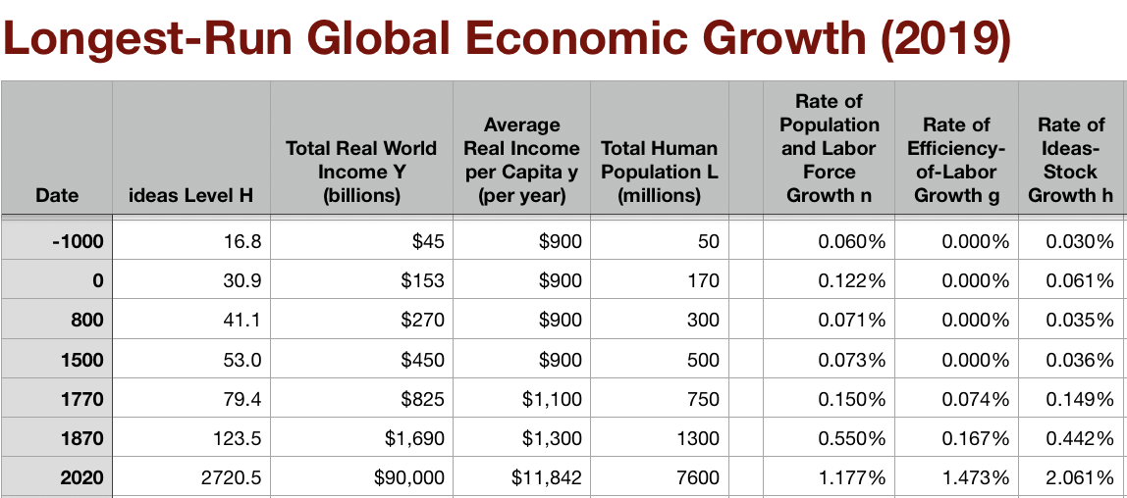
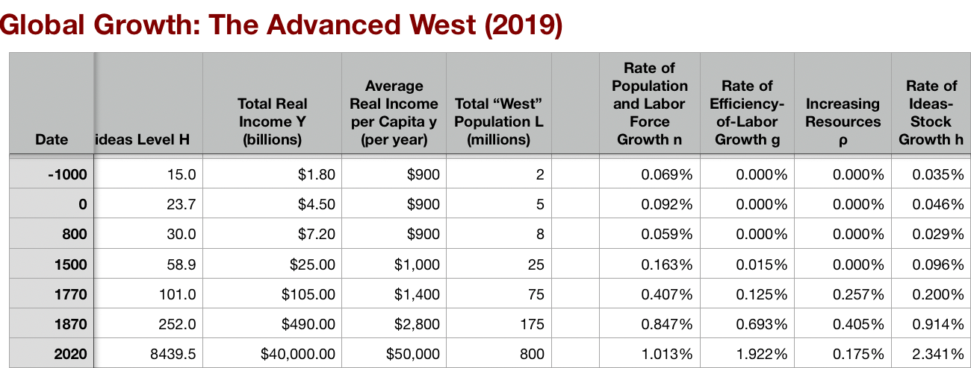
3.1. Intro Video: The Broad Sweep: Breaking Through
3.1.1. Why No Breakthrough Before 1500?
3.1.2. Class & Conflict at the End of the Middle Ages
3.1.3. The Commercial-Industrial Revolution
3.1.4. The Industrial Revolution
3.1.5. Why Northwest Europe?
<>
<>
2020-12-06
2021-02-14
<https://share.mmhmm.app/e3ca9eb982644dea96230d0a1e67e548> <https://github.com/braddelong/public-files/blob/master/econ-135-3.1-intro-video.pptx>
Notes:
Around 1500, discontinuously—in the broad sweep of history that is: it actually took two generations—the proportional rate of growth of the human useful ideas stock quadrupled: from an agrarian-age norm of about 3.5%/century to 15%/century.
By 1600 people were talking about utopia in the future: they were noticing that things are materially different than they were in their great grandparents day and materially different in the sense of humans having more technological power. And they are projecting that into the future.
Around 1770, again discontinuously, the proportional rate of ideas invented and deployed in the human economy undergoes another discontinuous upward leap: a tripling this time, giving the world in the century after 1870 12 times the rate of potential “enlargement of the human empire” relative to what took place in the agrarian age.
And then there is a regional inequality dimension. Draw a circle of about 300 miles radius around the white cliffs of Dover in England, at the point where the ocean water gap is shortest. That was the modern “west” in 1600, the civilization—that, plus where its people’s descendants settled, plus people who self-consciously set out to join them—that was going to grow in influence and dominate the rest of the world up to our day. If you except the vikings and the crusades, the first Europeans who made the rest of the world sit up and take notice of them did so in the 1500s, and came from Portugal and Spain. Portugal and Spain, Italy, and the Dover circle—those were the three core areas of medieval Roman Catholic church-led culture in the late middle ages. By the 1600s—Latin America’s notionally Castillian-descended elite aside—Spanish and Portuguese had been overrun and superseded in European expansion by people from the Dover circle: English, Dutch, and French.
This "west “ had been increasing its ideas stock faster than the rest of the world between the Dark Age nadir and 1500. But this was catchup: gaining confidence in technologies like gunpowder, the compass, and printing that had long been known and deployed elsewhere in the world—plus building a functional social organization rather than simply the ad hoc personal hierarchical bonds of the feudal system.
After 1500 the west begins to develop an edge—in control of resources, as conquest, settlement, imperialism, and neoimperialism give it control over a greater share of land and resources; and in ideas invented and deployed as well, as science, technology, and capitalism drive innovation and deployment. For the 270 years of the commercial-imperial era the bulk of the still relatively narrow gap in growth between the west and the rest is produced by conquest and settlement and exploitation: resources, with the ideas-invention edge secondary. That changes after 1870 with the coming of the British Industrial Revolution.
====
How is it that this breakthrough out of agrarian-age Malthusian near-stagnation takes place then, in 1500, and there, in the Dover Circle?
Suppose we take the growth-theory insight that ideas are non-rival—hence human energy devoted to thinking up better ideas for how to manipulate nature and organize humans promises a much much greater return then using human labor to produce goods and services using established techniques. Even taking account of stepping-on-toes and low-hanging-fruit-has-been-picked effects, that insight leads us to expect human economic growth to accelerate as time passes.
We can fit that model to a human race of 15 million people in the year -3000, 50 million people in the year -1000, and 170 million people in the year one. We then expect a breakthrough to commercial-revolution growth rates around 500, and to industrial revolution era growth rates before 700.
We did not have that.
Instead we had the late antiquity pause. The Romans of the 100s were very confident that they were the Acme of civilization. Subsequent years are regress. There is no guarantee from the principle that two heads should be better than one that humanity would escape the agrarian age, at least not in any particular Century or millennium.
====
The worldwide acceleration in the pace of ideas growth after 1500 seems largely due to the first major human globalization: the fact that advances in sea traffic near the world together so that for at least some commodities the entire world became your market, and so you could expand the scale of your operations in the division of labor. Plus, probably more important, it was due to the Columbian exchange: the fact that many old-world crops grew extremely well in the New World and many New World crops grew extremely well in the old world, and the consequent enormous upward leap in the bio technology that humanity had its disposal. That knowledge, and then the further advances in knowledge that we are now low hanging fruit after the Columbian exchange and with the first globalization pushed up growth in the ideas stock everywhere. That led shared increasing potential prosperity in the commercial-imperial age to be widely distributed.
All this was true only if you avoided being conquered or enslaved.
And a great many people were conquered or enslaved in the commercial imperial age.
More knowledge about technology and better knowledge about geography can be used for good or ill. And the benefits were one-sided. Americans got decimated by plague, conquered, and then dominated by a nptionally Castillian-descended elite. Africans got enslaved, with enormous dire consequences also for those who escaped being enslaved via the collapse in social trust across the entire continent. In many places on the seacoast arriving Europeans in the commercial-imperial age did not make positive rather than negative bids: instead of making handsome positive-bid offers to pay for the resources and products of the rich and mysterious middle and far East, they made negative-bid offers via the laughter of the guns. And even where they did pay, the long-term benefits for Asia from trade we're dubious: Asians were eager to except the silver Europeans offered, but you can’t eat silver.
The Columbian exchange, on the other hand, greatly aided humanity’s ability to utilize nature in Asia as elsewhere.
And Europe? What was not to like. The Columbian exchange greatly boosted productivity within Europe. The coming of globalization meant that Europeans could enslave persons in the Americas to dismantle a mountain of silver to pay for Asian conveniences and luxuries over centuries. And then there was the triangle trade: guns to slaves to sugar—and tobacco, and other greatly valued staple commodities.
The edges—first Portuguese and Spanish; then French, Dutch, and English—in sailing the world’s oceans and in applying gunpowder in various ingenious ways that Europeans initially had in the 1500s were not major. They do not seem to me to be enough to explain why the world’s oceans became so European-dominated so quickly after 1500.
Let me suggest five additional factors, or rather fiver characteristics of European civilizations that melded together:
1. Bureaucracy—the legal order as it had developed in western Europe, especially as a result of fights over authority between medieval emperors and popes, had created institutions and people who thought of themseles as serving them. Thus a more durable reach and a longer purpose for society than could be found in any society in which something like, say, the great Chinese Indian Ocean exploration expeditions could be stopped by the decision of a single courtier
2. Holiness—that expansion and exploration were commanded by God
3. Honor—conquest as a way of demonstrating excellence
4. Profit—merchants who saw expansion as a way of opening new markets to them.
5. Military—because Europe was not threatened by horse-archers, firearms were worth developing. Firearms led to drill, and to professionalism. (And not just in Europe: in the Ottoman Empire as well—and in Babur’s assault upon India and the Delhi Sultanate.)
Bureaucracy was unique to Europe. The combined-arms gunpowder-empire army was not unique—Ottoman, Mogul in its first stages, Muscovy—but was rare. However, all civilizations had each of these other three elements. But in European expansion they all went together in ways that other civilizations’ expansions could not. Chinese merchants ventured to Malaysia without the assistance of the Emperor’s soldiers, or the legitimation of priests. Muslim clerics ventured to Malaysia without the assistance of the Sultan’s soldiers, or large numbers of merchants to make their ventures profitable. Local potentates could seek to conquer, but the absence of merchants meant that their conquests were not profitable for others, and were not legitimated by God. So continuity of effort broke down. And European seaborne empires picked up the pieces. The Duke of Alburquerque, with soldiers and sailors trained and paid by the Portuguese king, merchants to make it all very profitable and hence worth pouring effort into, and priests to provide ideological glue in confidence in a holy mission, took and held Malacca, and so the Portuguese controlled the nexus between the Indian Ocean and the Pacific for centuries.
====
Now we come, starting around 1870, to the British Industrial Revolution Age. Another ratcheting up of the piece of ideas invention and deployment, centered around technologies that apply non-human power to production in the context of automatic machinery. And the creation of an economic system in which increasing productivity led to increasing profits which were then, in the main, not spent on luxury or to create immediate social power, but instead invested in further amplifying humanity’s productive powers. And it was the fact that profitability under the capitalist mode of production leads to investment which leads to greater productivity which raises the incentives to invent and deploy even more productive technologies—created an extraordinarily powerful virtuous circle, a runaway process of growth that's all worldwide progress in ideas, already four times the agrarian age norm during the commercial imperial age, ratchet up worldwide via an additional tripling to 12 times the Agrarian-age norm of the pace of ideas growth.
Robert Allen believes that to make this happen you needed to have a sophisticated society capable of technological innovation and development, and you also need to have factor prices that make it extremely profitable to develop non-human power sourceand automatic machinery. If factor prices are not so aligned, you will not have inventive activity directed toward those sectors where breakthrough is possible. And if inventive activity is not focused on the one narrow sector of the economy in which an industrial breakthrough is possible, it will not happen. In that case, we will have a commercial-imperial age world for a long time—not indefinitely, sooner or later something will happen. But for a long time. As it was, England in the 1700s had the sophisticated society, the nascent engineering and scientific community, and the factor prices to direct innovation to the sweet spot. And so we got the industrial revolution.
====
Look at the percentage of world manufacturing output in different parts of the world from 1750 up to the present. The numbers as to the global redistribution of manufacturing are simply gonzo. During the age of breakthrough, and even after, the world becomes much more unequal, as manufacturing grows massively in the regions that will become the global north, and absolutely shrinks elsewhere. Why this concentration of manufacturing in a few regions and countries is something we will spend a lot of time on later in the course.
There. That is it. The overview of 1500-1870, the age of the commercial-imperial and the industrial revolutions. I could teach four. I have. You only get a week. Let me note that there is a lot here, and it is complex Agrarian-Age history has one single, Malthusian, major thread. This has many more moving pieces.
1820 words

Slide 2
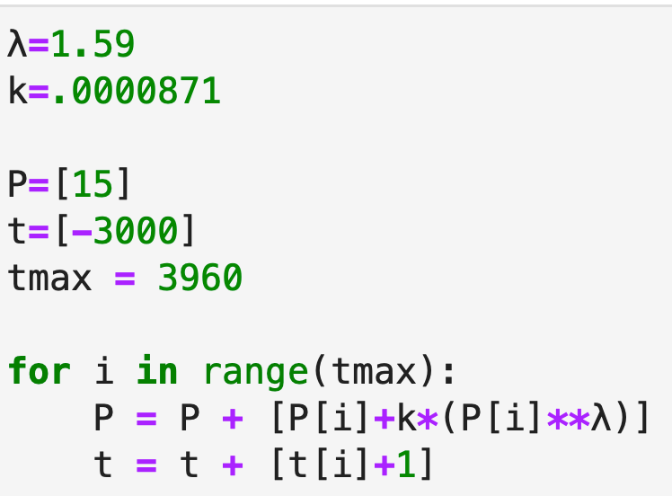
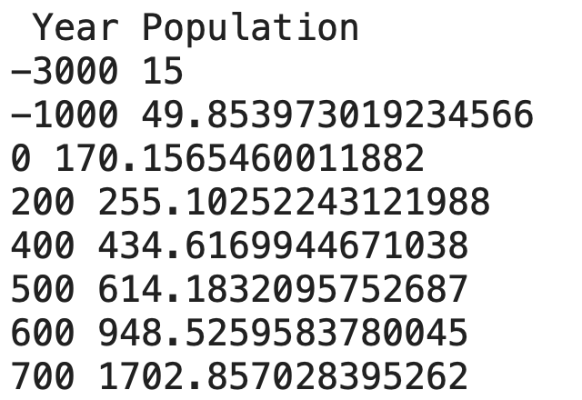
Certainly the Antonines of the Roman Empire Thought They Were Approaching the Limit of Attainable Human Felicity…
Aelius Aristides: The Roman Oration:
“Whatever the seasons make grow and whatever countries and rivers and lakes and arts of Hellenes and non-Hellenes produce are brought from every land and sea… so that the city appears a kind of common emporium of the world. Cargoes from India and, if you will, even from Arabia the Blest one can see in such numbers as to surmise that in those lands the trees will have been stripped bare….
“Your farms are Egypt, Sicily and the civilized part of Africa…. The wonder is not that the harbor has insufficient space… but that even the sea has enough….
“All meet here, trade, shipping, agriculture, metallurgy, all the arts and crafts that are or ever have been, all the things that are engendered…. It is not easy to which is greater, the superiority of this city in respect to the cities that now are or the superiority of this city respect to the empires that ever were…”
There must be stepping-on-toes & low-hanging-fruit picked effects:
$$\frac{1}{P}\frac{dP}{dt}=kP^{λ-1}$$
Let’s fit this to a population of 15 million in -3000, & 50 million in -1000, & 170 million in year 1…
We then get…
Even with SOT & LHF
We ought to have gotten a breakthrough to Commercial-Imperial Revolution growth rates by 500
Instead, we got the Late-Antiquity Pause
And a reversion to the ideas growth rates of the period from -3000 to -1000
Despite much greater human populations and much more powerful information technologies
Why no breakthrough before 1500 from any previous efflorescences? And why the 1500 breakthrough?
Notes:
How is it that this breakthrough takes place then, in 1500, and there, in the Dover Circle?
Suppose we take the growth theory insight that ideas are non-rival Dash hence human energy devoted to thinking up better ideas for how to manipulate nature and organize humans promise is a much much greater return then using human labor to produce goods and services using established techniques. Even taking account of stepping on toes and the low hanging fruit has been picked effects, that insight leads us to expect human economic growth to accelerate as time passes. We can fit that model to a human race than 15 million people in the year -3000 50 million people in the year -1000 and 170000,000 people in the year one. We didn't expect a breakthrough to commercial revolution growth rates around 500 and to industrial revolution era growth rates before 700. We did not have that. Instead we had the late antiquity pause. The Romans of the 100s were very confident that they were the Acme of civilization. Subsequent years are regress. There is no guarantee from the principle that two heads should be better than one that humanity would escape the agrarian age, at least not in any particular Century or millennium.

Slide 3
Resources! And Political Economy!
The Columbian Exchange
Corn, the potato, chocolate, &c.: substantial boost to calories
Benefits everywhere!
But one-sided: Europe gains empire and resources wherever its ships can sail and cannon can shoot
Sugar islands and the slave trade
  400 calories per Briton per day by 1750?
  The underdevelopment of Africa
    12.5 million Atlantic African slave trade
    (2 million Mediterranean, 4 million Black Sea, 1 million Viking, 17 million Indian Ocean, 30 million Graeco-Roman)
The East Indies
Spices—later silks, porcelain, cottons: 80% fall in real price
Benefits everywhere
  But benefits one-sided: disassembling a mountain of silver in Peru in order to import luxuries from China, India, Malaysia, and Indonesia…
Political Economy
The merchants of Bristol, the nabobs, the King of Spain: New wealth to add in to the scales…
To serve God, to win glory, and to grow rich—ideologists, soldiers, and merchants
Inflation
Notes:
The worldwide acceleration in the pace of ideas growth after 1500 seems largely due to the first major human globalization: the fact that advances in sea traffic near the world together so that for at least some commodities the entire world became your market and so you could expand the scale of your operations in the division of labor, plus, probably more important, the Columbian exchange: the fact that many old-world crops grew extremely well in the New World and many New World crops grew extremely well in the old world, and the consequent enormous upward leap in the bio technology that humanity had its disposal. That knowledge, and then the further advances in knowledge that we are now low hanging fruit after the Columbian exchange and with the first globalization pushed up growth in the ideas stock everywhere. That lead shared increasing potential prosperity in the commercial imperial age to be widely distributed.
All this was true only if you avoided being conquered or enslaved. And a great many people were conquered or enslaved in the commercial imperial age. More knowledge about technology and better knowledge about geography can be used for good or ill. And the benefits were one-sided. Americans got decimated by plague, conquered, and then dominated by a nptionally Castillian-descended elite. Africans got enslaved, with enormous dire consequences also for those who escaped being enslaved via the collapse in social trust across the entire continent. In many places on the seacoast arriving Europeans in the commercial-imperial age did not make positive rather than negative bids: instead of making handsome positive-bid offers to pay for the resources and products of the rich and mysterious middle and far East, they made negative-bid offers via the laughter of the guns. And even where they did pay, the long-term benefits for Asia from trade we're dubious: Asians were eager to except the silver Europeans offered, but you can’t eat silver. The Columbian exchange, on the other hand, greatly aided humanity’s ability to utilize nature in Asia as elsewhere.
And Europe? What was not to like. The Columbian exchange greatly boosted productivity within Europe. The coming of globalization meant that Europeans could enslave persons in the Americas to dismantle a mountain of silver to pay for Asian conveniences and luxuries over centuries. And then there was the triangle trade: guns to slaves to sugar—and tobacco, and other greatly valued staple commodities.
The relatively minor edges, first Portuguese in Spanish and then French Dutch and English, in selling the worlds oceans and in applying gunpowder in various ingenious ways does not seem to me to be enough to explain why the worlds oceans became so European dominated so quickly after 1500. Let me suggest four additional factors, or rather four characteristics of European civilizations that melded together:
1. Bureaucracy—the legal order as it had developed in western Europe, especially as a result of fights over authority between medieval emperors and popes, had created institutions and people who thought of themseles as serving them. Thus a more durable reach and a longer purpose for society than could be found in any society in which something like, say, the great Chinese Indian Ocean exploration expeditions could be stopped by the decision of a single courtier
2. Holiness—that expansion and exploration were commanded by God
3. Honor—conquest as a way of demonstrating excellence
4. Profit—merchants who saw expansion as a way of opening new markets to them.
Now, save for bureaucracy, all civilizations had each of these elements. But in European expansion, they all went together. Chinese merchants ventured to Malaysia without the assistance of the Emperor’s soldiers, or the legitimation of priests. Muslim clerics ventured to Malaysia without the assistance of the Sultan’s soldiers, or with large numbers of merchants to make their ventures profitable. And local potentates could seek to conquer, but the absence of merchants meant that their conquests were not profitable for others, and were not legitimated by God. So continuity of effort broke down. And European seaborne empires picked up the pieces.

Slide 4
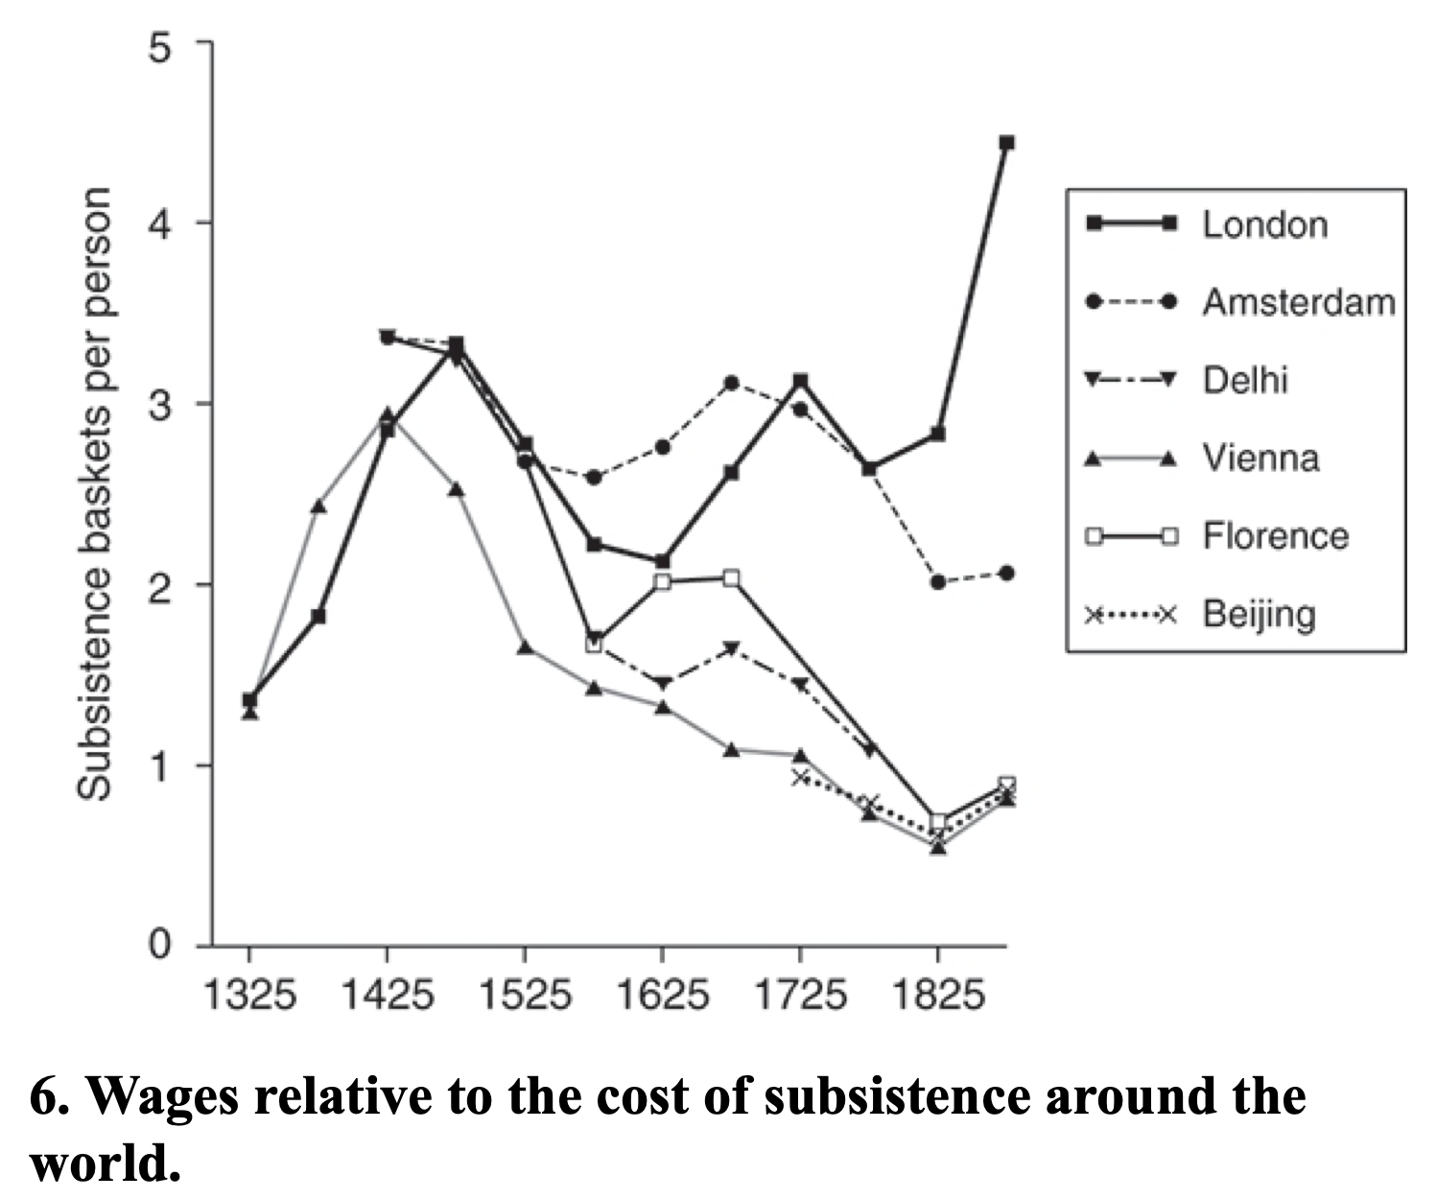
Triggers of the Industrial Revolution
Allen (2017): “Institutions, practices, and culture that supported technological innovation and business investment, they were not sufficient on their own to explain the Industrial Revolution. Other parts of the world were equally blessed, but they did not have industrial revolutions…”:
Specific triggers:
  Empire, commerce, and real wages…
  Cotton—a fiber that could be worked by machine…
  Factories…
  Coal…
  & steam engines…
165K HP in 1830, 2.1M HP in 1870:
1712: Newcomen: 5 HP
1733: 1K HP (100 engines)
1775: 9K HP (600 engines)
1800: 40K HP (500 Watt, 1500 Newcomen engines)
1830: 165K HP
1870: 2.1M HP
Notes:
Now we come, starting around 1870, to the British Industrial Revolution Age. Another ratcheting up of the piece of ideas invention and deployment, centered around technologies that apply non-human power to production in the context of automatic machinery. And the creation of an economic system in which increasing productivity led to increasing profits which were then, in the main, not spent on luxury or to create immediate social power, but instead invested in further amplifying humanity’s productive powers. And it was the fact that profitability under the capitalist mode of production leads to investment which leads to greater productivity which raises the incentives to invent and deploy even more productive technologies—created an extraordinarily powerful virtuous circle, a runaway process of growth that's all worldwide progress in ideas, already four times the agrarian age norm during the commercial imperial age, ratchet up worldwide via an additional tripling to 12 times the Agrarian-age norm of the pace of ideas growth.
Robert Allen believes that to make this happen you needed to have a sophisticated society capable of technological innovation and development, and you also need to have factor prices that make it extremely profitable to develop non-human power sourceand automatic machinery. If factor prices are not so aligned, you will not have inventive activity directed toward those sectors where breakthrough is possible. And if inventive activity is not focused on the one narrow sector of the economy in which an industrial breakthrough is possible, it will not happen. In that case, we will have a commercial-imperial age world for a long time—not indefinitely, sooner or later something will happen. But for a long time. As it was, England in the 1700s had the sophisticated society, the nascent engineering and scientific community, and the factor prices to direct innovation to the sweet spot. And so we got the industrial revolution.

Slide 5
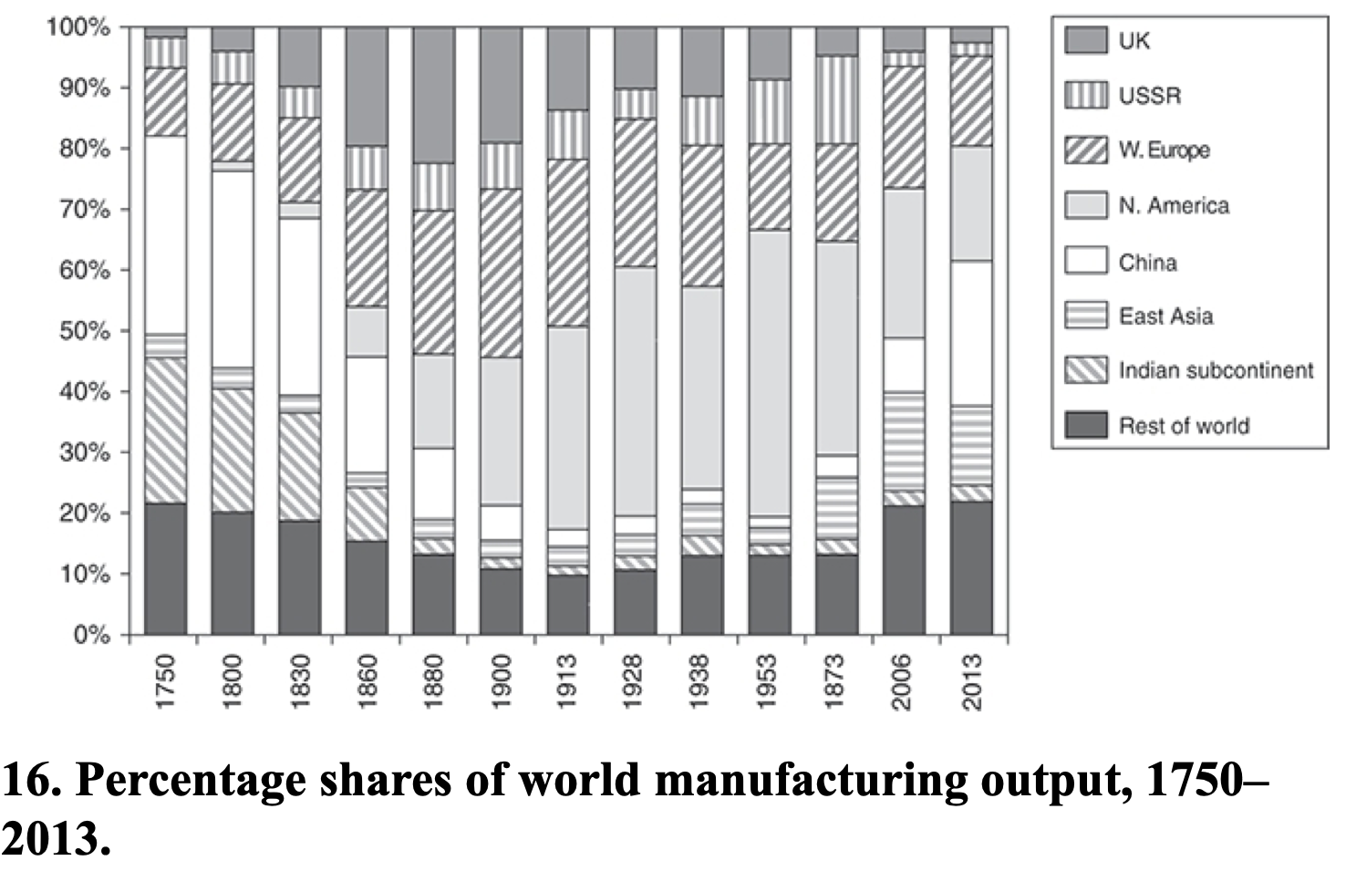
Allen: Spread of Industrialization
Robert Allen (2017): The Industrial Revolution: A Very Short Introduction <https://delong.typepad.com/files/allen-industrial.pdf>, chs. 3, 5-6:
Western Europe: 12% in the 18th century to 28% in 1913
North America: Less than 1% in the 18th century to 47% in 1953
The Pacific Rim share dropped from 4 per cent to 2 per cent in the early 19th century, but then increased to 5 percent in the first half of the 20th century. By 2006, these countries were producing 17 per cent of the world’s manufactures
China in 1953 at 2% of manufacturing was at its all time low. 9 per cent in 2006. 25 per cent in 2013
The Indian subcontinent: 2% of the world’s manufactures in 1973 and only 3% in 2013
Notes:
Look at the percentage of world manufacturing output in different parts of the world from 1750 up to the present. The numbers as to the global redistribution of manufacturing are simply gonzo. During the age of breakthrough, and even after, the world becomes much more unequal, as manufacturing grows massively in the regions that will become the global north, and absolutely shrinks elsewhere. Why this concentration of manufacturing in a few regions and countries is something we will spend a lot of time on later in the course.
There. That is it. The overview of 1500-1870, the age of the commercial-imperial and the industrial revolutions. I could teach four. I have. You only get a week. Let me note that there is a lot here, and it is complex Agrarian-Age history has one single, Malthusian, major thread. This has many more moving pieces.

