Slide 1

DevEng 215: Week 12: Food Security
Th 2020-11-12 12:00 PST <https://berkeley.zoom.us/j/92547663468?pwd=MWhlTE1nQzJuRFN4a1BPdkZJT1NmUT09> <https://bcourses.berkeley.edu/courses/1497096>
Questions:
What is the main factor determining the direction of the food sovereignty movement? On the premise that neoliberalism and globalization continue, which of the movements in Mexico and Ghana is likely to achieve their goal of protecting food sovereignty?
Despite the fact of “Ghanaians are not starving”, what is the motivation behind donors to actively pursue GMOs in the name of the Green Revolution?
Can the Mexican and Colombian farmers' campaigns, which strategically focus only on the GMO of maize, really help protect their food sovereignty and cultural autonomy?
What do the numerous success stories of Campesino a Campesino movement in Latin America Altieri and Toledo provided suggest to Global North, who thinks GMO is the only alternative to reducing global poverty? Can these successes serve as an opportunity to change their perspective?
How will this pandemic affect the Global South in the long term? Given the opinion of many experts that this pandemic will not be the last pandemic we will experience in our lives, what changes can be made in the Global North's view and policy toward the Global South?
<https://www.icloud.com/keynote/0rNAZBWA9MYYbOJp0wd1Y3w1g>
2020-11-12

Slide 2
Food Insecurity: History
Year 1: 170 million people; avg. GI/pop growth rate: 0.07%year, 2%/generation
Year 1500: 500 million people; avg. pop growth rate: 0.15%/year, 4.5%/generation; avg GI growth rate: 0.22%/year, 6.6%/generation
Year 2020: 7.8 billion people; avg. pop growth rate: 1.05%/year 30%/generation
Year 2100: 11 billion people; zpg attained; GI growth rate ?????
2020-11-12

Slide 3
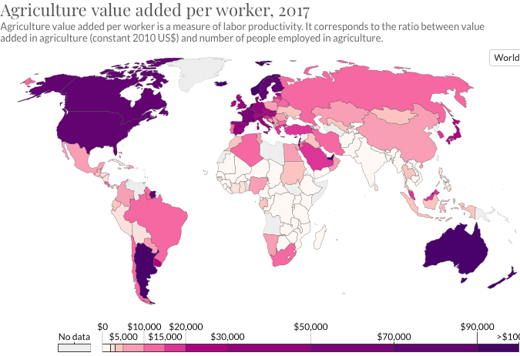
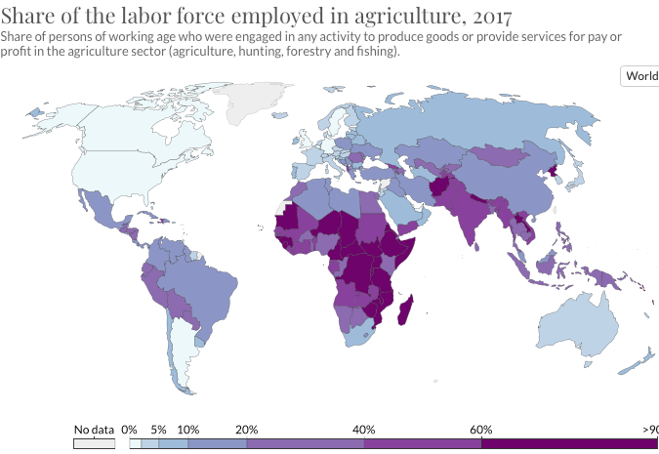
Salience of Agriculture
26% of the working-age population are farmers and farm laborers today—leaving 74% freed-up to do other things
Back in 1991 43% of the working-age population were farmers and farm laborers
Back in 1800 70% of the working-age population were farmers and farm laborers
2020-11-12

Slide 4
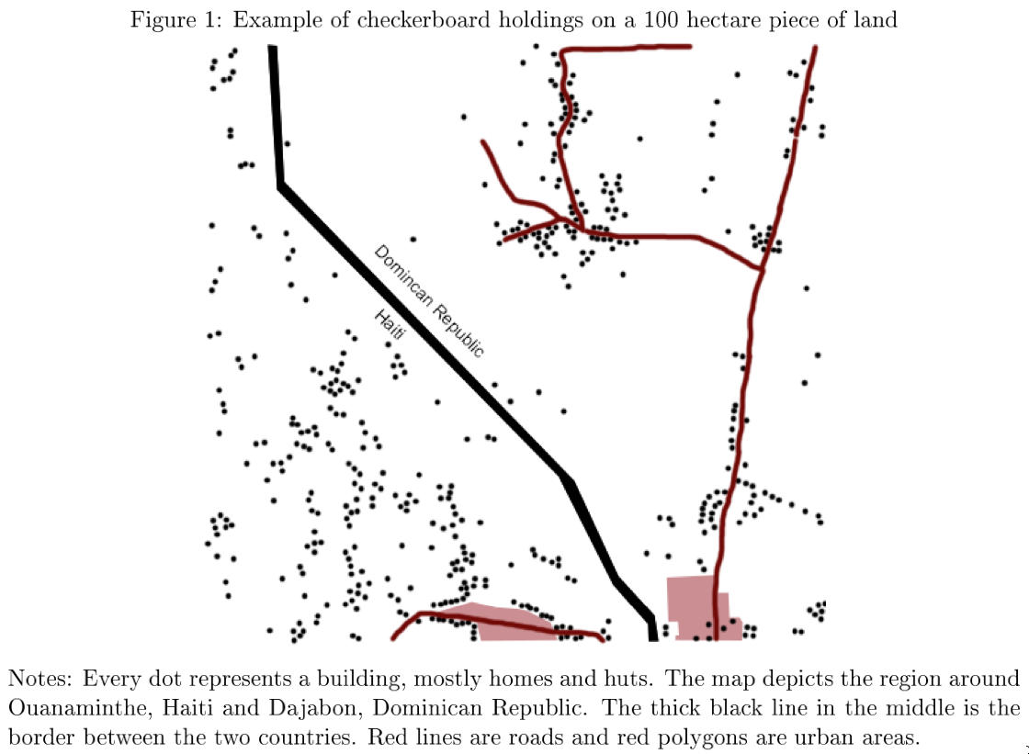
Clapp and Isakson (2018): What is the Link Between Food and Finance?
In every market economy, wealth is social power—and wealth is pretty much the only form of social power
Wealth is derived from control of resources useful in production or exchange—especially in the production or exchange of commodities for which the rich have a serious jones
Finance allows you to:
  Acquire social power today by making promises that diminish your social power in the future
  Acquire social power today promising to provide insurance in the future
  Divest yourself of social power today in exchange for acquiring social power in the future
On what terms are these exchanges made? And when are they good ideas?
  Making money by bearing risks; making money by inducing others to bear risks they do not understand…
The Mexican Revolution and the ejido…
  Removing land from the market, and placing it in… what other realm of social power? Patriarchal? Bureaucratic? Patrimonial?
  Craig Palsson: Incomplete Property Rights & Structural Change in Haiti <https://economics.ucdavis.edu/events/papers/copy_of_1114Palsson.pdf>
  Haiti: 43% farmers: NI per capita $2K/year
  DR: 8% farmers: NI per capita $17K/year
<https://bcourses.berkeley.edu/courses/1497095/files/77911803?module_item_id=15927911>
2020-11-12

Slide 5
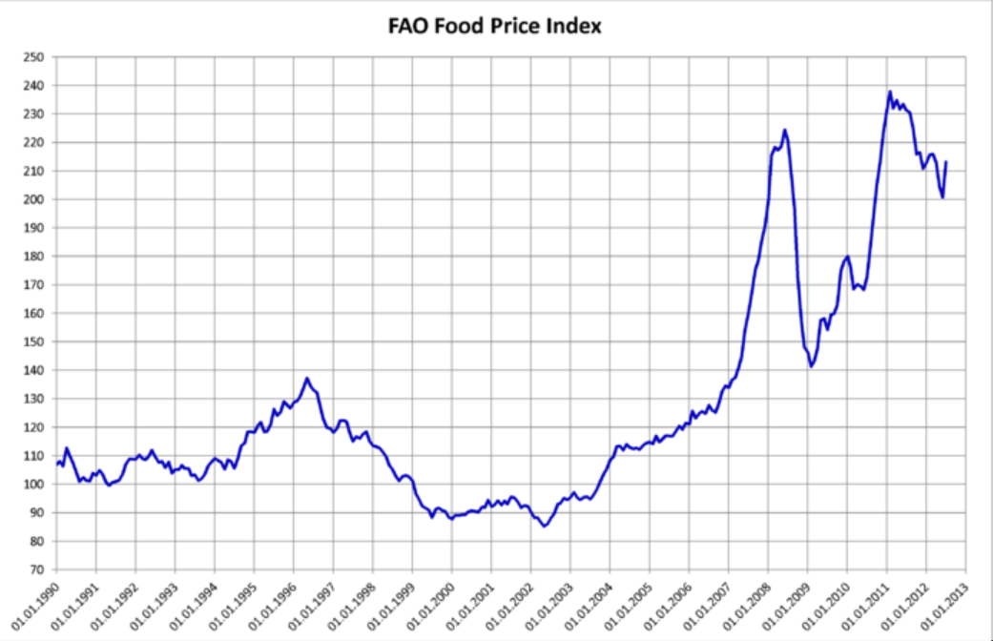
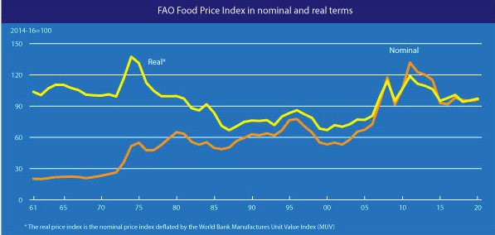
McMichael and Schneider (2011): Food Security Politics and the Millennium Development Goals
  FAO food-price index: cereals, vegetable oil, dairy, meat, sugar
  If you are not self-sufficient—and who can be?—and if you are sufficiently poor to be spending a very large chunk of your income on staple calories and nutrients, the workings of the world market can ruin your life
  Ration-by-wealth
  IFPRI (2010): Reflections on the Global Food Crisis <http://cdm15738.contentdm.oclc.org/utils/getfile/collection/p15738coll2/id/5724/filename/5725.pdf>
  Oil prices: effects on:
    Fertilizer costs
    Biofuel demand
    Cereals demand from OPEC
    Panic rice bubble
    Dollar depreciation—reduces incomes for all goods priced in dollars
<https://bcourses.berkeley.edu/courses/1497095/files/77911773?module_item_id=15927916>
2020-11-12

Slide 6


Amanor (2019): Global Value Chains and Agribusiness
  DeKalb AgResearch (now part of Bayer)
    Founded in 1923 out of DeKalb County Farm Bureau
  Pioneer Hi-Bred International
    Founded in 1926 by a group including American socialist and future Vice President Henry A. Wallace
    Bought by DuPont in 1999, sold off and now called Corteva Agrisciences
  “Intellectual property” oligopolists
  “Parastatal Marketing Boards”—and the exploitation of export agriculture for the benefit of the country or ruling clique
  Cocoa—Côte d’Ivoire (50%), Ghana (20%), Malaysia (10%), Philippines (6%) , Brazil (5%)…
    Cargill, Archer Daniels Midland, Barré Callebaut—and the oligopolistic logic of collective action
  Del Monte Gold Pineapple (MD2): “requires a complex array of fertilizers, hormones, and other inputs…”; “the demands of European supermarket chains had pushed smallholders out of the market… running pipe-borne water, packing houses, and rigorous testing… for pesticide residues…”
<https://bcourses.berkeley.edu/courses/1497095/files/77911802?module_item_id=15927915>
2020-11-12

Slide 7
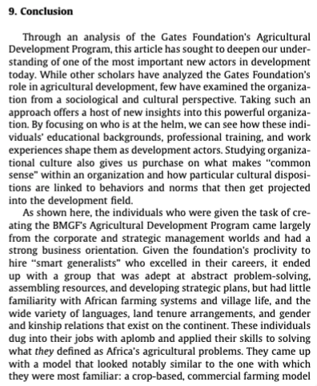
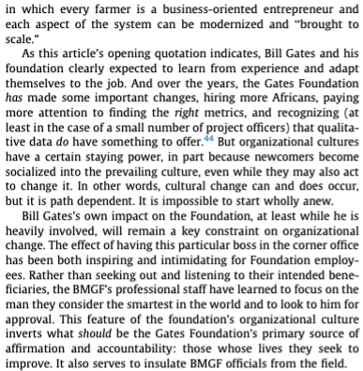
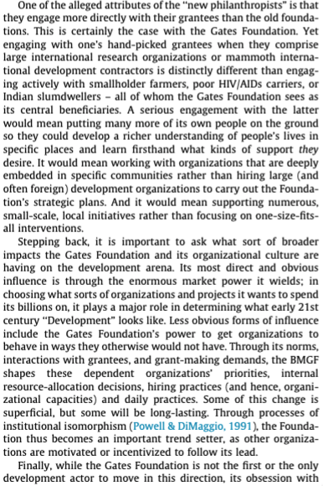
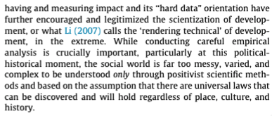
Schurman (2018): Micro(soft) Managing a ‘Green Revolution’ for Africa
<https://bcourses.berkeley.edu/courses/1497095/files/78796747?module_item_id=16024434>
2020-11-12

Slide 8
Butler (2014): 4H; Wise: Failing African Green Revolution
Butler:
Pedro Sanchez, director of the Agriculture and Food Security Center at Columbia University’s Earth Institute, told me subsidies are probably the only way new farming methods can make it in Ghana. He worked with the Malawian government when it introduced hybrid corn in 2005, offering farmers a discount of up to 70 percent on seeds and fertilizer. Within a few years, the country had tripled its yields. For the first time in recent history, farmers actually had a surplus of corn instead of a shortfall.
But nine years in, Malawian farmers are still dependent on government subsidies for both seeds and fertilizer—and foreign funding is now drying up. And there are other drawbacks, too: As farmers scale up their operations, it will be hard to regulate the amount of fertilizer they use—just as it was in the United States, where runoff has harmed streams and drinking water and created vast oceanic dead zones.
One hot afternoon toward the end of my trip, as I am leaving a club’s maize plot at a school in a small village, a young science teacher stops me. He tells me that his farmer friends have seen how well the DuPont seed grows, and they want to plant it again—but it’s too expensive. He urges me to write an article that will convince DuPont that Ghanaian farmers need more free seed. Someday, he says, his friends hope to increase their yields enough that they can afford Pioneer seeds year after year. But in order to do that, the farmers just need a little boost. “Please tell DuPont to give us more seeds,” he said. “We don’t have feathers to fly. We are praying that DuPont will continue to provide for us.”
Wise:
The Alliance for a Green Revolution in Africa (AGRA) was founded in 2006 with the goal of bringing high-yield agricultural practices to 30 million smallholder farming households. With the adoption of commercial seeds and inorganic fertilizer, AGRA set out to double crop productivity and incomes while halving food insecurity by 2020. As AGRA reaches its self-declared deadline for these ambitious goals, how well has AGRA done in increasing productivity, incomes, and food security? The organization has received roughly $1 billion in funding, two-thirds of it from the Bill and Melinda Gates Foundation, and disbursed more than $500 million in grants, mainly in 13 priority African countries.
The Green Revolution technology campaign has been supported during this time by international programs far larger than AGRA and notably by national governments in Africa, which have spent roughly $1 billion per year on programs that subsidize the purchase of commercial seeds and fertilizers. There is little publicly available documentation of impacts, from AGRA, the Gates Foundation, or donor governments that have supported the initiative. This paper attempts to fill some of that accountability gap.
Because AGRA declined to provide data from its own monitoring and evaluation, we use national-level data to assess progress in productivity, poverty reduction, and food security in AGRA’s 13 countries. We find little evidence of widespread progress on any of AGRA’s goals, which is striking given the high levels of government subsidies for technology adoption. There is no evidence AGRA is reaching a significant number of smallholder farmers. Productivity has increased just 29% over 12 years for maize, the most subsidized and supported crop. This falls well short of doubling yields, which would be a 100% increase. Overall staple crop yields have grown only 18% over 12 years.
Meanwhile, undernourishment (as measured by the FAO) has increased 30% in AGRA countries. These poor indicators of performance suggest that AGRA and its funders should change course. We review more promising approaches African governments and donors should consider.
<https://bcourses.berkeley.edu/courses/1497095/modules/items/15933052> <https://bcourses.berkeley.edu/courses/1497095/modules/items/15927926>
2020-11-12

Slide 9
Catch Our Breath
Let’s reflect on what we have just heard & seen…
Comments
Questions
Readings

Slide 10
========================

