Slide 1
On the Evolution of Payments Systems
Stephen Quinn (Texas Christian University)
William Roberds (Federal Reserve Bank of Atlanta)
Views presented are those of the authors and do not represent the official views of any part of the Federal Reserve System.

Slide 2
History Suggests
State intervention is a key factor.
State-supplied money anchors the payments system.
Regulations orient the direction of payments system innovation.
The evolving system then creates new innovations, new crises, and new regulations.

Slide 3
Analytical Framework
Risk of payment technology not working
Cost Saving Innovations
Successful
State Money
Resource cost of using payment technology
Source: Adaptation of Berger, Hancock and Marquardt (1996: 700)
Notes:
Other dimensions could be large value v small value payments, privacy, etc.
Successful state money is what people want to use when not obliged to.
Very hard to be less risky than a successful state money.

Slide 4
Venice circa 1500
Risk
Deposit Banks
Bank failure
Credit risk
Bills of Exchange
Easily lacking 3% of content
Coin
0%
1%
3%
Cost
Notes:
Innovations move along a cost/risk trade off from the anchor.
The nodes are combinations of firms, instruments, and supporting technology.
Innovation requires rule of law and sufficiently non-expropriative government.
Model emphasized payments heterogeneity.

Slide 5
Venetian Pivot
Risk
Merchant Credit
Deposit Banks
Bills of
Exchange
Coin
Cost
Notes:
Pivot represents payment system development: lower cost for the same risk/lower risk for the same cost.
Requires building of a network.

Slide 6
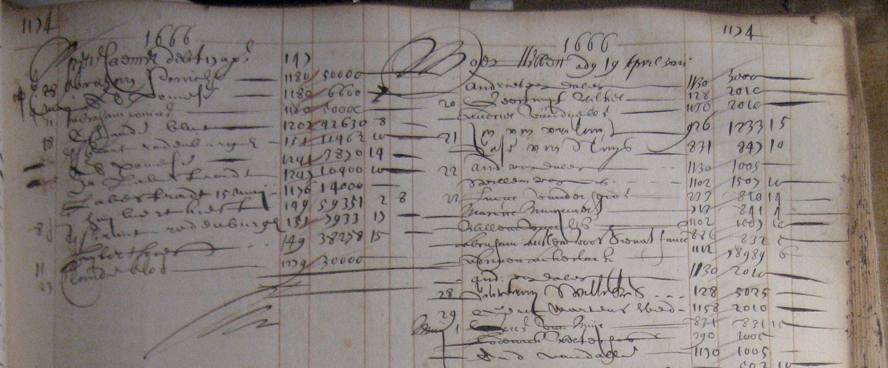
Anchor
Notes:
The focus of our research.

Slide 7
Paper Anchor
Public Bank
Ledgers
Shortage of coins
Sovereign
Debt
Notes:
Early modern era was full of experiments in creating public banks with paper anchors.
Most flounder. A few, like Amsterdam and England, succeeded: i.e. people wanted to use their money.

Slide 8
Alchemy of an Anchor
Paradox: state-sponsored payments entities hold the same assets as private-sector rivals.
Goal is to create more trustworthy liabilities.
For success, some magic ingredient is required.
Survivor Bias: Alchemy often does not work, yet easy to remember the successes.
  Failure: France, 1720
Notes:
Again, successful state money is what people want to use when not obliged to.

Slide 9
Political Economy
Political risks determine long run success of new anchor, i.e.
How to generate credibility (the expectation of repayment)?
How to generate legitimacy (the appropriate application of state power)?
Notes:
How to keep public bank close enough to politics to gain legitimacy yet far enough away from politics to gain credibility? Today, one answer is a Paul Tucker style narrow mandate. Amsterdam stayed narrow by being a municipal entity that avoided state (provincial) debt.

Slide 10
Amsterdam Shift
Risk
Merchant Banking
Coins
Bank of Amsterdam Ledger
Cost
Notes:
Shifts in payments system anchor is highly entwined with political economy. Success made the Bank florin (guilder) the era’s reserve currency.
The shift can also spark rapid innovation. Merchant banking used BoA balances for wholesale funding (acceptance credit) using bills of exchange instead of demand deposits. Amsterdam money market becomes hub for much of Europe in the 1700s.

Slide 11
Regulation

Slide 12
New York circa 1970
Risk
Banks
New Deal Regulations
Federal Reserve
Cost
Notes:
Some New Deal regulations like Regulation Q became very costly with inflation.
Powerful incentives developed to circumvent regulations. Note, Fed reserves are now the anchor.

Slide 13
Banks
Information Sensitive Lending
Money-like
Safe Asset
Bank
Notes:
Banks want to form: they are a profitable risk/cost trade off favored by customers.
Banks are also a fragile arrangement with negative externalities at failure.

Slide 14
New York Cycle
Risk
Shadow Banks
Innovation and/or
circumvention
Banks
New Deal Regulations
Federal Reserve
Cost
Notes:
Innovation/circumvention was the creation of MMMFs and Repo-based market funding.
The new rivals pressured banks who pressured regulators for the relaxation: end Reg Q, allow interstate branch banking, end Glass-Steagall.

Slide 15
U.S. Regulatory Cycle
National Banking Act: 1863
Trusts
Panic of 1907
Federal Reserve Act: 1913
State Banks
Great Contraction: 1929-1933
Banking Act 1933: FDIC
Shadow Banks
Panic of 2008
Dodd-Frank Act: 2010
Fintech?
Notes:
Regulation reduces risks but increases costs. In time, innovation works around regulations. Often incumbents gain accommodation to compete with new forms. Eventually, a crisis occurs, and the severe crises include a payments (safe assets) panic. New regulations seek to solve the problem, and the cycle resumes.

Slide 16
Conclusions
Payment system innovation is usually the incremental building of networks on a state anchor (Venice).
New anchors can cause punctuated evolution that turns on political economy (Amsterdam).
Regulation often reduces risk now and increases risk later (New York).

