Slide 1

5.[6-8].1. AfriAsia: Intro Video
Required:
Nunn (2008): The Long Term Effects of Africa's Slave Trades <https://dash.harvard.edu/bitstream/handle/1/3710252/Nunn_Long-TermEffects.pdf>
Robert Bates: Markets & States in Tropical Africa, selections <https://github.com/braddelong/public-files/blob/master/readings/book-bates-markets-selections-chs-6-%26-7.pdf>
Optional:
Sevket Pamuk (2014): Institutional Change & Economic Development in the Middle East, 700-1800 <https://delong.typepad.com/files/pamuk.pdf>
Laura Panza & Jeffrey Williamson (2015): Did Muhammad Ali Foster Industrialization in Early Nineteenth-Century Egypt? <https://github.com/braddelong/public-files/tree/master/readings/notes-panza-%26-williamson-egypt>
  Is sub-Saharan Africa's trajectory a unique one, a “special way”, or has it just been an intensification of growth retarding features also seen substantially at work elsewhere?
  How are we to understand the end of apparent African retardation around 2000?
  Do you think what is going on in the interior of China, with the exception of a few cities along the Yangtze that look a lot like the coasts, is more like what has been going on in the rest of Asia or just the Pacific rim story delayed by a few decades?
  Is your guess that China or India is more likely to be the world's predominant superpower come 2100?
  Up until 1500 the Middle East, especially what is now Turkey, Iran, and Egypt, seemed to have important and impressive civilizational advantages over western Europe. How does the story of western Europe's growing post 1500 edge in prosperity look different if one looks not from the western European vantage point, as we did earlier in the course, but from the Middle Eastern? And why the “sudden stop” of the Middle East in development around 1500? (It really was doing fine in comparative perspective before then.)
  Could Muhammed Ali’s dynasty have led a “Meiji Restoration” in Egypt, had his descendants been truly fortunate?
  Why does it seem that (both) Egypt (and Japan) had so much more state capacity to at least attempt reform in the 1800s to start to take advantage of the Industrial Revolution?
  Why didn’t the bad predatory institutions of the Netherlands abroad in Indonesia leak back home, and damage the Dutch economy as well?
<https://youtu.be/C3ZVyJVajxU> <https://github.com/braddelong/public-files/blob/master/econ-135-5.3.1-afriasia-intro-video.pptx> <https://www.icloud.com/keynote/0VezaUu7103MrY5-2QCzDH62Q> 2021-04-19
Notes:
5.4. The Global South
====
5.4.1. Africa
Read: Nunn (2008): The Long Term Effects of Africa's Slave Trades <https://dash.harvard.edu/bitstream/handle/1/3710252/Nunn_Long-TermEffects.pdf>
Read & listen: <https://github.com/braddelong/public-files/blob/master/econ-135-lecture-21b.pptx>
Discussion thread: <https://bcourses.berkeley.edu/courses/1487685/discussion_topics/5747048>
Zoom q&a session: <https://github.com/braddelong/public-files/blob/master/econ-135-zoom-2020-04-14-10.02.09-92696375431-africa.zip>
5.4.2. South Asia & Middle East
Read: Pamuk (2014): Institutional Change & Economic Development in the Middle East, 700-1800 <https://delong.typepad.com/files/pamuk.pdf>
Read & listen: <https://github.com/braddelong/public-files/blob/master/econ-135-lecture-21.pptx>
Zoom q&a session: <https://github.com/braddelong/public-files/blob/master/econ-135-zoom-2020-04-16-09.59.01-99819691485.zip>
Discussion thread: <https://bcourses.berkeley.edu/courses/1487685/discussion_topics/5747048>
Optional Notes & Further Readings:
Bates: Markets & States in Tropical Africa <https://github.com/braddelong/public-files/blob/master/readings/book-bates-markets-%26-states.pdf>
====
Watch: the intro video
Read & listen: to these virtual lecture
Attend: the Tuesday course-wide zoom session (Tu 09:30)
Read: Nunn & Pamuk, & (perhaps) Bates
Do: the quiz & the “deep roots” calculation assignments (by the end of Su)
Contribute: to the section discussion thread (by the end of Su)
Attend: half-hour zoom section, & both half-hour zoom pod meetings
Present: if called on, the conclusions of your pod meeting (Fr morning)
Provide: feedback
2021-04-13

Slide 2
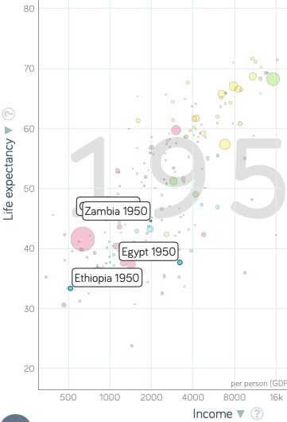
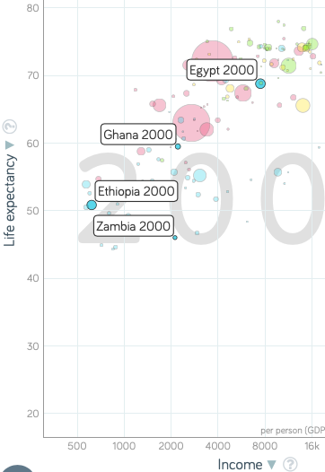
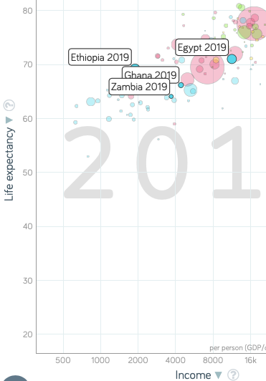
Africa Falls Behind, 1950-2000
Notes:
Today African retardation—that most sub-Saharan African countries are lagging well behind the rest of the global south in terms of levels of prosperity and income—is one of the most important and also one of the most puzzling facts about the modern economic growth process. But this retardation was not the case as recently as 1950. Back in 1950, African nations were "normal" for global south economies. They had levels of prosperity and income and productivity that were respectable—not global north levels but respectable—in 1950. And African economies do get richer, albeit at a slow and inadequate pace, from 1950 to 2000.
But by 2000 their levels of prosperity are no longer respectable for the global south. The rest of the global south went roaring on by most of the countries of Africa in that half century, in which African growth was distinctly inadequate by virtually everyone's anticipated or contemporaneous benchmarks. The exceptions are the economies of the Maghreb: the Mediterranean littoral economies north of and in the Sahara.
Thus any satisfactory explanation of African retardation must be rooted either (a) in things that have happened since 1950, or (b) account for why underlying structural causes of today's relative African poverty were masked in the world as it was back in 1950.

Slide 3
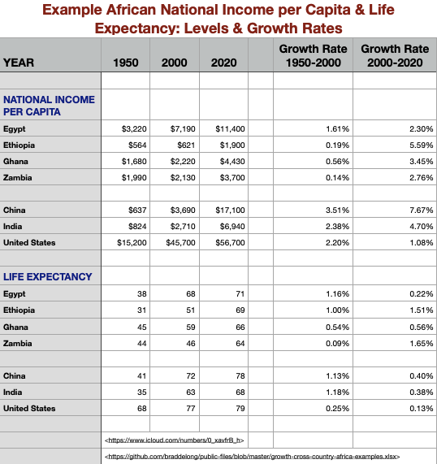
Africa Falls Behind, 1950-2000
Four example African countries:
Egypt (north, Maghreb), Ethiopia (east, poor), Ghana (west, well-integrated economically), & Zambia (south, industrializing)
  Zambia, Ghana richer than Portugal in 1950
Egypt does not converge, but it grows along with the world from 1950-2000
The other three? Not
  Substantial 1950-2000 improvements in life expectancy & other social indicators, however
What changes for good for Africa in 2000?
Notes:
To get a sense of the diversity of African experience since 1950, let us briefly look at four example African countries: Egypt, in the north, in the Maghreb; Ethiopia, in the east, and very poor; Ghana, in the west, and well integrated economically into the world economy; and Zambia, in the south, and industrializing at what seemed to be a sustainable and was a rapid pace back in 1950. Note that both Zambia and Ghana were richer than Portugal in 1950.
Since 1950, Egypt does not converge to anything like the global north norm. But Egypt grows along with the world from 1950 to 2000. The other three? No. There are substantial 1950 to 2000 improvements in life expectancy and other social indicators however. But in terms of levels of income per capita and of labor productivity, the African economies of Ethiopia, Ghana, and Zambia have an average growth rate of 0.3% per year. This is in a world and over a half century in which the United States grows at 2.2, India grows at 2.4, and China grows at 3.5% per year.
Then after 2000 sub-Saharan Africa picks up its mat and walks.
Ethiopian real income growth has averaged 5.6% per year since 2000: a doubling time of 12 years. Income per capita growth in Ghana is averaging 3.5% per year: Ghana is now twice as rich and prosperous as it was in 2000. Zambia has seen growth at 2.8% per year, fast enough to double income and productivity levels in a quarter century.
Admittedly, these numbers are still small beer relative to India's 4.7% per year or China's 7.7% per year, if we can indeed trust that last number. However, in a world in which the United States has only averaged 1.1% per year in income growth since 2000, the performance of Ethiopia, Ghana, and Zambia is heartening and even impressive.

Slide 4
I Samuel 8:4 ff.
All the elders of Israel gathered themselves together, and came to Samuel unto Ramah:
And said unto him, “Behold, thou art old, and thy sons walk not in thy ways: now make us a king to judge us like all the nations.”…
And Samuel told all the words of the Lord unto the people that asked of him a king. And he said:
  “This will be the manner of the king that shall reign over you: He will take your sons, and appoint them for himself, for his chariots, and to be his horsemen; and some shall run before his chariots. And he will appoint him captains over thousands, and captains over fifties; and will set them to ear his ground, and to reap his harvest, and to make his instruments of war, and instruments of his chariots. And he will take your daughters to be confectionaries, and to be cooks, and to be bakers.
  “And he will take your fields, and your vineyards, and your oliveyards, even the best of them, and give them to his servants. And he will take the tenth of your seed, and of your vineyards, and give to his officers, and to his servants. And he will take your menservants, and your maidservants, and your goodliest young men, and your asses, and put them to his work.
  “He will take the tenth of your sheep: and ye shall be his servants.
  “And ye shall cry out in that day because of your king which ye shall have chosen you; and the Lord will not hear you in that day…”
Notes:
The Hebrew Bible’s book of 1 Samuel contains a discussion of the value of the state. It is not a favorable one.
Let me quote from the King James translation, even though it is not the easiest to understand. The language is beautiful. And since this is an ancient document speaking to us from the distant past, a translation that registers that is, I think, more true than one that tells us that these people could be alive with us today and thinking as we do:
>All the elders of Israel gathered themselves together, and came to Samuel unto Ramah. And they said unto him:
>>Behold, thou art old, and thy sons walk not in thy ways: now make us a king to judge us like all the nations.…
>And Samuel told all the words of the Lord unto the people that asked of him a king. And he said:
>>This will be the manner of the king that shall reign over you:
>>He will take your sons, and appoint them for himself, for his chariots, and to be his horsemen; and some shall run before his chariots. And he will appoint him captains over thousands, and captains over fifties; and will set them to ear his ground, and to reap his harvest, and to make his instruments of war, and instruments of his chariots.
>>And he will take your daughters to be confectionaries, and to be cooks, and to be bakers.
>>And he will take your fields, and your vineyards, and your oliveyards, even the best of them, and give them to his servants. And he will take the tenth of your seed, and of your vineyards, and give to his officers, and to his servants. And he will take your menservants, and your maidservants, and your goodliest young men, and your asses, and put them to his work.
>>He will take the tenth of your sheep: and ye shall be his servants.
>>And ye shall cry out in that day because of your king which ye shall have chosen you; and the Lord will not hear you in that day…

Slide 5
Slavery in Africa
Slave trades in the past millennium:
“Black Sea”
“Barbary Coast”
Indian Ocean
Atlantic-Caribbean
Two moments at which slavery rapidly intensified:
  Coming of the slavery-driven “Atlantic economy” after 1600
  Abolition of the slave trade, followed by redeployment of slaves into African plantations to grow export agricultural crops
    30% of western Sudanese slaves in 1900? Slavery “abolished” in Sierra Leone in 1928, in Nigeria in 1936, in Mauritania in 1981
Slave trades: Atlantic1600-1850: 13M? Indian Ocean 1000-1900: 5M? Internal African 1500-1900: 5M? Trans-Saharan 1200-1900: 3M? Barbary Coast 1500-1800: 1.5M? Black Sea 1400-1750: 3M?
Population of Africa in 1700: 60M?
  People born in Africa & surviving to age 5, 1500-1800: 360M?
Notes:
The trans-Atlantic European-run guns-slaves-sugar slave trade that ripped the heart out of Africa from 1600 to 1850 is only one of the major slave trades in the past millennium of human history. Ther are in addition the “Black Sea”, “Barbary Coast”, Indian Ocean, and internal African slave trades.
There appear to be two eras in the past at which the effects and scale of African slavery rapidly intensified: The first is the coming of the slavery-driven “Atlantic economy” after 1600. The second is, somewhat paradoxically, the era of the abolition of the Atlantic slave trade. It was followed by redeployment of slaves into African plantations to grow export agricultural crops. And the profits from selling plantation-grown crops turned out to be greater than those of selling people overseas.
The scale of this? We really do not know. Was it really the case that 30% of western Sudanese wer slaves in 1900? How long did this last? Supposedly, slavery was “abolished” in Sierra Leone in 1928, in Nigeria in 1936, in Mauritania in 1981.
If you want numbers—and we do—here are our best guesses as to the size of the slave trades: Atlantic 1600-1850: 13M? Indian Ocean 1000-1900: 5M? Internal African 1500-1900: 5M? Trans-Saharan 1200-1900: 3M? Barbary Coast 1500-1800: 1.5M? Black Sea 1400-1750: 3M?
Compare these to a population of Africa in 1700 of perhaps 60 million, and to perhaps 360 million people born in Africa & surviving to age 5 over the years 1500-1800.

Slide 6
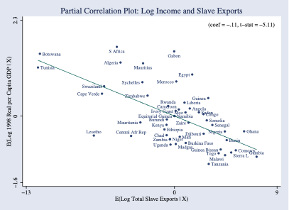
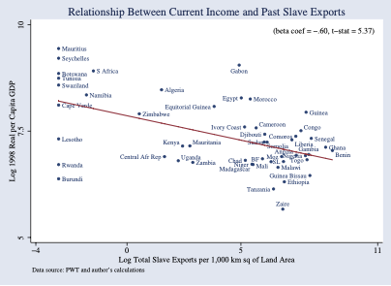
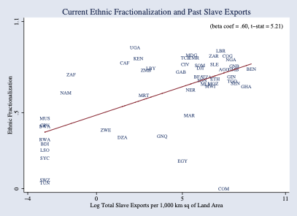
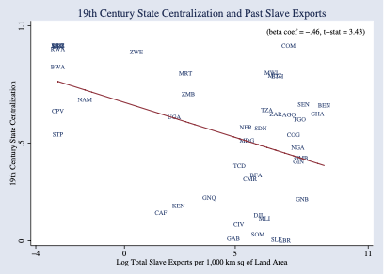
Consequences
Societal disintegration:
Nathan Nunn has constructed estimates:
  The negative effects of the slave trade on income per-capita in Africa.
  Shipping records, plantation records, sales receipts, the ethnicity/origin of slaves
  Intensity of slaving negatively correlated with income today
  Intensity of slaving negatively correlated with institutional quality.
  A fall of one standard deviation in the extent of slaving raises income per capita by 50%
Notes:
The consequences in terms of societal disintegration and thus the creation of the deep roots of African retardation may have been very large indeed. Nathan Nunn has crunched the numbers on the correlation of slave raiding with economic retardation within Africa, and has found that the intensity of slave raiding is strongly negatively associated with institutional quality and economic prosperity today: where the intensity of slave raiding is lower by one standard deviation, income per capita is higher by 50%.

Slide 7
Why Trade Slaves?
Astonishingly “Inefficient”:
20% of captives died en route between Africa and the Americas.
Far more died in the violence of capture or on the way to be sold
  (Joseph Miller estimated that 50% of the slaves caught in the interior of Angola died before being sold at the coast
Low African population density
Slavery worthwhile by elites to avoid paying high wages
But that means slaves would have been very productive kept in Africa
  (Slave exports from Bali, and the 1815 Mt. Tambora explosion)
Lack of centralized states meant maintaining domination not easy
Sell slaves to Europeans, & maintaining domination then becomes their problem
Notes:
And then there is the underlying question: why would a society—even a dysfunctional society—trade away its people to other continents for money? For one thing, intercontinental slaving is astonishingly “inefficient”. 20% of captives died en route between Africa and the Americas. Far more died in the violence of capture, or on the way to be sold. (Joseph Miller estimated that 50% of the slaves caught in the interior of Angola died before being sold at the coast.) You can argue that low African population density made it worthwhile for elites to resort to slavery and domination to avoid paying the high market wages that would have been generated by a wage-labor system in the context of a high land-labor ratio. But that high land-labor ratio means that slaves would have been very productive kept in Africa
Melissa Dell notes the consequences of the 1815 Mt. Tambora explosion for the island of Bali. The soil of Bali, enriched by volcanic ash, became much more productive. And in the explosion’s aftermath slave exports from Bali ceased: more profitable to enslave people, but then keep them at home and set them to work farming the newly enriched volcanic soils.
Was it that the lack of centralized states meant maintaining domination was not easy? That you could sell slaves to Europeans and Middle Easterners, and that maintaining domination then becomes their problem? Perhaps.

Slide 8
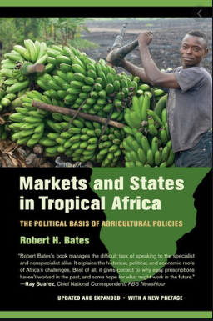
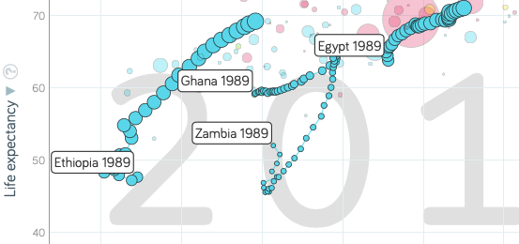
Markets and States in Tropical Africa
Robert Bates’s classical statement of the problem:
Written long before predatory post-colonial African states had reached their peak
But do not think that slave-raiding and colonial heritage patterns have doomed Africa
Since 2000, African growth has gotten itself in gear
Prosperity doubling times for Ethiopia, Ghana, and Zambia of 12, 20, and 26 years respectively—impressive…
Notes:
The classic statement of the poisonous political economy of the corrupt, predatory, and patrimonial states of postcolonial Africa was Robert Bates's book: Markets and States in Tropical Africa. It was written long before this predatory post-colonial political-economic configuration had reached its peak.
But do not think that the slave-raidng and colonial-rule patterns that underlay the development of this political economy have come to doom Africa.
Since 2000, African growth has gotten itself in gear. Prosperity has advanced pretty much all across the continent. Since 2000, the doubling times for Ethiopian, Ghanaian, and Zambian productivity levels have been 12, 20, and 26 years respectively. That is impressive, especially considering what had come before.

Slide 9
5.[6-8].[7-8]. Lecture: South Asia & Middle East
Asia south of Siberia is really big! Lots of things happen!!
  Even if we do hive-off the Pacific Rim
  Plus the Maghreb is much more like the Mashriq than it is like Africa south of the Sahara Desert
Just look at a few places
  Ottoman Empire
  Qing China
  Dutch colonialism in Indonesia
  Egypt
Notes:
We have toured the continents, trying to make sense of the “Great Divergence”—to find historically nuanced and locally appropriate ways of understanding why it is that the post-1800 era that sees human technology advance at a previously unimagined rate has seen so much of the world fail to share even semi-equally in this explosion in potential prosperity.
We have theories—or perhaps better guesses—as to why industrial-era prosperity spread to western Europe and to North America, and as to why Latin America failed to share proportionately. We have at least noted if not fully understood the sources of the Pacific rim of Asia’s miracles. We have examined the puzzle of African retardation.
What is left is the MENA, and all of Asia except its Pacific coast: an enormous grab-bag of different experiences.
We just have time and space to look at a few places: the Ottoman Empire, its independent quasi-possession Egypt, Dutch colonalisim in Indonesia, and the non-coastal bulk of China under the Qing dynasty.
I do not think we have enough knowledge or brainpower to draw solid general conclusions: we are just at the stage of noting particular examples and experiences.

Slide 10
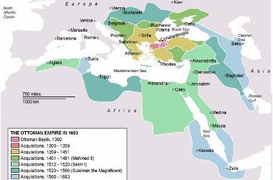
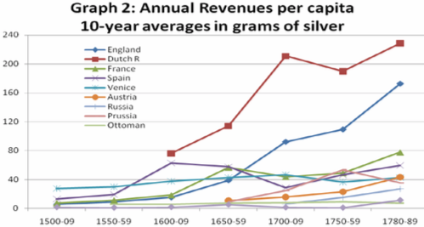
Ottoman Empire
Mehmet II “the Conqueror”’s army takes Constantinople in 1453
Most successful gunpowder empire of its day:
  Biggest and most effective artillery park in the world
  Best-disciplined infantry soldiers in the world: the janissaries
  Highly-motivated professional, feudal, and conquistador cavalry: timarli sipahilar, kapikulu sipahilar, & akincilar
But in the Outer Empire state both predatory & weak:
  Around 1800 in Egypt the Mamluks were extracting 2/3 of peasant incomes through taxes (Owen, p. 36).
  In Anatolia about 50% (p. 37).
  Owen: “not a situation which permitted any accumulation of capital in the agricultural sector nor any regular increase in production…”
Notes:
In 1453 the armies of Sultan Mehmet II Osmanli, called “the conqueror” showed up outside the walls of Constantinople. Constantinople then was no longer the city of half a million it hahadve been in the 400s. Perhaps 50,000 people lived with in its walls, and much of it had become farming villages. Still, it was the seat of the Eastern Roman Empire, and Emperor Constantine was the heir to a regime that could claim to be continuous with the first Emperor Augustus Caesar’s assumption of power as Princeps after his admirals had defeated Marcus Antonius at the Battle of Actium.
Constantinople had fallen to internal coups, and once to a surprise double-cross by Frankish crusaders let inside the walls as allies. But it had never been conquered by seige. But Mehmet II was at the head of the most successful gunpowder empire of its day. He had the biggest and most effective artillery park that the world had hitherto seen. He had the best-disciplined corps of infantry soldiers then existing in the world: the janissaries. He had highly-motivated professional, feudal, and conquistador cavalry—the timarli sipahilar, kapikulu sipahilar, & akincilar. The days when crusaders from the west could take the pressure off of Constantinople by fighting in Palestine or Egypt were long gone. The last two crusades had been disasters: the Ottomans had decisively defeated the Crusade of Nicopolis in 1396 and the Crusade of Varna in 1444. And so Constantinople fell, and became the Sultan’s capital. Thereafter the Ottoman Sultans possessed the title Kaysar-i-Rum: Caesar of Rome, which they held until the deposition of the last Ottoman sultan in 1922.
But the empire was a military-bureaucratic superstructure on top of a peasant-mercantile economy. In the outer empire the state was both predatory & weak, extracting between 1/2 and 2/3 of peasant incomes through taxes almost all of which were then siphoned off by local notables and bureaucrats, with very little reaching the center. It was “not a situation which permitted any accumulation of capital in the agricultural sector nor any regular increase in production.”

Slide 11
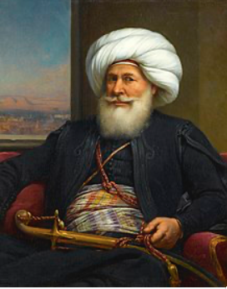
Egypt
Muhammad Ali Pasha al-Mas'ud ibn Agha:
Reigned 1805-1848
Albanian orphan, tax collector in the Ottoman-ruled Greek port of Kavala, bored
Signed up as a mercenary in the Ottoman army sent to reoccupy Egypt
By 1803 commanded a regiment of his fellow Albanians
Ottoman governor of Egypt could not afford to pay his soldiers… Mutiny! Muhammed Ali wound up on top…
Population of Egypt in 1840: 5 million?
Figure 1.2 million in the potential outside-the-home paid or self-employed labor force.
By the late 1830s one in five was at work in manufacturing
By the late 1830s one in 11 was at work in mechanized manufacturing
In an era in which British manufactured exports were deindustrializing every other peripheral country on the globe, impressive…
Notes:
Muhammed Ali (1769-1849), an Albanian orphan, son of a shipping merchant Ibrahim Agha and his wife Zeynep, was bored being a tax collector in the Ottoman-ruled Greek port of Kavala. In 1801 he enlisted as a mercenary in the Ottoman army sent to occupy Egypt. By 1803 he commanded a regiment of his ethnically Albanian fellow-countrymen.
The Ottoman governor of Egypt could not afford to pay. He dismissed his Albanian troops. They mutinied, took over the government, and collected their pay. But Albanian commander Tahir Pasha then had no money to pay the Turkish janissaries.
Somehow Muhammed Ali wound up on top.
He retained the loyalty of his Albanians and managing to suppress both Turkish janissaries and Egyptain Mamluks. He then received at least the temporary blessing of Ottoman Sultan Selim III the Reformer (before he was deposed, imprisoned, and murdered by his own janissaries).

Slide 12
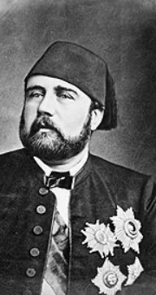
The Khedive Ismail
The Egyptian succession:
Muhammed Ali (1805-48), grandson Abbas (1848-54), uncle Said (1854-63), nephew Ismail (1863-79)
The machines could not be kept working
The cotton boom of the 1860s
Suez Canal opened 1869
1876 state bankruptcy
Egyptian independence ended with Ismail, with puppets only afterwards
Notes:
In Egypt in the first half of the 1800s, the machines could not be kept working.
Muhammed Ali (1805-48), grandson Abbas (1848-54), uncle Said (1854-63), nephew Ismail (1863-79)
In 1863, six years before the completion of the Suez Canal, the relatively young Khedive Ismail took the throne of Egypt.
Ismail had been educated in France: he was open to European influences, eager to modernize his country, and eager to play the role of the open-handed Eastern ruler. He became ruler of Egypt in 1863, in the middle of the "cotton famine" created by the American Civil War and the consequent temporary disappearance of the U.S. South from the world's cotton supply. The consequence was a cotton boom everywhere else in the world: the factories of the industrial revolution needed cotton to run on, and they were willing to pay almost any price for it. Egypt grew cotton. And so for a few years it seemed as though Egypt's economic resources and wealth were growing rapidly and were inexhaustible.
Suez Canal opened in 1869. That made Egypt truly strategic in the geopolitics of the 1800s.
But the cotton boom was followed by a bust. In 1876 the Egyptian government declared bankruptcy. The creditors of the Khedive became the rulers of the country. Ismail abdicated. Two financial controllers—one British, one French—were appointed with substantial control over taxes and expenditures. Their task was to make sure that Egypt was “governed” by Ismail's son to keep up revenue and pay off the debt. The Egyptians wondered why they were being highly-taxed to pay off debts run up by their extravagant ex-Khedive. British troops restored order in 1882. Thereafter the Khedive was a British puppet: the strategic importance of the Suez Canal for communications with India meant that British troops were to stay in Egypt on varying pretexts and for various reasons until 1956.
Muhammed Ali’s great-grandchildren were indeed the puppets of French bankers and British proconsuls

Slide 13
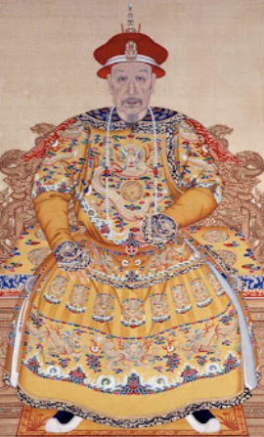
Qing Dynasty China
“Revere the emperor & resist the barbarians!” will not work:
Many western China specialists see and can almost touch an alternative history
One in which late-nineteenth century China stood up economically, politically, and organizationally.
Japan, after all:
  won its short victorious war against Russia in 1905,
  negotiated as an equal with Britain and the U.S. over warship construction in 1921,
  was perhaps the eighth industrial power in the world by 1929
We economists tend to be more skeptical:
  QIMCS built up under Robert Hart in the 1860s
  Failure of infrastructure management
  Failure to collect the salt tax
  Failure to suppress the Taiping
  Lack of realism—fighting France over Vietnam
Notes:
imperial China, poor and disorganized in 1870: a country where the government and the economy were in crisis. The ethnically Manchurian Qing Dynasty could not rally the country behind a slogan like “revere the emperor and resist the foreign barbarians” because the emperor and his relatives identified themselves as foreigners. Moreover, they were regarded by the Han elite as barbarians.
Over more than two centuries of rule the Qing government of China had trained its Confucian landlord-bureaucrat-scholar aristocracy to be incapable of taking effective action. Effective action might be directed against the Central Government Security Perimeter (which is, perhaps, how we ought to translate what was back then translated as “Forbidden City”).
Many western China specialists see and can almost touch an alternative history—one in which late-nineteenth century China stood up economically, politically, and organizationally. Japan, after all, won its short victorious war against Russia in 1905, negotiated as an equal with Britain and the U.S. over warship construction in 1921, and was perhaps the eighth industrial power in the world by 1929.
We economists are much more skeptical. We note that while things like the Qing Imperial Maritime Customs Service built up in the 1860s under Robert Hart, Hart allowed no Chinese officials in it primarily because he feared he would be unable to control their corruption, given the powerful protectors in the Qing imperial court such officials would acquire. We note the corrupt and incompetent bureaucracies that failed to manage the Yellow River dikes and the Grand Canal. We note that the Qing could not get their local officials to collect the salt tax. We note that when in the mid-1880s the Qing Dynasty, having bought foreign metal-working machinery and built a navy, arsenals, and docks, thought it was strong enough to oppose the French conquest of Vietnam. Its fleet was destroyed in an hour: the Chinese navy lost 572 dead, while the French lost five. In 1895 the Qing Dynasty thought it was strong enough to oppose the Japanese extension of their sphere of influence to Korea. It was wrong. The Treaty of Shimonoseki added Taiwan, Korea, and southern Manchuria to Japan's sphere of influence.

Slide 14
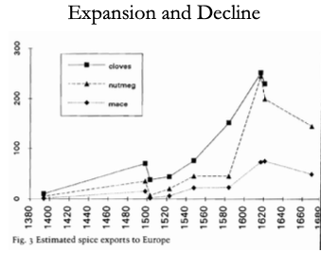
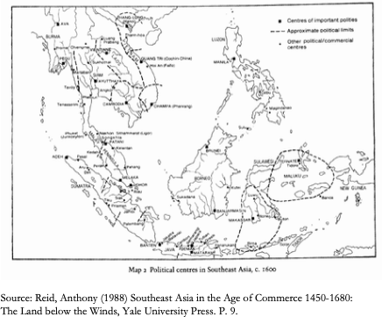
Dutch Colonial Indonesia
In the 16th century, Java (in modern Indonesia) and Malaysia were amongst the most urbanized places in the world:
Then the Dutch show up, with ships and cannon and muskets and well-drilled infantry…
And by 1900 Indonesia is very poor…
Ambon and Banda:
  In Ambon the V.O.C. took over the existing feudal structure, which they used to monopolize supply.
  In Banda, the V.O.C.:
    killed most of the population in 1621 (probably over 20,000 people)
    reorganized the production of nutmeg
    established slavery system
    ex-employees of the VOC as planters
“Comprador” elites…
De-economization: Reid (1993, Chapter 5): “When a Dutch factor visited Magindanao in 1686 he was told “Nutmeg and cloves can be grown here, just as in Malaku. They are not there now because the old Raja had all of them ruined before his death. He was afraid the Dutch Company would come to fight with them about it…”
Notes:
In 1453 the armies of Sultan Mehmet II Osmanli, called “the conqueror” showed up outside the walls of Constantinople. Constantinople then was no longer the city of half a million it hahadve been in the 400s. Perhaps 50,000 people lived with in its walls, and much of it had become farming villages. Still, it was the seat of the Eastern Roman Empire, and Emperor Constantine was the heir to a regime that could claim to be continuous with the first Emperor Augustus Caesar’s assumption of power as Princeps after his admirals had defeated Marcus Antonius at the Battle of Actium.
Constantinople had fallen to internal coups, and once to a surprise double-cross by Frankish crusaders let inside the walls as allies. But it had never been conquered by seige. But Mehmet II was at the head of the most successful gunpowder empire of its day. He had the biggest and most effective artillery park that the world had hitherto seen. He had the best-disciplined corps of infantry soldiers then existing in the world: the janissaries. He had highly-motivated professional, feudal, and conquistador cavalry—the timarli sipahilar, kapikulu sipahilar, & akincilar. The days when crusaders from the west could take the pressure off of Constantinople by fighting in Palestine or Egypt were long gone. The last two crusades had been disasters: the Ottomans had decisively defeated the Crusade of Nicopolis in 1396 and the Crusade of Varna in 1444. And so Constantinople fell, and became the Sultan’s capital. Thereafter the Ottoman Sultans possessed the title Kaysar-i-Rum: Caesar of Rome, which they held until the deposition of the last Ottoman sultan in 1922.
But the empire was a military-bureaucratic superstructure on top of a peasant-mercantile economy. In the outer empire the state was both predatory & weak, extracting between 1/2 and 2/3 of peasant incomes through taxes almost all of which were then siphoned off by local notables and bureaucrats, with very little reaching the center. It was “not a situation which permitted any accumulation of capital in the agricultural sector nor any regular increase in production.”
——
In the inner empire the state was predatory but strong—strong enough to keep a hereditary nobility and notable class from becoming organized and powerful enough to constrain the sultan. Feifs and monopolies never became hereditary—thus property never became hereditary and secure—but was always in the gift of the sultan, who could give and take away at whim.
In the year 1400 the urban population of the Middle East was perhaps equal to the urban population of Europe. But the Middle East cities were few and very large: centers of elite consumption not of trade, rather than parts of a distributed productive network providing services and commodities to and paying for imports from the countryside. Instead, overwhelmingly the cities in the Ottoan Empire taxed the countryside and then did nothing to develop or support it. To become too rich and too successful as an urban merchant was to become a target without powerful political protectors of your own. And then one might as well enter the game of becoming a political protector, rather than continuing to expand mercantile or manufacturing activity.
By the year 1500, Europe recovering still from the Black Death sees perhaps half again as many cities as 1400. The Middle East sees fewer cities. And by 1800 the urban population of Europe is easily five times that of the Middle East.
The Ottoman Empire ought to have benefited from the Columbian exchange as much as other parts of the world. The Ottoman Empire, located next to the expanding commercial societies of Europe, ought to have been able to take advantage to share more fully in the benefits of the commercial revolution. Was it all the redirection of global trade from through the Middle East to around the Cape of Good Hope—the closing-off of the Silk Road and related routes—that caused the extremely rapid relative decline of commercial activity in the Middle East? This is a puzzle, or at least something to note, because India and China appear to share fully in the commercial revolution era expansion of trade.
—-
Muhammed Ali (1769-1849), an Albanian orphan, son of a shipping merchant Ibrahim Agha and his wife Zeynep, was bored being a tax collector in the Ottoman-ruled Greek port of Kavala. In 1801 he enlisted as a mercenary in the Ottoman army sent to occupy Egypt. By 1803 he commanded a regiment of his ethnically Albanian fellow-countrymen.
The Ottoman governor of Egypt could not afford to pay. He dismissed his Albanian troops. They mutinied, took over the government, and collected their pay. But Albanian commander Tahir Pasha then had no money to pay the Turkish janissaries.
Somehow Muhammed Ali wound up on top.
He retained the loyalty of his Albanians and managing to suppress both Turkish janissaries and Egyptain Mamluks. He then received at least the temporary blessing of Ottoman Sultan Selim III the Reformer (before he was deposed, imprisoned, and murdered by his own janissaries).
——
Muhammed Ali, son of Agha, called “the fortunate”, looked northwest at Europe and east to India. He noted Egypt’s role as crossroads between Africa and Asia, and between the Atlantic-Mediterranean Sea and the Red Sea-Indian Ocean. He ruled a prosperous kingdom—but he saw that Europeans might do to his or his children’s kingdom what Europeans had done to prosperous kingdoms in India.
So Muhammed Ali strove to make Egypt great: new crops, land reform, a modern military, a focus on cotton as an export, and the construction of state-owned textile factories to jump-start Egyptian industry. He understood that unless he could keep the machines working, his great-grandchildren would become the puppets of French bankers and British proconsuls.
——
Population of Egypt in 1840 was perhaps 5 million, so figure that 1.2 million was the size of the potential outside-the-home paid or self-employed labor force.
Of these people, by the late 1830s one in five was at work in manufacturing. By the late 1830s one in eleven was at work in mechanized manufacturing: 65,000 in textiles, 11,000 processing sugarcane and milling wheat and rice, 15,000 making weapons, plus more.
In an era in which British manufactured exports were deindustrializing every other peripheral country on the globe, impressive.
The products of the factories were sold to Egyptians—not exported. Egypt did not have the power to prohibit manufactured imports: it was still, as far as its external tariffs were concerned, a part of the Constantinople-centered Ottoman Empire, and the Ottoman sultan needed the forbearance of the British Empire, which he bought by being as agreeable as possible to Britain. Tariffs were low. But British goods landed on the docks of Alexandria could simply not be processed through the customs bureau. And within Egypt non-tariff barriers could prevent the movement and sale of goods.
——
Mohammed Ali’s industrial policies made Egypt ninth in the world in cotton spinning in the 1830s. It had as many spindles per capita as the United States or France or Spain. It had many more spindles per capita than Belgium, Germany, Austria-Hungary, Russia or Mexico.
Admittedly, the products of its factories had a captive market in Egypt: the military had to buy from Muhamed Ali’s factories, as did other internal Egyptian customers cut off from product they did not carry the domestic manufacture internal transport stamp.
——
Were the factories profitable? NO! Were subsidies and the policies continued? They were soft-pedaled in the 1840s, at the end of Muhammed Ali’s reign, and then dismantled under his successor. Muhammed Ali was old and sick, his favorite son Ibrahim had tuberculosis and died before him, the next heir his grandson Abbas was called “bigoted and sensual”. The factories were expensive. Change was a source of trouble. Money could be spent on racehorses and palaces and provide more pleasure to the ruler.
No self-sustaining communities of engineering practice or of industrial entrepreneurship emerged
And so Abbas shut it all down.
Laura Panza and Jeffey Williamson write somewhat defensively:
>We appreciate that Ali often supplied his "state industries" with incompetent (military) managers, with equipment that was poorly maintained, and so on, but our focus is on the impact of his main industrial policies: the size and impact of the "marketing board" food price wedge or virtual export tax on domestic food prices; the size and use of "marketing board" and land tax revenues on infrastructure investment; the size and impact of the "marketing board" price wedge in supplying cheap intermediates to manufacturing; offsetting impacts of rising nominal labor cost as the "marketing board" supplied more expensive foodstuffs to urban workers; and the effectiveness of his nontariff barriers in keeping out foreign competition. Whether these policies transformed the Egyptian economy is another matter entirely, and is not explored here.
They did not transform the Egyptian economy.
They were not self-sustaining after the subsidies were removed. No domestic entrepreneurs wanted to fill in the gap left by the exit of the state from mechanized textile production.
——
In Egypt in the first half of the 1800s, the machines could not be kept working.
Muhammed Ali (1805-48), grandson Abbas (1848-54), uncle Said (1854-63), nephew Ismail (1863-79)
In 1863, six years before the completion of the Suez Canal, the relatively young Khedive Ismail took the throne of Egypt.
Ismail had been educated in France: he was open to European influences, eager to modernize his country, and eager to play the role of the open-handed Eastern ruler. He became ruler of Egypt in 1863, in the middle of the "cotton famine" created by the American Civil War and the consequent temporary disappearance of the U.S. South from the world's cotton supply. The consequence was a cotton boom everywhere else in the world: the factories of the industrial revolution needed cotton to run on, and they were willing to pay almost any price for it. Egypt grew cotton. And so for a few years it seemed as though Egypt's economic resources and wealth were growing rapidly and were inexhaustible.
Suez Canal opened in 1869. That made Egypt truly strategic in the geopolitics of the 1800s.
But the cotton boom was followed by a bust. In 1876 the Egyptian government declared bankruptcy. The creditors of the Khedive became the rulers of the country. Ismail abdicated. Two financial controllers—one British, one French—were appointed with substantial control over taxes and expenditures. Their task was to make sure that Egypt was “governed” by Ismail's son to keep up revenue and pay off the debt. The Egyptians wondered why they were being highly-taxed to pay off debts run up by their extravagant ex-Khedive. British troops restored order in 1882. Thereafter the Khedive was a British puppet: the strategic importance of the Suez Canal for communications with India meant that British troops were to stay in Egypt on varying pretexts and for various reasons until 1956.
Muhammed Ali’s great-grandchildren were indeed the puppets of French bankers and British proconsuls
——
imperial China, poor and disorganized in 1870: a country where the government and the economy were in crisis. The ethnically Manchurian Qing Dynasty could not rally the country behind a slogan like “revere the emperor and resist the foreign barbarians” because the emperor and his relatives identified themselves as foreigners. Moreover, they were regarded by the Han elite as barbarians.
Over more than two centuries of rule the Qing government of China had trained its Confucian landlord-bureaucrat-scholar aristocracy to be incapable of taking effective action. Effective action might be directed against the Central Government Security Perimeter (which is, perhaps, how we ought to translate what was back then translated as “Forbidden City”).
Many western China specialists see and can almost touch an alternative history—one in which late-nineteenth century China stood up economically, politically, and organizationally. Japan, after all, won its short victorious war against Russia in 1905, negotiated as an equal with Britain and the U.S. over warship construction in 1921, and was perhaps the eighth industrial power in the world by 1929.
We economists are much more skeptical. We note that while things like the Qing Imperial Maritime Customs Service built up in the 1860s under Robert Hart, Hart allowed no Chinese officials in it primarily because he feared he would be unable to control their corruption, given the powerful protectors in the Qing imperial court such officials would acquire. We note the corrupt and incompetent bureaucracies that failed to manage the Yellow River dikes and the Grand Canal. We note that the Qing could not get their local officials to collect the salt tax. We note that when in the mid-1880s the Qing Dynasty, having bought foreign metal-working machinery and built a navy, arsenals, and docks, thought it was strong enough to oppose the French conquest of Vietnam. Its fleet was destroyed in an hour: the Chinese navy lost 572 dead, while the French lost five. In 1895 the Qing Dynasty thought it was strong enough to oppose the Japanese extension of their sphere of influence to Korea. It was wrong. The Treaty of Shimonoseki added Taiwan, Korea, and southern Manchuria to Japan's sphere of influence.
——
Consider the story of the Kaiping coal mine. Li Hongzhang was the bureaucratic prime mover behind that and such other “self-strengthening efforts” as the 1878 cotton mills in Shanghai, the Tianjin arsenal, the telegraph between Tianjin and Peking, and more. Individual governors-general like Li Hongzhang who made economic development a top priority could make some things happen—elsewhere things did not happen, outside of the foreign concessions and treaty ports like Qingdao, Tientsin, Shanghai, Guangdong, and Hong Kong.
In 1877 he commissioned experienced, wealthy, Hong Kong treaty-port comprador-merchant Tang Tingshu to build a modern, industrial, large-scale coal mine in Kaiping. They faced unusual forms of opposition. A British telegraph cable of 1882 stating that mining work had been stopped because Chi Shihchang, a vice-president of the Board of Civil Offices, had declared that: “mining methods angered the earth dragon... [and so] the late empress could not rest quietly in her grave…” Li Hongzhang was this given the choice between abandoning his project for a modern coal mine to fuel steam engines or accepting blame for any death or disease that might strike the imperial family. Given the size of the imperial family and mortality in the late nineteenth century, it would be a brave bureaucrat indeed who certify that there was no geomantic danger to the grave of the late empress from the earth dragon.
Li Hongzhang was brave.
Production began in 1881. By 1889, 3000 workers in three shifts were producing 700 tons of coal a day using steam lifts, underground coal cars on rails, and pneumatic drills. By 1900, 9000 workers were producing 200 tons OF coal a day The miners were producing 1/4 of what was expected of miners in America or Australia.
The mine was both a public governmental project and a private capitalist enterprise. The mine director was both an employee of the company’s Hong Kong shareholders and an official of the Qing administrative bureaucracy. Thus when mine director-general Tang Tingshu died in 1892 his replacement, Chang Yenmao, was neither a merchant nor an industrialist nor an engineer. Chang Yenmao was a political fixer for the Empress Dowager Cixi.
By 1900 Chang Yenmao was perhaps the wealthiest men in Tientsin.
Herbert Hoover at the time was a 26 year-old expatriate mining engineer on the make. Herbert Hoover arrived in Tientsin in 1900 just in time to be besieged in the city by the Boxer—a better translation would be the “Fighters United for Justice”—Rebellion. Mine director-general Chang Yenmao had fled to inside Tientsin. He feared, rightly, that the Boxers would execute him as a corrupt puppet of the European. Inside Tientsin he found that the besieged Europeans wanted to execute him for passing intelligence to the Boxers.
Somehow Hoover got Chang released from prison. Somehow Chang gave Hoover a power of attorney to reincorporate the Kaiping mine as a British-flag enterprise in London controlled completely by Herbert Hoover as the representative on the spot of the London-based majority shareholders. The new company also had a Europeans-only club. The local British charge d'affaires on the spot was disgusted at how Hoover and company had: “made a pretty pile at the expense of the Chinese.... legally the Board of Directors were unassailable... but... morally they were in the wrong.... [Britain should not] give its countenance to a financial transaction which had fleeced Chinese shareholders... lined the pockets of an Anglo-Belgian gang…” And Chang Yenmao and his associates were “wild… [because] they thought themselves rather smarter... and got themselves fairly had by a Yankee man of straw…” named Herbert Hoover.
In 1901 Herbert Hoover took over the mine.
He found that the 9000-worker payroll had been padded by 6000 names, and that the director of personnel doing the padding and collecting the wages had paid Chang Yenmao £10000—50,000—for the post. Under Chang Yenmao’ the company paid £20000—100000 dollars—a year in dividends. Hoover was able to pay out £150,000—750,000 dollars—a year in dividends.
The upshot was that what Li Hongzhang and his successor in the Qing government Yuan Shihkai had thought was a strategic imperial government enterprise was now the property of a British-Belgian investors’ syndicate, with no interest in building China’s engineering capacity or supporting its foreign policy strategy.
A social-economic structure that could not find and promote executives but instead replaced them with corrupt political fixers, a political-ritual culture that required that a modernizing governor focus his attention constantly on the enterprise and run interference to protect it from anti-modernizers, and an educational system that continued to turn out literati instead of engineers and thus required foreign technical personnel for everything—outside the charmed circles created by the extraterritorial foreign concessions, and to a slight degree the immediate span of control of the few modernizing governors, modern industries did not develop and modern technologies were simply not applied in late imperial China.
Visionary reforming politician Sun Yatsen had offered his services to Li Hongzhang in 1894, but Li sent him away. Sun Yatsen built up a financial and propaganda network among Chinese emigrants beyond the reach of the government. Military politicians like Yuan Shihkai came to the conclusion that working with the Manchu court was useless. At the beginning of 1912 Sun Yatsen launched his rebellion, and the Qing dynasty fell. Yuan Shihkai and his peers refused to suppress the rebellion, and thought their chances would be better without the Manchu Dynasty.
The six-year-old emperor abdicated. The new Chinese republic’s president turned out to be not Sun Yatsen military politician Yuan Shihkai. But Yuan Shihkai’s authority over his peers and near peers—army commanders, provincial governors, and other would-be warlords—was nil.
China descended into near-anarchy.
——
Last, let us look at Dutch colonial Indonesia.
In the 1500s century, Java (in modern Indonesia) and Malaysia were amongst the most urbanized places in the world. Then the Dutch show up, with ships and cannon and muskets and well-drilled infantry. And by 1900 Indonesia is very poor.
Consider Ambon and Banda.
In Ambon the V.O.C. took over the existing feudal structure, which they used to monopolize supply—pay the workers as little as possible, depose feudal princelings who do not do their will, turning them into “compradors”, run the closest they can to maximally extractive institutions.
In Banda, the V.O.C. killed most of the population in 1621 (probably over 20,000 people), reorganized the production of nutmeg, and established lage scale slavery with ex-employees of the VOC as planter-intermediaries.
Melissa Dell quotes Reid (1993, Chapter 5):
>When a Dutch factor visited Magindanao in 1686 he was told “Nutmeg and cloves can be grown here, just as in Malaku. They are not there now because the old Raja had all of them ruined before his death. He was afraid the Dutch Company would come to fight with them about it…”
Up till 1800 or so land-based empires and powers could negotiate with Europeans and divide the surplus from growing world commerce. But anywhere where naval cannon could reach, European colonialists found that they could cheaply and easily impose the most extractive and predatory institutions possible.

Slide 15
Catch Our Breath
Let’s reflect on what we have just heard & seen…
Comments
Questions
Readings

