Slide 1

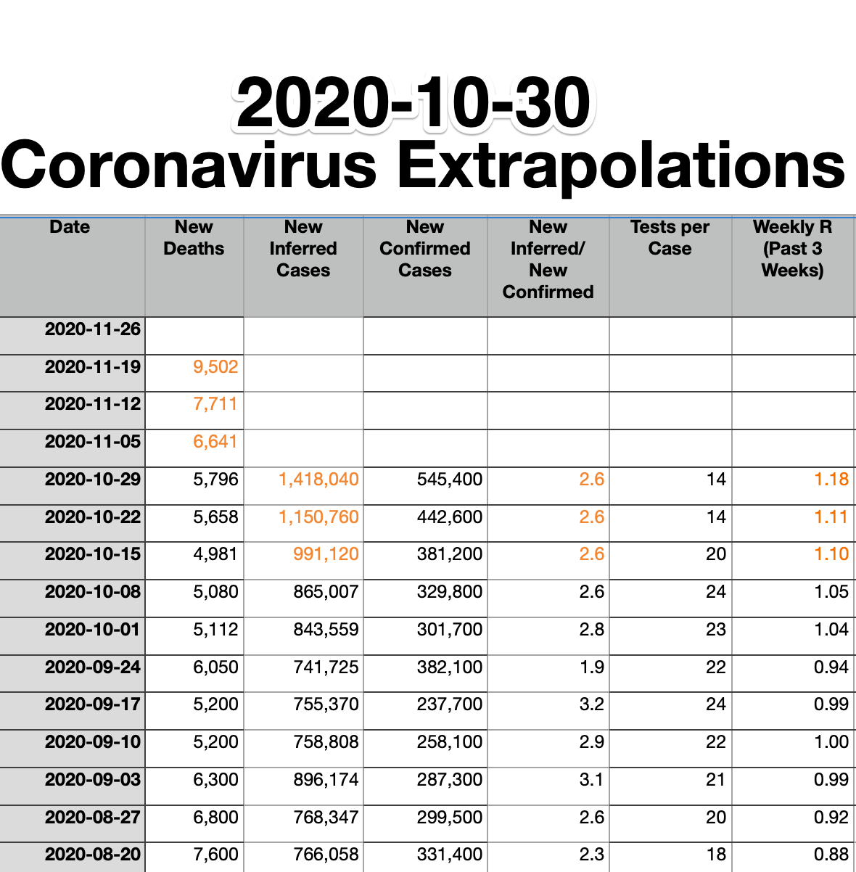
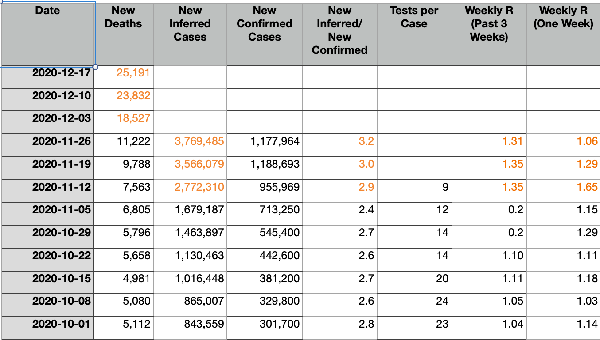
COVID Forecasts: 2020-11-26
It gives me no pleasure that my simple national model of coronavirus cases—project cases back three weeks from deaths, and then extrapolate case growth out from confirmed case growth and from the number of cases per test—continues to run dead-on…
<https://www.icloud.com/keynote/0bCYYctIKV9_4ICVqtSe5qItQ> <https://www.bradford-delong.com/2020/11/covid-forecasts.html>
2020-11-26
Notes:
It gives me no pleasure that my simple national model of coronavirus cases—project cases back three weeks from deaths, and then extrapolate case growth out from confirmed case growth and from the number of cases per test—is running dead-on:
I forecast a week ago that we would have 6641 deaths in the seven days ending Th 2020-11-05.
We had 6805 deaths.
The model is now predicting that we will see 12893 deaths in the seven days ending on Thanksgiving: Th 2020-11-26.
And if our current inferred last-three-weeks R=1.24 were to continue, we would have 3,671,728 cases in the seven days ending on Thanksgiving.

Slide 2
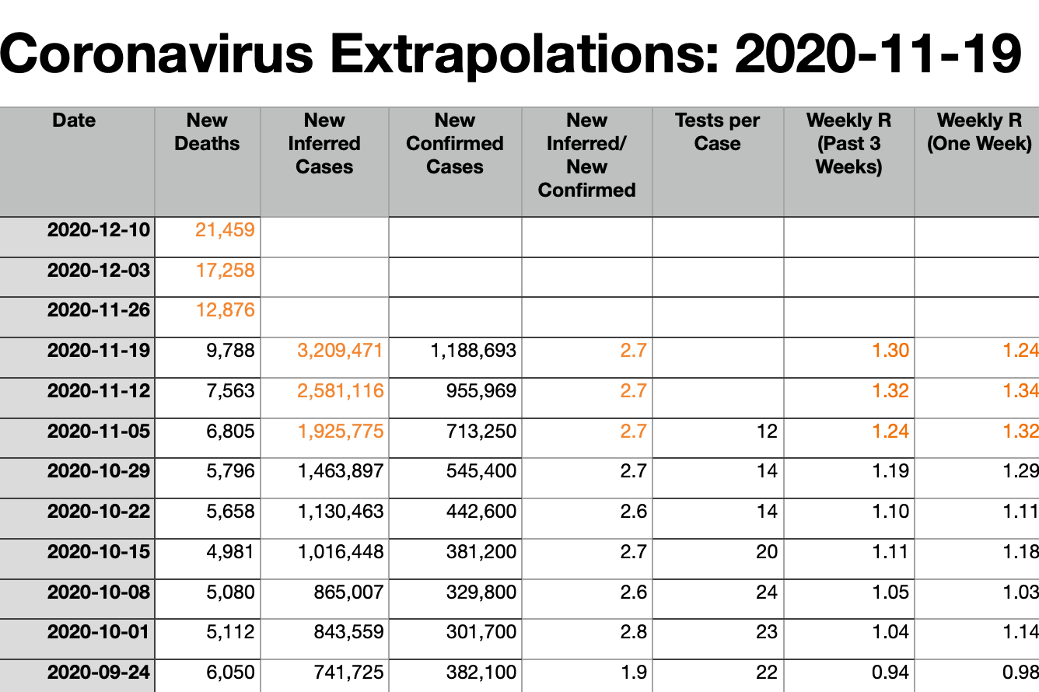
COVID Forecasts: 2020-11-19
It gives me no pleasure that my simple national model of coronavirus cases—project cases back three weeks from deaths, and then extrapolate case growth out from confirmed case growth and from the number of cases per test—continues to run dead-on…
<https://www.icloud.com/keynote/0bCYYctIKV9_4ICVqtSe5qItQ> <https://www.bradford-delong.com/2020/11/covid-forecasts.html>
2020-11-19
Notes:
It gives me no pleasure that my simple national model of coronavirus cases—project cases back three weeks from deaths, and then extrapolate case growth out from confirmed case growth and from the number of cases per test—is running dead-on:
I forecast a week ago that we would have 6641 deaths in the seven days ending Th 2020-11-05.
We had 6805 deaths.
The model is now predicting that we will see 12893 deaths in the seven days ending on Thanksgiving: Th 2020-11-26.
And if our current inferred last-three-weeks R=1.24 were to continue, we would have 3,671,728 cases in the seven days ending on Thanksgiving.

Slide 3
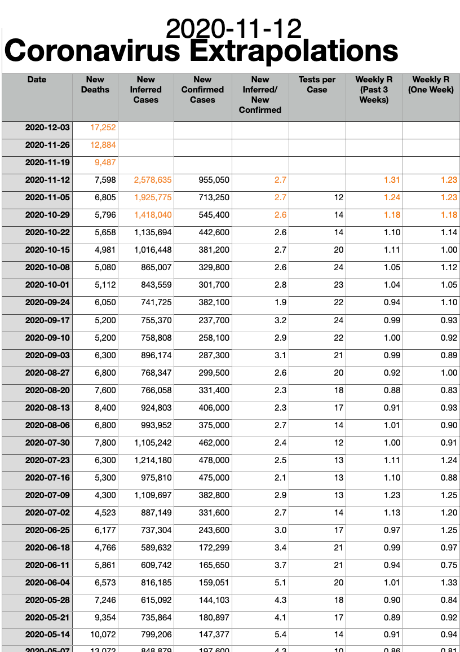
COVID Forecasts: 2020-11-12
It gives me no pleasure that my simple national model of coronavirus cases—project cases back three weeks from deaths, and then extrapolate case growth out from confirmed case growth and from the number of cases per test—continues to run dead-on…
<https://www.icloud.com/keynote/0bCYYctIKV9_4ICVqtSe5qItQ> <<https://www.bradford-delong.com/2020/11/covid-extrapolations-as-of-2020-11-06.html>
2020-11-06
Notes:
It gives me no pleasure that my simple national model of coronavirus cases—project cases back three weeks from deaths, and then extrapolate case growth out from confirmed case growth and from the number of cases per test—is running dead-on:
I forecast a week ago that we would have 6641 deaths in the seven days ending Th 2020-11-05.
We had 6805 deaths.
The model is now predicting that we will see 12893 deaths in the seven days ending on Thanksgiving: Th 2020-11-26.
And if our current inferred last-three-weeks R=1.24 were to continue, we would have 3,671,728 cases in the seven days ending on Thanksgiving.

Slide 4
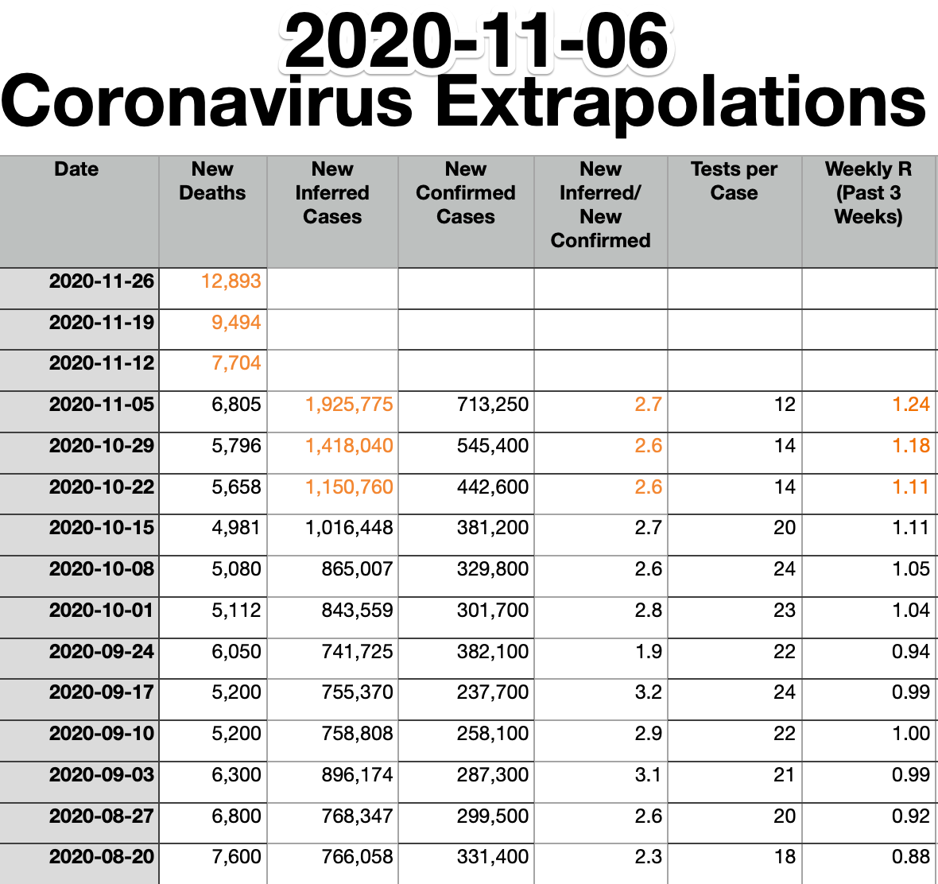
COVID Forecasts: 2020-11-06
It gives me no pleasure that my simple national model of coronavirus cases—project cases back three weeks from deaths, and then extrapolate case growth out from confirmed case growth and from the number of cases per test—is running dead-on:
I forecast a week ago that we would have 6641 deaths in the seven days ending Th 2020-11-05.
We had 6805 deaths.
The model is now predicting that we will see 12893 deaths in the seven days ending on Thanksgiving: Th 2020-11-26.
And if our current inferred last-three-weeks R=1.24 were to continue, we would have 3,671,728 cases in the seven days ending on Thanksgiving.
<https://www.icloud.com/keynote/0bCYYctIKV9_4ICVqtSe5qItQ> <<https://www.bradford-delong.com/2020/11/covid-extrapolations-as-of-2020-11-06.html>
2020-11-06
Notes:
It gives me no pleasure that my simple national model of coronavirus cases—project cases back three weeks from deaths, and then extrapolate case growth out from confirmed case growth and from the number of cases per test—is running dead-on:
I forecast a week ago that we would have 6641 deaths in the seven days ending Th 2020-11-05.
We had 6805 deaths.
The model is now predicting that we will see 12893 deaths in the seven days ending on Thanksgiving: Th 2020-11-26.
And if our current inferred last-three-weeks R=1.24 were to continue, we would have 3,671,728 cases in the seven days ending on Thanksgiving.

Slide 5
Catch Our Breath
Let’s reflect on what we have just heard & seen…
Comments
Questions
Readings

Slide 6
========================

