Slide 1
DevEng 215:
Week 5: Development as an Industry
J. Bradford DeLong
Professor of Economics and Chief Economist Blum Center for Developing Economies, U.C. Berkeley
Week 5: Th 2020-09-24 12:00 Noon
<https://www.icloud.com/keynote/0O18MqdAKb4Cmadq15O8r3b9Q>

Slide 2
Joeva Rock Says: GPP 115 Live
From Joeva Rock:
Tu September 22nd, 2-3:30p (Week 5)
Tu October 6th, 2-3:30p (Week 7)
Tu October 20th, 2-3:30p (Week 9)
Tu October 27th, 2-3:30p (Week 10)
Tu November 10th, 2-3:30p (Week 12)

Slide 3
Seven Questions…
From Haley Wohlever:
Are the notions of progress and modernity universal? If not, whose notions should we adhere to? (Pigg's study)
In today's world, can social, cultural, and political progress be achieved without material advancement?
Rather than viewing poverty as purely economic, is there a more holistic and perhaps better way to conceptualize it? (Escobar's paper)
Where do statistics/narratives come from and how can we validate them? (Ferguson's paper)
What were social norms around discussing money when you grew up? What factors influenced that and how has it influenced the way you view your own and others' economic status today? (Lawson and Elwood's case studies)
What/when is the most dangerous rhetoric around development today and why?
How closely linked are the destinies of "developed" and "underdeveloped" or "developing" countries?

Slide 4
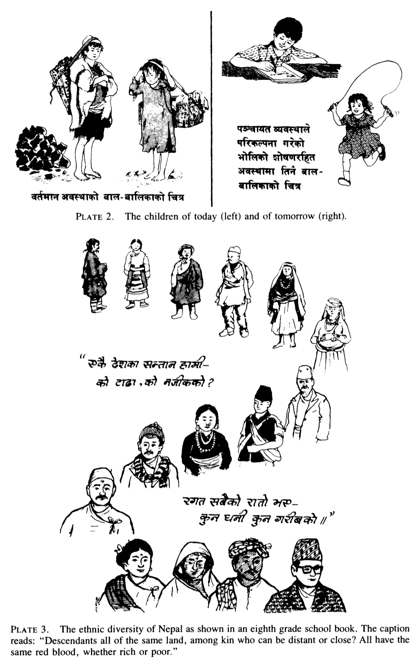
Pigg: Inventing Social Categories via Place
Conceptualizing “development” in Nepal:
“bikas”—dherai bikas, thorai bikas, bikas chhaina
New breeds of goats and chickens, water pipes, electricity, videos, schools, commercial fertilizer, roads, airplanes, health posts, and medicines…
  A_{dministered from Kathmandu}
  Staffed at the higher levels by people posted to local projects from other places.
  Geographically concentrated, to varying degrees
  _{National pedagogy:}
  We are all Nepalis—ethnic, regional, linguistic differences unimportant
  _{We are peaceloving and brave}
  We live from Sagarmāthā to Lumbin
  _{Small families are good}
  _{Children should be vaccinated}
  Our villages are good—and we need to leave or at least transform them
Stacy Leigh Pigg (1992): Inventing Social Categories through Place: Social Representations and Development in Nepal <https://github.com/braddelong/public-files/blob/master/readings/article-pigg-categories-place.pdf>

Slide 5
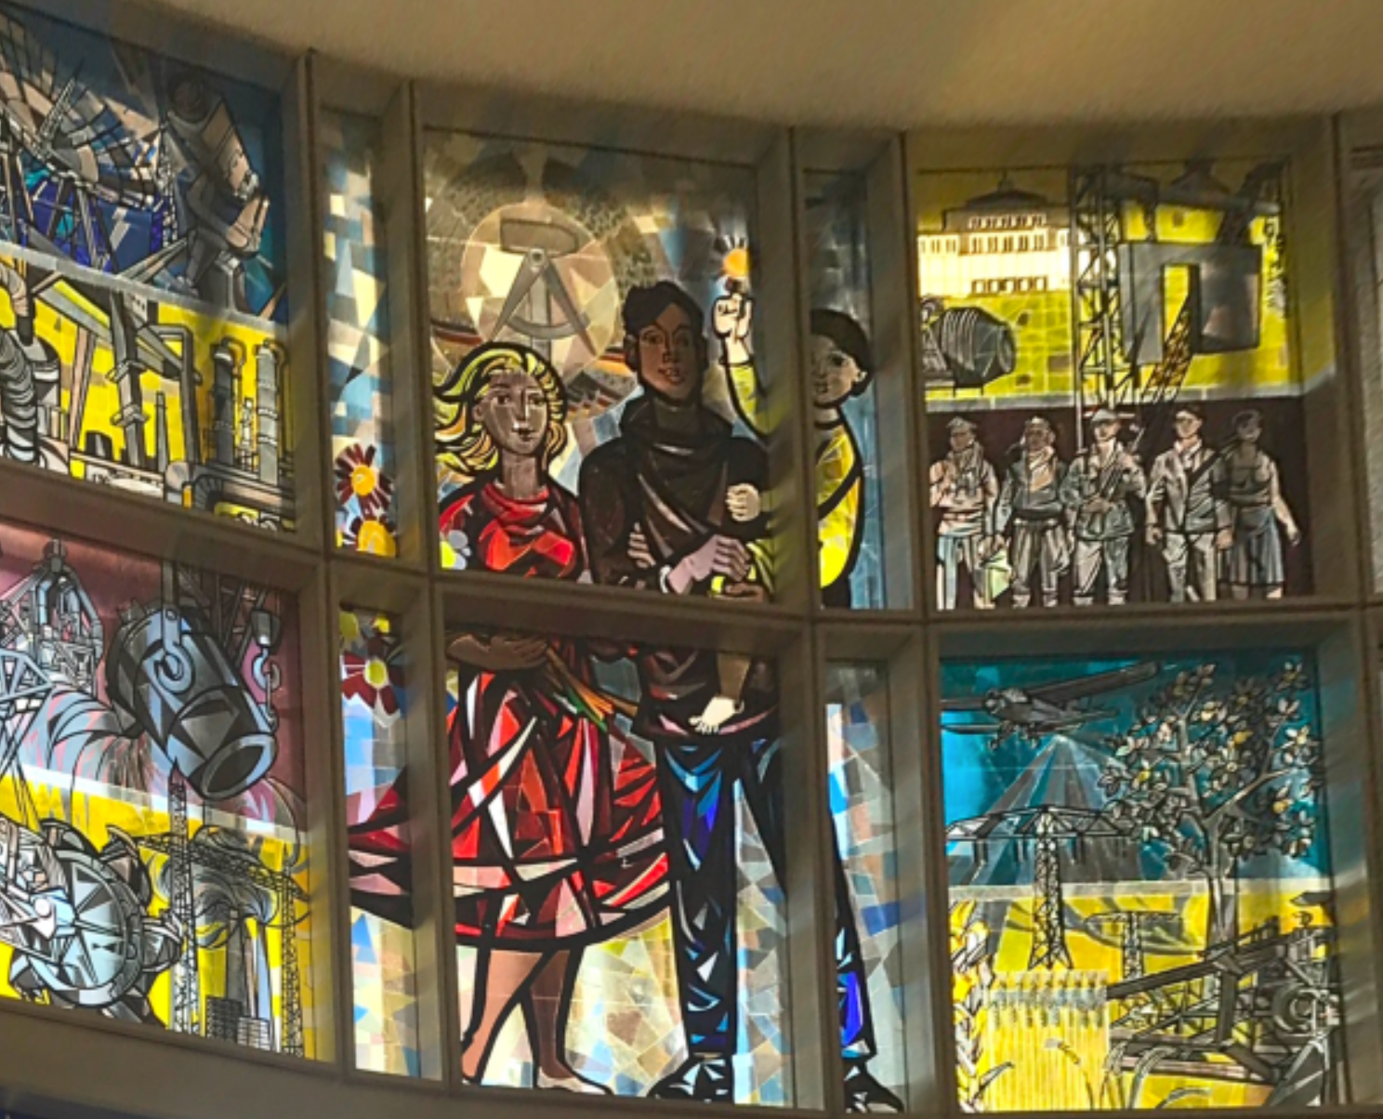
Walter Womacka: The Family & Society Under Full Communism
The former State Council building
Berlin’s Schlossplatz—Palace Plaza
How East Germany imagined it would be…
Comsats
Refineries
Steelmakinig
Power generation
Construction
Cross-occupation cooperation
Aerospace
Nature
Electricity transmission
Masonic
Flowers
Nuclear family—bourgeois & working class & health signifiers

Slide 6
The Ideological Milieu: Escobar’s Characterization
Development Discourse:
“Modernization” as the only alternative to archaism
Industrialization and urbanization as inevitable road to progressive change
Material advancement as the only road to social, cultural, and political progress
Capital formation as the key link
Poverty prevents sufficient domestic savings mobilization—at least at less than a horrific and near-genocidal cost
Arturo Escobar: The Invention of “Development” <https://github.com/braddelong/public-files/blob/master/readings/article-escobar-1999-invention-of-development.pdf>

Slide 7
Left-Wing “Sacrifice” Discourse
Bertholt Brecht: To Those Born Afterwards:
Our strength was limited. The goal
was far away
It was clearly visible, even though for me
unreachable.
Thus passed my time
that was given to me on earth.
You who will emerge on the surface of the floodwater
in which we drowned
remember also
when you speak of our weaknesses
the dark times
whom you escaped…

Slide 8
Right-Wing “Sacrifice” Discourse
John Maynard Keynes: Economic Consequences of the Peace:
The immense accumulations of fixed capital which, to the great benefit of mankind, were built up… could never have come about in a society where wealth was divided equitably. The railways… [were,] not less than the pyramids of Egypt, the work of labour which was not free to consume in immediate enjoyment the full equivalent of its efforts. Thus this remarkable system depended for its growth on a double bluff or deception. On the one hand the labouring classes accepted from ignorance or powerlessness, or were compelled, persuaded, or cajoled by custom, convention, authority, and the well-established order of society into accepting, a situation in which they could call their own very little of the cake that they and nature and the capitalists were co-operating to produce. And on the other hand the capitalist classes were allowed to call the best part of the cake theirs and were theoretically free to consume it, on the tacit underlying condition that they consumed very little of it in practice….
In the unconscious recesses of its being society knew what it was about. The cake was really very small in proportion to the appetites of consumption, and no one, if it were shared all round, would be much the better off by the cutting of it. Society was working not for the small pleasures of today but for the future security and improvement of the race— in fact for 'progress'. If only the cake were not cut but was allowed to grow in the geometrical proportion predicted by Malthus of population, but not less true of compound interest, perhaps a day might come when there would at last be enough to go round, and when posterity could enter into the enjoyment of our labours. In that day overwork, overcrowding, and under- feeding would come to an end, and men, secure of the comforts and necessities of the body, could proceed to the nobler exercises of their faculties…

Slide 9
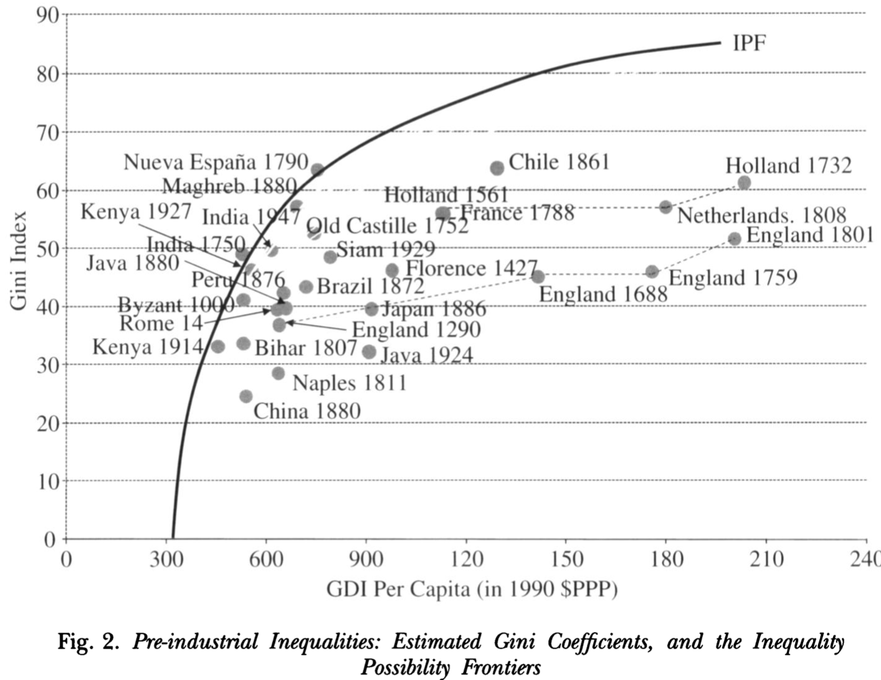
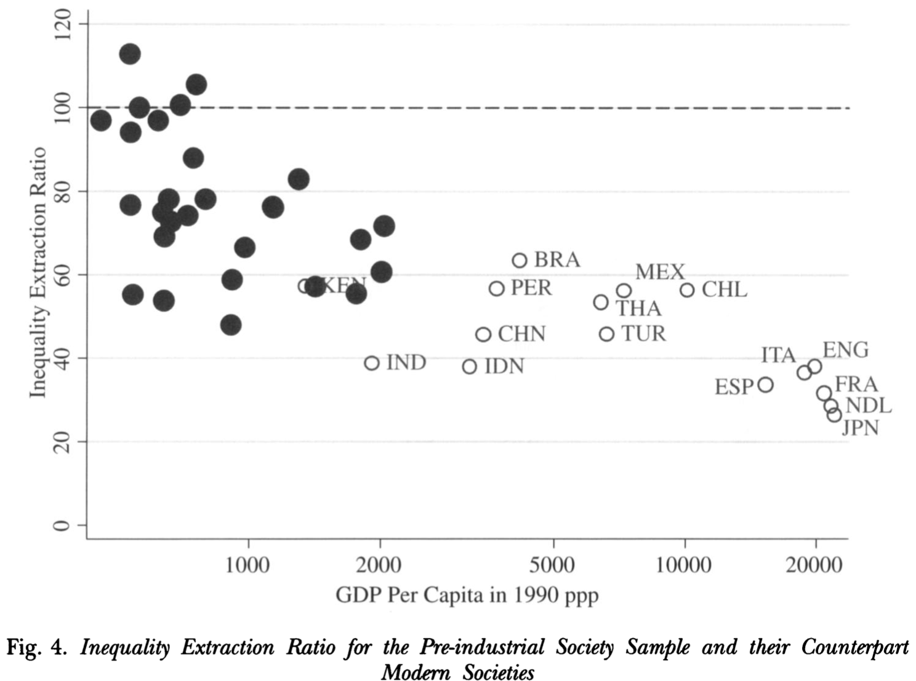
“Inequality Possibility Frontiers”
Without societal wealth, little is possible:
Branko Milanovic & .al: Pre-Industrial Inequality <https://github.com/braddelong/public-files/blob/master/readings/article-milanovic-%26-al-pre-industrial-inequality.pdf>

Slide 10
Ferguson
Excluded from the World Bank’s analysis are:
  The political power of the state and its class basis
  Use of official positions and state power by the bureaucratic elite , cliques, and fashions
  Mention of the undemocratic character of the ruling government or political opposition is studiously avoided
  The state is taken to have no interest other than “development”
  Where “bureaucracy” is seen as a problem, it is not a political but merely an organizational matter
  The Thaba-Tseka project “became like a bread crumb thrown into an ant’s nest”
    Needing to construe themselves as apolitical, the planners viewed its failure as…
    The result of choosing the wrong organizational chart
    Rather than of a predatory government using project resources for the purpose of strengthening the position of its own functionaries
  What does Ferguson mean by: “Change comes when, as Michel Foucault says, ‘critique has been played out in the real, not when reformers have realized their ideas…’”
James Ferguson (1994): The Antipolitics Machine: “Development” & Bureaucratic Power in Lesotho <https://github.com/braddelong/public-files/blob/master/readings/article-ferguson-1994-antipolitics.pdf>

Slide 11
Lawson & Ellwood
When & how do non-poor people with social power meet, interact with, and come to know about poor people & poverty?:
    Welfare office & community task force
    Processes of governance:
      “Insiders”
      “Space invaders”
      Governance & discipline
    Zones of contact:
    Constraints & options…
    Choices, guardrails, coaching, & reflection mechanisms…
Victoria Lawson & Sarah Elwood (1994): Encountering Poverty: Space, Class, and Poverty Politics <https://github.com/braddelong/public-files/blob/master/readings/article-lawson-%26-ellwood-1993-encountering-poverty.pdf>

Slide 12
Lawson & Ellwood
From Haley Wohlever:
Are the notions of progress and modernity universal? If not, whose notions should we adhere to? (Pigg's study)
In today's world, can social, cultural, and political progress be achieved without material advancement?
Rather than viewing poverty as purely economic, is there a more holistic and perhaps better way to conceptualize it? (Escobar's paper)
Where do statistics/narratives come from and how can we validate them? (Ferguson's paper)
What were social norms around discussing money when you grew up? What factors influenced that and how has it influenced the way you view your own and others' economic status today? (Lawson and Elwood's case studies)
What/when is the most dangerous rhetoric around development today and why?
How closely linked are the destinies of "developed" and "underdeveloped" or "developing" countries?

Slide 13
People
Brad DeLong delong@econ.berkeley.edu
Tvetene Carlson tjcarlson@berkeley.edu 3034966195 G Civil & Environmental Eng MS, Civil & Environmenta
Casey Finnerty casey.finnerty@berkeley.edu 20956015 G Civil & Environmental Eng PhD
Adrian Hinkle adrian.hinkle@berkeley.edu 3034272154 G Civil & Environmental Eng PhD
Mekhala Hoskote mdhoskote@berkeley.edu 24205468 G Health & Medical Sciences MS
Kelly Conway kelly_conway@berkeley.edu
Haley Wohlever haley.wohlever@berkeley.edu
Hanna Seo hanna_seo@berkeley.edu
Sara Mahmoud sara_mahmoud@berkeley.edu
Margie Lauter margielauter@berkeley.edu
Dana Geffner dana_geffner@berkeley.edu
Notes:
From a cynical perspective the interesting question might be not why was there economic stagnation in much and absolute economic decline in some ofemerging markets, but why there was rapid growth in other portions. Chile, Mexico, southern Brazil, and Panama in Latin America; Algeria in Saharan and Botswana in sub-Saharan Africa; and Hong Kong, Malaysia, Singapore, South Korea, Taiwan, Thailand, and now, of course, China in Asia are countries that have made impressive strides toward closing the relative material prosperity gap vis-a-vis the global north in the post-World War II era. How have they managed to do this? What have been the key factors separating successful from unsuccessful episodes of economic development?
The natural conclusion from emerging-market history is that successful economic development is difficult without either a limited government or a developmental state: the logic of politics is that of favors performed, wealth redistributed, inﬂuence exercised, and taxes collected; that is very different from the logic of economic growth. Only a state that is limited in the amount of damage it can do to the economy, or a state that is secure enough, independent enough, and committed to rapid economic growth can avoid this development trap.
These are the two roads to successful rapid development: “neoliberalism,” on the one hand; and the so-called “developmental state” approach that has been so successful in East Asia on the other. Either insulate the economy from the (semi-predatory) government so that the government’s attempts to tilt the distribution of income in favor of the politically powerful are relatively ineffective and do little harm, or create a government bureaucracy whose first goal is development, and which views interests as its tools to be used in promoting economic growth, rather than as its masters.
These pressures have, in the post-World War II period at least, been strong enough to counteract the natural tendency for poor countries to learn rapidly about technology and catch up to rich ones. There is no clear reason on the horizon for these pressures to diminish. Optimists hope that the record of economic failure provided by much third world experience in the past generation will lead to the creation of intellectual pressures for reform strong enough to overcome the bias for stagnation.
And if ideas truly are the decisive forces making history in the long run, perhaps the optimists are right.
If the optimists are wrong, then we are all in big trouble. Successful handling of the future’s global environmental problems, and successful long-run stabilization of human populations, hinges on successful industrialization in the third world and the consequent—rapid—passage through the demographic transition.
----
One way to read the economic history is as repeated attempts to produce the second: to create a pro-growth “developmental state.” Yet in the last analysis there is nothing worse than state-led development led by an anti-developmental state. And that was what too many post-independence Asian and African and too many post-World War II Latin American states turned out to be.
Thus starting in the 1980s hopes for development—outside of the Pacific Rim, where the successful “developmental state” has been was already clearly a reality— shifted in the direction of “neoliberalism.” It seemed better to try to limit the state’s involvement in the process of development, because its interventions were more likely to be destructive than constructive. Rely, instead, on the world market as a source of demand, and on the requirements for integration into the world market and cooperation with the international agencies set up after World War II as a source of good-enough governance.

Slide 14
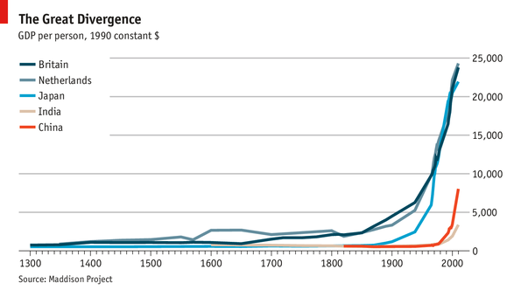
The Great Divergence

