Slide 1
4.2.1.2. Intro Video: Plutocracy, & Inequality
There are, really, two topics this week:
The second topic is inequality within societies—the phenomenon of plutocracy, of rule by the extraordinarily wealthy, in a way that creates for the extraordinarily wealthy their truly extraordinary wealth, and maintains it.

Slide 2
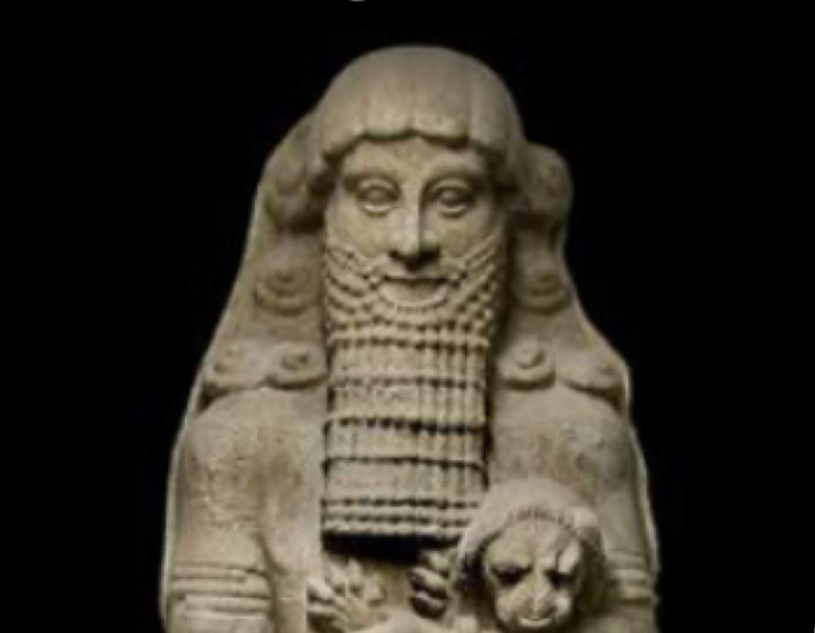
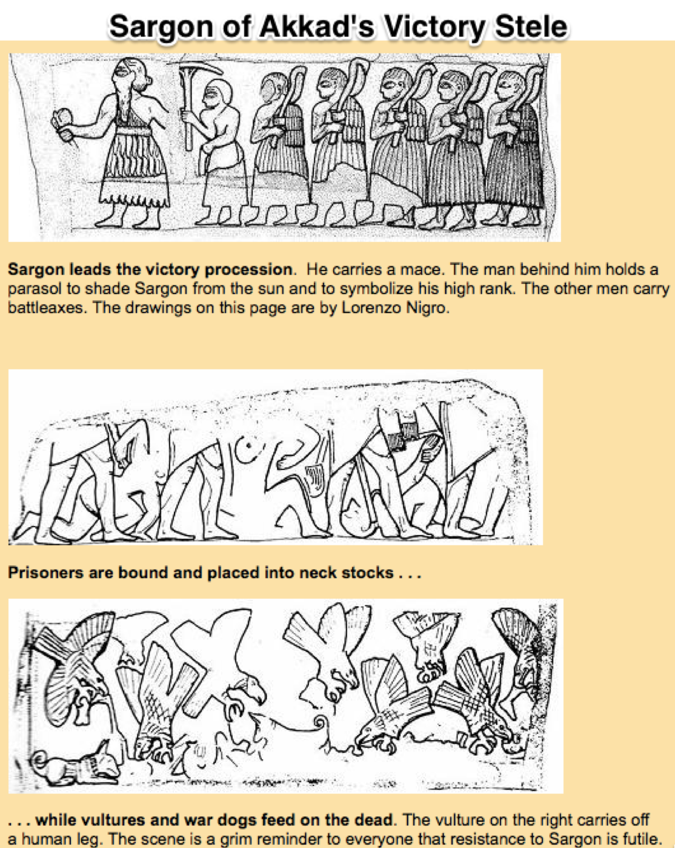
4.2.1.2. Intro Video: Plutocracy, & Inequality: Origins of Gross Inequality in the Agrarian Age
Notes:
The phenomenon of plutocracy, of gross inequality, arrives no later then The rise of Uruk back more than 5000 years ago. When we look at the oldest written documents, the most common symbols are for numbers. The most common mon-numerical symbol we find is that for “female slave brought from someplace distant”. “Male slave brought from someplace distant” is not far behind. The oldest work of literature we possess, “The Men Who Saw the Things of the Deep”—what we call the Epic of Gilgamesh, starts with the city of Uruk under the absolute rule of King Gilgamesh. His actions appear to be only constrained by the gods, and not always by them. Gilgamesh can, without limit, command the young men to train and fight and work and build for him. He can command the women to cook and clean and serve and service him.
Such a style of life–one in which you engross far more than your equal share of society’s resources by virtue of your skill as a thug with a spear, notionally being a good shepherd of the people protecting them from wolves, comes only with the agrarian age. And do note that the protection offered is of a peculiar kind. The standard metaphor is of the “good shepherd of the people”. But the shepherd does not protect the sheep because he wants the sheep to live their best lives for the longest possible time. The shepherd wants wool, milk, and meat: that is what, in his view, the sheep are for. He is not their servant. They are not his companions or friends. To the extent that he exercises good lordship—good shepherdship—their well-being is purely instrumental.

Slide 3
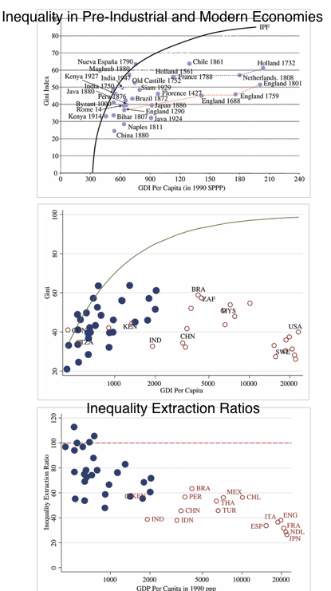
Agrarian-Age & Modern Inequality
Notes:
And as the economy and civilization has grown, the top of the inequality pyramid has gotten higher and higher. The possibility of somebody with the relative social power of a Julius Caesar is inconceivable before the coming of the agrarian age. The possibility of somebody with the relative social power of a Jeff Bezos or a Joe Biden or, in their own way, of a Taylor Swift or a George Clooney muse,
Once the agrarian age arrives—strike that, once the city-states of Summer and Akkad and the kingdom of Egypt arises—it looks as though agrarian-age societies rapidly become about as an equal as they could be. It looks as if they were much more unequal then they would die off and vanish. Malthusian dynamics keep lower-class standards of living at the Malthusian warranted population growth rate setpoint, given the marriage and other demographically relevant institutions of society. The upper class maintains its dominion and its standard of living by virtue of its effective monopoly of coercive violence via its panoply of weapons and its training, and by enforcing exit from its numbers, either through violent death or through some process of derogeance.
The coming of the imperial-commercial and then the industrial revolution sees a change in the character of the elite: from one that is primarily one of military landlord aristocrats end, where the centralized state is strong enough to collect taxes, state servants, with an egg mixture of slavelords; to one of merchant prices, industrial capitalists and employers, with again, for a long time, a strong admixture of slavlLords The coming of the industrial revolution also appears to see a steep rise in income and wealth inequality. But that inequality is then eroded by the coming of democracy and the rise of the social insurance state.

Slide 4
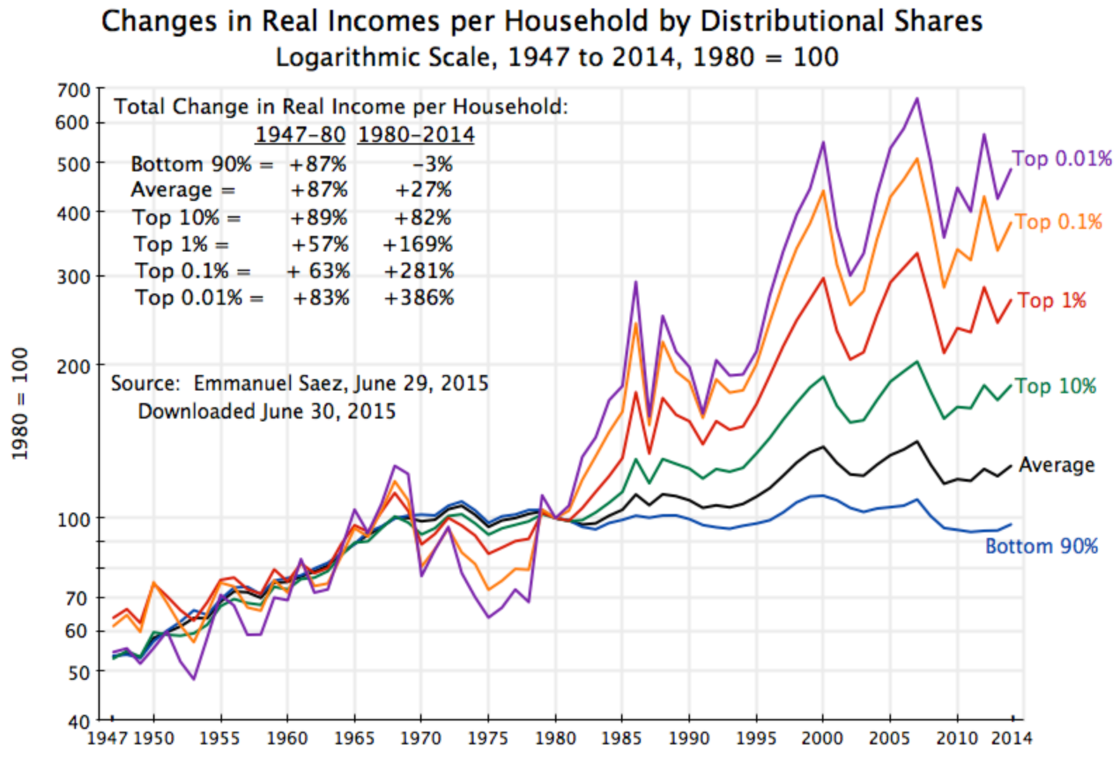
The Coming of a Second Gilded Age
Notes:
The past 35 years however, have seen the coming of a second Gilded Age: the rise, especially in the United States, of a plutocratic upper class that is now much much richer relative to the wealth of the rest of the population than any upper class ever—save possibly for the robber barons of the first Gilded Age at the height of the industrial-revolution expansion of manufacturing.
There are those who argue that our modern day in a quality is not nearly as burdensome on society as a previous inequality because the stakes are lower. It is not as though whether you are rich or poor determines whether you live or die, or whether your children are healthy or are stunted. (Although we have seen a degree of this very sharp edge of inequality return over the past year.) And, indeed, there is some truth to this. As John Maynard Keynes like to say, it is much better for someone to be a tyrant with respect to their bank balance then to be a tyrant over other people directly. On the other hand, few tyrants would decide, as Purdue Pharmaceuticals, under the lash of its Sackler family’s and its other owners’ demands for profits, did, that it should addict as many people as possible to oxycodone. Few tyrants would decide, as Mark Zuckerberg did, that allowing Alex Jones free reign to spread moral poison and misinformation on Facebook was worth it. Why? Because he, Mark, could then sell ads for overpriced gold funds and fake diabetes cures to Joannes is terrified audience who is eyeballs were than glued to the screen.
Knotty questions deserving of thought.

Slide 5
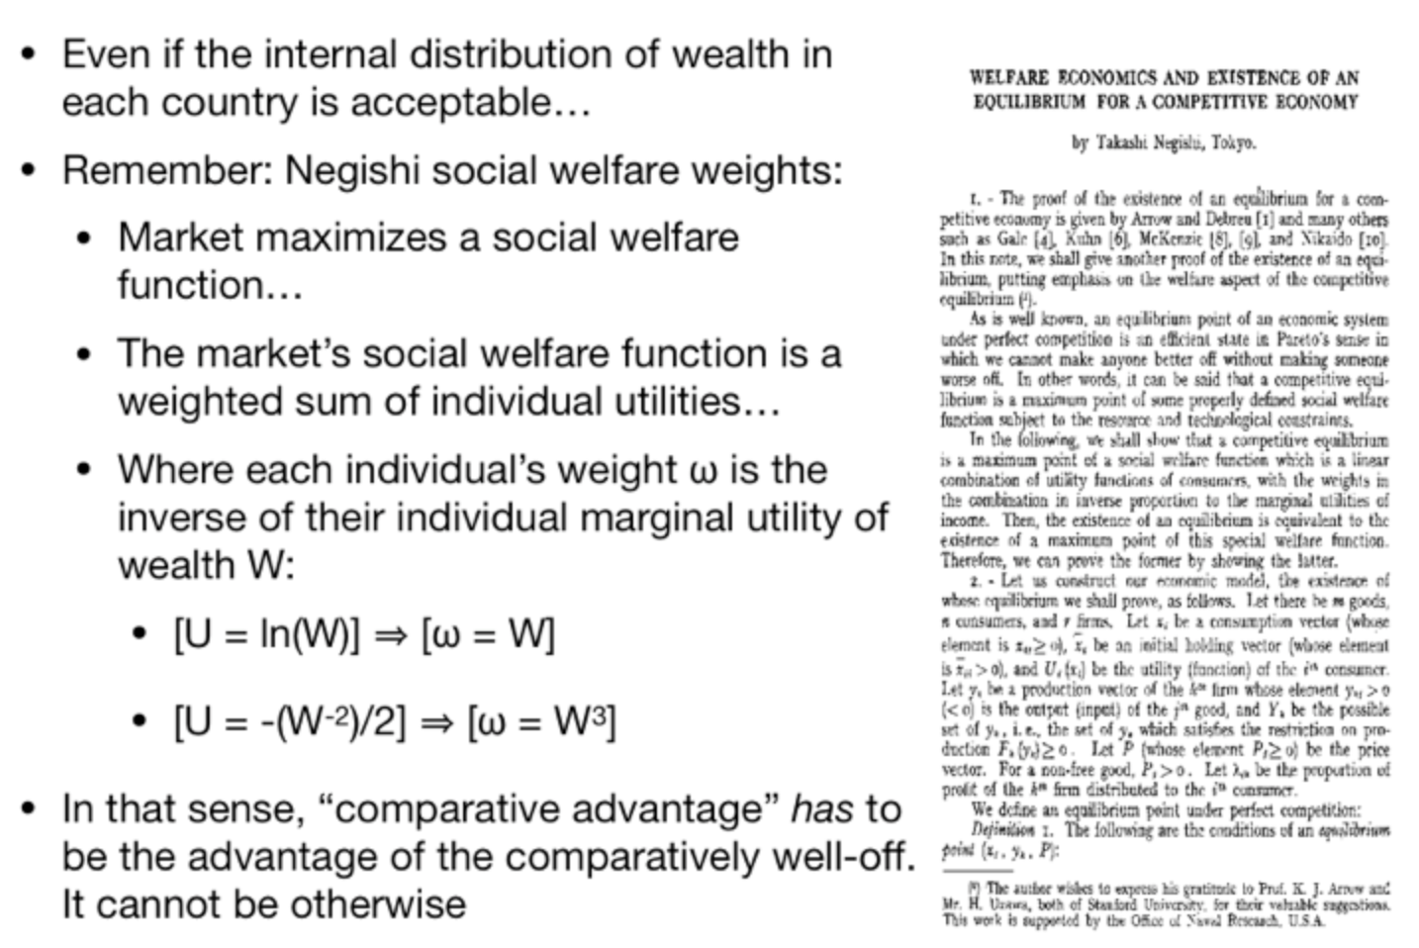
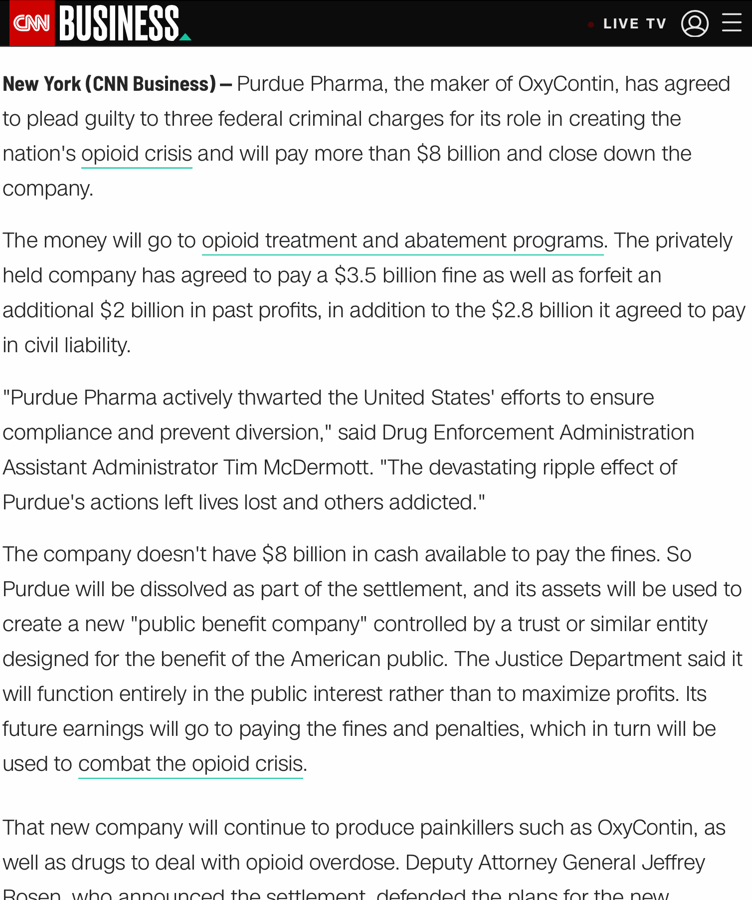
Inequality & Societal Well-Being
Notes:
One way to look at it: Even a well-functioning market economy with perfect competition, and all the appropriate Pigouvin taxes and bounties to compensate for externalities, does not maximize any sensible societal well-being function. It does maximize a societal well-being function. But the one that the market economy, even when the market economy works “optimally” in an Arrow-Debreu-Mackenzie sense, maximizes is a societal well-being function in which each person’s well-being counts in proportional to the square of their wealth.
For anyone with any utilitarian leanings whatsoever, this is monstrous and disgusting.
Even if you are not a utilitarian, you had better be damn sure that you like society’s distribution of wealth and think that those with five times the money really do deserve 25 times as much social power over others and to get the good things of life, before you approve of the inequality in society.

