Slide 1
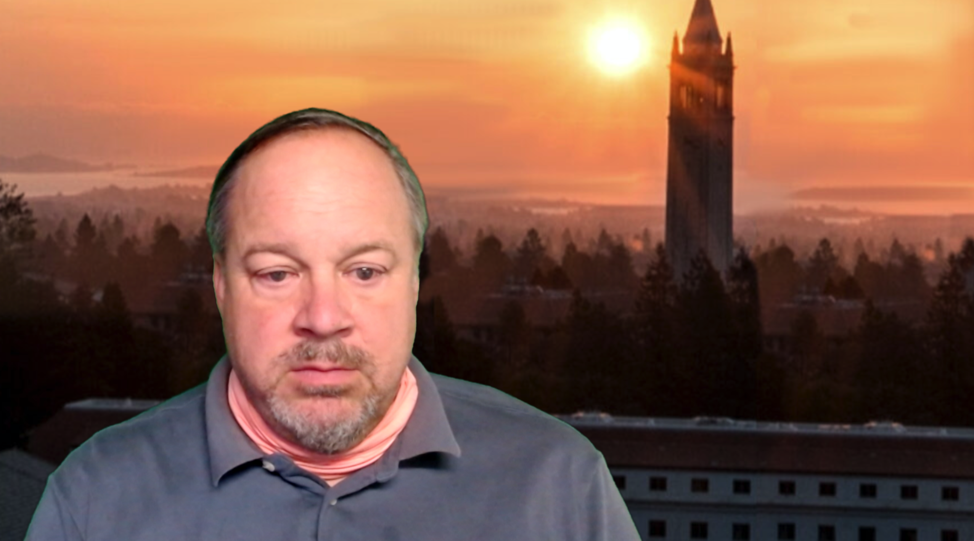
DevEng 215: Week 10: Disaster Capitalism II: Puerto Rico: Questions & Slides
Th 2020-10-29 <https://berkeley.zoom.us/j/92547663468?pwd=MWhlTE1nQzJuRFN4a1BPdkZJT1NmUT09> <https://bcourses.berkeley.edu/courses/1497096>
Questions:
Bonilla emphasizes the temporality of disaster. What else must the global majority wait for? How long do they expect to wait for disaster relief, a good job, a democratic government? What are the reasons often given as to why they must wait for all these things?
Dinzey-Flores in their conclusion notes that a society, whether they gain independence or continue under the government of their colonizer, in either case must manage and fight against the endemic colonial infrastructure (economic, cultural, political). Does independence matter? How are disaster responses different between independent states and their still colonized neighbors, how are they the same?
Environmental Justice touches upon many complex subjects: water access, food security, and pollution exposure just to name a few. García-López identifies the injustices for these many issues are connected Puerto Rico’s colonial history and how it continues in the inequality between Puerto Rico and the U.S. but also between people on Puerto Rico. A distant colonizer taking advantage of the local people is the typical colonial presentation. However, the local inequality in a colonial state can be just as stark of a difference between the colony and the colonizer. Could local inequality be as important to perpetuating colonial institutions as distant neocolonialists?
Llorens article heavily emphasizes migration from Puerto Rico and how it has created two communities of islanders and state-side migrants. She notes how this migration has created a divide between these populations, but also a powerful ally on the mainland. This is a common dichotomy, migrants helping their communities from afar, but needing to leave the communities to do so. Can migration be seen as a symptom of colonialism, of people that can escape leaving after disaster or simply to pursue opportunity? Does this migration perpetuate or help address global inequality, both?
Naomi Klein’s video explicitly focuses on, and the other readings touch upon, the privatization of government services during the recovery period after Hurricane Maria. Last week we also read about a similar story when investors bought property on the cheap in New Orleans to develop. Both of these “recovery efforts” were started long before either Hurricane was even known. Their respective governments trying to convince the public to adopt these “reasonable reforms” before using the timing of a natural disaster to implement them. Are we able to recognize these “reform” efforts that could take advantage of a disaster? Do you know of any current companies/governments/individuals that used Covid as an excuse to implement one of their schemes?
2020-10-29

Slide 2
Disaster Capitalism? Why
There’s no money in avoiding a “natural disaster” (externalities!)
There’s no money to be made preparing for a “natural disaster”
  Insurance markets are hard to generate & maintain…
After a “disaster”, a lot of people want things really, really bad
  So there is a great deal of money to be made by price-gouging them…
After a “disaster”, a lot of people have no social power—no money—at all
  Hence they are completely invisible to all market processes
  & how do you set up functional—rather than exploitative —non-market processes?
2020-10-29

Slide 3
Hilda Llorens: Ruin Nation
<https://github.com/braddelong/public-files/blob/master/readings/article-llorens-2018-ruin-nation.pdf>
§936
Commonwealth Project: “local autonomy… cultural nationalism… [plus] American consumerism”
40% of males of prime working age born in Puerto Rico are in the continental United States—plus second & third generation continent inhabitants who regard themselves as Puerto Ricans.
Llorens calls this: “In the mainland cities where so many Puerto Ricans have migrated— they go “seeking a better life,” but instead land among other ruins in post-industrial U.S. cities like Hartford and Bridgeport, Connecticut, and many others…
Llorens calls this: “a source of internal oppression among Puerto Ricans themselves…”
Llorens talks of: “Puerto Ricans acquiescing to egregious policies, treatment, and corruption from the island’s political class… voting them into office time and again, instead of supporting non-mainstream party candidates and pursuing possible alliances with progressive groups like Latinx, African-American, and Native-American civil rights organizations…”
Hilda Llorens is a faculty member in the Department of Sociology and Anthropology at the University of Rhode Island.
2020-10-29

Slide 4
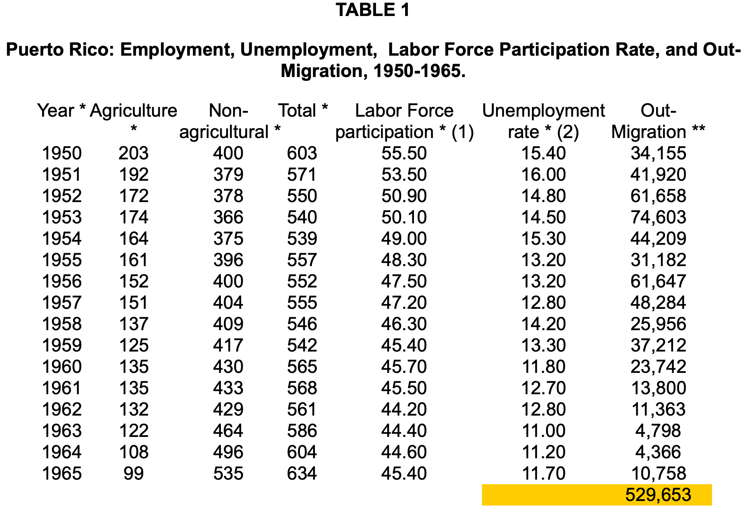
Gustavo A. Garcıa-Lopez: Environmental Injustice… Unnatural Disasters
<https://github.com/braddelong/public-files/blob/master/readings/article-garc%C3%ADa-lópez-2018-environmental-injustice.pdf>
From Maria: $60B in economic damage
200,000 migration wave to continent (Puerto Rico population: 3.5M)
“The Jones Act, PROMESA Act, FEMA’s unequal treatment after the hurricane, and the history of imposed environmentally destructive and unjust industrialization called ‘Operation Bootstrap.’…”
  Jones: Goods transported between U.S. ports must be carried by U.S. owned & operated ships…
  PROMESA—Puerto Rico’s creditors sued to invalidate it, but their cae was dismissed by the Supreme Court on June 1, 2020
  “Operation Bootstrap”—break up large landholdings, and encourage industry
2020-10-29

Slide 5
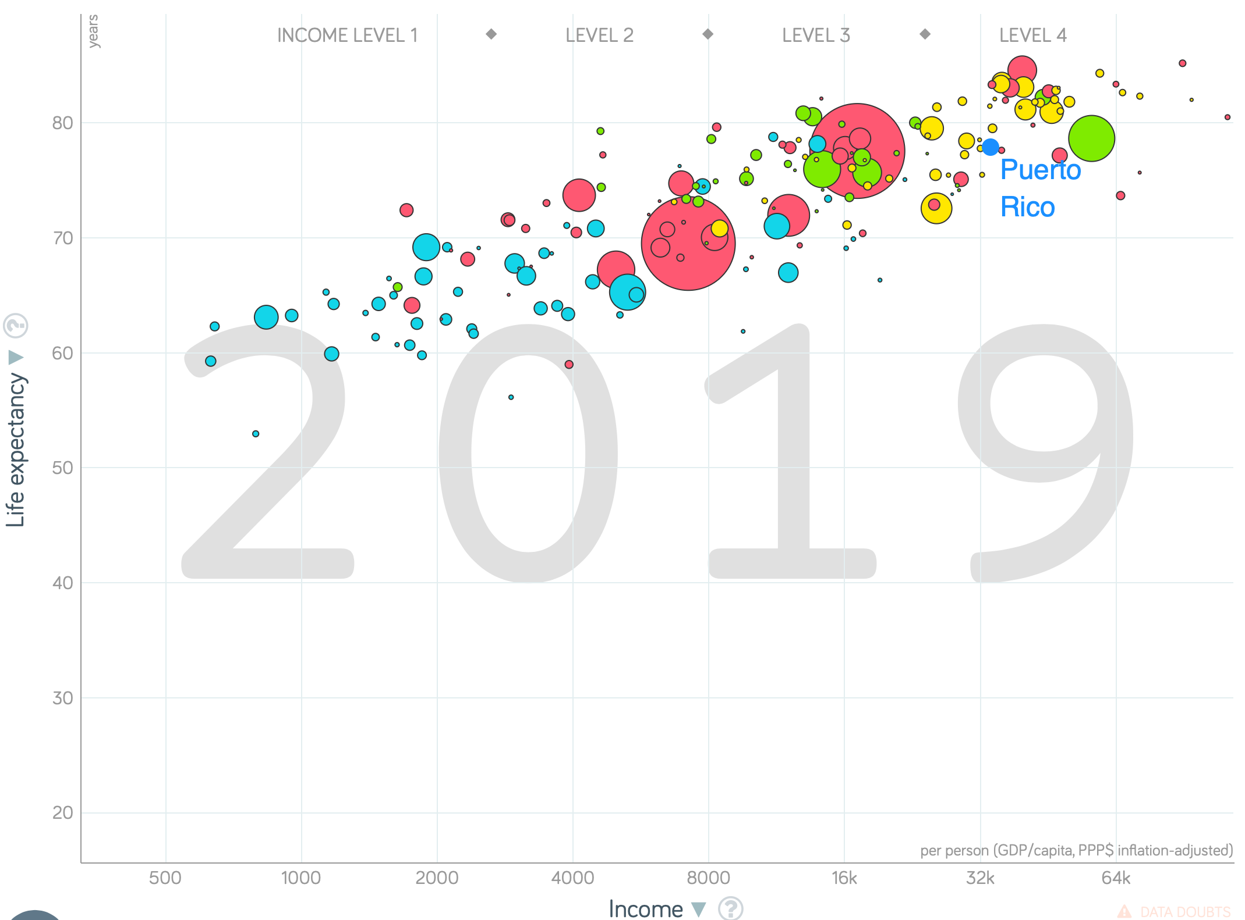
Zaire Dinzey-Flores: The Development Paradox
<https://github.com/braddelong/public-files/blob/master/readings/articlre-dinzey-flores-2018-development-faradox.pdf>
“Puerto Rico shares convergent stories of decay and deindustrialization with cities like Detroit and New York City…”
“Today, Puerto Rico sits politically and economically challenged by the pull of not being “developed” like the U.S. yet not being “underdeveloped” like other parts of the Caribbean and Latin America…”
2020-10-29

Slide 6
Yarimar Bonilla: The Coloniality of Disaster
<https://github.com/braddelong/public-files/blob/master/readings/article-bonilla-2020-coloniality.pdf >
“The cavalry never arrived. Government trucks did not turn up to clear the debris. Instead, neighbors had to clear their own paths with machetes. Tankers of drinking water didn’t appear, so residents headed to the river with buckets, or built their own make-shift infrastructure out of PVC pipes that connected directly to mountain springs…”
“At one point, people thought that what was needed in Puerto Rico was more media coverage. But the media came. They documented. They managed to keep the story alive. Puerto Rico was featured in news re- ports to an unprecedented degree, but this made no difference…”
“The leaves that were ripped off trees by hurricane winds have now grown back, and the environmental ravages of the storm have started to fade, but infrastructure remains in shatters…”
“The great majority of Puerto Ricans spent well over a hundred days without electricity, running water, or traffic signals — that is, without the invisible infrastructure of daily life…”
2020-10-29

Slide 7
Catch Our Breath
Let’s reflect on what we have just heard & seen…
Comments
Questions
Readings

Slide 8
========================

