Slide 1
Development Engineering 215: Global Poverty Challenges and Hopes: A Perspective for Development Engineers
J. Bradford DeLong
Professor of Economics and Chief Economist Blum Center for Developing Economies, U.C. Berkeley
Th 2020-09-03 12:00 Noon

Slide 2
Introduction
Despair: At most 8% of the world’s population has a standard of living more than half of today’s U.S. median. Rejoice: the world today is so much fabulously richer than it was in 1800. That is a miracle. Recoil: our knowledge—of how to run governments; of how to organize markets, firms, and property; and of how to apply science and technology—is so sketchily and unevenly distributed around the world, leaving only a small part of it as what we would see as rich and huge chunks of it as what we do see as desperately poor, is a scandal, and a crime against humanity.
Today the median household’s standard of living in the United States, Switzerland, or Singapore is 55 times $1.90 a day. Yet 9% of humanity today—700 million people—lives below that dire poverty line. Half the world’s population lives at less than $7 a day. 20% of humanity at less than $3.
Except for the last generation’s worth, all of technological progress has been open-sourced by the workings of the global patent system. All of the organizational and business models of the most productive firms and value chain networks in the world are public: open to inspection. Anyone who can gain access to one of the nine billion telephones currently existing can dial-up anybody else—although not necessarily gain an answer. There are readily scheduled or easily chartered transportation services that allow people to reach nearly any point of land (save for pieces of Antarctica) on the globe in twenty-four hours. Non-perishable goods can be carried around the world for pennies: twenty dollars per cubic foot is the current quoted price for Shanghai-Long Beach. And services can be delivered for less over those nine billion phones and other network connections. The world today is—in communications and transportations—tiny.
How can it be that a world that is so much richer and so much smaller than the world of two centuries ago is so much more unequal—that we still have 9% of the globe’s population at a living standard that is (save for public health, and access to the village phone) little distinguished from those of our pre-industrial ancestors?
And what can sociology, economics, political science, and history tell us about the answer to that question, and about the future question: what can we do about it?
What do future development engineers need to know in addition to knowing the engineers—what do they need to know about the economics, the political economy, the sociology, the anthropology, and the institutions—in order to be effective and competent?

Slide 3
“Development”
Three Big Questions:
How can it be that a world that is so much richer and so much smaller than the world of two centuries ago is so much more unequal—that we still have 9% of the globe’s population at a living standard that is little distinguished from those of our pre-industrial ancestors?
What can sociology, economics, political science, and history tell us about the answer to that question, and about the future question: what can we do about it?
What do future development engineers need to know in addition to knowing the engineering—what do they need to know about the economics, the political economy, the sociology, the anthropology, and the institutions—in order to be effective and competent?

Slide 4
DevEng 215 & GPP 115
GPP 115:
Joeva Rock
<https://bcourses.berkeley.edu/courses/1497095>
What do we know?
DevEng 215:
What can we do?
What do we need to watch out for?
How can we leverage GPP for DevEng
  Given that the Blum Center has very little resources for this…
DevEng: Development Engineering?
DevEng: Engineering Development?

Slide 5
Plan of Course
Imagining the “end of poverty” & Millennial development—Brad 2020-09-03
Colonial & imperial beginnings—Adrian 2020-09-10
Modernization to “development” 2020-09-17
Inventing “development” 2020-09-24
Globalization 2020-10-01
Philanthropy 2020-10-08
Disaster capitalism: Katrina 2020-10-22
Disaster capitalism: Maria 2020-10-29
The business of agriculture 2020-11-05
Sovereignty over food 2020-11-12
Health infrastructure 2020-11-19
Health citizenship 2020-11-25 (rescheduled)
Global citizenship 2020-12-03
Be willing to lead (or at least step in to fill awkward pauses and direct discussion in a productive direction) one (or maybe two) Thursday class sessions:
  Circulate a list of seven questions for thought about the GPP 115 readings/lectures for that week
  Suggest at least one additional reading/video/object in the world to engage with that would have been the next thing to add to the course materials
  Ask Joeva if the DevEng 215 students can present to GPP 115
By mid December, come up with a prospectus for what a DevEng-relevant chapter of your Ph.D. dissertation might be

Slide 6
Seven Questions for Week 1
Hickel, Marcos, Perspectives, Talwalker, Sachs, Easterly, Kanbur & Sumner:
Hickel: Odious debt, pharmaceutical IP & grey-market transactions, global north agricultural subsidies & export programs—how do those narrow possibilities for economic development in the village of Mpaka on the road from Manzini in Eswatini to Maputo in Mozambique?
Subcommander Marcos writes that, for progressive intellectuals, “fight[ing] the power of images with nothing but words” is “to their considerable disadvantage”. Why does he think it is to their disadvantage?
As we approached 2015, could we have “be[en] proud of steady progress on many fronts, including reducing poverty, expanding access to improved water sources, increasing primary school enrolment of girls, and lowering child and maternal mortality rates”? Did “these results represent a steadfast commitment to improving the human condition, and a validation of the approach embodied in the MDGs”?
Clare Talwalker: how can we make progress in reducing global poverty in a world in which (a) the market economy focuses its attention on satisfying the preferences and desires of the rich, and (b) the “loyalty” of the rich to the world’s poor is very thin?
Jeff Sachs believes in “Big Pushes”. Why?
Bill Easterly believes in “gardening” and in grass-roots. Why?
Kanbur & Sumner: How is it that from 1990 to 2012 deep global poverty changed from their being huge numbers of very poor people in poor countries, to there being (predominantly) very poor people in middle-income countries?

Slide 7
“Development”
Karl Marx (1867): Capital:
“The physicist either observes physical phenomena where they occur in their most typical form and most free from disturbing influence, or, wherever possible, he makes experiments under conditions that assure the occurrence of the phenomenon in its normality. In this work I have to examine the capitalist mode of production.... Their classic ground is England. That is the reason why England is used as the chief illustration.... If... the German reader... in optimist fashion comforts himself with the thought that in Germany things are not nearly so bad; I must plainly tell him, 'De te fabula narratur!’ [‘It’s the story of you’ – Horace]....
“The natural laws of capitalist production... [are] working with iron necessity towards inevitable results. The country that is more developed industrially only shows, to the less developed, the image of its own future…”

Slide 8
Eras of Development
Post-WWII Truman: “hand up”—technocratic: infrastructure, institutions, technologies
  The “drive to high mass consumption”
  Division of labor depends on the extent of the market; cf.: Adam Smith: Wealth of Nations
  Institutionalization via Bretton Woods macro NGOs (World Bank, IMF) and other institutions (USAID)
Karl Polanyiesque: A “Great Transformation”
  In contrast to a belief in the “system of natural liberty”
  Human institutions and practices need to be transformed for industrialization to take hold
    Market economy/market society/“double movement”
“Washington Consensus” of neoliberalism did not produce hoped-for results. Or did it?
  If a country cannot run a public utility water system in the public interest, why would you think it be able to conduct a privatization auction in the public interest?

Slide 9
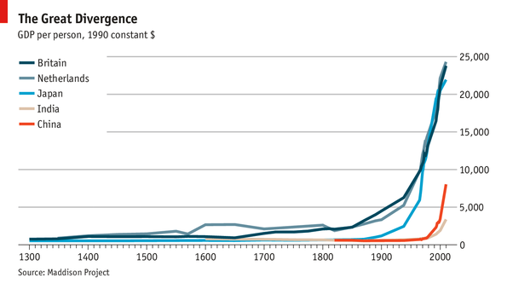
The Great Divergence

Slide 10
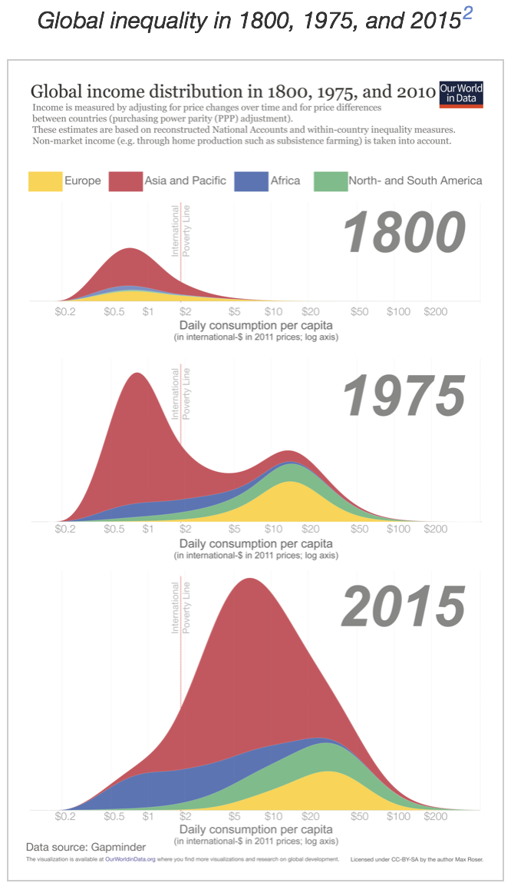
Max Roser et al.: Our World in Data
<https://ourworldindata.org/>
  Stasis at the bottom—people whose lives are still not that distinguishable from all of our pre-industrial ancestors
    How is such an atrocity possible in a world as rich and as connected as ours is?
  1800-1975: Industrial Revolution, Modern Economic Growth—and the creation of the First and Third Worlds
    The “development of underdevelopment”
  1975-2015: China stands up; India gets off the ground—back to one bell-shape
    With a lower African tail…

