Slide 1
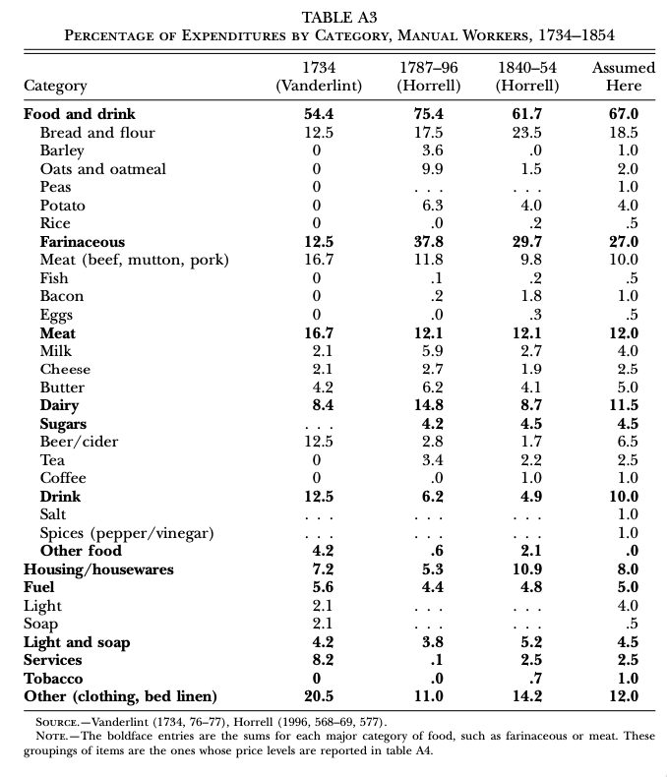
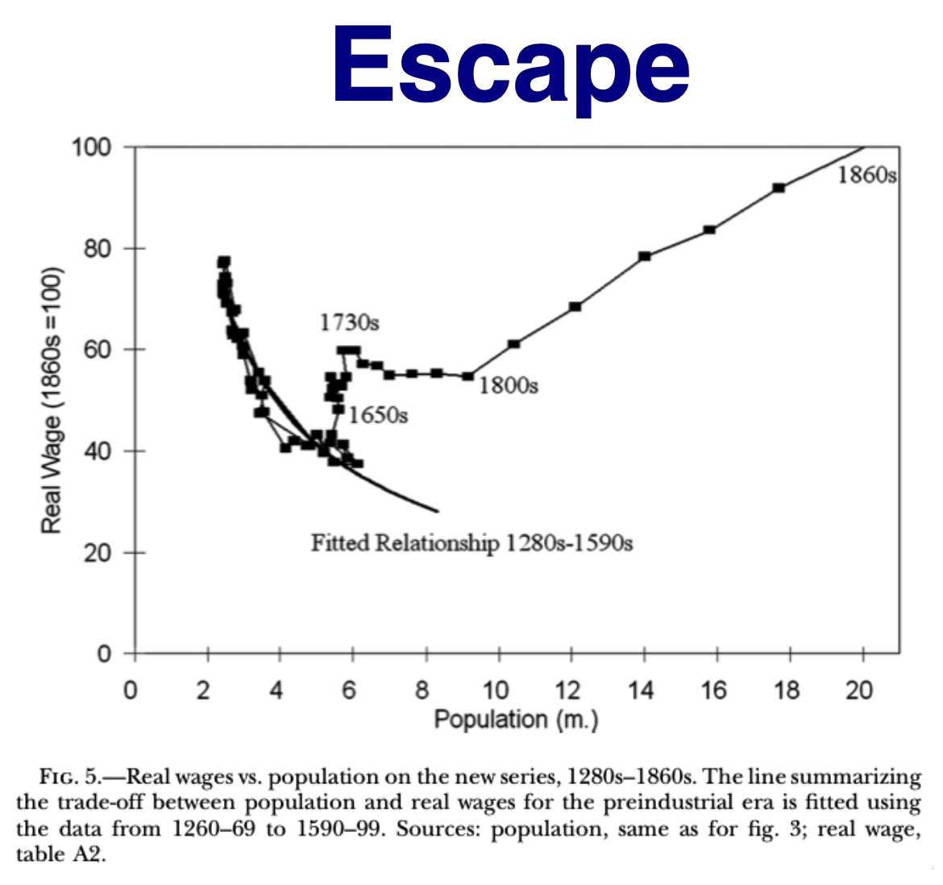
2.1. Intro Video: Agrarian Near-Stagnation: “Subsistence” & “Escape”
From Clark: Condition of Working Class in England
"Manual workers”—70% of median, 50% of average
70% spent on food
  30-40% grains
  20% meat and dairy
This is a very rich pre-industrial population
2021-02-02
Notes:
in the years straddling 1800, the British lower working class—the richest working class that the world had ever seen anywhere or anywhen up to that date since the agarian age had set its hold on humanity—still spent between 55% and 75% of its income on food. Other working classes at and before that date were in worse shape: they were even closer to “subsistence”. The British working class was surely as rich as pre-Industrial Revolution working classes got. But it still looks to me worse-off than your typical gatherer-hunter. And the British working class was up to 3 times as rich as unlucky agrarian-age populations—those under the harrow of Malthus’s “positive check” rather than possessing social institutions that delayed the age of female first marriage.
Would it have been better to have been a working-class Briton around 1800 or a gatherer-hunter before -8000? Probably a gatherer-hunter.
On the one hand you are buff! But lots of within-humanity violence: you run a substantial risk of being stabbed to death and having to watch your babies' brains bashed out against rocks. On the other hand you, have a chance of a long slow death from starvation and malnutrition, while you are stunted, weak, with very bad teeth, and probably stupid from protein deprivation in utero. There is little to choose with respect to life expectancy. Infant mortality appears to be the same. Oh: and gatherer-hunters face interesting lives in which they constantly solve environmental and social puzzles, sort of a la a slow-motion version of Super Mario. Plus the agrarian age brings patriarchy, and much more wealth and status inequality. Thus hunter-gatherers look much better off to me than those whom Mill in 1870 saw as living the live of "drudgery & imprisonment”.
That was man’s fate—the human condition—in the agrarian age.
====
But then comes escape, somehow. Escape comes remarkably late. Not until the 1850s was the real wage in England above what it had been in the post-Bubonic Plague surviving-working-class medieval golden age of the 1400s. But escape does come. Much of this course will be about that escape—when and why it came, in different parts of the world. For now, however, I want you to think about why “escape” did not come earlier. Between 1600 and 1800, the population of England moves up from 6 to 10 million while real wages grow by half. Taking account of a 30% increase In land and other natural resources devoted to fueling Britain’s economy, and in terms of our index of ideas, that’s a rate of increase of ¼% per year across two centuries in a country becoming the world’s industrial leader. But why did it not come earlier? Why was the world stuck with 1/10% per year being the best any society did in terms of ideas, as opposed to investment-driven efflorescences, before?
And then, of course, there is the nearly tenfold leap to get us to our day of modern economic growth. That, also, really needs explanation.
====
An obvious place for us humans to have gotten something like Britain 1600-1800 before is Rome: the Roman Empire in the years after 1 or 150. There are, of course, other candidates. But Rome is the one I know most about, hence the one I want to focus on.
We have the Axial-Age—from -1000 to the year 1—acceleration in ideas growth: a doubling of the ideas growth rate from 0.03 to 0.06% per year—note how ludicrously low those are: 6% a century! Just enough technological progress to hold standards of living constant with a 12% increase in population and a 12% reduction in average farm size! Over a century! And at the century’s end comes the rise of the Pax Romana in the Mediterranean—and beyond, to Scotland, Roumania, Austria, Armenia. The largest empire the world had ever seen; one whose elite was interested in public works for urbanization and transport in a way not found in any previous empire, and one—most important—not solely interested in exploiting the empire for the benefit of a ruling city or a ruling cases. Don’t get me wrong: they were interested in exploiting the empire for the benefit of the senatorial and knightly classes. But they were also interested into turning people, at least people with social power, in the empire into _Romans_ So we get this mammoth expansion in trade, this mammoth expansion in investment, this simultaneous rise in population but also in standards of living in the sense of comfortable conveniences throughout the empire (and luxruies too).
And. Then. It. All. Goes. Away. Mediterranean shipping. Rhine River-valley construction. Lead atoms from smelters carried into the atmosphere and dropped onto the Greenland ice. All gone. And the Pax Romana with it. And trade. And comfort. And the rule of law. And the ability of low-class people, as citizens, to have their property and their rights protected by magisrates.
====
And it could have been different. They were capable of astonishing feats of intellectual creativity and precision metalwork. The Anti-Kythera mechanism blows the mind of modern researchers—both the astronomy of Hipparchus that it is based on, and the instantiation of Hipparchus’s ideas in a precision-metalworked device that _must_ have been pqrt of a tradition of such devices.
In rhetoric, Pericles and Demosthenes. In generalship, Caesar and Alexander. In governance, Augustus and Trajan. In philosophy, Aristotle and Xeno. In sculpture, in literature—even in making a living via presenting-yourself-as-a-celebrity, Phryne—Mnesarete daughter of Epicles of Thespiae—would have had nothing to learn from Kim Kardashian. Anyone who, 2000 years after your death, people are still writing poems about you assuming that readers will know that you were thought to have been the best life model for statues of Aphrodite-Venus…
They were us. And ghe Anti-Kythera mechanism underscores how much they were us in mechanical ingenuity and intellectual creativity. And yet… not. No age of the commercial revolution followed the Antonine Dynasty—or Iraq’s Abbasid, or the Han, or the Athenian Empire, or… a number of other efflorescences.
====
The standard theory of why ideas growth was so low back in the agrarian age is Moses FInley’s, which you will read. But there are a host of other possible explanations as well.
And then there is the—separate—question of: why the late-antiquity pause? Even given the general slowness of ideas generation, there were still impressive efflorescences. So what kept the efflorescence of the Roman Empire from breaking through in to Commercial Revolution-scale growth, and then Industrial Revolution, and then Modern Economic Growth? And then what kept other efflorescences from breaking through into commercial revolution-scale growth?
For, remember, ultimately one did. After the Bubonic Plague of 1346-8 in western Europe there came the Renaissance. And that efflorescence did trigger faster growth: it triggered the Commercial-Imperial Revolution.

Slide 2
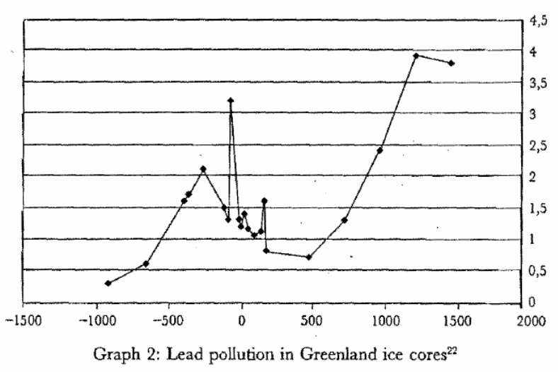
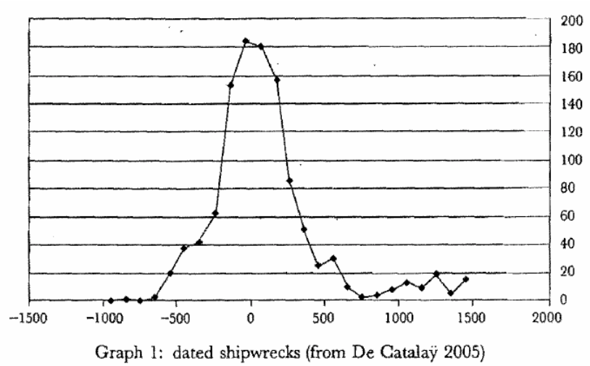
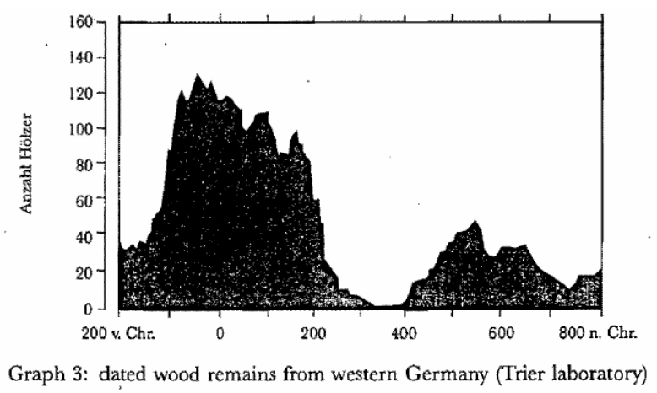
Roman Efflorescence, But Then the Dark Age Begins…
Slide taken from Melissa Dell
For the Roman Empire, the collapse of Roman authority was pronounced, particularly in the West:
By 450AD all the trappings of Roman economic prosperity were gone.
Money vanished from circulation.
Urban areas were abandoned and buildings stripped of stone.
The roads were overgrown with weeds.
The only type of pottery which was fabricated was crude and hand made, not manufactured.
People forgot how to use mortar and they also forgot how to read and write.
Roofs were made of branches, not tiles.
The Eastern Roman Empire lived on, but it contracted significantly with the rise of Islam in the 7th Century.
2021-02-02
Notes:
An obvious place for us humans to have gotten something like Britain 1600-1800 before is Rome: the Roman Empire in the years after 1 or 150. There are, of course, other candidates. But Rome is the one I know most about, hence the one I want to focus on.
We have the Axial-Age—from -1000 to the year 1—acceleration in ideas growth: a doubling of the ideas growth rate from 0.03 to 0.06% per year—note how ludicrously low those are: 6% a century! Just enough technological progress to hold standards of living constant with a 12% increase in population and a 12% reduction in average farm size! Over a century! And at the century’s end comes the rise of the Pax Romana in the Mediterranean—and beyond, to Scotland, Roumania, Austria, Armenia. The largest empire the world had ever seen; one whose elite was interested in public works for urbanization and transport in a way not found in any previous empire, and one—most important—not solely interested in exploiting the empire for the benefit of a ruling city or a ruling cases. Don’t get me wrong: they were interested in exploiting the empire for the benefit of the senatorial and knightly classes. But they were also interested into turning people, at least people with social power, in the empire into _Romans_ So we get this mammoth expansion in trade, this mammoth expansion in investment, this simultaneous rise in population but also in standards of living in the sense of comfortable conveniences throughout the empire (and luxruies too).
And. Then. It. All. Goes. Away. Mediterranean shipping. Rhine River-valley construction. Lead atoms from smelters carried into the atmosphere and dropped onto the Greenland ice. All gone. And the Pax Romana with it. And trade. And comfort. And the rule of law. And the ability of low-class people, as citizens, to have their property and their rights protected by magisrates.

Slide 3
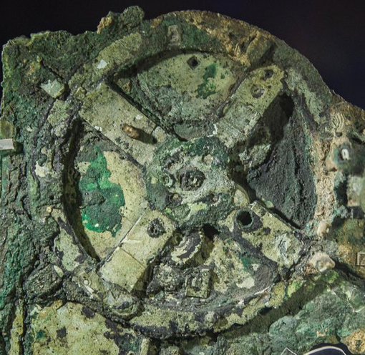
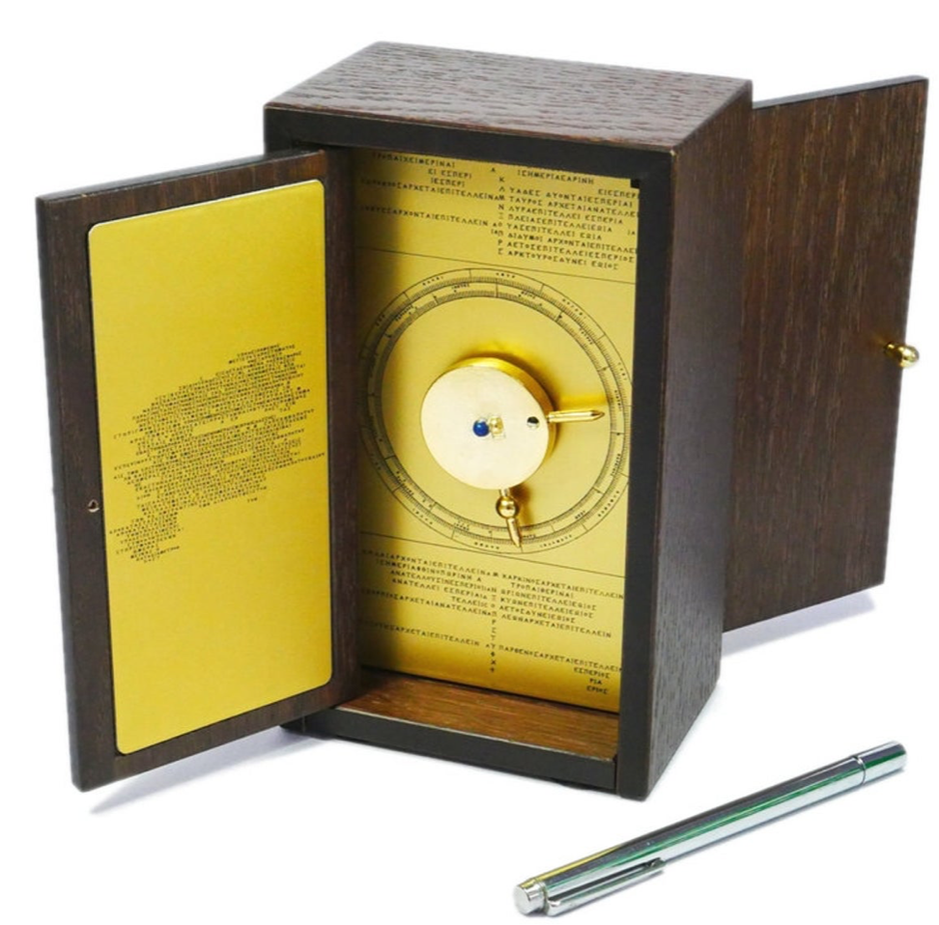
The Anti-Kythera Mechanism
What is this?
Built between -150 and -70. Rhodes 13” x 7” x 4“ wooden box. Gears—largest 5” in diameter
Wikipedia: “37 gear wheels enabling it to follow the movements of the Moon and the Sun throu the zodiac, to predict eclipses and even to model the irregular orbit of the Moon, where the Moon's velocity is higher in its perigee than in its apogee. This motion was studied in the 2nd century BC by astronomer Hipparchus of Rhodes, and it is speculated that he may have been consulted in the machine's construction. The knowledge of this technology was lost at some point in antiquity. Similar technological works later appeared in the medieval Byzantine and Islamic worlds, but works with similar complexity did not appear again until the development of mechanical astronomical clocks in Europe in the fourteenth century…”
What is this?
Brian Resnick: “A main gear would move to represent the calendar year, and would, in turn, move many separate smaller gears to represent the motions of the planets, sun, and moon. So you could set the main gear to the calendar date and get approximations for where those celestial objects would be in the sky on that date…. You, as a user, could input a few simple variables and it would yield a flurry of complicated mathematical calculations.… All the user had to do was enter the main date on one gear, and through a series of subsequent gear turns, the mechanism could calculate things like the angle of the sun crossing the sky. (For some reference, mechanical calculators—which used gear ratios to add and subtract—didn’t arrive in Europe until the 1600s)…”
2021-02-02
Notes:
And it could have been different. They were capable of astonishing feats of intellectual creativity and precision metalwork. The Anti-Kythera mechanism blows the mind of modern researchers—both the astronomy of Hipparchus that it is based on, and the instantiation of Hipparchus’s ideas in a precision-metalworked device that _must_ have been pqrt of a tradition of such devices.
In rhetoric, Pericles and Demosthenes. In generalship, Caesar and Alexander. In governance, Augustus and Trajan. In philosophy, Aristotle and Xeno. In sculpture, in literature—even in making a living via presenting-yourself-as-a-celebrity, Phryne—Mnesarete daughter of Epicles of Thespiae—would have had nothing to learn from Kim Kardashian. Anyone who, 2000 years after your death, people are still writing poems about you assuming that readers will know that you were thought to have been the best life model for statues of Aphrodite-Venus…
They were us. And ghe Anti-Kythera mechanism underscores how much they were us in mechanical ingenuity and intellectual creativity. And yet… not. No age of the commercial revolution followed the Antonine Dynasty—or Iraq’s Abbasid, or the Han, or the Athenian Empire, or… a number of other efflorescences.

Slide 4
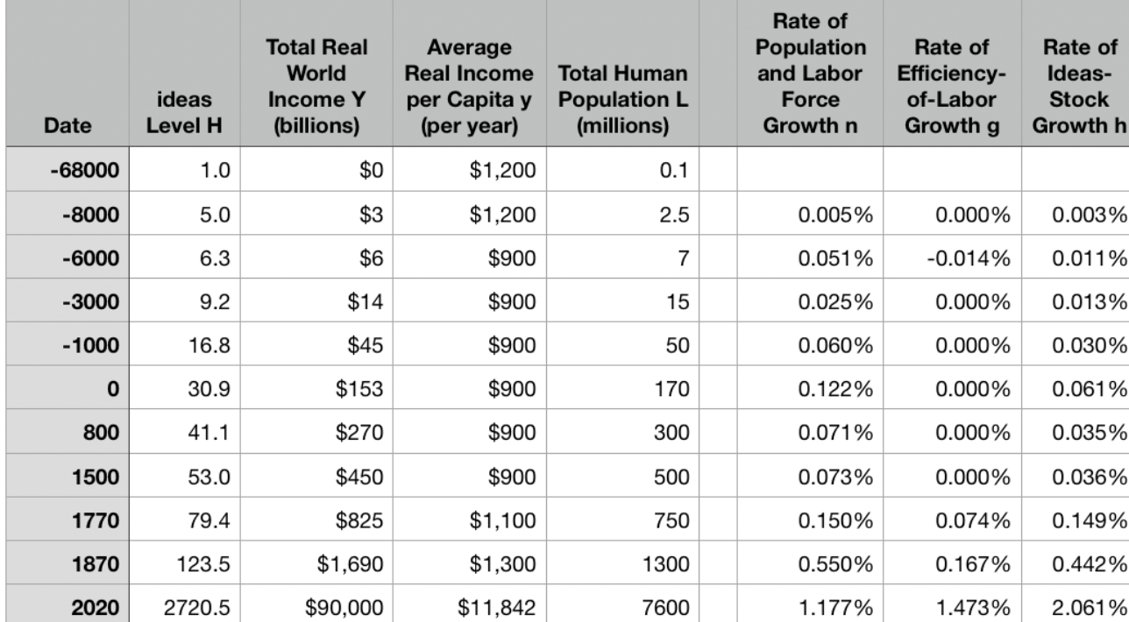
Why Was Pre-Industrial Progress so Slow on Average?
Moses Finley: Technical Innovation and Economic Progress in the Ancient World <https://delong.typepad.com/finley-technical.pdf>
Finley is the standard reference
But is he right?
What are the alternatives?
  Two heads are better than one—not that many heads in the old days
  And communications technologies were not great
  “Labor really cheap” explanation
  GPT explanations
  Low elasticity of demand explanations
  “Developmental” vs. “extractive”
The late-antiquity pause:
  A separate issue?
  An example of the limits to growth
Notes:
The standard theory of why ideas growth was so low back in the agrarian age is Moses FInley’s, which you will read. But there are a host of other possible explanations as well.
And then there is the—separate—question of: why the late-antiquity pause? Even given the general slowness of ideas generation, there were still impressive efflorescences. So what kept the efflorescence of the Roman Empire from breaking through in to Commercial Revolution-scale growth, and then Industrial Revolution, and then Modern Economic Growth? And then what kept other efflorescences from breaking through into commercial revolution-scale growth?
For, remember, ultimately one did. After the Bubonic Plague of 1346-8 in western Europe there came the Renaissance. And that efflorescence did trigger faster growth: it triggered the Commercial-Imperial Revolution.

