Slide 1
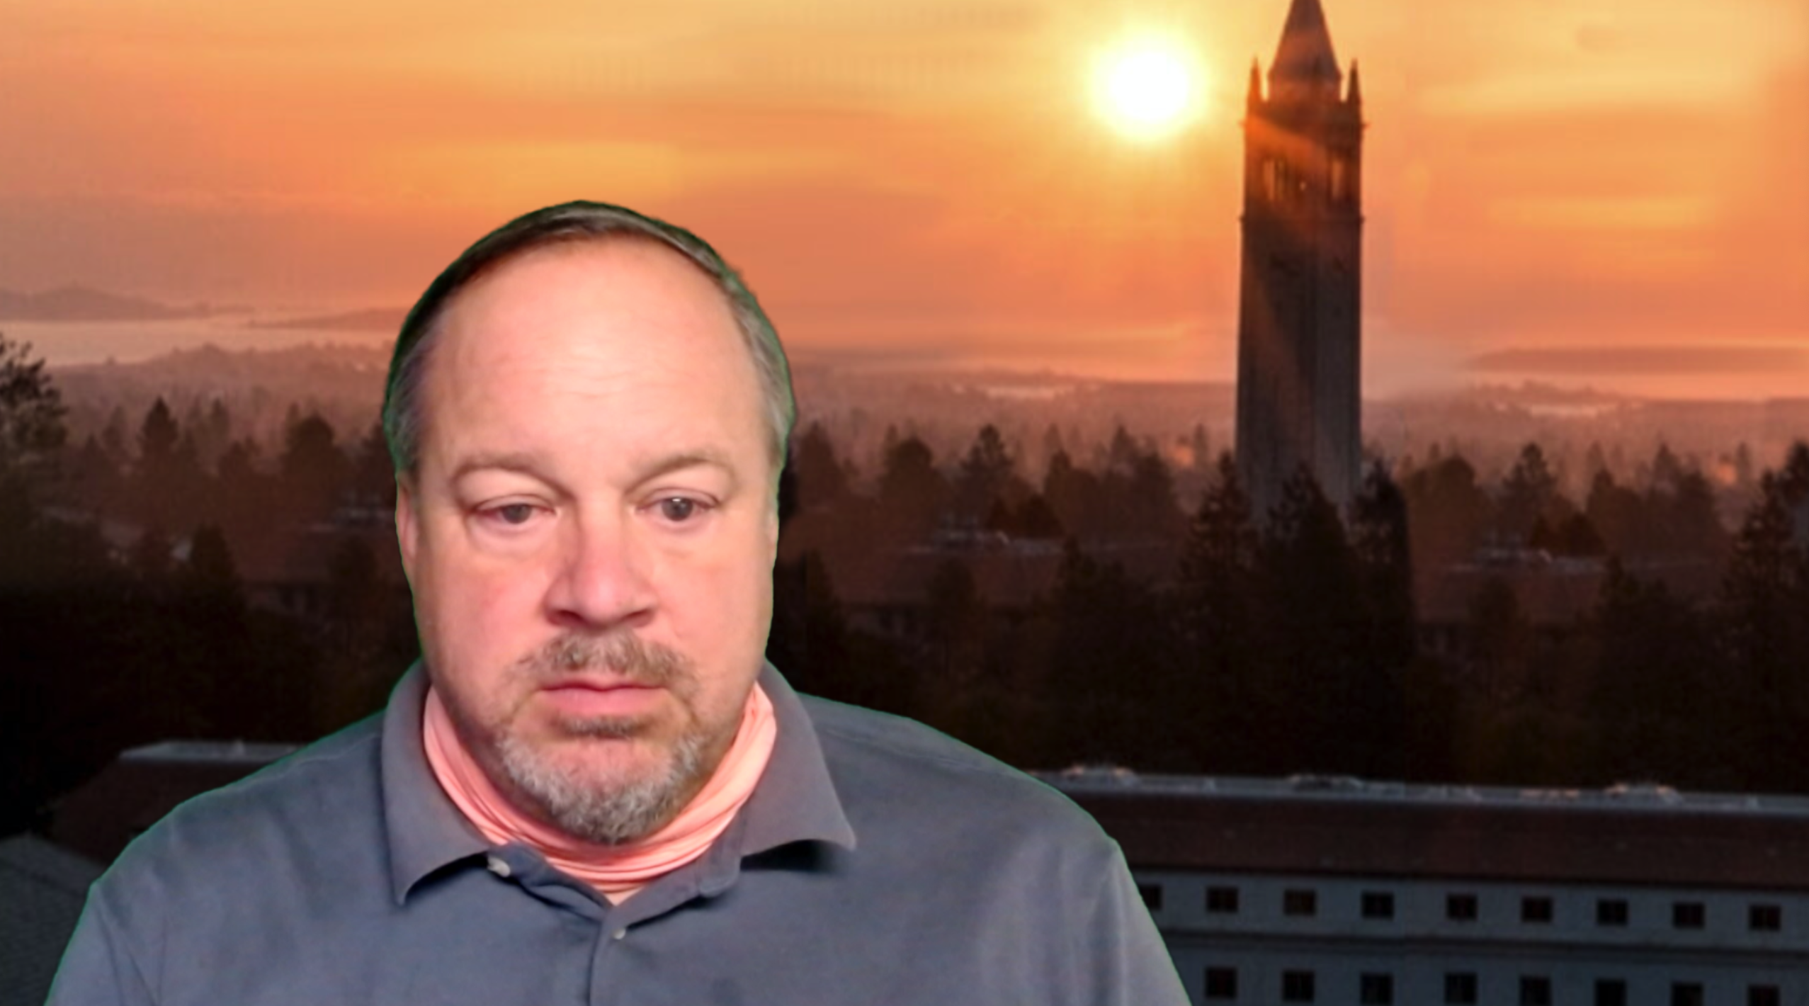
Future of Fintech: History
History creates problems/opportunities; who takes steps to solve them, and how do they do so?
“Chartalist” approach—anchor, first-mover, regulator, forecloser, appropriator
  Successful state money
  Private entrepreneurs who are “safe enough” (counterparty, marketplace risk)
Trust—widen your circle of trust (Partha Dasgupta):
  Commodities: from friends, kin, neighbors → state → money
2020-10-19
<https://www.icloud.com/keynote/0eqVET8B0fmqY2TM-T1XGpPIA>
Brad DeLong delong@econ.berkeley.edu

Slide 2
Future of Fintech: History II
History creates problems/opportunities; who takes steps to solve them, and how do they do so?
Trust—widen your circle of trust
  Commodities: from friends, kin, neighbors → state → money
  Payments: money → merchant credit → bills of exchange → deposit banks → Bank of Amsterdam/John Law/South Sea/Bank of England → sufficient insulation from the fiscal needs of the state
  Coin → bullion → ledger
Brad DeLong delong@econ.berkeley.edu
2020-10-19

Slide 3
Future of Fintech: History III
History creates problems/opportunities; who takes steps to solve them, and how do they do so?
Regulatory arbitrage by private entities that are “safe enough”—until they are not
State as seizer of opportunities (South Sea Bubble)
  Anchor, first-mover, validator, regulator, forecloser, appropriator
Trust—widen your circle of trust
  Commodities: from friends, kin, neighbors → state → money
  Payments: money → merchant credit → bills of exchange → deposit banks → Bank of Amsterdam/John Law/South Sea/Bank of England → sufficient insolation from the fiscal needs of the state || Coin → bullion → ledger
  Financing??
Brad DeLong delong@econ.berkeley.edu
2020-10-19

Slide 4
Future of Fintech: History IV
History creates problems/opportunities; who takes steps to solve them, and how do they do so?
Ant, VISA, FacebookPay?, ??
Brad DeLong delong@econ.berkeley.edu
2020-10-19

Slide 5
Catch Our Breath
Let’s reflect on what we have just heard & seen…
Comments
Questions
Readings
2020-10-19 Mo 08:00 PDT Fintech seminar <https://berkeley.us2.list-manage.com/track/click?u=41fdd73e709718d13fe9e71ce&id=edbdad525d&e=cedd4adff7> passwd: 607583
<https://www.icloud.com/keynote/0eqVET8B0fmqY2TM-T1XGpPIA>
<>

Slide 7
========================

