Slide 1
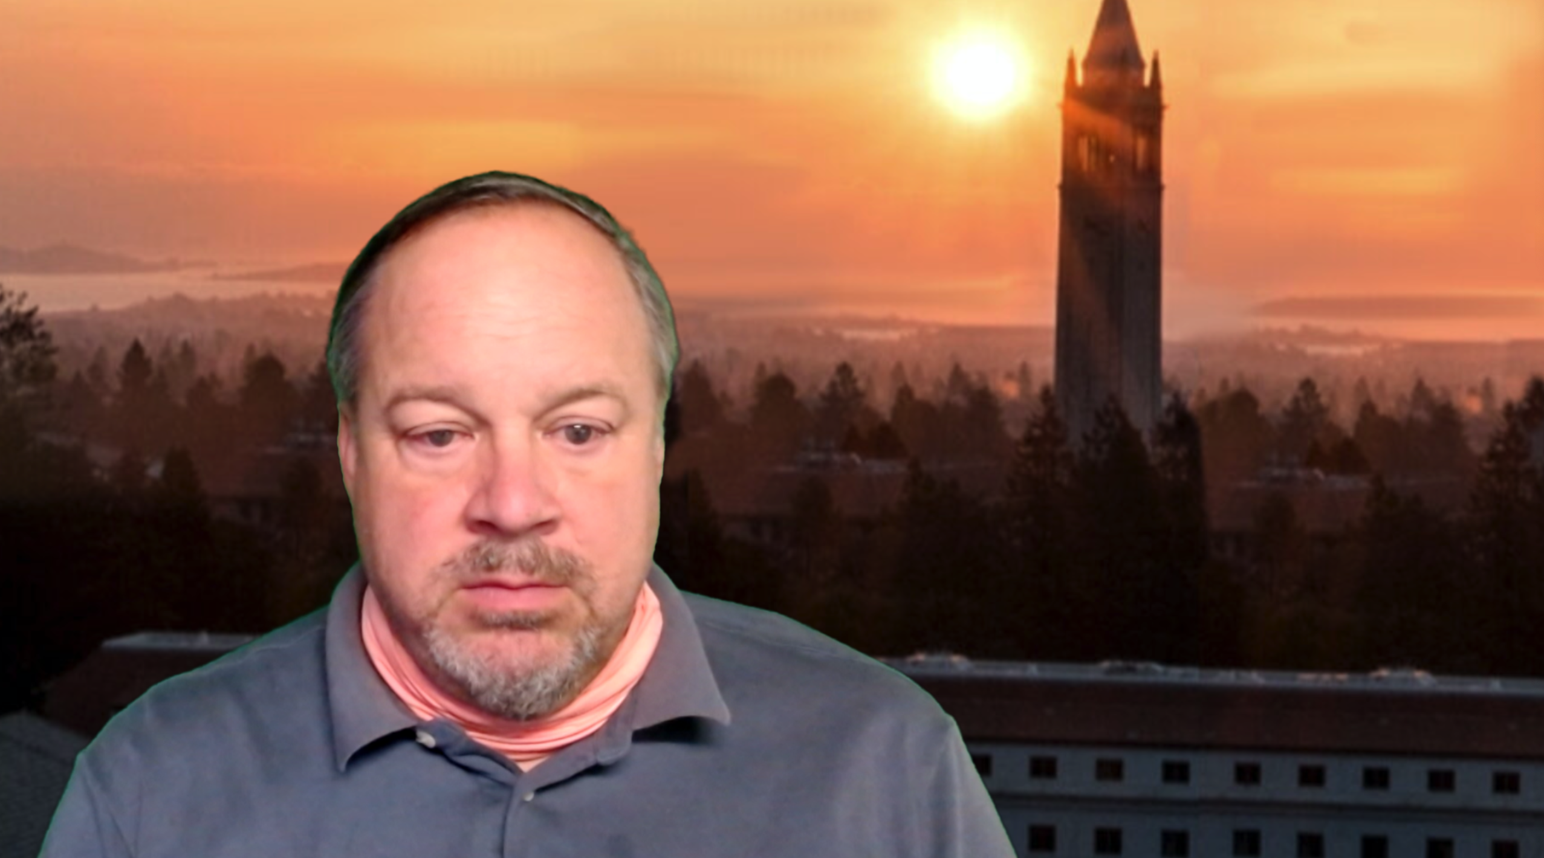
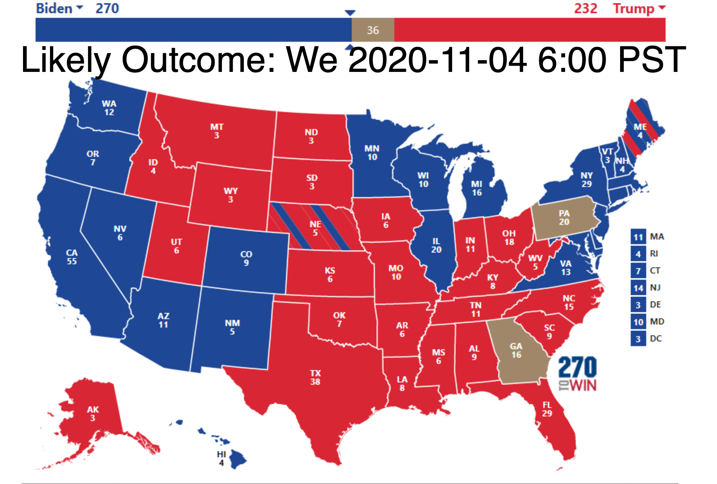
I Really Do Think Joe & Kamala Have Got This Under Control
That is all…
====
.#notetoself #orangehairedbaboons #politics #2020-11-04
<https://www.bradford-delong.com/2020/11/i-really-do-think-joe-kamala-have-got-this-under-control.html> <https://www.icloud.com/keynote/0D0_rT8gYqxxO6pPSRIbgR2Uw>
<https://www.bradford-delong.com/2020/11/i-really-do-think-joe-kamala-have-got-this-under-control.html> <https://www.icloud.com/keynote/0D0_rT8gYqxxO6pPSRIbgR2Uw>
2020-11-04

Slide 2
Catch Our Breath
Let’s reflect on what we have just heard & seen…
Comments
Questions
Readings

Slide 3
========================

