Slide 1




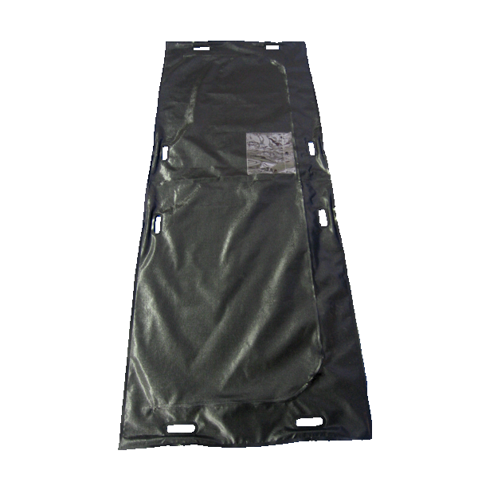
What
How
Why
Provision of low-cost caskets
Encouragement of cremation
Immediate use of body bags after victims pass away
Temporary morgues
Provide info on efficiency of cremation
Corpses have a high chance of passing on the disease
Reduced transmission

Slide 2



What
How
Why
No travel restrictions or screening of travelers
No closing of public events
Only events >5,000 people
Travelling from far away
Public backlash heavily outweighs the potential benefits
Not very effective methods in preventing H1N1

Slide 3







What
How
Why
Assemble a PR task force
Ensure all reported cases are medically confirmed
Schedule routine press conferences
Use ISDA Task Force
Online case reporting
Use social media and website
Announce press schedule in advance
Keeps public informed
Helps with accurate case reporting
Avoids panic

