Slide 1
A Better Restaurant Rating System
An Exploratory Analysis

Slide 2
Restaurant Ratings are Flawed!
Sites like Foursquare and Yelp rely on users for ratings
These can be biased and incomplete with lack of reviews
Not fair for the restaurant owner or the next patron choosing where to eat

Slide 3
A Better Rating Model Starts with Exploration
K-Means Cluster Analysis of Restaurants in Chicago
Restaurant details from Foursquare API
developer.foursquare.com
Demographic data from Federal Financial Institutions Examination Council (FFIEC)
www.ffiec.gov

Slide 4
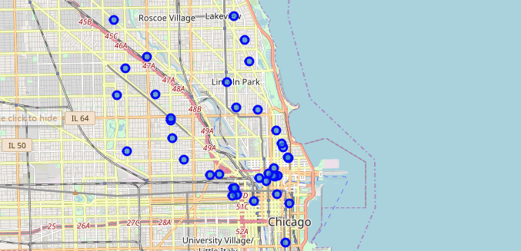
Map of Restaurants in Dataset

Slide 5
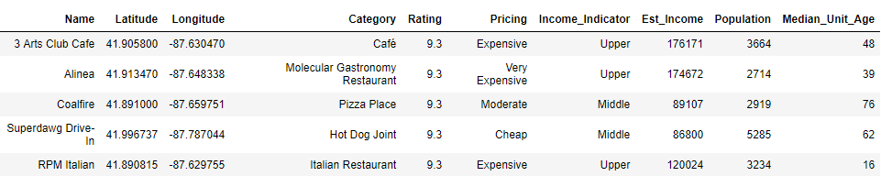
A Few samples from the Merged Dataset
Total sample size of 50
Due to Foursquare Premium API limitations

Slide 6
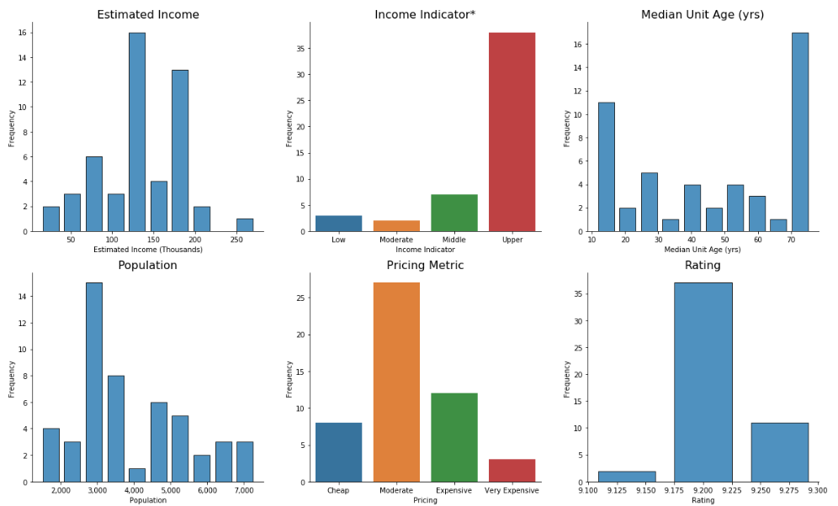
Explore the Data
The majority of our sample of restaurants reside in Upper Income Bracket areas.
We can remove Income Indicator since Estimated Income provides a more granular detail.
Median Unit Age gives us an idea of how mature the area is. It appears most areas are either newly rebuilt or historic, with less in-between.
Ratings from Foursquare are sorted by descending order, so it is a challenge to obtain a wider variety of ratings.

Slide 7
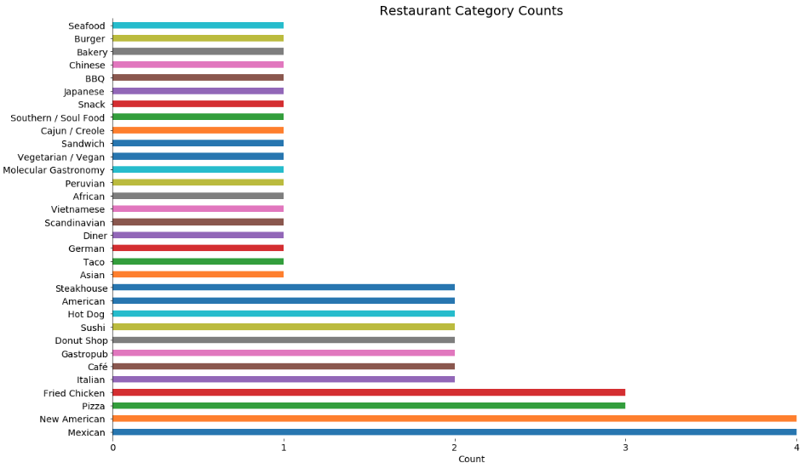
Restaurant Category Breakdown

Slide 8
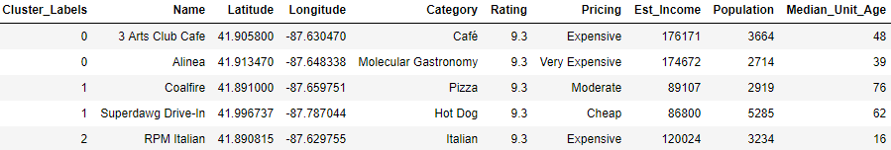
K-Means Clustering
After running with several different cluster counts, 3 was most logical given the small size of the dataset.

Slide 9
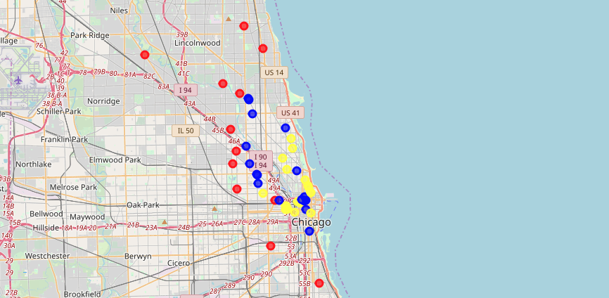
Map of Restaurants with Respective Clusters
Cluster 0: Yellow
Cluster 1: Red
Cluster 2: Blue

Slide 10
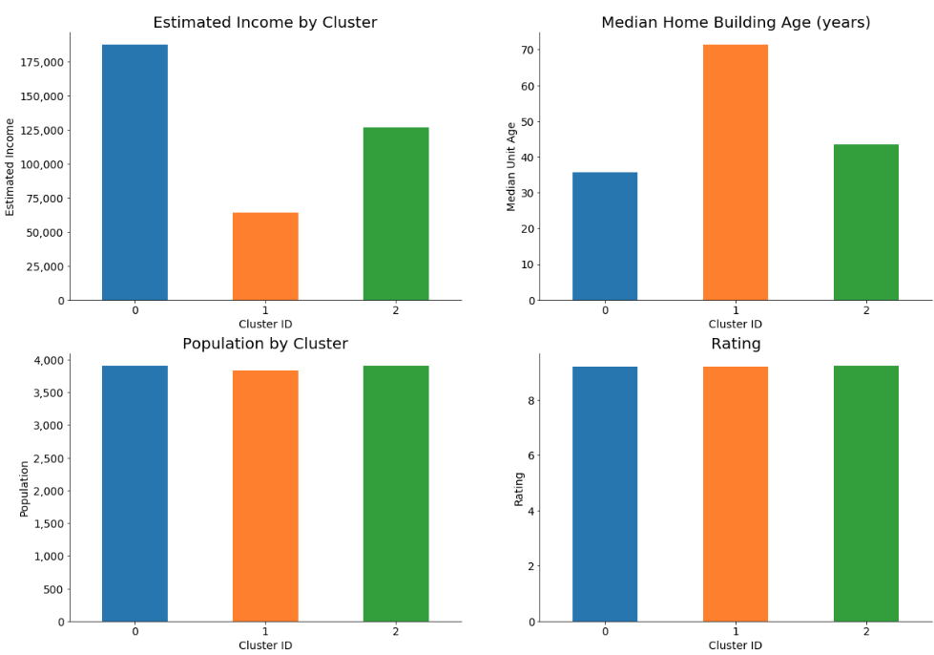

Slide 11
Findings
Older neighborhoods with lower incomes located further from the city center (cluster 1) stood out from the other clusters.
Insufficient Data due to Foursquare API limitations.
Need to rerun analysis following API premium access to obtain minimum 500 data points
Need random sample query for a larger distribution of User Ratings (used query sorts by User Rating, creating a bias towards high ratings).

Slide 12

Questions???

