Slide 1
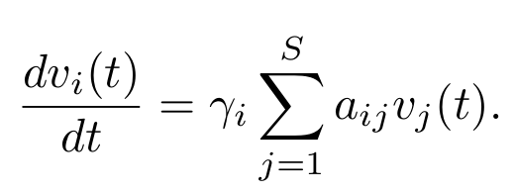


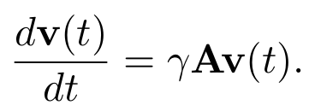
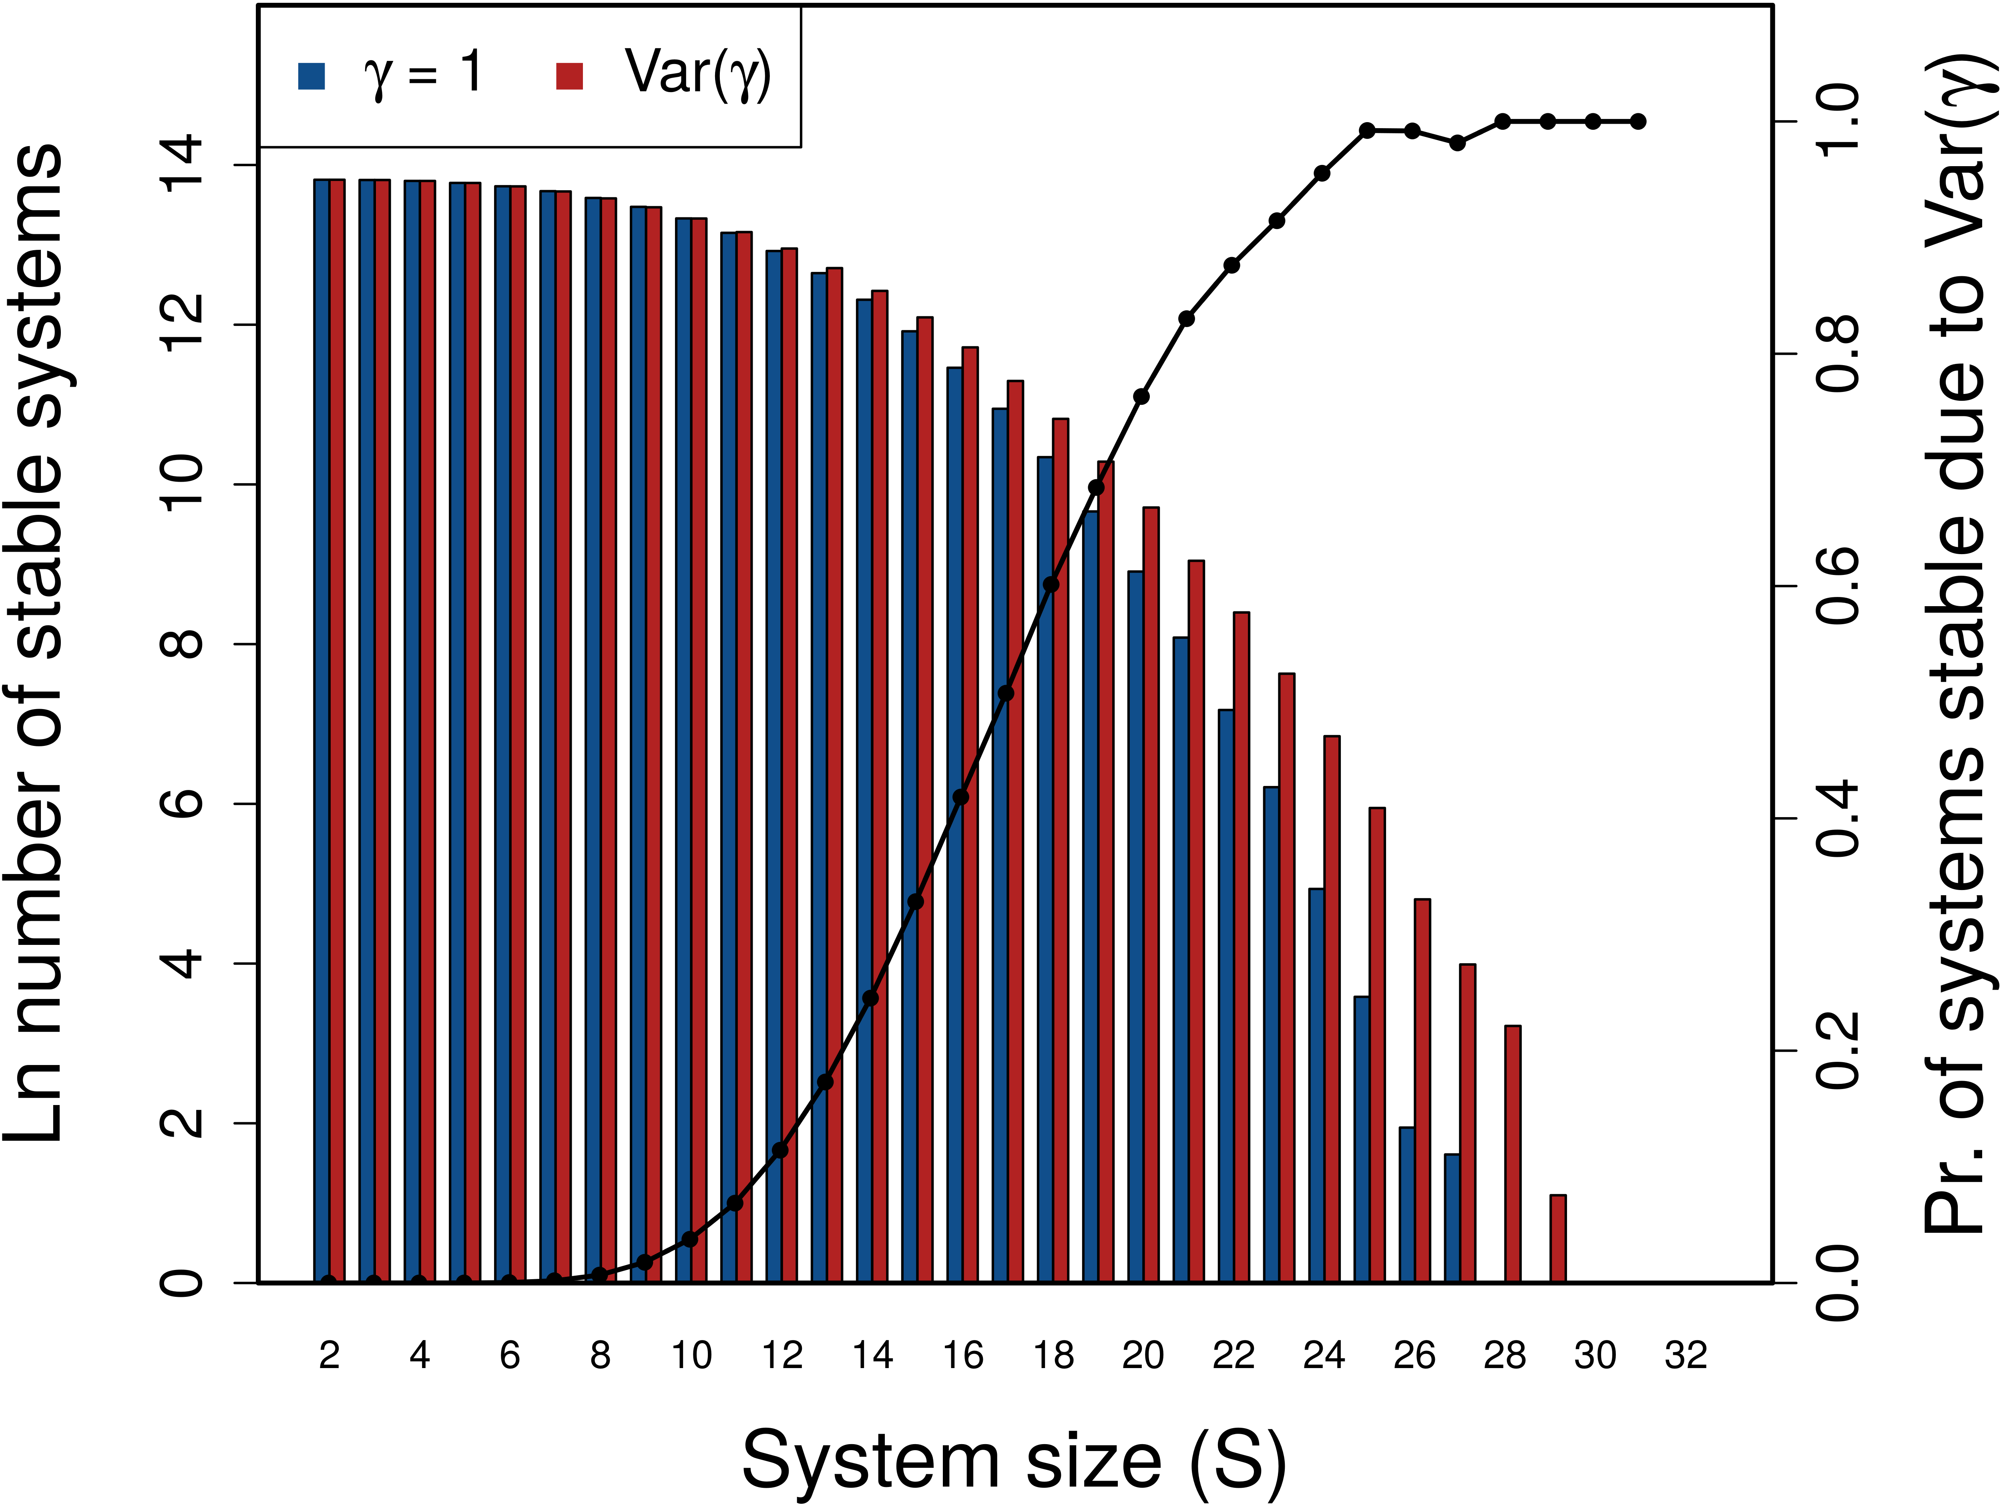
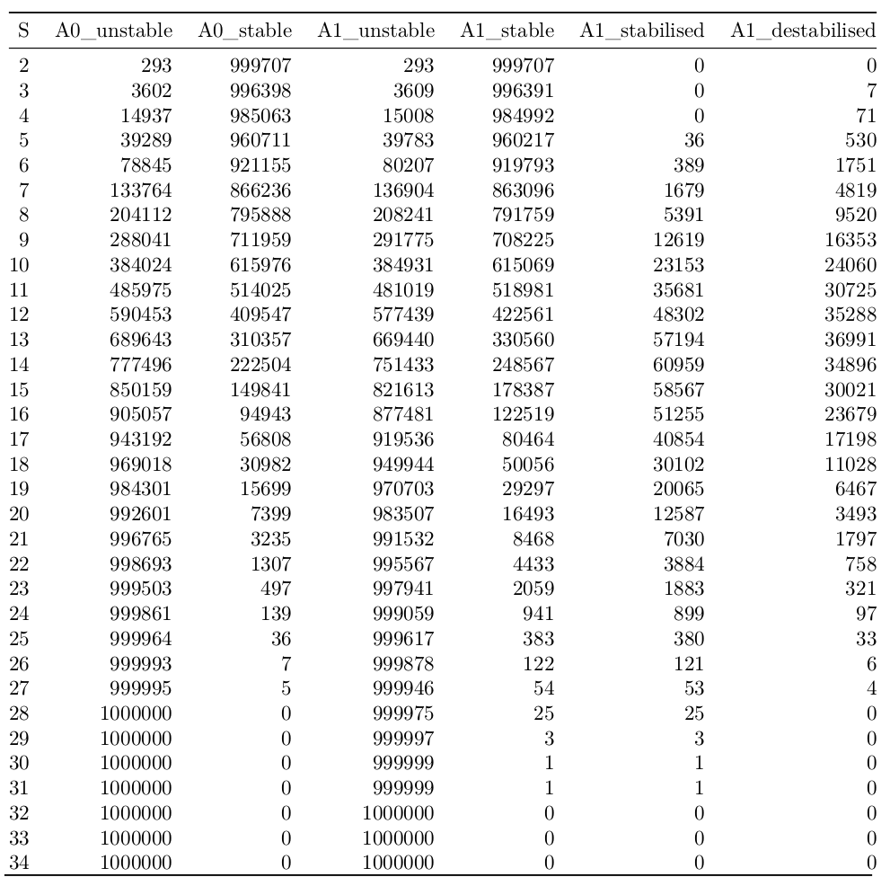
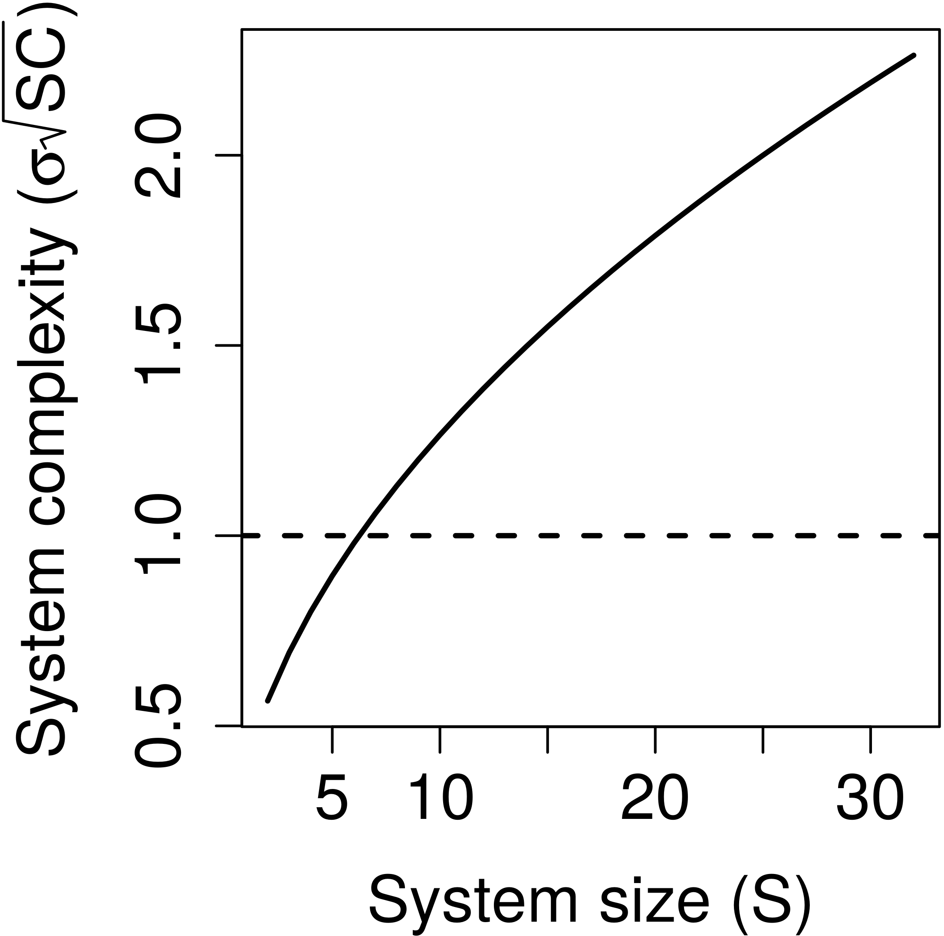
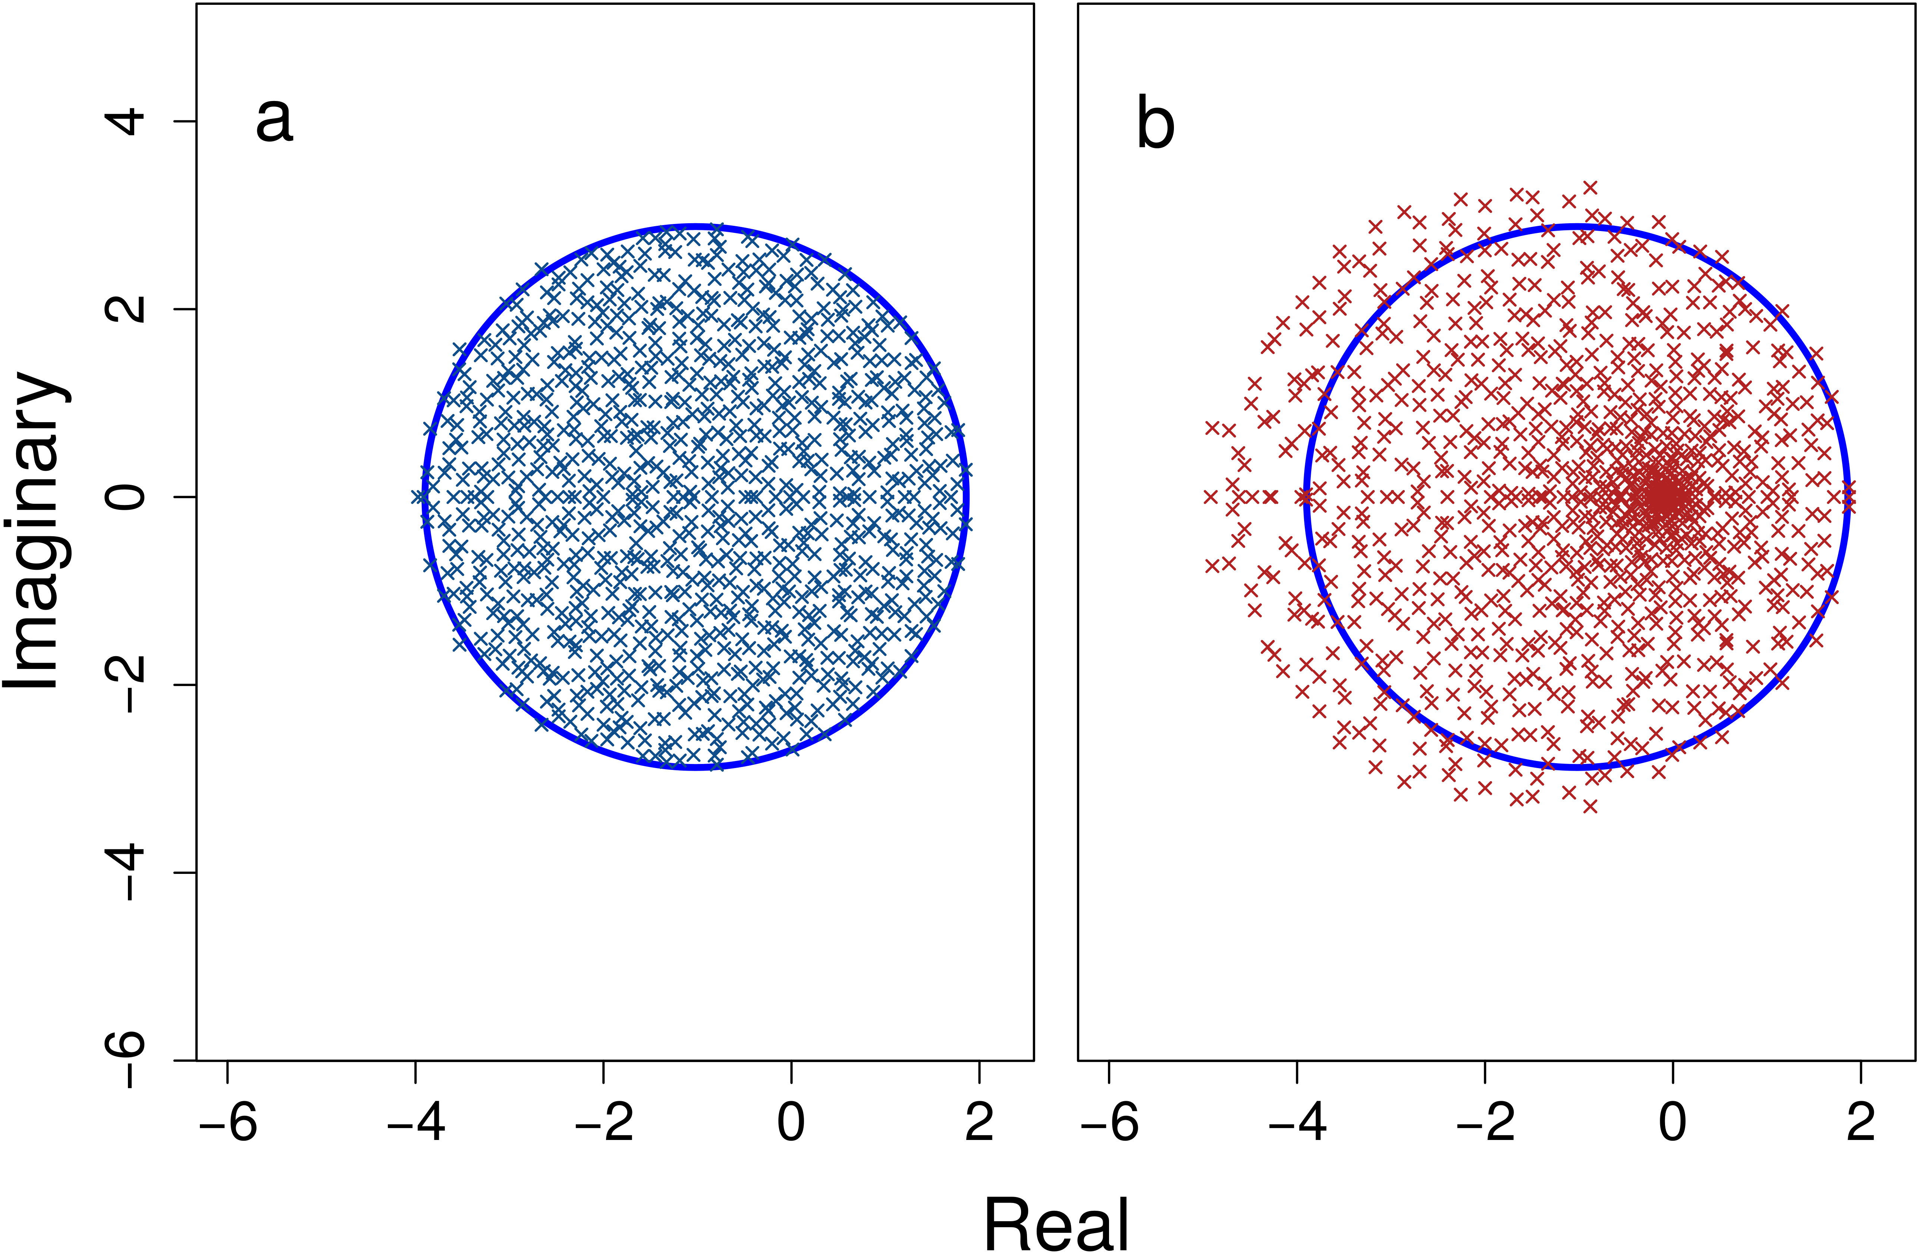
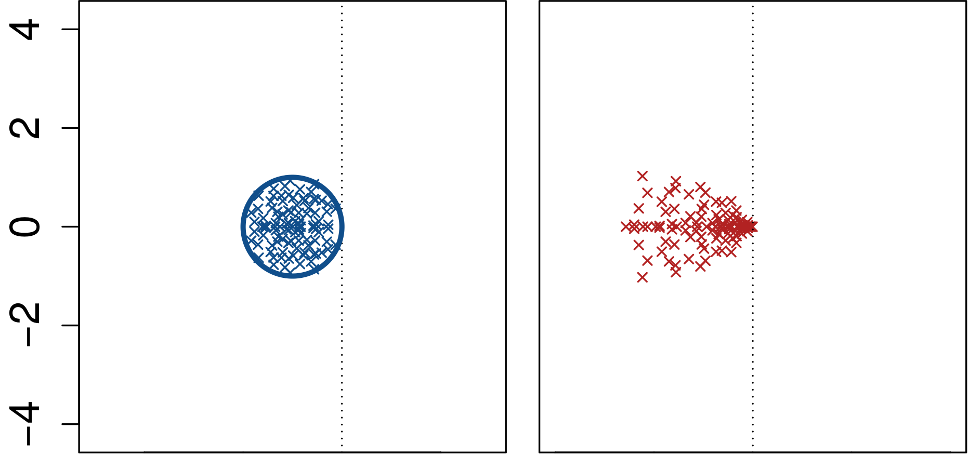

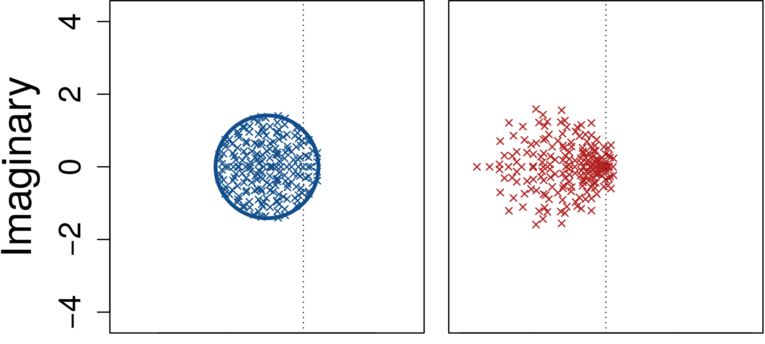
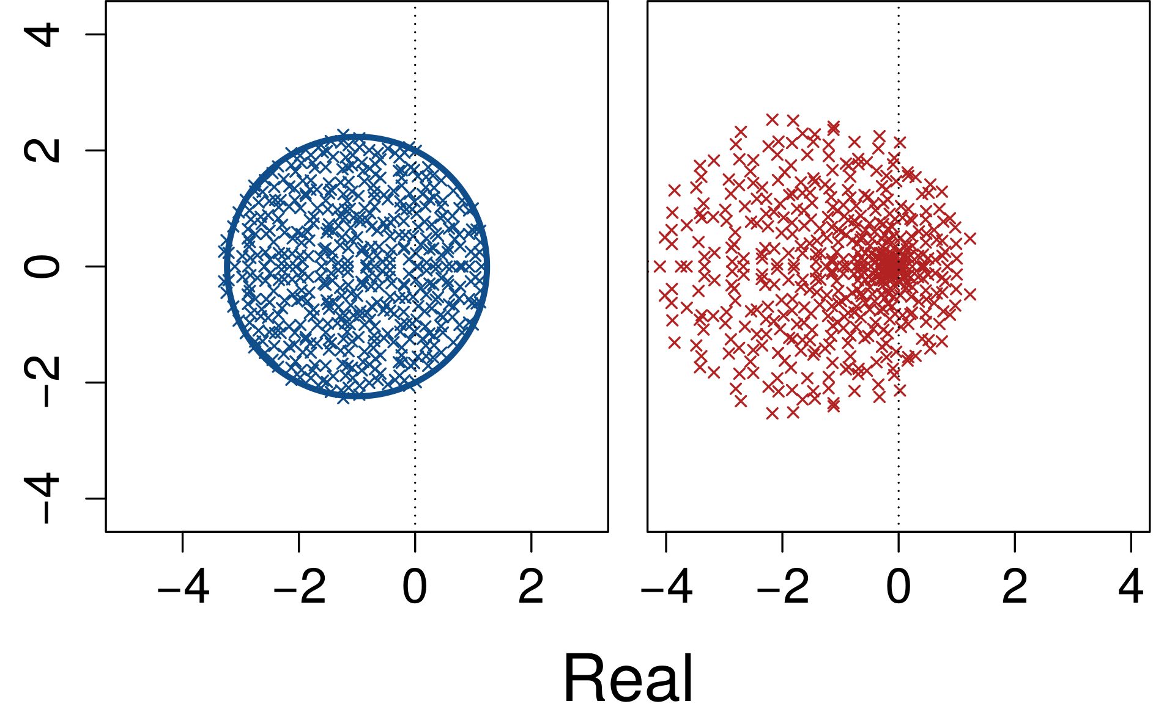



Variation in the rate at which individual system components respond to perturbation underlies the stability of complex systems.
Title:
Subtitle
Leeroy Jenkins, author2,
author3, author4
Component response rate variation underlies the stability of complex systems
Mathematical details. Following May^{1,2}, the value of a component i at time t (v_{i}(t)) is affected by the value of j (v_{j}(t)) and j's marginal effect on i (a_{i,j}), and by i's response rate (γ_{i}),
In matrix notation²,
In the above, γ is a diagonal matrix in which elements correspond to individual component response rates. Therefore, M = γA defines system component values and can be analysed using the techniques of May¹⁻³. Row means of A are expected to be identical, but variation around this expectation will naturally arise due to random sampling of A off-diagonal elements (a_{i,j} ~ N(0, σ²) if i ≠ j; a_{i,j} = -1 if i = j) and finite S. In simulations, the total variation in M row means attributable to A is small relative to that attributable to γ, especially at high S. Variation in γ specifically isolates the effects of differing component response rates, hence causing differences in expected M row means.
Under default parameter values, C = 1, σ = 0.4, and γ_{i} ~ U(0, 2).
Duthie, A. Bradley http://bradduthie.github.io @bradduthie
BACKGROUND
The stability of a complex system decreases with increasing size (S), inter-connectivity (C), and variance in interaction strength (σ²).
Stability occurs if σ√(SC) is sufficiently low.
The effect of variation in the response rates of system components (γ) is unknown.
MODELLING
Generated random matrices (M) with known S, C, and σ².
Eigenanalysis to assess the stability of M across. increasingly high S values.
Compare stability with and without variation in γ.
Left: Simulation results without (A0) and with (A1) inclusion of γ.
Right. System size (S) increases complexity. Dotted line shows May’s¹ criteria for stability.
System stability with (red) and without (blue) variation in component response rate (γ), across 1 million M per S.
DISCUSSION
Studies of complex systems should account for component response rate variation
Note: Results do not imply that variation in γ causes stability in complex systems
Results relevant for life and social sciences:
Trait evolution (biological networks)
Transaction speed (economic networks)
Communication speed (social networks)
Additional notes. I also found the following results:
System feasibility (e.g., in an ecological community) was not affected by γ given a generalised Lotka-Volterra model and random species intrinsic growth rates (r_{i}).
A targeted manipulation of γ using an evolutionary algorithm increased system stability.
For ecological communities, γ increased stability in competitive and predator-prey networks, but not mutualist networks.
Results were general across different C and σ, and for different distributions of γ values.
Above. Eigenvalues before (a) & after (b) γ
Code available on GitHub
https://github.com/bradduthie/RandomMatrixStability
References.
1. May, R. M. Will a large complex system be stable? Nature 238, 413-414 (1972).
2. May, R. M. Qualitative stability in model ecosystems. Ecology 54, 638–641 (1973).
3. Ahmadian, Y., Fumarola, F. & Miller, K. D. Properties of networks with partially structured and partially random connectivity. Physical Review E - Statistical, Nonlinear, and Soft Matter Physics 91, 012820 (2015).
Take a picture to
download the full paper

