Slide 1
Introduction to regression
In regression, our objective is to understand some dependent variable Y based on an independent variable X. Regression is a tool for predicting the value of Y as a function of X. We can use this tool to do the following,
Support hypotheses of causation of changes in y values due to changes in x values
Predict y values as a function of x values
To explain the variation of y values using x values
Regression analysis can be used to support causal hypotheses, but it cannot, by itself be used to determine causality.

Slide 2
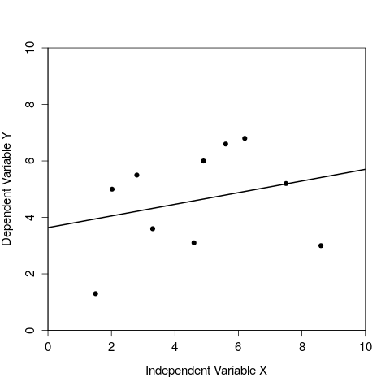
Visualising a regression of y values against x values
Figure 1: A regression of one dependent variable y against the independent variable x.

Slide 3
Regression includes independent and dependent variables
It is critical to correctly distinguish between the independent and dependent variables.
Independent variable (X) is free to vary
Dependent variable (Y) is predicted to change given a change in the independent variable
Different results will be obtained if the two variables are confused
In an experiment, the independent variable is something that we as researchers have control over (e.g., amount of fertiliser to put down on a field), whereas the dependent variable is something that we would measure when collecting our data (e.g., total crop yield of the field).

Slide 4
Regression line
The line of best fit in a regression can be described mathematically with a simple equation,
y = a + bx
This equation includes the variables x and y, and two coefficients
a is the intercept; the value of y that is predicted when x = 0
b is the slope; how much y changes for a change one unit of x
Note that data points rarely will sit right on the regression line. The residual is defined by the difference between the measured value of y (i.e., the data point) and the y value predicted by the regression line (i.e., the vertical distance between the data point and the line).

Slide 5
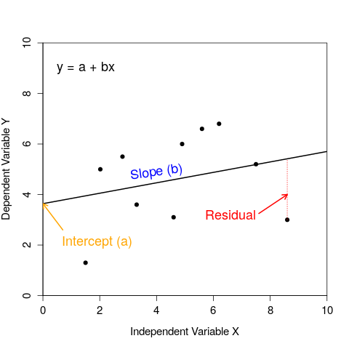
Visualising a regression of y values against x values
Figure 2: A regression of one dependent variable y against the independent variable x.

Slide 6
How do we decide what is the best fit line?
Now we can turn to how we calculate where the regression line should be through our data.
How do we know what our intercept (a) and slope (b) should be?
Use the method of least squares regression
Minimise the sum of squares of all the residual values
To get an intuitive sense for how the regression line minimises the sum of squares, use this interactive application to adjust the slope and intercept to try to find the line of best fit (it will turn blue when you succeed).

Slide 7
Assumptions of regression
Regression is a widely used, but also often misused, statistical technique. It is important to be aware of the assumptions underlying linear regression.
The independent variable x is measured without error
The relationship between X and Y is linear
For any value of X, Y is normally distributed
For all values of X, the variance of the residuals is identical
Note that even if our assumptions are not perfectly met (indeed, they rarely if ever will be), this does not completely invalidate the method of linear regression. But large violations of one or more of these assumptions might indeed be problematic.

Slide 8
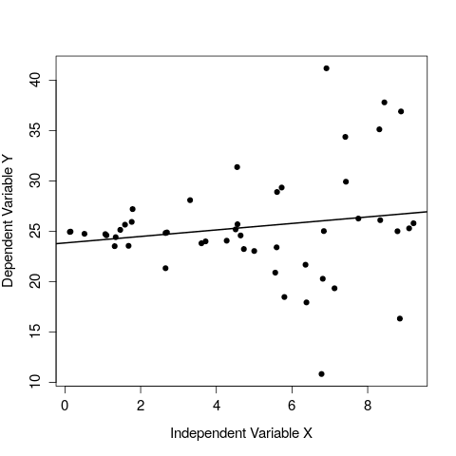
Assumptions of regression
Figure 1: A regression of one dependent variable y against the independent variable x in which there is clear heteroscedasticity.

Slide 9
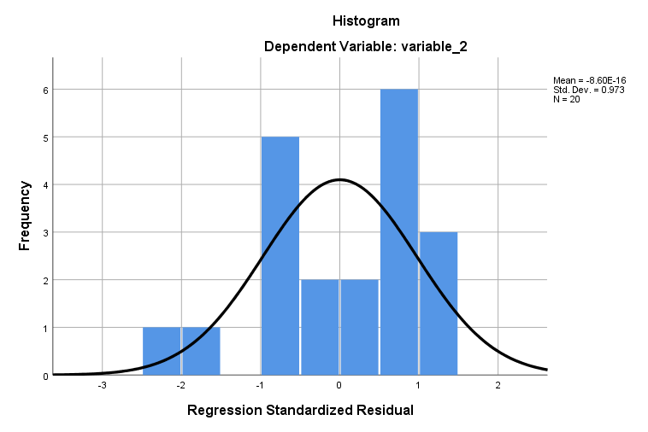
Assumptions of regression
Figure 4: Example of a histogram of the residual values of a model produced in SPSS

