Slide 1
Example regression analysis in SPSS
Example from the 1974 cars data set to predict fuel efficiency in miles per gallon (mpg) of cars given their mass (wt) in kilograms.
Our response or dependent variable is miles per gallon
Our predictor or independent variable is car mass
Before fitting our regression model, we should check our assumptions of linear regression.

Slide 2
Example regression analysis in SPSS
The independent variable X is measured without error. Independent variable (car mass) should be fixed (i.e., measured without error).
The relationship between X and Y is linear. We can check in SPSS; select 'Graph > Legacy Dialogs > Scatter/Dot', then select 'Simple Scatter' from the available options.
For any value of X, Y is normally distributed. Values of the dependent variable, miles per gallon, should be normally distributed. We can check this in SPSS using 'Analyse > Descriptive Statistics > Explore', then putting 'mpg' in the Dependent List.
For all values of X, the variance of the residuals is identical. We can check by plotting the data in SPSS in the same scatter plot that we used to check that the relationship was linear.

Slide 3
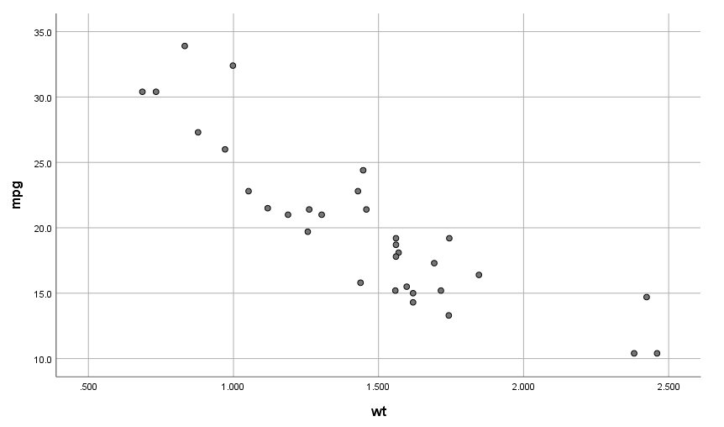
Checking assumptions of linear regression
Figure 1: Scatterplot showing SPSS output for car mass (wt) and car miles per gallon (mpg)

Slide 4
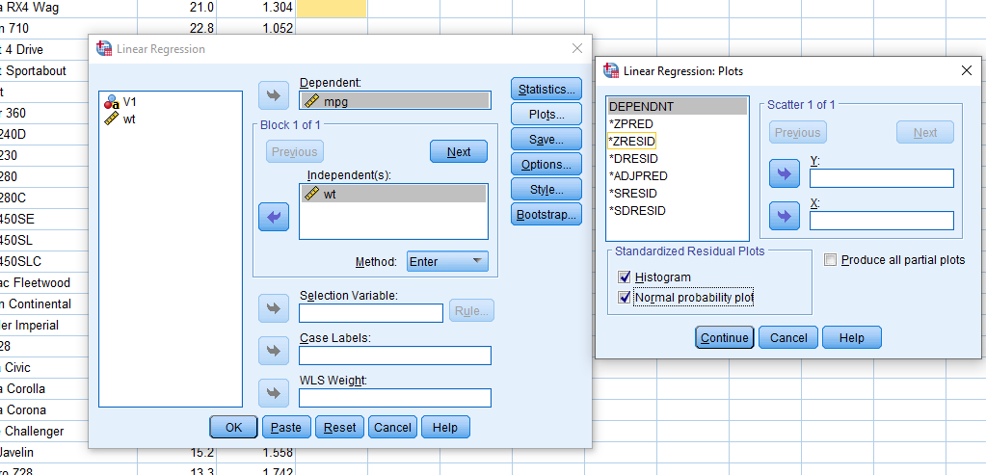
Fitting the linear regression model
'Analyse > Regression > Linear'
Figure 2: Options in SPSS for creating linear regression plots
Every regression model in SPSS will produce four tables (we can ignore the first for now).

Slide 5
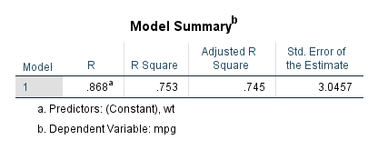
Fitting the linear regression model
Figure 3:Model summary output table in SPSS

Slide 6
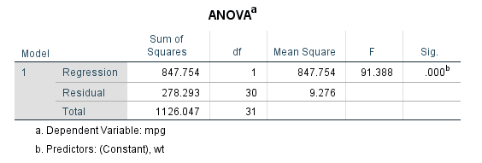
Fitting the linear regression model
Figure 4: ANOVA summary output table in SPSS

Slide 7
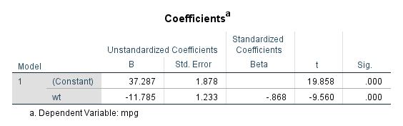
Fitting the linear regression model
Figure 5: Coefficients summary output table in SPSS

Slide 8
Assumption of normally distributed residuals
Next, we can look at the output of the residual diagnostics to check our assumption that the residuals are normally distributed.
We can see the Histogram showing the Regression Standardised Residual output.
Figure 6: SPSS output showing regression residuals.

Slide 9
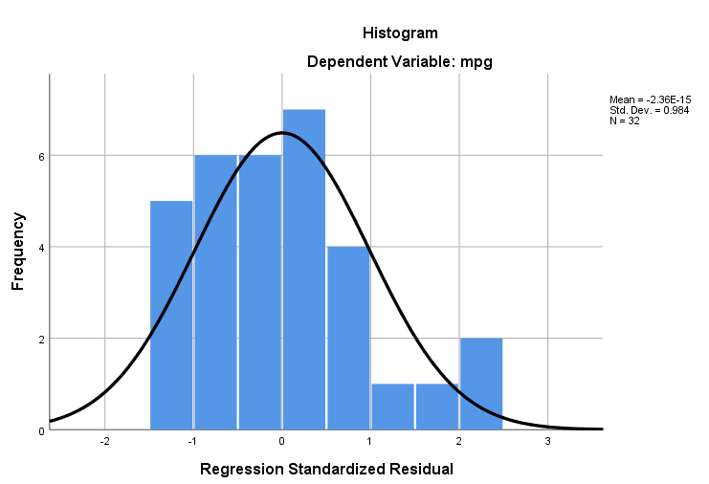
Assumption of normally distributed residuals
Figure 6: SPSS output showing regression residuals.

