Slide 1
Introduction to statistics

Slide 2
Importance of statistical literacy in society
World increasingly reliant on data and statistics
Statistical analysis is critical in science
Statistical literacy is important in modern life
Misuse and misunderstandings of statistics can have serious consequences
This course will give you the understanding and skills you need to be statistically literate and do and understand fundamental statistical analyses.

Slide 3
Importance of statistical literacy in society
"Good statistics are like a telescope for an astronomer, a microscope for a bacteriologist, or an X-ray for a radiologist. If we are willing to let them, good statistics help us see things about the world around us and about ourselves -- both large and small -- that we would not be able to see in any other way" (Hartford 2020)
Harford, T. 2020. How to make the world add up: ten rules for thinking differently about numbers. Hachette UK.

Slide 4
Importance of statistical literacy as professionals
Journal of Animal Ecology
Bentlage et al. (2025). Results:
“At the population level, total rainfall from February to August had a significant quadratic effect on the annual divorce rate, which increased in years with low and high rainfall (GLM, estimate = 0.335 ± 0.091, p-value = 0.003; Figure S1b). Rainfall effects explained 46.7% of the annual divorce rate’s variance (r 2 = 0.467).”
Bentlage, AA, et al. 2025. Rainfall is associated with divorce in the socially monogamous Seychelles warbler. Journal of Animal Ecology. 94:85-98.

Slide 5
Importance of statistical literacy as professionals
Marine Biology
Liu et al. (2025). Materials and Methods:
“Experimental data were presented as the mean ± standard deviation of results obtained from three parallel samples [. . . ]. A one-way analysis of variance (ANOVA) combined with the least significant difference (LSD) method was employed to assess the variance and significance of nutrient content in algal detritus under different environmental conditions (Table 1) (p < 0.05).”
Liu, Z, et al. 2025. The impact of dissolved oxygen and sediments on the decomposition of Sargassum thunbergii. Marine Biology, 172:28.

Slide 6
Importance of statistical literacy as professionals
Journal of Environmental Sciences
Tava et al. (2025). Results:
“Soil microbial biomass was highly significantly (P < 0.01) and positively correlated with alkaline phosphomonoesterase activity in untreated soils (D0, r_{T03} = 0.92 and r_{T14} = 0.77) and at D01 rate (r_{T03} = 0.86 and r_{T14} = 0.71) at both time points T03 and T14.”
Tava, A, et al. 2025. Saponins in soil, their degradation and effect on soil enzymatic activities. Journal of Environmental Sciences, 154:378-389.

Slide 7
Importance of statistical literacy as professionals
Cell
Nishijima et al. (2025). Methods:
“To investigate correlations between the microbiome profile (i.e. species-level taxonomic and functional compositions) and the experimentally measured microbial load, Pearson correlation coefficients were calculated between the log₁₀ transformed relative abundance of each microbial species/functions and the microbial load in each cohort separately.”
Nishijima, S, et al. 2025. Fecal microbial load is a major determinant of gut microbiome variation and a confounder for disease associations. Cell. 188:222-236

Slide 8
Importance of statistical literacy as professionals
Journal of Environmental Geography
Ziti et al. (2025). Results:
“The Mann-Kendall trend test shows an increasing, statistically significant (p = 0.031, α = 0.05) trend in annual mean temperatures between 1969 and 2021 in the sub-catchment, a condition that may contribute to the proliferation of dry conditions in the catchment.”
Ziti, C et al. 2025. Climate Change Response Strategies and Implications on Sustainable Development Goals in Mutirikwi River Sub-Catchment of Zimbabwe. Journal of Environmental Geography, 17:1-14.

Slide 9
Importance of statistical literacy as professionals
Frontiers in Education
Naim et al. (2025). Methods:
“The study uses multiple linear regression analysis to examine the relationship between independent variables (socioeconomic status, funding per student, teacher-student ratio, availability of advanced coursework, tuition fees, scholarship availability, and diversity of the student body) and dependent variables (test scores, graduation rates, enrolment statistics, and post-graduation employment rates).”
Naim, A. 2025. Equity Across the Educational Spectrum: Innovations in Educational Access Crosswise all Levels. Frontiers in Education 9:1499642

Slide 10
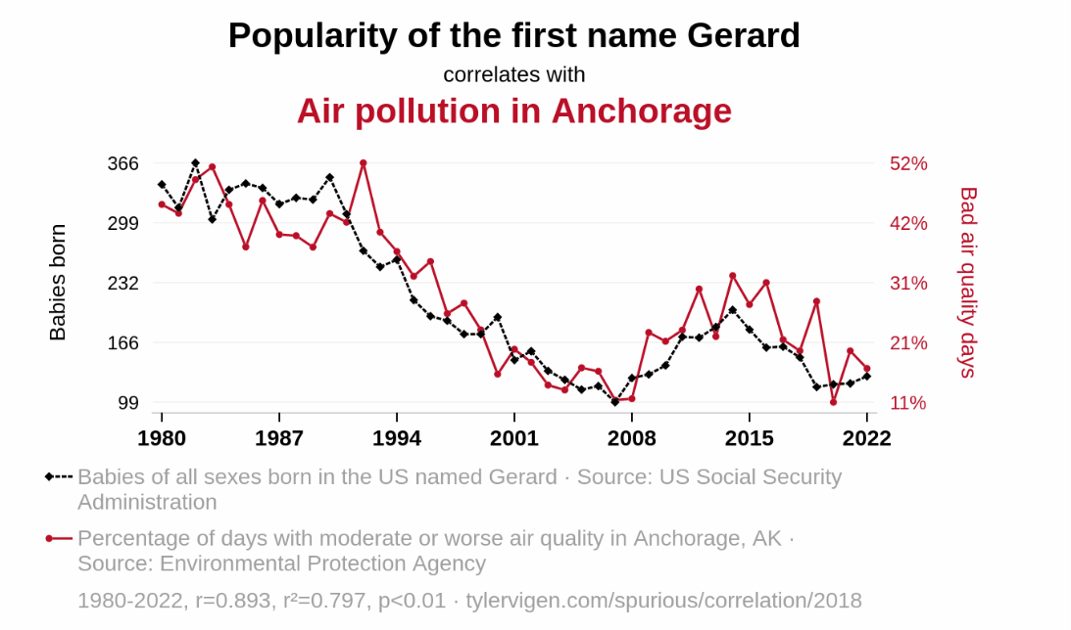
Statistical literacy is important
Vigen, Tyler. 2025. Spurious correlations: Accessed 19 JAN 2025 (CC-BY-4.0) https://www.tylervigen.com/spurious-correlations

Slide 11
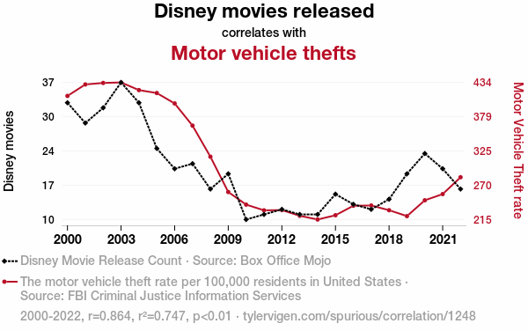
Statistical literacy is important
Vigen, Tyler. 2026. Spurious correlations: Accessed 6 JAN 2026 (CC-BY-4.0) https://www.tylervigen.com/spurious-correlations

Slide 12
Statistical literacy is important
ChatGPT Explanation:
As Disney downshifted its movie production, there were fewer car-related films and spin-off merchandise, leading to a reduced interest in automobiles. This eventually put the brakes on the demand for stolen cars, steering would-be thieves towards other, non-automotive pursuits.
Vigen, Tyler. 2026. Spurious correlations: Accessed 6 JAN 2026 (CC-BY-4.0) https://www.tylervigen.com/spurious-correlations

Slide 13
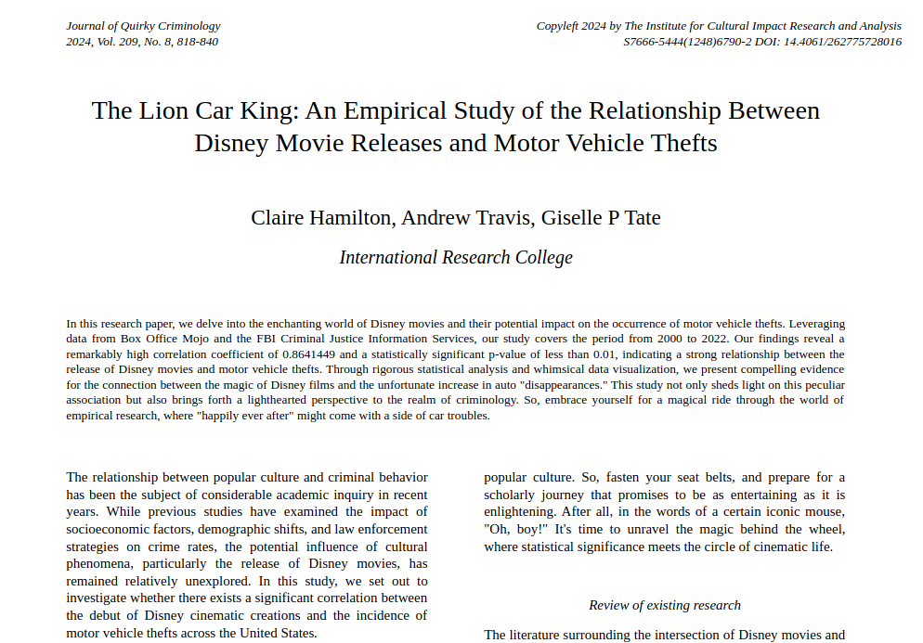
Statistical literacy is important
Vigen, Tyler. 2026. Spurious correlations: Accessed 6 JAN 2026 (CC-BY-4.0) https://www.tylervigen.com/spurious-correlations

Slide 14
Intended Learning Outcomes (ILOs)
(1) Manipulate datasets and characterise their statistical properties.

Slide 15
Intended Learning Outcomes (ILOs)
(2) Demonstrate an understanding of null hypothesis testing.

Slide 16
Intended Learning Outcomes (ILOs)
(3) Choose and apply the correct statistical test to unseen data using statistical software.

Slide 17
Intended Learning Outcomes (ILOs)
(4) Interpret the results of statistical tests in order to generate conclusive statements on scientific problems.

Slide 18
Teaching materials
Book chapters
Audiobook chapters
Lecture material
Practicals
Interactive apps
Quizzes

Slide 19
Statistical software
Spreadsheets (any)
MS Excel
LibreOffice Calc
Google Sheets
jamovi
Free and open-source
Windows, Mac, Linux, Chrome
Easy transition to R

