Slide 1
Tidy data and data files

Slide 2
Background mathematics
Addition
Subtraction
Multiplication
Division
Exponents
Roots

Slide 3
Addition and Subtraction
Addition
Natural numbers
1, 2, 3, 4, …
Subtraction
Integers
…, -2, -1, 0, 1, 2, ...

Slide 4
Inequalities
Greater than (>)
6 > 5
Less than (<)
-4 < 2

Slide 5
Inequalities
Greater than or equal to (≥)
P ≥ 0.1
Less than or equal to (≤)
P ≤ 0.05

Slide 6
Multiplication and Division
Multiplication
Add a number multiple times
4 + 4 + 4 = 12
4 × 3 = 12
4 * 3 = 12 or 4(3) = 12
Division
12 ÷ 3 = 4
12/3 = 4
Rational numbers

Slide 7
Exponents and roots
Exponent
Multiply a number multiple times
4 × 4 × 4 = 64
4³ = 64
Roots
∛(64) = 4
64^{1/3} = 4
Real numbers (√(2) ≈ 1.414)

Slide 8
Negative exponents
4⁻¹ = 1/4
4⁻² = 1/16
Applies to units
6 gl⁻¹ = 6 g/l

Slide 9
Logarithms
Exponent to which a number needs to be raised to get another number,
10³ = 1000.
10 raised to the power of 3 equals 1000,
log₁₀(1000) = 3.

Slide 10
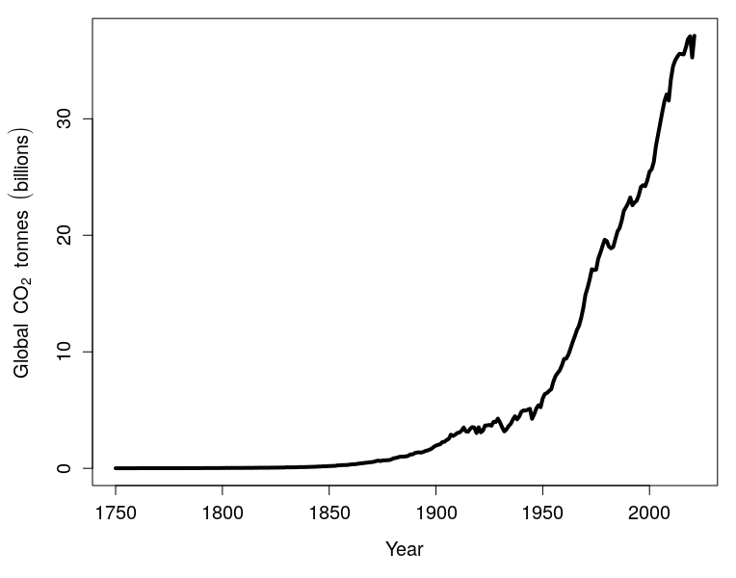
Logarithms in figures
Figure 1: Global carbon dioxide emissions from 1750-2021.

Slide 11
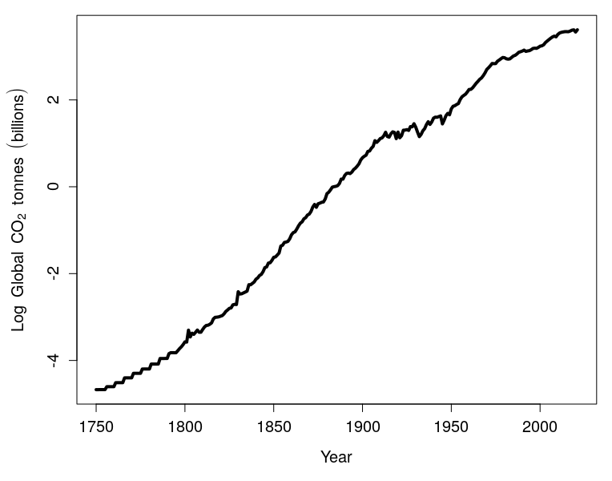
Logarithms in figures
Figure 2: Natural logarithm of global carbon dioxide emissions from 1750-2021.

Slide 12
Natural logarithms
Exponent to which a number needs to be raised to get another number,
e¹ ≈ 2.718282.
Sometimes log is denoted 'ln',
ln(2.718282) = 1.

Slide 13
Order of operations
x = 3² + 2(1 + 3)² – 6 × 0

Slide 14
Order of operations
Brackets (Parentheses)
Exponents & radicals
Multiplication & division
Addition & subtraction

Slide 15
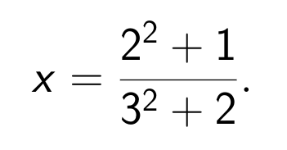
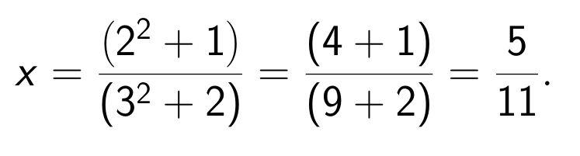
Order of operations
Division bars imply parentheses,
Above is (2² + 1)/(3² + 2),

Slide 16
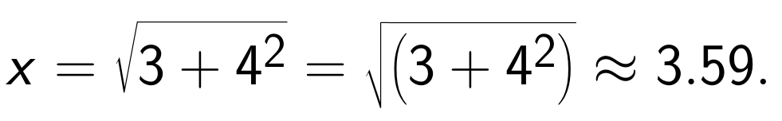
Order of operations
Radicals imply parentheses

Slide 17
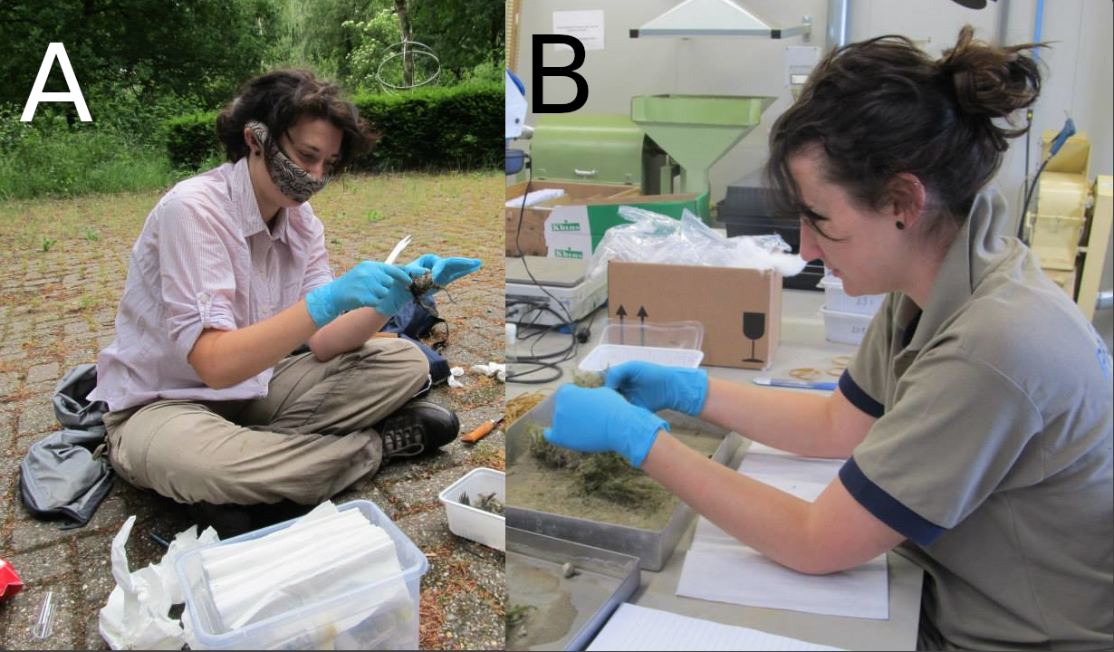
Tidy data: Getting data in the right format
Figure 1: Dr Becky Boulton collects data from nest boxes in the field (A), then processes nest material in the lab (B).

Slide 18
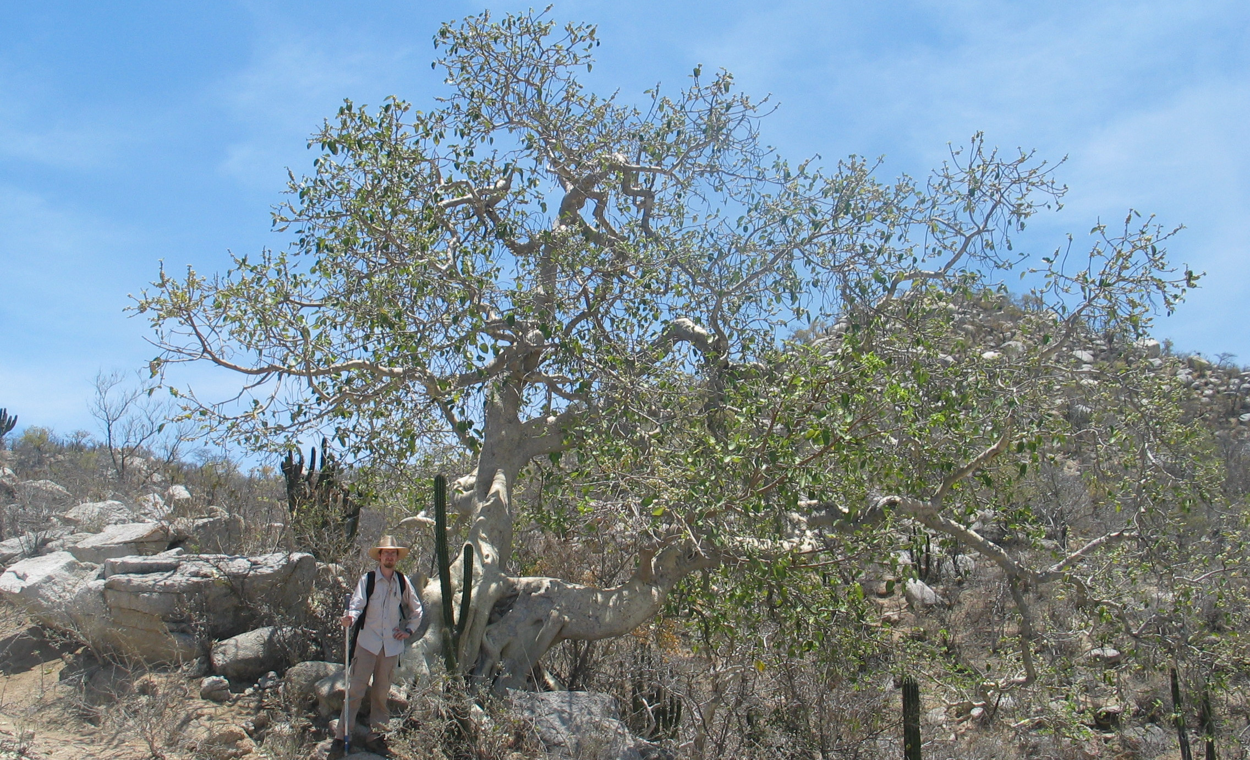
Data collection is messy
Figure 2: Sonoran Desert Rock Fig in the desert of Baja, Mexico.

Slide 19
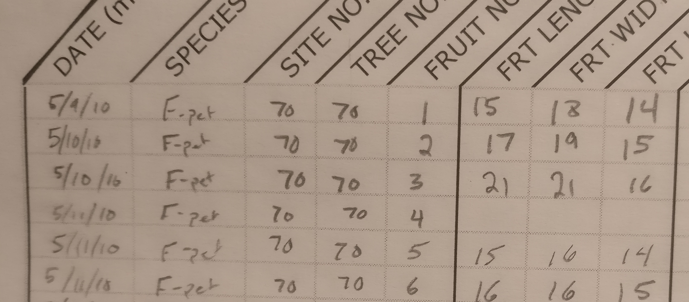
Data collection is messy
Figure 3: A portion of a lab notebook used to record measurements of fig fruits from different trees in 2010.

Slide 20
Observations and variables
Observation: Units of sample
Variable: Unit measurement

Slide 21
Observations and variables
Observation: Fig trees
Variable: Tree height, location

Slide 22
Three characteristics of tidy data
Summarised by Wickham (2014)¹:
Each variable gets its own column.
Each observation gets its own row.
Different units of observation require different data files.
Wickham, H. 204. J Stat. Softw. 59:1-23.

Slide 23
Three characteristics of tidy data
Tree | Species | Height (m) | Leaf length (cm)
1 | Oak | 20.3 | 8.1
2 | Oak | 25.4 | 9.4
3 | Maple | 18.2 | 12.5
4 | Maple | 16.7 | 11.3

Slide 24
File extensions and types
File extensions (e.g., PDF, JPG, DOCX)
Text files (e.g., TXT, CSV, HTML)
Binary files (e.g., PNG, MP3, PDF)

Slide 25
File extensions and types
Text files can be opened by a plain text editor
Binary files require a specific program
Text files (e.g., CSV) are more secure long-term

Slide 26
Files stored in nested folders
Important to organise files in a project
One folder for a project, nested files
Recommend a folder for SCIU4T4

Slide 27
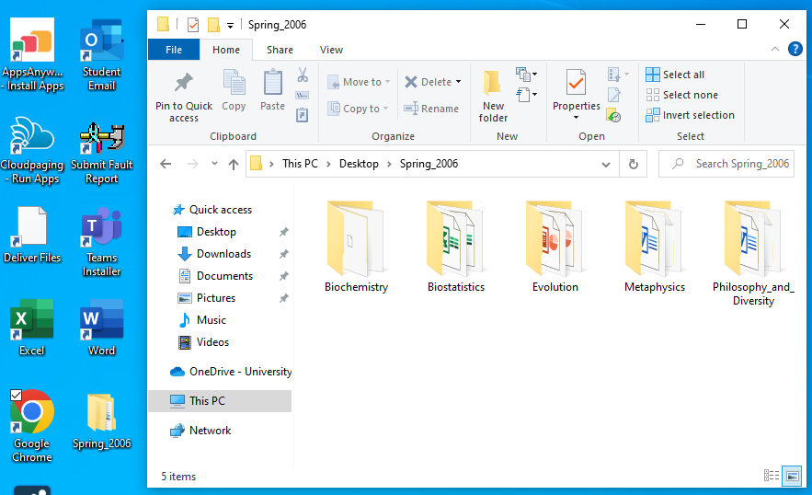
Files stored in nested folders
Figure 1: Windows file directory showing the file organisation of modules taken during spring 2006. In this case, the 'Spring_2006' folder is located on the desktop; the path to the folder is visible in the toolbar above the folders.

