Slide 1
Decimals, significant figures, and plots

Slide 2
Decimal places
Digits after the decimal point (including 0s)
Value: 1.23041
5 Decimals: 1.23041
4 Decimals: 1.2304
3 Decimals: 1.230
2 Decimals: 1.23
1 Decimals: 1.2

Slide 3
Decimal places
Digits after the decimal point (including 0s)
Value: 1430.02021
5 Decimals: 1430.02021
4 Decimals: 1430.0202
3 Decimals: 1430.020
2 Decimals: 1430.02
1 Decimals: 1430.0

Slide 4
Significant figures
All digits of a number
Initial 0s don't count
Other 0s do count
21.341
0.032
0.010230

Slide 5
Significant figures
Digits needed to infer the accuracy of a value¹
240.23432 implies more accuracy than 240
1.324 implies more accuracy than 1.3
Rahman, N A. 1968. A Course in Theoretical Statistics. Charles Griffin & Company, London.

Slide 6
Significant figures
All digits of a number
Initial 0s don't count
Other 0s do count
0.32400
0.00031
2000

Slide 7
Rounding to specific digits or significant figures
Rules for rounding:
Round based on digit to the right
If digit is [0, 1, 2, 3, 4] round down
If digit is [5, 6, 7, 8, 9] round up
Round down keeps digit the same
Rounding up increases digit by 1
Round 0.1234 to 3 decimal places
0.1234 -> 0.123

Slide 8
Rounding to specific digits or significant figures
Rules for rounding:
Round based on digit to the right
If digit is [0, 1, 2, 3, 4] round down
If digit is [5, 6, 7, 8, 9] round up
Round down keeps digit the same
Rounding up increases digit by 1
Round 0.1235 to 3 decimal places
0.1235 -> 0.124

Slide 9
Rounding to specific digits or significant figures
Rules for rounding:
Round based on digit to the right
If digit is [0, 1, 2, 3, 4] round down
If digit is [5, 6, 7, 8, 9] round up
Round down keeps digit the same
Rounding up increases digit by 1
Round 3.184 to 3 significant figures
3.184 -> 3.18

Slide 10
Rounding to specific digits or significant figures
Rules for rounding:
Round based on digit to the right
If digit is [0, 1, 2, 3, 4] round down
If digit is [5, 6, 7, 8, 9] round up
Round down keeps digit the same
Rounding up increases digit by 1
Round 3.185 to 3 significant figures
3.185 -> 3.19

Slide 11
Rounding to specific digits or significant figures
Rules for rounding:
Round based on digit to the right
If digit is [0, 1, 2, 3, 4] round down
If digit is [5, 6, 7, 8, 9] round up
Round down keeps digit the same
Rounding up increases digit by 1
Round 3.195 to 3 significant figures
3.195 -> 3.20

Slide 12
Rounding to specific digits or significant figures
Rules for rounding:
Round based on digit to the right
If digit is [0, 1, 2, 3, 4] round down
If digit is [5, 6, 7, 8, 9] round up
Round down keeps digit the same
Rounding up increases digit by 1
Round 12.9806 to 3 significant figures
12.9806 -> 13.0

Slide 13
Rounding to specific digits or significant figures
Rules for rounding:
Round based on digit to the right
If digit is [0, 1, 2, 3, 4] round down
If digit is [5, 6, 7, 8, 9] round up
Round down keeps digit the same
Rounding up increases digit by 1
Round 12.9806 to 1 significant figure
12.9806 -> 10

Slide 14
Rounding to specific digits or significant figures
Rules for rounding:
Round based on digit to the right
If digit is [0, 1, 2, 3, 4] round down
If digit is [5, 6, 7, 8, 9] round up
Round down keeps digit the same
Rounding up increases digit by 1
Round 10.023 to 2 significant figures
10.023 -> 10.

Slide 15
Rounding to specific digits or significant figures
2000 in significant figures
2 × 10³
2.0 × 10³
2.00 × 10³
2.000 × 10³

Slide 16
Data visualisation
Histograms
Barplots
Pie Charts
Box-whisker plots

Slide 17
Histogram
Important visualisation tool
Show distribution of continuous data
Need for statistical decision-making
How to build a histogram

Slide 18
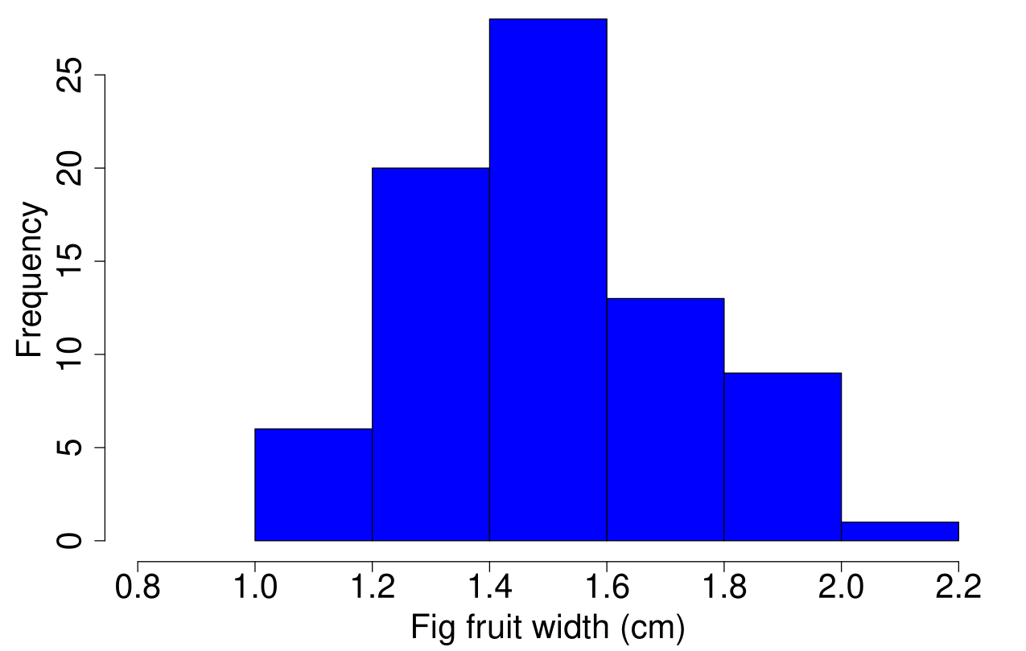
Histogram
Figure 1: Fig fruit width (cm) using data from 78 fig fruits

Slide 19
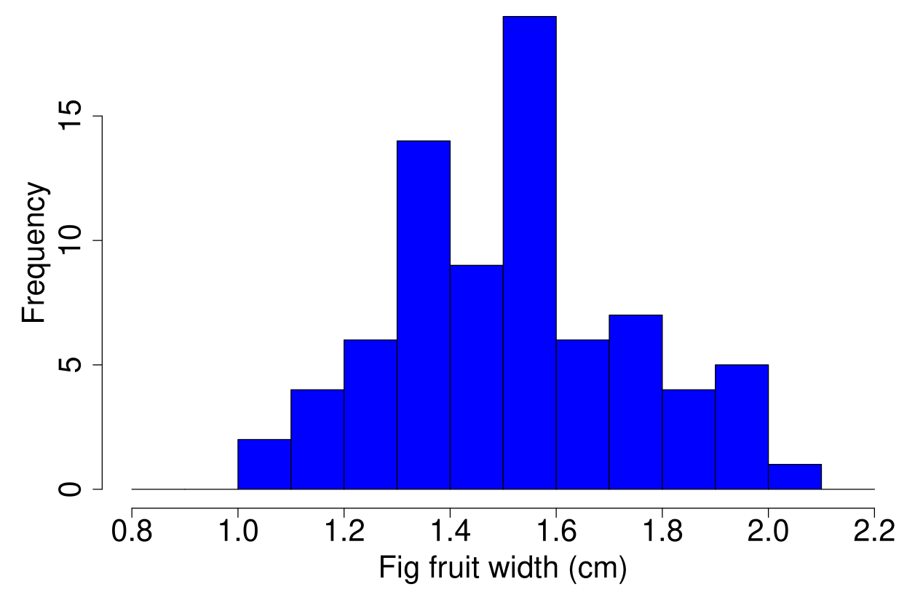
Histogram
Figure 2: Fig fruit width (cm) using data from 78 fig fruits

Slide 20
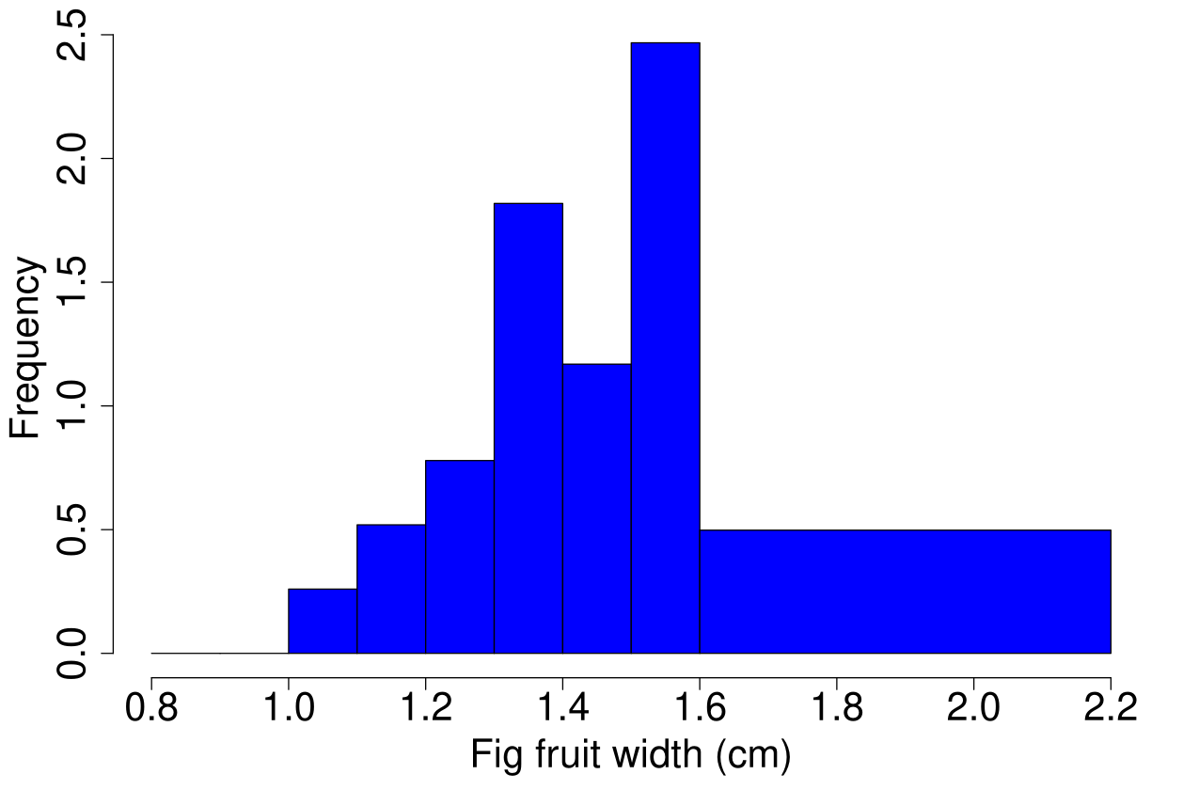
Histogram
Figure 3: Fig fruit width (cm) using data from 78 fig fruits

Slide 21
Barplots
Visualise categorical data
Categories separated in bars
Heights indicate magnitudes
Different from histograms

Slide 22
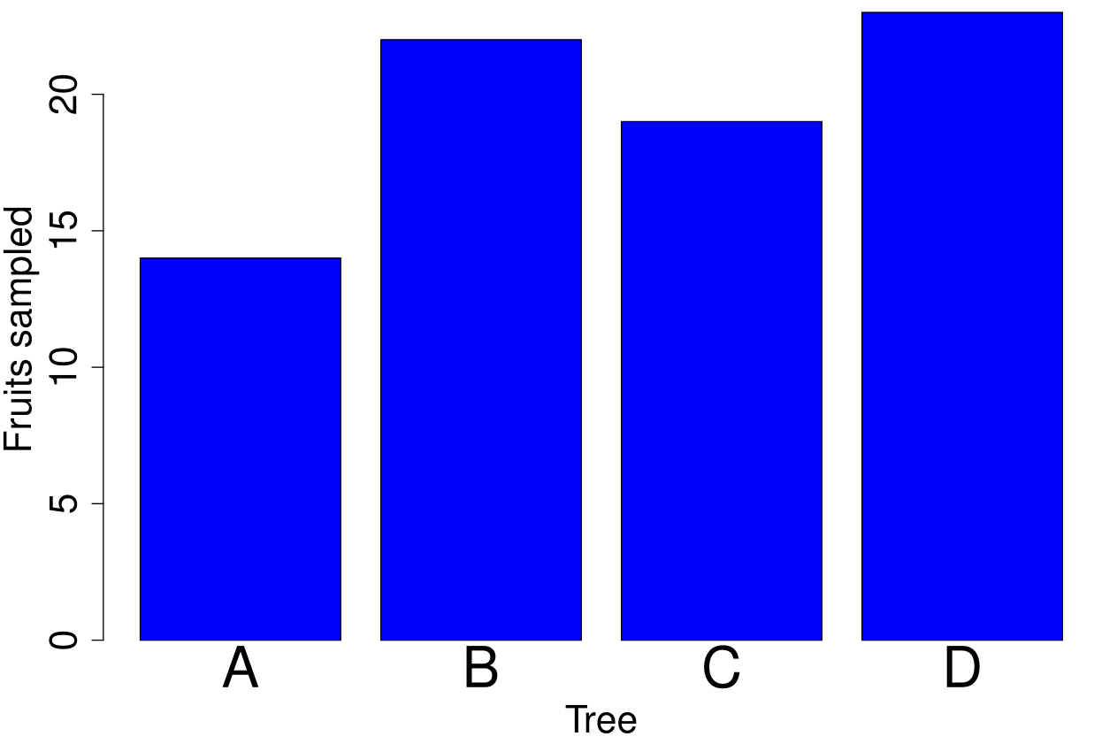
Barplots
Figure 4: Fruits from each of four trees (78 total)

Slide 23
Pie charts
Visualise categorical data
Show percentage of categories
Used less often than barplots
Do not show absolute magnitudes

Slide 24
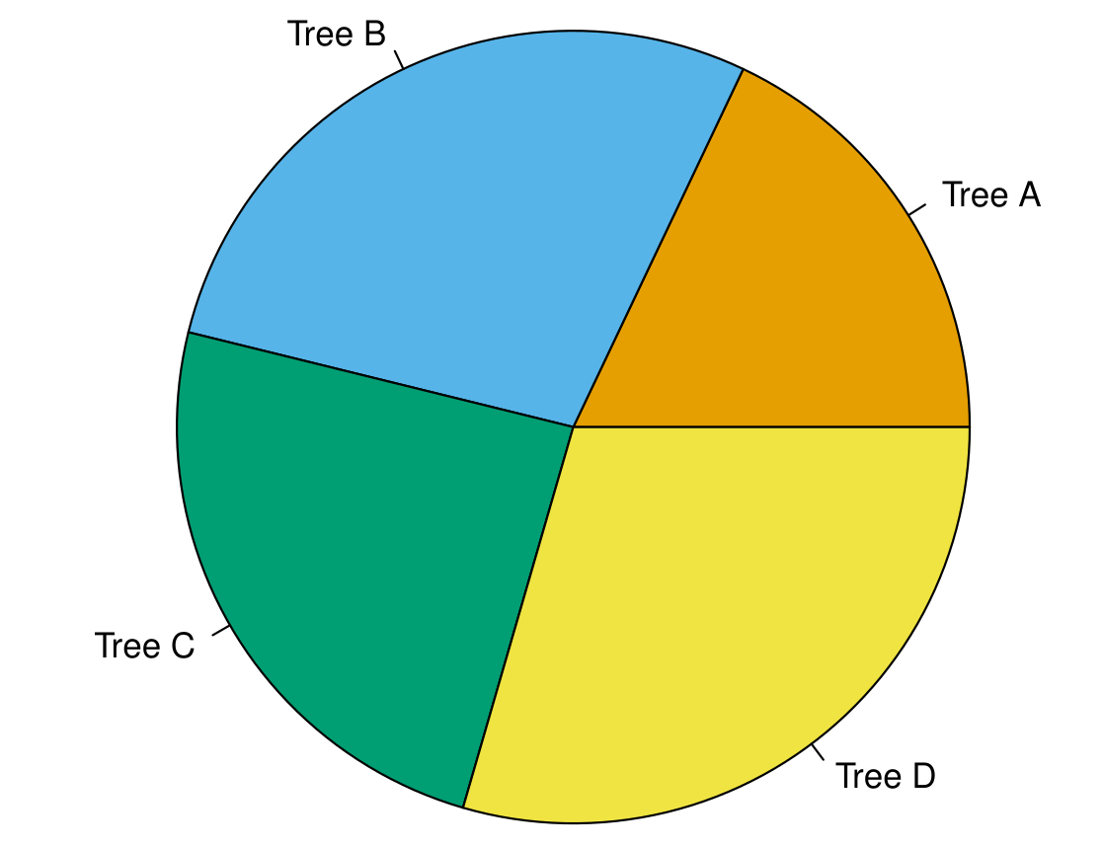
Pie charts
Figure 5: Pie chart of fruits from 4 trees.

Slide 25
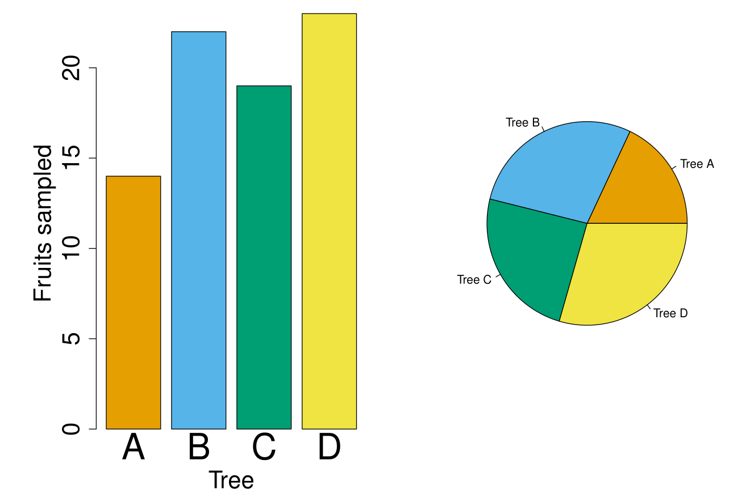
Barplot versus pie charts
Figure 6: Barplot and pie chart of fruits from 4 trees.

Slide 26
Box-whisker plots (boxplots)
Show distributions
Visualise summary statistics
Can compare distributions
More compact than a histogram (but a bit less information)

Slide 27
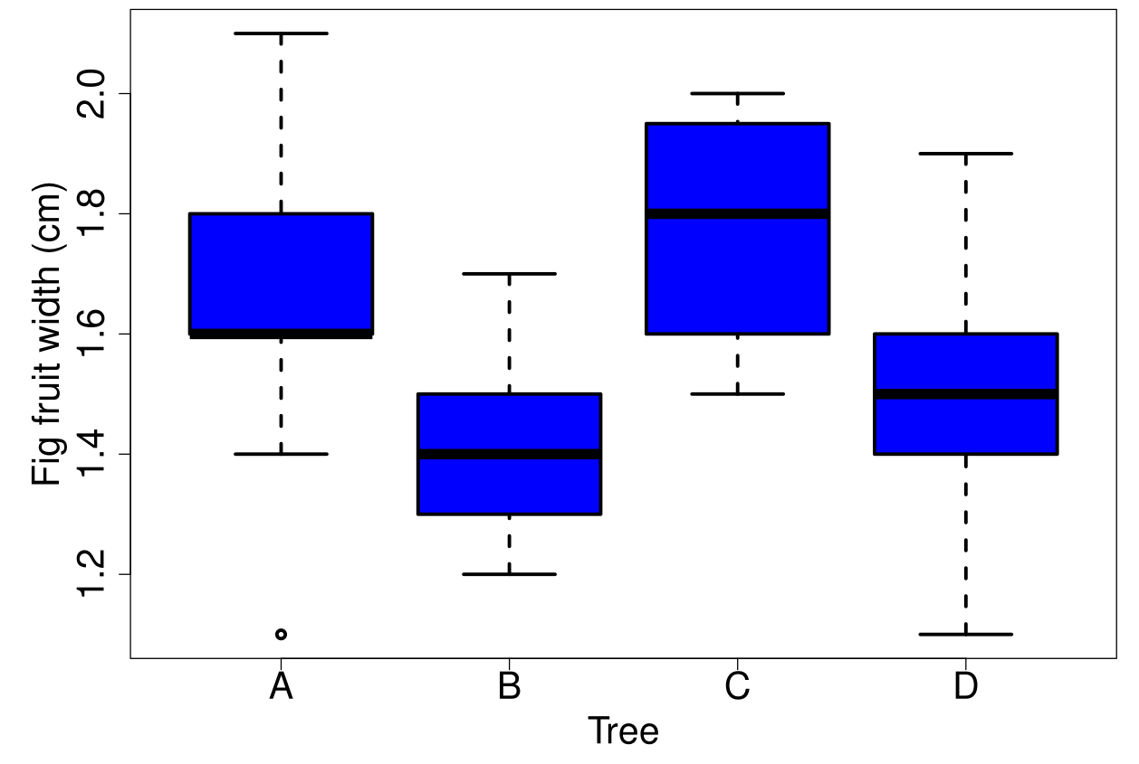
Box-whisker plots (boxplots)
Figure 7: Boxplot of fig fruit widths (cm) collected from 4 trees

Slide 28
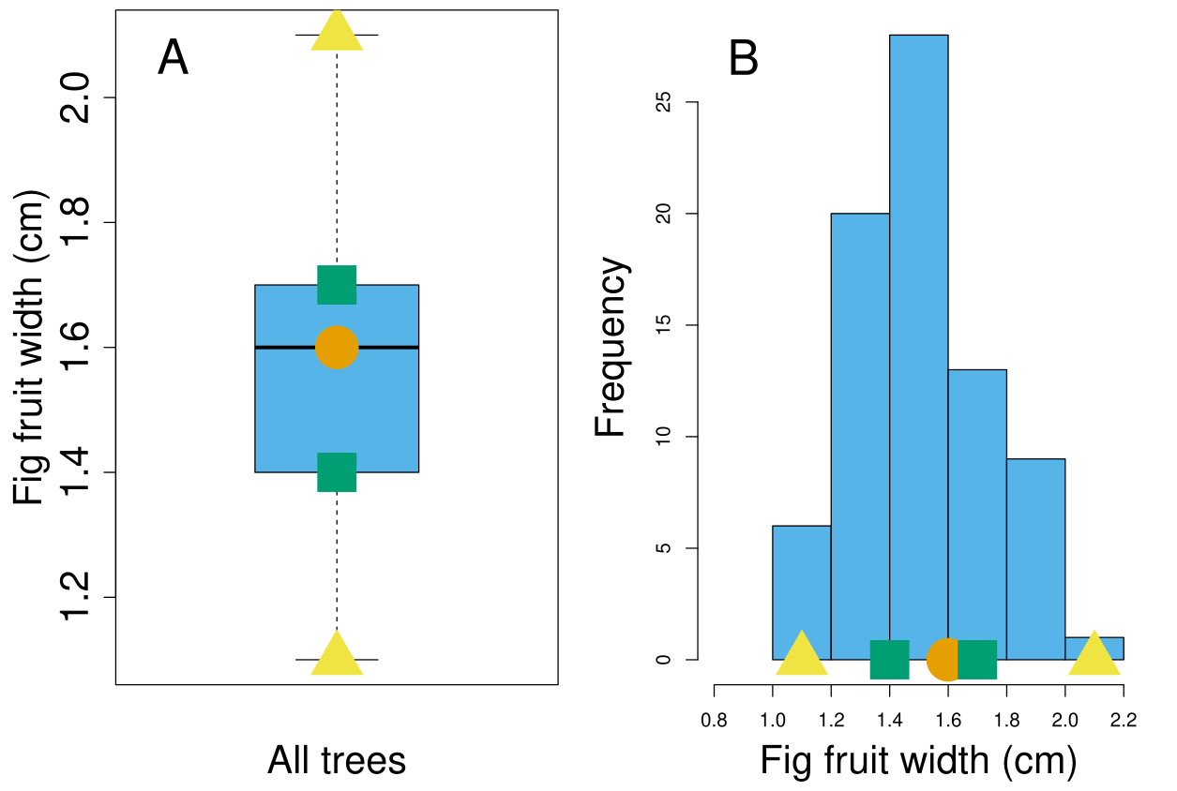
Boxplot versus histogram
Figure 8: Boxplot (A) vs Histogram (B) of fig fruit widths (cm)

Slide 29
Data visualisation principles
Show the data
Make the meaning clear
Avoid distorting what the data have to say
Make the data accessible
Focus on the content
David Sterratt. 2025. CC BY-SA 4.0 Source: https://github.com/Inf2-FDS/fds-visualisation

Slide 30
Data visualisation principles: Show the data
Show as much as possible
Try to avoid a confusion
No one "right" visualisation
Help reader compare several pieces of data

Slide 31
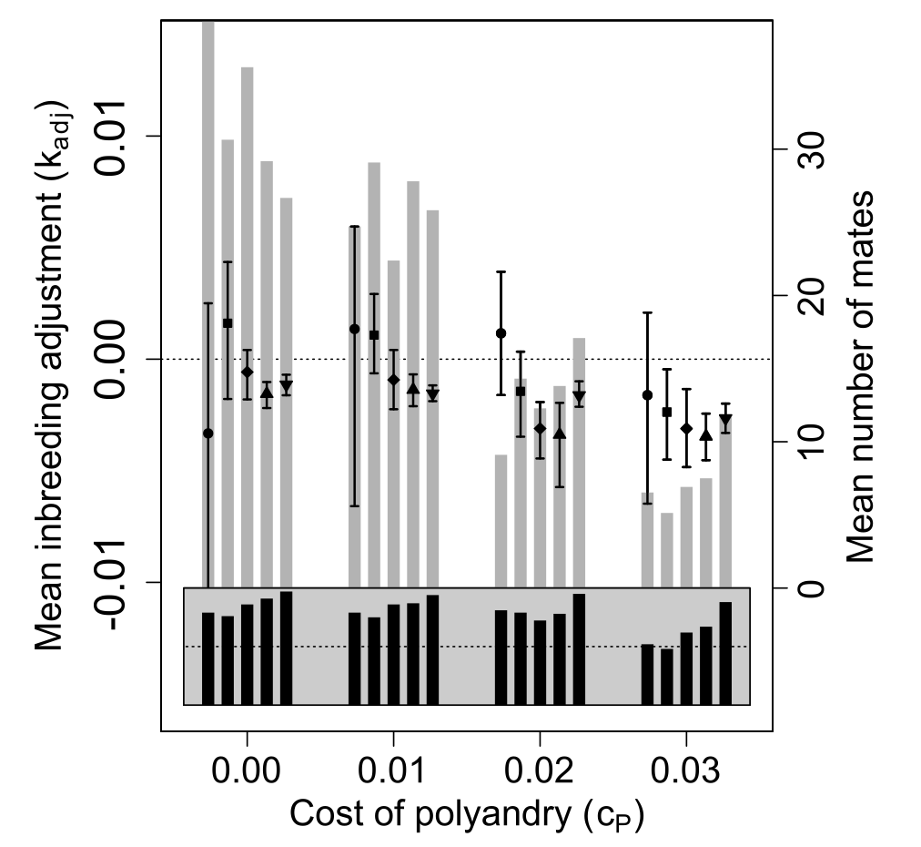
Data visualisation principles: Show the data

Slide 32
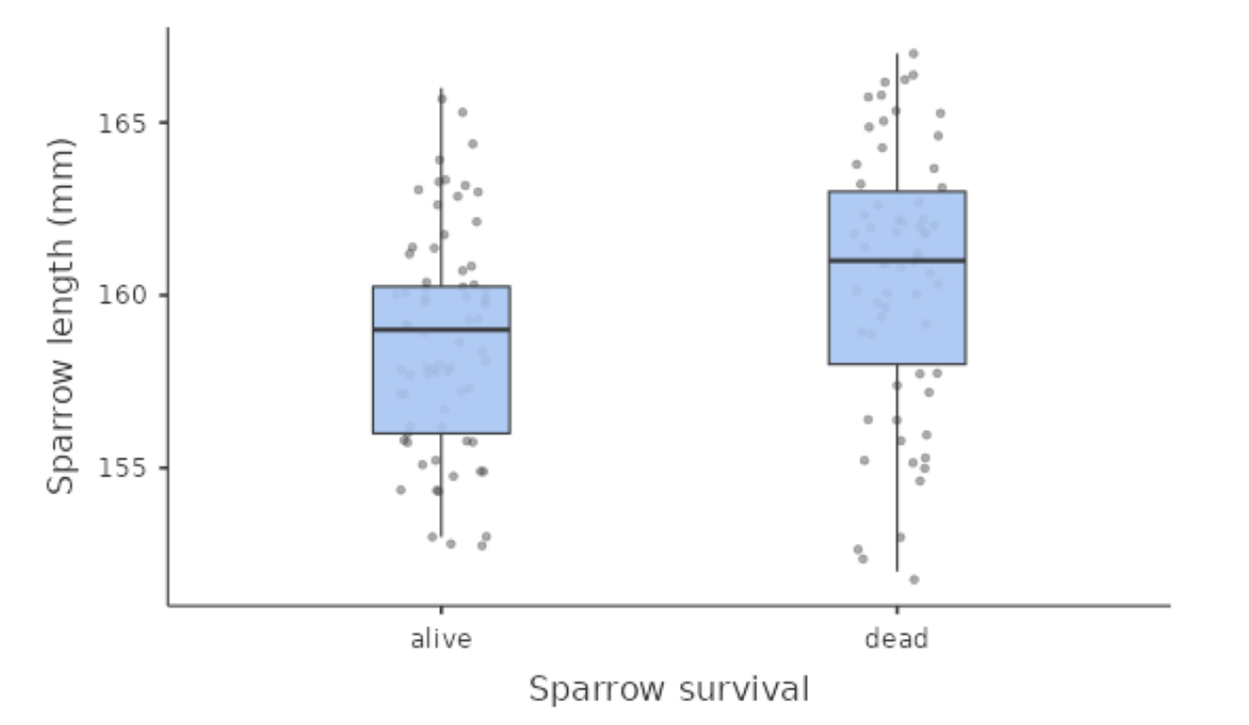
Data visualisation principles: Show the data
Figure 9: Sparrow length (mm) for different survival outcomes following an unusually large storm at Brown University in 1898 (N = 136).

Slide 33
Making the meaning clear
Informative captions
Meaningful axis labels
Relevant units
Describe error bars

Slide 34
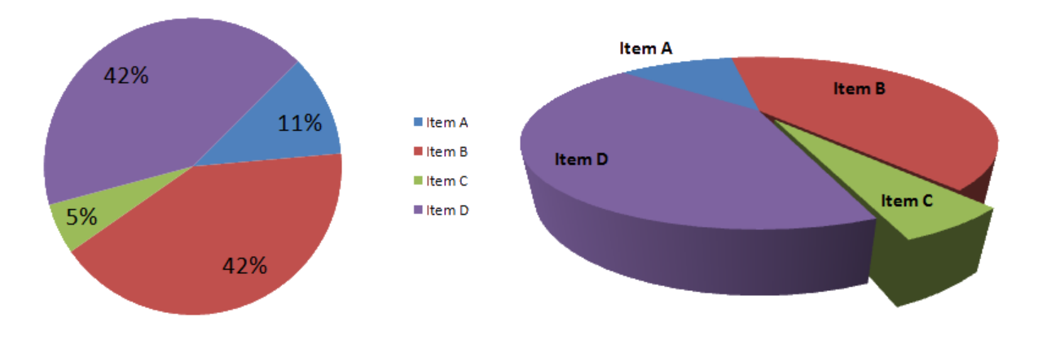
Avoid distorting what the data have to say
Need to clearly see patterns in data
Avoid the use of 3D if possible
Easier to compare lengths than areas¹
Easier to compare lengths than angles¹
David Sterratt. 2025. CC BY-SA 4.0 Source: https://github.com/Inf2-FDS/fds-visualisation
Image: Public domain.

Slide 35
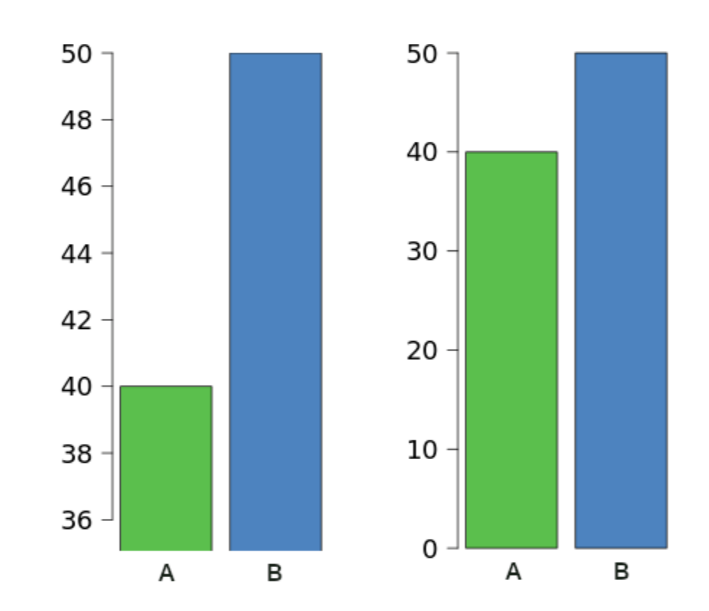
Avoid distorting what the data have to say

Slide 36
Make the data accessible
Ensure text is legible
Avoid unncessary colours
Select colours carefully¹
David Sterratt. 2025. CC BY-SA 4.0 Source: https://github.com/Inf2-FDS/fds-visualisation
Wexler, S, et al. 2017. The Big Book of Dashboards: Visualizing Your Data

Slide 37
Focus on the content
Avoid colours or 3D with no meaning1
Avoid vertical grid lines
Use consistent colours across a report
Use an appropriate number of decimals
Check wording and spelling
Consider plotting modules in jamovi
David Sterratt. 2025. CC BY-SA 4.0 Source: https://github.com/Inf2-FDS/fds-visualisation

